Slide 1
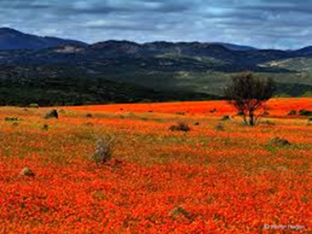
English Language Paper 1 A5 Evaluation question. You need: Exercise book at tab, green pen, glue, highlighter

Slide 2
Improving your answer to the: A5 Evaluation question. See the success criteria sheet at the end of your work. If aspect ticked – achieved Ticked with a cross – half achieved. Highlighted – you need to work on. All now answering – in green pen: Describe/Explain how the boy is different at the end of the extract to the beginning.

Slide 3
A5. To what extent do you agree with this? Include impressions created and how the writer has created these impressions.
AO4- This question tests the ability to evaluate texts critically and support this with appropriate textual reference.
You must track through the extract from beginning to end- WHOLE
You should note HOW and WHEN any changes are made, and WHY.
Discuss language and structure- 6-8 features
Critically evaluate – show both the positive and negative aspects of content and HOW expressed.
You should be using vocabulary to express your agreement:
Use: Similarly, to a certain extent, sentence starters, connectives etc. (see your Comparison sheet)

Slide 4
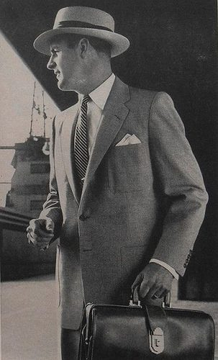
Narrative Perspectives
Key Vocabulary
Perspective
Show not Tell
Word Classes
Ambitious Vocabulary
Clauses
Who is this man?
Where is he going?
What is in the briefcase/top pocket
Has he got on the boat – or is he getting on it?
Write for 5 minutes – don’t think too hard about it – Just write.
LO: To write from different points of view.

Slide 5
Show not Tell – Create your own version
Telling: Michael was terribly afraid of the dark.
Showing: As his mother switched off the light and left the room, Michael tensed. He huddled under the covers, gripped the sheets, and held his breath as the wind brushed past the curtain.
Do Now
Key Vocabulary
Perspective
Show not Tell
Word Classes
Ambitious Vocabulary
Clauses

Slide 6
Show not Tell – Create your own version
Telling: The girl was delighted with her gift.
Show:
Telling: The man was furious.
Show:
Telling: Jemima was extremely upset.
Show:
Do Now
Key Vocabulary
Perspective
Show not Tell
Word Classes
Ambitious Vocabulary
Clauses

Slide 7
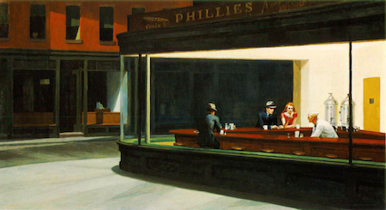
Whose point of view could a story be told from?
Key Vocabulary
Perspective
Show not Tell
Word Classes
Ambitious Vocabulary
Clauses
Write for 10 minutes.
Include:
Simple and complex sentences
Rhetorical question
A
Metaphor
P
S
Mastery

Slide 8
Now change the perspective. How does the story differ? What new information is given to the reader?
Write for 10 minutes.
Include:
Compound and either Fronted adverbial or embedded clause sentences
R
Adverbs
M
Personification
Simile
Mastery
Key Vocabulary
Perspective
Show not Tell
Word Classes
Ambitious Vocabulary
Clauses

Slide 9
Swap – read- comment. Purple pen
Write for 10 minutes.
Include:
Simple, Compound, Complex and either Fronted adverbial or embedded clause sentences
Rhetorical questions
Adverbs
Metaphor
Personification
Simile
Plenary
Key Vocabulary
Perspective
Show not Tell
Word Classes
Ambitious Vocabulary
Clauses

Slide 10
Narrative Perspectives
Key Vocabulary
Perspective
Show not Tell
Word Classes
Ambitious Vocabulary
Clauses
Who is this man?
Where is he going?
What is in the briefcase/top pocket
Has he got on the boat – or is he getting on it?
Write for 5 minutes – don’t think too hard about it – Just write.
LO: To write from different points of view.

Slide 11
Narrative Time Frames
He was an old man – he was probably in the army or a footballer or something – and he had wrinkles. He was sat somewhere doing something and then there was a car crash.
The old man said to his grandson, “Oh there’s been a car crash”
“Yes there has”, the grandson replied.
“Did I tell you I used to be in the army?”
“I thought you were a footballer” the grandson replied.
“Yeh I did, but I was in the army too” the old man said.
“Do you think this is too much dialogue and that actually it isn't saying anything about our characters?” asked the grandson.
“Yes. You’re probably right. Loads of dialogue is quite difficult to control and it doesn’t really show of our skill with writing.”
And then there was an explosion. A car came through the front room wall and it was filled with gangsters who sold drugs for a living.
“Ouch my back hurts and I’ve got wrinkles” said the old man.
One of the gangsters offered the old man some drugs to smoke. He did and it
helped his back. And then he woke up and it was all a dream.
Do Now
Key Vocabulary
Perspective
Show not Tell
Word Classes
Ambitious Vocabulary
Clauses
LO: To explore the effect of time in narratives

Slide 12
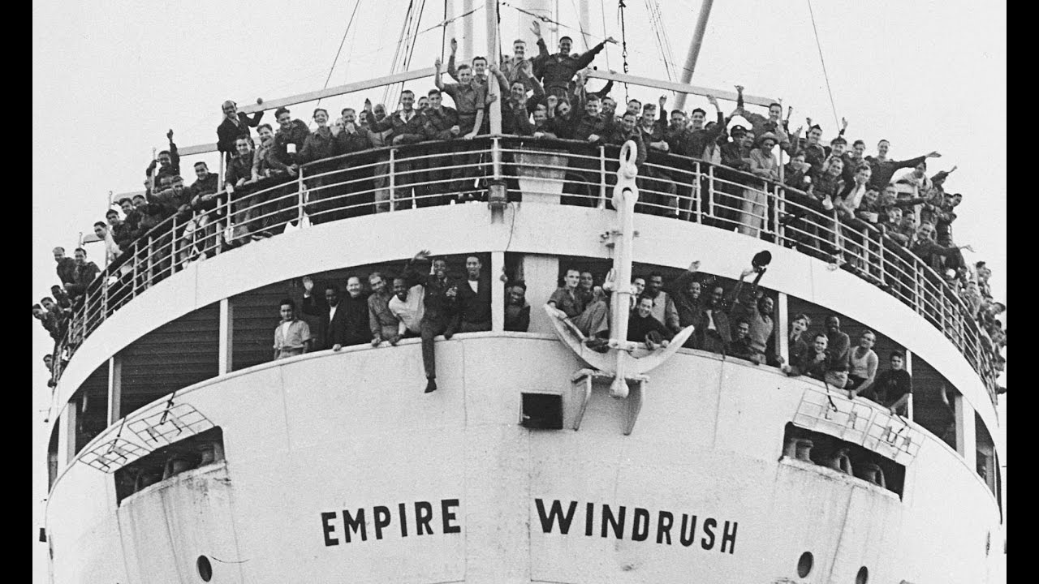
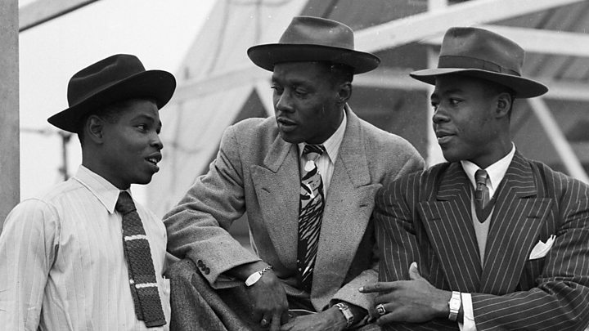
Narrative Time Frames
.
Checking Understanding
What do you know about these people?
Key Vocabulary
Perspective
Show not Tell
Word Classes
Ambitious Vocabulary
Clauses
LO: To explore the effect of time in narratives

Slide 13
Narrative Time Frames
.
Mastery
Write in first person, past tense about a man arriving in Britain/London for the first time.
Key Vocabulary
Perspective
Show not Tell
Word Classes
Ambitious Vocabulary
Clauses
LO: To explore the effect of time in narratives

Slide 14
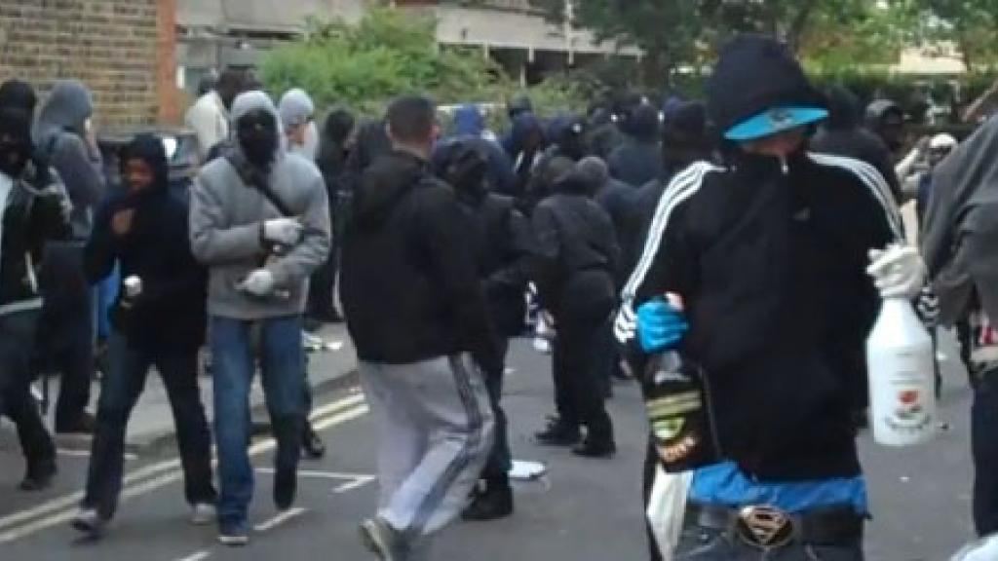
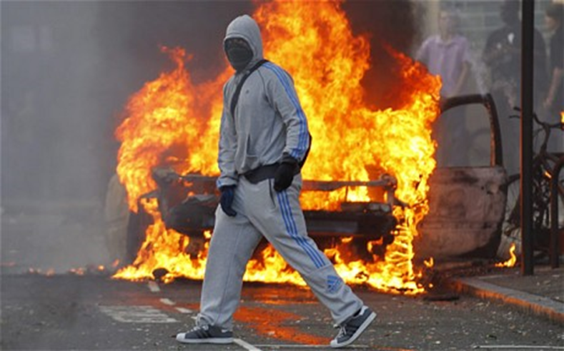
Narrative Time Frames
.
Checking Understanding
What do you know
about this event?
Key Vocabulary
Perspective
Show not Tell
Word Classes
Ambitious Vocabulary
Clauses
LO: To explore the effect of time in narratives

Slide 15
Narrative Time Frames
.
Mastery
Write in 1st person, present tense
as if you are watching the riots
take place.
Key Vocabulary
Perspective
Show not Tell
Word Classes
Ambitious Vocabulary
Clauses
LO: To explore the effect of time in narratives

Slide 16
Narrative Time Frames
.
Checking Understanding
How would the Windrush generation feel seeing the London riots?
Key Vocabulary
Perspective
Show not Tell
Word Classes
Ambitious Vocabulary
Clauses
LO: To explore the effect of time in narratives

Slide 17
Narrative Time Frames
.
Mastery
Looking at the scene below me, I think about the day I arrived in this country. My friend had turned towards me and stated, “…
But now…
Key Vocabulary
Perspective
Show not Tell
Word Classes
Ambitious Vocabulary
Clauses
LO: To explore the effect of time in narratives

Slide 18
Swap- read-comment-purple pen
.
Plenary
Has it met the criteria?
Key Vocabulary
Perspective
Show not Tell
Word Classes
Ambitious Vocabulary
Clauses
LO: To explore the effect of time in narratives

