Slide 1
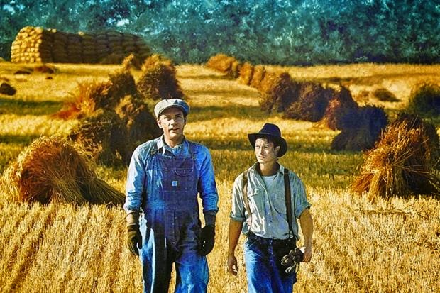

LESSON THREE

Slide 2
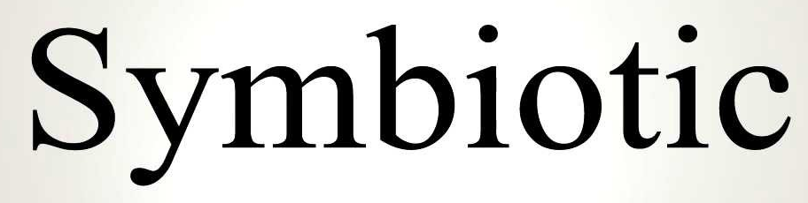
YOUR TASK
CONSIDER THIS!
Is Lennie the only person to benefit from the protagonists’ friendship?
NEW
VOCABULARY!
A relationship in which both people benefit. A balance that can only be achieved by working together.
Do Now
TODAY’S KEY QUESTIONS:
Can I make clear comparisons between characters in a text?
Can I explain how a writer uses language to create certain effects?

Slide 3
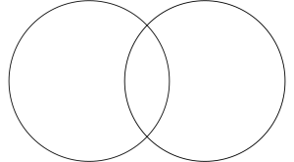
Comparing George and Lennie
Compare how Steinbeck presents the differences between George and Lennie in Chapter One.
Create a Venn diagram that show the similarities and differences between George and Lennie. Focus on:
how they speak
how they act
how they are described
Mastery
CONSOLIDATE YOUR KNOWLEDGE!
TODAY’S KEY QUESTIONS:
Can I make clear comparisons between characters in a text?
Can I explain how a writer uses language to create certain effects?

Slide 4
Compare how Steinbeck presents the similarities between George and Lennie in Chapter 1.
Mastery
TODAY’S KEY QUESTIONS:
Can I make clear comparisons between characters in a text?
Can I explain how a writer uses language to create certain effects?

Slide 5
Compare how Steinbeck presents the differences between George and Lennie in Chapter 1.
Mastery
TODAY’S KEY QUESTIONS:
Can I make clear comparisons between characters in a text?
Can I explain how a writer uses language to create certain effects?

Slide 6
Compare how Steinbeck presents the similarities and differences between George and Lennie in Chapter One.
What should my work look like?
It is clear that George is a strong leader who looks out for the childlike and immature Lennie when we are first introduced to Steinbeck’s protagonists at the beginning of the novel. To begin, Steinbeck presents George as ‘small and quick’. These adjectives imply that George is somewhat on edge. It suggests…
On the other hand, Lennie is described as walking ‘heavily’. The adverb ‘heavily’ suggests he is not graceful. Like the ‘bear’ he is compared to, Lennie is loud and not particularly clever. Furthermore, …
Regardless of how they are described, it is clear both men represent typical ranch workers. In 1930s America, …
Mastery
TODAY’S KEY QUESTIONS:
Can I make clear comparisons between characters in a text?
Can I explain how a writer uses language to create certain effects?
Can I write a GCSE style answer when responding to a text?

Slide 7
Compare how Steinbeck presents the similarities and differences between George and Lennie in Chapter One.
How do I start?
P
POINT: Firstly, John Steinbeck presents Lennie as ________.
E
EVIDENCE: He creates this impression by stating, ‘_____’.
Mastery
A
ANALYSIS: This is effective because _____.
By using the (word class) “___________” it suggests ______________.
A reader may feel ______ towards Lennie because _______.
P
POINT (LINKED): On the other hand, George ________.
TODAY’S KEY QUESTIONS:
Can I make clear comparisons between characters in a text?
Can I explain how a writer uses language to create certain effects?
Can I write a GCSE style answer when responding to a text?

