Slide 1
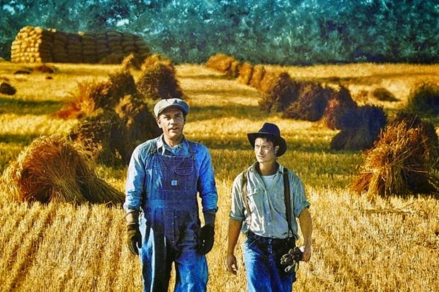
LESSON TWO
Notes:
@SPryke2

Slide 2
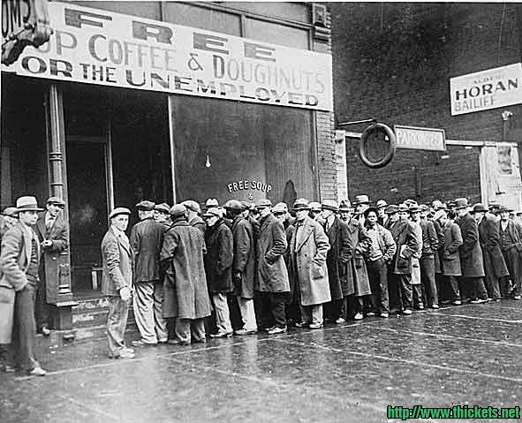
George & Lennie
Answer the 3 questions as notes for this picture. Aim for at least FIVE points in each box.
What can I see?
What can I infer (guess) from this photograph about The Great Depression?
What questions could I ask to further my knowledge or understanding?
Do Now
TODAY’S KEY QUESTIONS:
Can I make clear comparisons between characters in a text?
Can I explain how a writer uses language to create certain effects?

Slide 3
Match the vocabulary to the correct definitions.
in a way that shows great happiness or joy at a victory or achievement
a small bundle of possessions often carried by a homeless person
in a sullen, gloomy, or ill-humoured way
a vertical tube which people inside submarines can look through to see above the surface of the water
spoke tediously in a dull monotonous tone
Morosely Droned Triumphantly Periscope Bindle
Unlocking Vocabulary
TODAY’S KEY QUESTIONS:
Can I make clear comparisons between characters in a text?
Can I explain how a writer uses language to create certain effects?

Slide 4
Check Your Answers:
Triumphantly: in a way that shows great happiness or joy at a victory or achievement
Bindle: a small bundle of possessions often carried by a homeless person
Morosely: in a sullen, gloomy, or ill-humoured way
Periscope: a vertical tube which people inside submarines can look through to see above the surface of the water
Droned: spoke tediously in a dull monotonous tone
Answers
TODAY’S KEY QUESTIONS:
Can I make clear comparisons between characters in a text?
Can I explain how a writer uses language to create certain effects?

Slide 5
YOUR TASK
Read from the very beginning, to the end of Chapter One. Answer the questions as you go along in as much detail as you can.
I would like you to especially consider the setting of the story as well as the comparisons you could make between George and Lennie.
Reading Activity
TODAY’S KEY QUESTIONS:
Can I make clear comparisons between characters in a text?
Can I explain how a writer uses language to create certain effects?

Slide 6
1.Pick out words and phrases Steinbeck uses to present the setting in a positive light. Explain your choices.
2. How are George and Lennie different at the beginning of the novel?
3. Why do you think Lennie imitates George’s actions? What is Lennie like?
4. Find a quotation that proves George and Lennie are members of the proletariat class. Explain why you have chosen your quotation.
5. ‘Lennie made an elaborate pantomime of innocence’ – Why does Steinbeck emphasise the childlike nature of Lennie so much?
6. Find the comparisons between Lennie and animals. Why does Steinbeck make these comparisons?
7. Why did George and Lennie have to leave the town of Weed? What did Lennie do?
8. ‘Lennie avoided the bait. He had sensed his advantage’ – What is the significance of this line? What is Steinbeck saying about Lennie?
9. Now that you have learnt more about George and Lennie, what is your opinion of them?
10. What is George and Lennie’s ‘American Dream’? Use a quotation in your answer.
12. ‘Even though he snaps at Lennie, I think George is loyal to him and would do anything to protect him.’ To what extent do you agree? Use a quotation in your answer.
13. “‘Hide in the brush’ said Lennie slowly.’ What kind of word is ‘slowly’? What are the connotations of this?
14. Look back over the chapter. How has Steinbeck presented the destructive power of man? Consider how nature is presented at the beginning and the effect George and Lennie have had on it.
WANT AN EXTRA CHALLENGE?
Try the questions in bold!
Reading Activity

