Slide 1
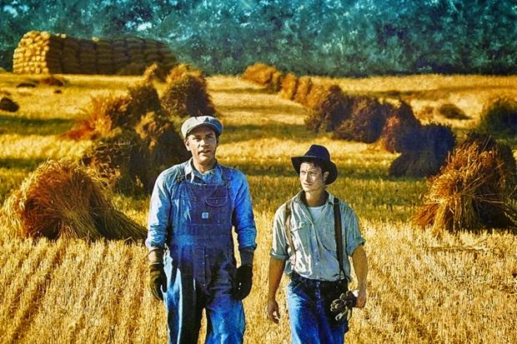
LESSON ONE

Slide 2
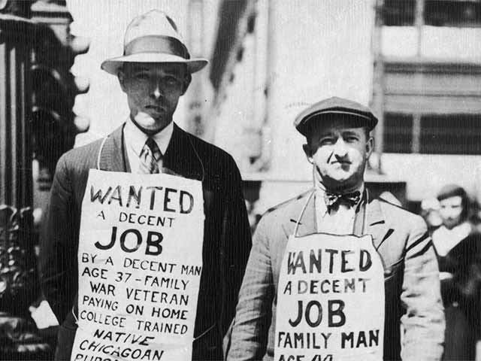
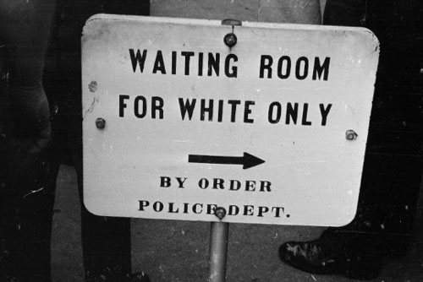
Context
How you think these pictures relate to ‘Of Mice and Men’?
What themes or ideas do you think the novel will explore and why?
Do Now
TODAY’S KEY QUESTIONS:
Can I confidently explain what is meant by CONTEXT?
Can I discuss the context of ‘Of Mice and Men’ and how societal issues inspired Steinbeck to write his novel?
Can I explain how a writer uses language to create CHARACTER?

Slide 3
SOCIAL/HISTORICAL CONTEXT
The social and historical context | Evidence from Images
The Great Depression
The Role of Women in Society
The Experiences of Minorities
The American Dream
Contextual Information
TODAY’S KEY QUESTIONS:
Can I confidently explain what is meant by CONTEXT?
Can I discuss the context of ‘Of Mice and Men’ and how societal issues inspired Steinbeck to write his novel?
Can I explain how a writer uses language to create CHARACTER?

Slide 4
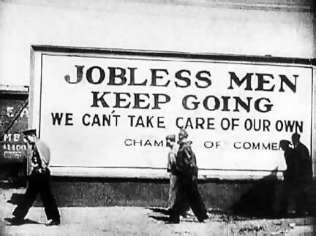
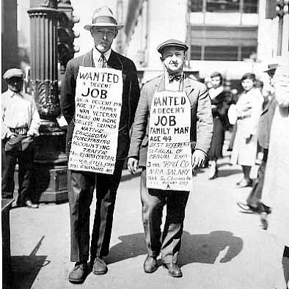
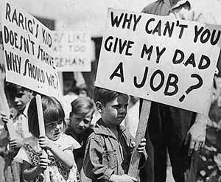
The Great Depression
Contextual Information
TODAY’S KEY QUESTIONS:
Can I confidently explain what is meant by CONTEXT?
Can I discuss the context of ‘Of Mice and Men’ and how societal issues inspired Steinbeck to write his novel?
Can I explain how a writer uses language to create CHARACTER?

Slide 5
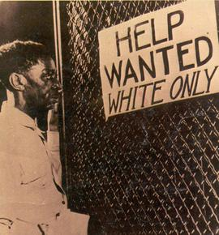
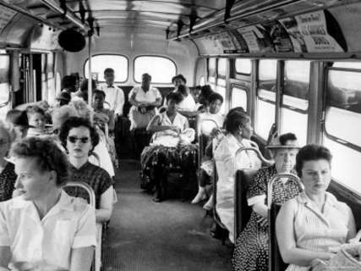
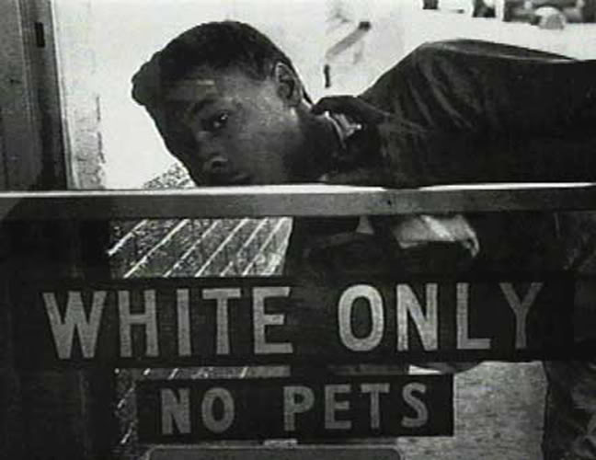
The Experiences of Minorities
Contextual Information
TODAY’S KEY QUESTIONS:
Can I confidently explain what is meant by CONTEXT?
Can I discuss the context of ‘Of Mice and Men’ and how societal issues inspired Steinbeck to write his novel?
Can I explain how a writer uses language to create CHARACTER?

Slide 6
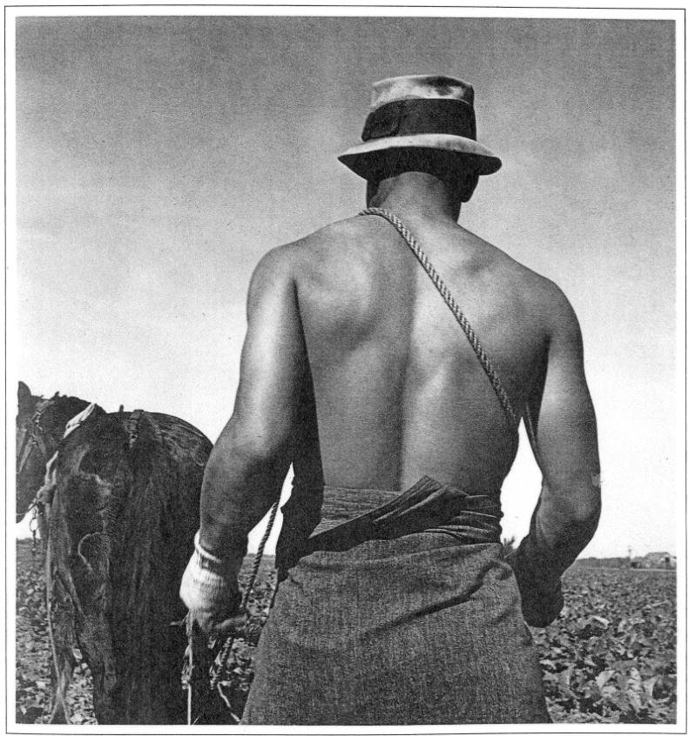
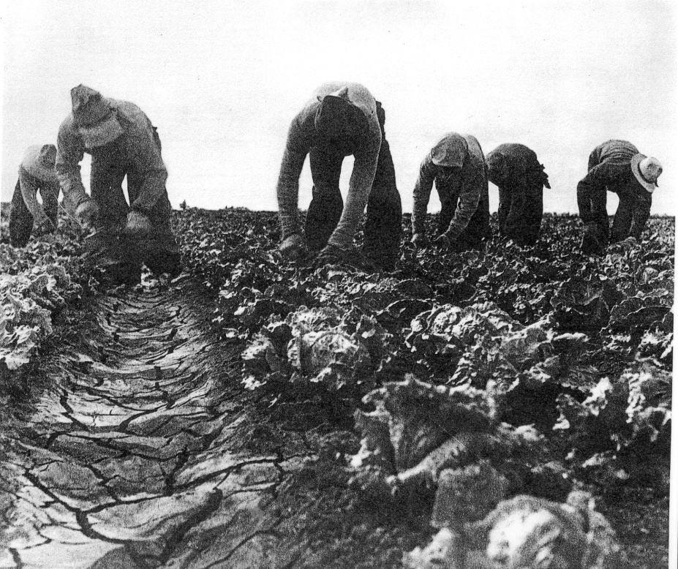
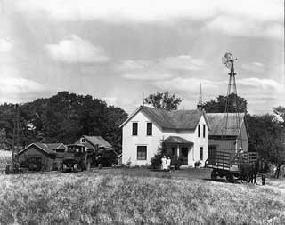
The American Dream
Contextual Information
TODAY’S KEY QUESTIONS:
Can I confidently explain what is meant by CONTEXT?
Can I discuss the context of ‘Of Mice and Men’ and how societal issues inspired Steinbeck to write his novel?
Can I explain how a writer uses language to create CHARACTER?

Slide 7
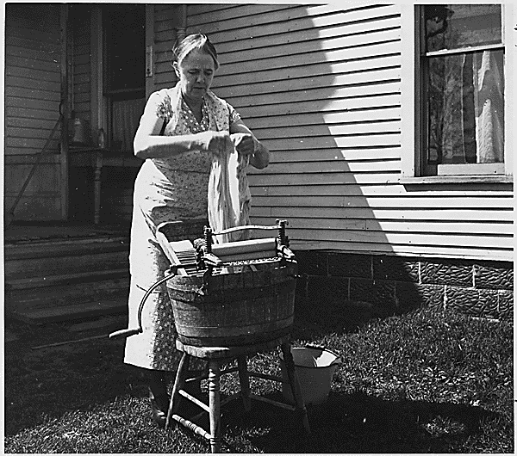
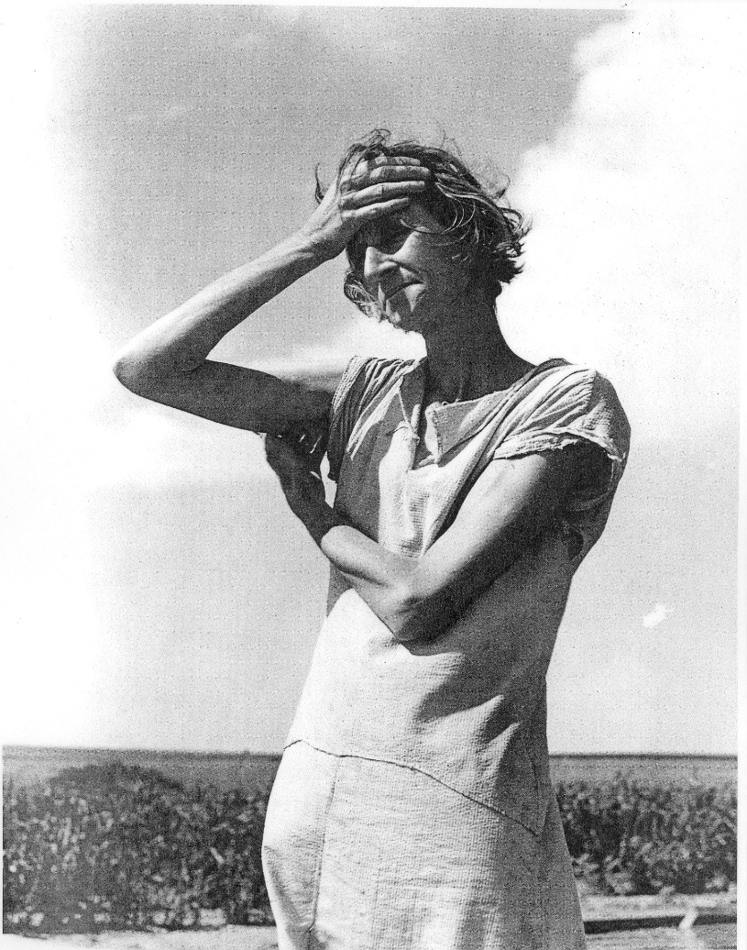
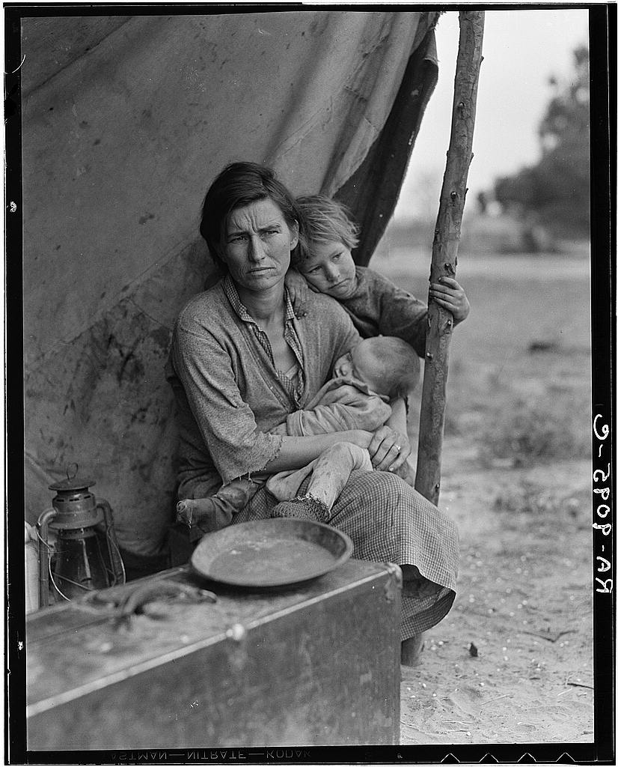
The Role of Women in Society
Contextual Information
TODAY’S KEY QUESTIONS:
Can I confidently explain what is meant by CONTEXT?
Can I discuss the context of ‘Of Mice and Men’ and how societal issues inspired Steinbeck to write his novel?
Can I explain how a writer uses language to create CHARACTER?

Slide 8
Of Mice and Men: Context
‘Proletariat Class’ means ‘working class’. Many men like George and Lennie would have no possessions or money in 1930s America. The only thing they had to offer was their ability to work.
Women were in charge of the home. There were very little opportunities for women. They did not have jobs and were not expected to earn money. That was down to their husbands.
The Great Depression was a severe worldwide economic depression that took place during the 1930s. The timing of the Great Depression varied across nations; in most countries it started in 1929 and lasted until 1941. The Great Depression led to many people losing all their money because it lost its value. This led to extreme poverty for millions of people.
A ‘Hooverville’ was like a shanty town. Many people were forced to make homes out of anything they could find when they lost their money. They were nicknames Hoovervilles after Herbert Hoover, the President of the United States at that time.
The American Dream was the term used to describe a richer, fuller life. People believed the ‘American Dream’ allowed them to make a better life for themselves, regardless of social class or circumstances of birth. It is the idea that EVERYONE can make a better life for themselves.
‘Of Mice and Men’ was written by John Steinbeck. He was born in Salinas, California in 1902. Although his family was wealthy, he was interested in the lives of the farm labourers and spent time working with them. He used his experiences as material for his writing.
Reading Activity
TODAY’S KEY QUESTIONS:
Can I confidently explain what is meant by CONTEXT?
Can I discuss the context of ‘Of Mice and Men’ and how societal issues inspired Steinbeck to write his novel?
Can I explain how a writer uses language to create CHARACTER?

Slide 9
Of Mice and Men: Context
Added to the man-made financial problems were natural ones. A series of droughts in southern mid-western states like Kansas, Oklahoma and Texas led to failed harvests and dried-up land. Farmers were forced to move off their land: they couldn't repay the bank-loans which had helped buy the farms and had to sell what they owned to pay their debts. Many economic migrants headed west to 'Golden' California, thinking there would be land going spare, but the Californians turned many back, fearing they would be over-run.
‘Of Mice and Men’ tells the story of George Milton and Lennie Small, two displaced migrant ranch workers, who move from place to place in California in search of new job opportunities during the Great Depression in the United States. ‘Of Mice and Men’ was written in 1937. ‘Of Mice and Men’ is set south of Soledad, California. ‘Soledad’ means loneliness in Spanish. Loneliness is a key theme in the novel.
Black people were treated horrendously in 1930s America. There were very little opportunities for black people at this time. Many people were discriminated against because of their race. Steinbeck shows this discrimination through the character of Crooks in the novel.
A ranch hand was a worker who endured physical labour. They would help the day to day running of the farm. They would be paid VERY little.
The Dust Bowl, also known as the Dirty Thirties, was a period of severe dust storms that greatly damaged the ecology and agriculture of the American and Canadian prairies (grasslands) during the 1930s, causing severe drought.
Reading Activity
TODAY’S KEY QUESTIONS:
Can I confidently explain what is meant by CONTEXT?
Can I discuss the context of ‘Of Mice and Men’ and how societal issues inspired Steinbeck to write his novel?
Can I explain how a writer uses language to create CHARACTER?

Slide 10
Of Mice and Men Context
1. What was the Great Depression?
2. What was the American Dream?
3. What is a migrant farmer?
4. What does the word ‘proletariat mean?
5. What was the role of women in 1930s America?
6. What was life like for black people in 1930s America?
7. What is Of Mice and Men about?
Contextual Information
TODAY’S KEY QUESTIONS:
Can I confidently explain what is meant by CONTEXT?
Can I discuss the context of ‘Of Mice and Men’ and how societal issues inspired Steinbeck to write his novel?
Can I explain how a writer uses language to create CHARACTER?

Slide 11
Of Mice and Men: Chapter 1
A few miles south of Soledad, the Salinas River drops in close to the hillside bank and runs deep and green. The water is warm too, for it has slipped twinkling over the yellow sands in the sunlight before reaching the narrow pool. On one side of the river the golden foothill slopes curve up to the strong and rocky Gabilan Mountains, but on the valley side the water is lined with trees— willows fresh and green with every spring, carrying in their lower leaf junctures the debris of the winter’s flooding; and sycamores with mottled, white, recumbent limbs and branches that arch over the pool. On the sandy bank under the trees the leaves lie deep and so crisp that a lizard makes a great skittering if he runs among them. Rabbits come out of the brush to sit on the sand in the evening, and the damp flats are covered with the night tracks of ‘coons, and with the spreadpads of dogs from the ranches, and with the split-wedge tracks of deer that come to drink in the dark.
There is a path through the willows and among the sycamores, a path beaten hard by boys coming down from the ranches to swim in the deep pool, and beaten hard by tramps who come wearily down from the highway in the evening to jungle-up near water. In front of the low horizontal limb of a giant sycamore there is an ash pile made by many fires; the limb is worn smooth by men who have sat on it.
Evening of a hot day started the little wind to moving among the leaves. The shade climbed up the hills toward the top. On the sand banks the rabbits sat as quietly as little gray sculptured stones. And then from the direction of the state highway came the sound of footsteps on crisp sycamore leaves. The rabbits hurried noiselessly for cover. A stilted heron labored up into the air and pounded down river. For a moment the place was lifeless, and then two men emerged from the path and came into the opening by the green pool.
Reading Activity
TODAY’S KEY QUESTIONS:
Can I confidently explain what is meant by CONTEXT?
Can I discuss the context of ‘Of Mice and Men’ and how societal issues inspired Steinbeck to write his novel?
Can I explain how a writer uses language to create CHARACTER?

Slide 12
Of Mice and Men: Chapter 1
They had walked in single file down the path, and even in the open one stayed behind the other. Both were dressed in denim trousers and in denim coats with brass buttons. Both wore black, shapeless hats and both carried tight blanket rolls slung over their shoulders. The first man was small and quick, dark of face, with restless eyes and sharp, strong features. Every part of him was defined: small, strong hands, slender arms, a thin and bony nose. Behind him walked his opposite, a huge man, shapeless of face, with large, pale eyes, and wide, sloping shoulders; and he walked heavily, dragging his feet a little, the way a bear drags his paws. His arms did not swing at his sides, but hung loosely.
The first man stopped short in the clearing, and the follower nearly ran over him. He took off his hat and wiped the sweat-band with his forefinger and snapped the moisture off. His huge companion dropped his blankets and flung himself down and drank from the surface of the green pool; drank with long gulps, snorting into the water like a horse. The small man stepped nervously beside him.
“Lennie!” he said sharply. “Lennie, for God’ sakes don’t drink so much.” Lennie continued to snort into the pool. The small man leaned over and shook him by the shoulder. “Lennie. You gonna be sick like you was last night.”
Lennie dipped his whole head under, hat and all, and then he sat up on the bank and his hat dripped down on his blue coat and ran down his back. “That’s good,” he said. “You drink some, George. You take a good big drink.” He smiled happily.
George unslung his bindle and dropped it gently on the bank. “I ain’t sure it’s good water,” he said. “Looks kinda scummy.”
Lennie dabbled his big paw in the water and wiggled his fingers so the water arose in little splashes; rings widened across the pool to the other side and came back again. Lennie watched them go. “Look, George. Look what I done.”
Reading Activity
TODAY’S KEY QUESTIONS:
Can I confidently explain what is meant by CONTEXT?
Can I discuss the context of ‘Of Mice and Men’ and how societal issues inspired Steinbeck to write his novel?
Can I explain how a writer uses language to create CHARACTER?

Slide 13
George & Lennie
Mastery

Slide 14
Answer the following to summarise what you have learnt today.
Summarise The Great Depression using 3 adjectives
Write down 2 new facts you learned today
Explain your first impressions of George and Lennie
Checking Understanding
TODAY’S KEY QUESTIONS:
Can I confidently explain what is meant by CONTEXT?
Can I discuss the context of ‘Of Mice and Men’ and how societal issues inspired Steinbeck to write his novel?
Can I explain how a writer uses language to create CHARACTER?

