Slide 1
A Midsummer Night’s Dream by William Shakespeare
Act 4 Scene 1

Slide 2
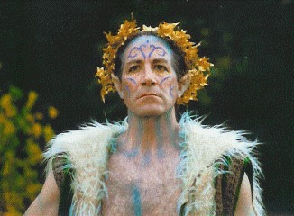
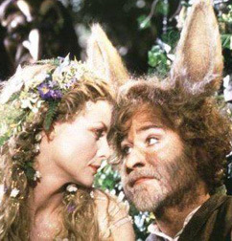
Starter: Prediction
Oberon removes the spell from Titania and she wakes up from her drug-induced sleep.
How do you think she reacts?
Write your answer quickly – put your thoughts down immediately.
Use: mind map, bullet points or paragraph.
Do Now

Slide 3
Learning Objective:
Examining how language in Act 4 of ‘A Midsummer Night’s Dream’ reveals the reactions of characters to events.
Noting the characters who explain their behaviour by saying they were dreaming or under a spell.
Learning Content

Slide 4
Progress Indicators:
Expected Progress: Understand a character’s reaction to what happened during the night.
Good Progress: Explain why the character has the reaction they do.
Outstanding Progress: Make inferences about the character’s reaction based on their use of language.
Learning Content

Slide 5
Unlocking Vocabulary
List all the words that you know which begin with ‘Anti..’ – what do they mean?
What might Antithesis mean in literature?
Find the meaning in a dictionary.
Infatuation- is it real love?
Unlocking vocabulary

Slide 6
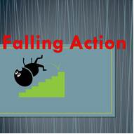
Falling Action
After the climax, or turning point, of a drama has been reached, most of the suspense is over. The highest emotional peak has been reached, and the major conflict has been encountered. Still, the audience likes to see all of the loose ends tied up. That occurs during the part of the plot known as the falling action. In ‘A Midsummer Night’s Dream’ the falling action mostly takes place in act 4.
Context

Slide 7
Read from Cambridge p101 – 105 Line 81 or Oxford p57 – 61 Line 83
1. The fourth act opens with Bottom at centre stage. What is your opinion of Bottom’s character? How might he be the antithesis, or opposite, of Theseus’s or Oberon’s character?
2. In this act, several characters look back at prior infatuations with disbelief. What do you think Shakespeare is saying about love and infatuation?
Reading & thinking Task

Slide 8
Act 4 Scene 1 (p103 Ca, P60 Ox)
OBERON
Welcome, good Robin.
See'st thou this sweet sight?
Her dotage now I do begin to pity:
For, meeting her of late behind the wood,
Seeking sweet favours from this hateful
fool,
I did upbraid her and fall out with her;
For she his hairy temples then had
rounded
With a coronet of fresh and fragrant
flowers;
When I had at my pleasure taunted her
And she in mild terms begg'd my patience,
I then did ask of her her changeling child;
Which straight she gave me, and her fairy
sent
To bear him to my bower in fairy land.
And now I have the boy, I will undo
This hateful imperfection of her eyes:
And, gentle Puck, take this transformed
scalp
From off the head of this Athenian swain;
That, he awaking when the other do,
May all to Athens back again repair
And think no more of this night's
accidents
But as the fierce vexation of a dream.
But first I will release the fairy queen.
Be as thou wast wont to be;
See as thou wast wont to see:
Dian's bud o'er Cupid's flower
Hath such force and blessed power.
Now, my Titania; wake you, my sweet
queen.
Reading & thinking Task
Reading & Writing Task

Slide 9
Act 4 Scene 1 (p103 Ca, P60 Ox)
OBERON
Welcome, good Robin.
See'st thou this sweet sight?
Her dotage now I do begin to pity:
For, meeting her of late behind the wood,
Seeking sweet favours from this hateful
fool,
I did upbraid her and fall out with her;
For she his hairy temples then had
rounded
With a coronet of fresh and fragrant
flowers;
When I had at my pleasure taunted her
And she in mild terms begg'd my patience,
I then did ask of her her changeling child;
Which straight she gave me, and her fairy
sent
To bear him to my bower in fairy land.
And now I have the boy, I will undo
This hateful imperfection of her eyes:
And, gentle Puck, take this transformed
scalp
Reading & thinking Task
Reading & Writing Task

Slide 10
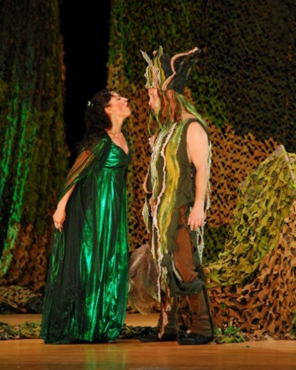
Act 4 Scene 1 (p103 Ca, P60 Ox)
OBERON contd
From off the head of this Athenian swain;
That, he awaking when the other do,
May all to Athens back again repair
And think no more of this night's
accidents
But as the fierce vexation of a dream.
But first I will release the fairy queen.
Be as thou wast wont to be;
See as thou wast wont to see:
Dian's bud o'er Cupid's flower
Hath such force and blessed power.
Now, my Titania; wake you, my sweet
queen.
Reading & thinking Task
Reading & Writing Task

Slide 11
Tasks
Your tasks:
1.Re-read and annotate the extract – what does he call Bottom? Underline/highlight any interesting or unusual words, insults, how does he refer to Titania at the end?
2. Quotation finder: Find a ½ quotations which …
a) suggests that Oberon feels bad for making a fool of Titania.
b) shows that Oberon thinks of Bottom as a common or insignificant character.
c) shows that Oberon has taken pleasure from winding Titania up.
d) reveals that Oberon got what he wanted all along.
e) shows the audience that Oberon wants it all to be over and nothing
more than a dream.
f) shows that, once released from the effect of the potion, Titania is
repulsed by Bottom.
g) that Bottom will be the same once again.
3. See the lines in bold which begin: ‘Be as thou wast wont to be;’
a) Say them out loud to your self – (you may need to do this quietly). Listen to how it sounds, can you hear a rhythm? What has created this?
b) What do you notice about HOW these lines differ from Oberons’ usual speech?
c) What is Oberon doing at this moment when he is saying these 4 lines?
Challenge: Why do you think Shakespeare used this language and rhythm in the four lines in task 3? What is the effect. What is Oberon doing?
Reading & Writing Task

