Slide 1
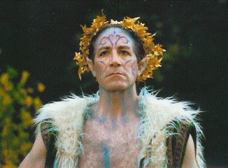
Act 4 Scene 1 (p103 Ca, P60 Ox)
OBERON
Welcome, good Robin.
See'st thou this sweet sight?
Her dotage now I do begin to pity:
For, meeting her of late behind the wood,
Seeking sweet favours from this hateful
fool,
I did upbraid her and fall out with her;
For she his hairy temples then had
rounded
With a coronet of fresh and fragrant
flowers;
When I had at my pleasure taunted her
And she in mild terms begg'd my patience,
I then did ask of her her changeling child;
Which straight she gave me, and her fairy
sent
To bear him to my bower in fairy land.
And now I have the boy, I will undo
This hateful imperfection of her eyes:
And, gentle Puck, take this transformed
scalp
From off the head of this Athenian swain;
That, he awaking when the other do,
May all to Athens back again repair
And think no more of this night's
accidents
But as the fierce vexation of a dream.
But first I will release the fairy queen.
Be as thou wast wont to be;
See as thou wast wont to see:
Dian's bud o'er Cupid's flower
Hath such force and blessed power.
Now, my Titania; wake you, my sweet
queen.
Reading & thinking Task
Reading & Writing Task

Slide 2
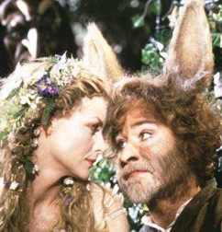
Act 4 Scene 1 (p103 Ca, P60 Ox)
OBERON
Welcome, good Robin.
See'st thou this sweet sight?
Her dotage now I do begin to pity:
For, meeting her of late behind the wood,
Seeking sweet favours from this hateful
fool,
I did upbraid her and fall out with her;
For she his hairy temples then had
rounded
With a coronet of fresh and fragrant
flowers;
When I had at my pleasure taunted her
And she in mild terms begg'd my patience,
I then did ask of her her changeling child;
Which straight she gave me, and her fairy
sent
To bear him to my bower in fairy land.
And now I have the boy, I will undo
This hateful imperfection of her eyes:
And, gentle Puck, take this transformed
scalp
Reading & thinking Task
Reading & Writing Task

Slide 3
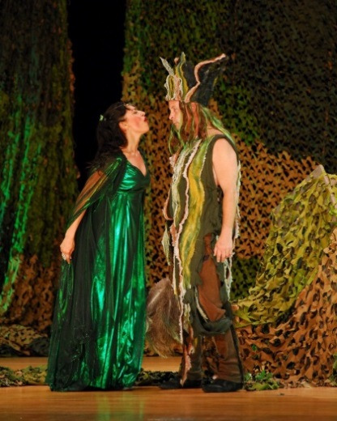
Act 4 Scene 1 (p103 Ca, P60 Ox)
OBERON contd
From off the head of this Athenian swain;
That, he awaking when the other do,
May all to Athens back again repair
And think no more of this night's
accidents
But as the fierce vexation of a dream.
But first I will release the fairy queen.
Be as thou wast wont to be;
See as thou wast wont to see:
Dian's bud o'er Cupid's flower
Hath such force and blessed power.
Now, my Titania; wake you, my sweet
queen.
Reading & thinking Task
Reading & Writing Task

Slide 4
Tasks
Your tasks:
1.Re-read and annotate the extract – what does he call Bottom? Underline/highlight any interesting or unusual words, insults, how does he refer to Titania at the end?
2. Quotation finder: Find a ½ quotations which …
a) suggests that Oberon feels bad for making a fool of Titania.
b) shows that Oberon thinks of Bottom as a common or insignificant character.
c) shows that Oberon has taken pleasure from winding Titania up.
d) reveals that Oberon got what he wanted all along.
e) shows the audience that Oberon wants it all to be over and nothing
more than a dream.
f) shows that, once released from the effect of the potion, Titania is
repulsed by Bottom.
g) that Bottom will be the same once again.
3. See the lines in bold which begin: ‘Be as thou wast wont to be;’
a) Say them out loud to your self – (you may need to do this quietly). Listen to how it sounds, can you hear a rhythm? What has created this?
b) What do you notice about HOW these lines differ from Oberons’ usual speech?
c) What is Oberon doing at this moment when he is saying these 4 lines?
Challenge: Why do you think Shakespeare used this language and rhythm in the four lines in task 3? What is the effect. What is Oberon doing?
Reading & Writing Task

Slide 5
Diary Entry
Write Titania’s Diary for after she has woken up from the spell?
What does she remember?
How does she feel?
Is she happy or angry with Oberon?
What is she going to do next?
Writing Task

