Slide 1
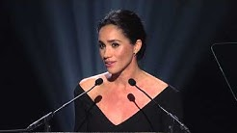
https://www.youtube.com/watch?v=Zkb-zg4JCLk
Checking Understanding
Watch and listen to the speech and list….
memorable words, techniques and devices used….

Slide 2
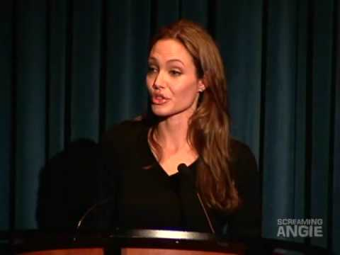
Angelina Jolie on World Refugee Day
Checking Understanding
Watch and listen to the speech and list….
memorable words, techniques and devices used….
Notes:
Watch up to 2:12

Slide 3
How does Obama use language and devices in order to persuade his audience?
We, the people, still believe that our obligations as Americans are not just to ourselves but to all prosperity. We will respond to the threat of climate change, knowing that the failure to do so will betray our children and future generations.
Some may still deny the overwhelming judgement of science, but none can avoid the devastating impact of raging fires, crippling drought or powerful storms. A path towards sustainable energy sources will be long and sometimes difficult, but America cannot resist this transition.
We must lead it! We cannot concede to other nations the technology that will power new jobs and new industries; we must claim its promise. That’s how we will maintain our economic vitality and our national treasure. You and I as citizens have the power to set this country’s course. You and I as citizens have the obligation to shape the debates of our time not only with the votes we cast but with the voices we lift in defence of our most ancient values and enduring ideas. Will you join us?
Mastery

Slide 4
Write a speech that would be delivered to Parliament about your views on climate change and what should be done to prevent it.
Planning:
Mastery

