Slide 1
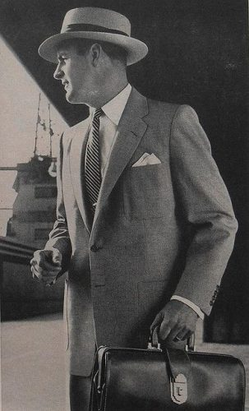
Narrative Perspectives
Key Vocabulary
Perspective
Show not Tell
Word Classes
Ambitious Vocabulary
Clauses
LO: To write from different points of view.

Slide 2
Show not Tell – Create your own version
Telling: Michael was terribly afraid of the dark.
Showing: As his mother switched off the light and left the room, Michael tensed. He huddled under the covers, gripped the sheets, and held his breath as the wind brushed past the curtain.
Do Now
Key Vocabulary
Perspective
Show not Tell
Word Classes
Ambitious Vocabulary
Clauses

Slide 3
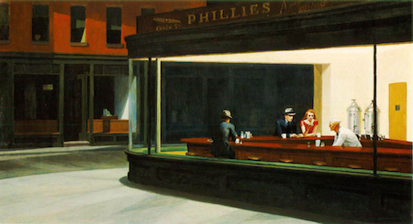
Whose point of view could a story be told from?
Mastery
Key Vocabulary
Perspective
Show not Tell
Word Classes
Ambitious Vocabulary
Clauses

Slide 4
Now change the perspective. How does the story differ? What new information is given to the reader?
Mastery
Key Vocabulary
Perspective
Show not Tell
Word Classes
Ambitious Vocabulary
Clauses

Slide 5
Narrative Time Frames
He was an old man – he was probably in the army or a footballer or something – and he had wrinkles. He was sat somewhere doing something and then there was a car crash.
The old man said to his grandson, “Oh there’s been a car crash”
“Yes there has”, the grandson replied.
“Did I tell you I used to be in the army?”
“I thought you were a footballer” the grandson replied.
“Yeh I did, but I was in the army too” the old man said.
“Do you think this is too much dialogue and that actually it isn't saying anything about our characters?” asked the grandson.
“Yes. You’re probably right. Loads of dialogue is quite difficult to control and it doesn’t really show of our skill with writing.”
And then there was an explosion. A car came through the front room wall and it was filled with gangsters who sold drugs for a living.
“Ouch my back hurts and I’ve got wrinkles” said the old man.
One of the gangsters offered the old man some drugs to smoke. He did and it
helped his back. And then he woke up and it was all a dream.
Do Now
Key Vocabulary
Perspective
Show not Tell
Word Classes
Ambitious Vocabulary
Clauses
LO: To explore the effect of time in narratives

Slide 6
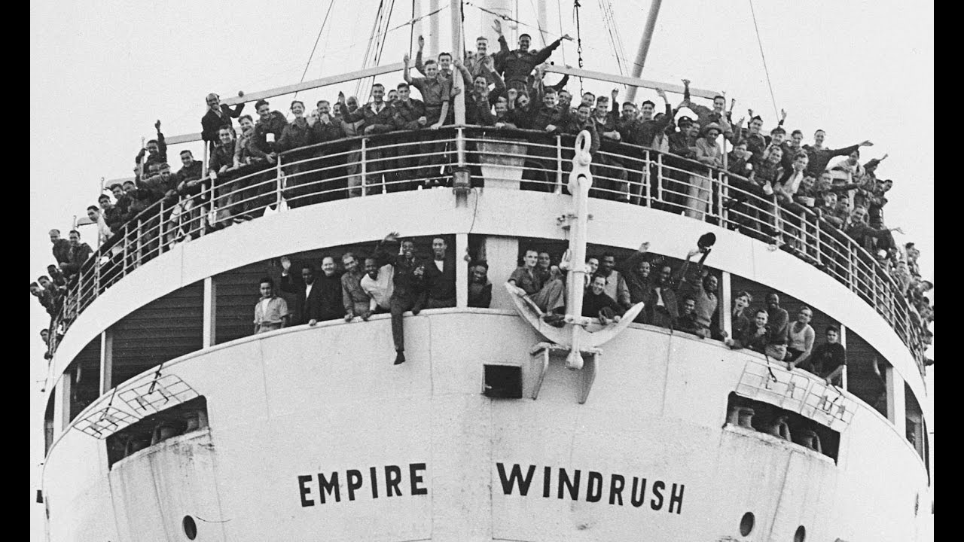
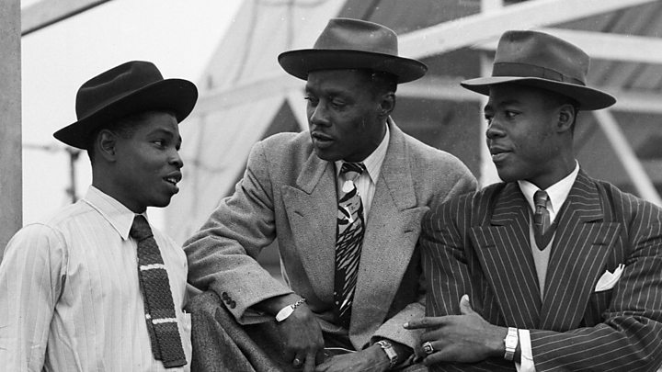
Narrative Time Frames
.
Checking Understanding
What do you know about these people?
Key Vocabulary
Perspective
Show not Tell
Word Classes
Ambitious Vocabulary
Clauses
LO: To explore the effect of time in narratives

Slide 7
Narrative Time Frames
.
Mastery
Write in first person, past tense about a man arriving in Britain/London for the first time.
Key Vocabulary
Perspective
Show not Tell
Word Classes
Ambitious Vocabulary
Clauses
LO: To explore the effect of time in narratives

Slide 8
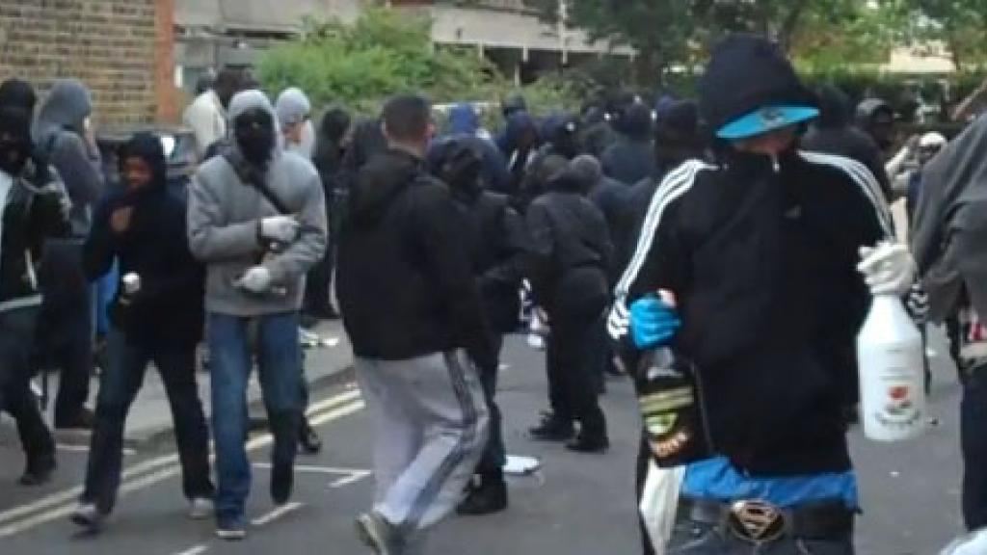
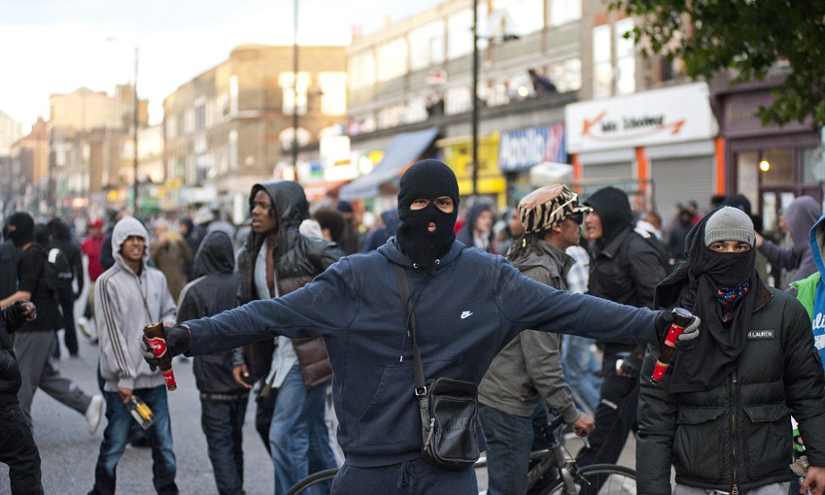
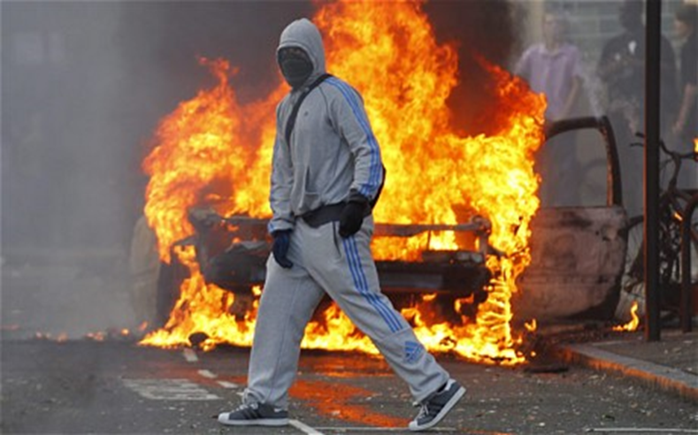
Narrative Time Frames
.
Checking Understanding
What do you know
about this event?
Key Vocabulary
Perspective
Show not Tell
Word Classes
Ambitious Vocabulary
Clauses
LO: To explore the effect of time in narratives

Slide 9
Narrative Time Frames
.
Mastery
Write in 1st person, present tense
as if you are watching the riots
take place.
Key Vocabulary
Perspective
Show not Tell
Word Classes
Ambitious Vocabulary
Clauses
LO: To explore the effect of time in narratives

Slide 10
Narrative Time Frames
.
Checking Understanding
How would the Windrush generation feel seeing the London riots?
Key Vocabulary
Perspective
Show not Tell
Word Classes
Ambitious Vocabulary
Clauses
LO: To explore the effect of time in narratives

Slide 11
Narrative Time Frames
.
Mastery
Looking at the scene below me, I think about the day I arrived in this country. My friend had turned towards me and stated, “…
But now…
Key Vocabulary
Perspective
Show not Tell
Word Classes
Ambitious Vocabulary
Clauses
LO: To explore the effect of time in narratives

