Slide 1
The benefits of living in the 21st Century
LO: to show understanding of the conditions in 19th Century by writing a narrative essay
To know how to use varied sentences to make our writing more interesting.
Using correct SP & G

Slide 2
Compound sentences – subordinate and main clauses
Compound sentences: contain more than one piece of information. The words ‘and’, ‘but’ and ‘or’ are used to join two simple sentences together. e.g. ‘The cat sat on the mat and licked his paw.’
NOW TRY THIS
Join the following sentences together to make compound sentences. Choose the most suitable conjunction from the list below. Use each conjunction once only.
1. I enjoy reading. I don’t enjoy cooking.
2. Ben is considerate. He always talks to me with me when I’m unhappy.
3. Kate ran home from school quickly. She was excited.
4. Babies cry all of the time. They can get some attention from their mum.
5. Year Seven is a hardworking class. All of the children want to do well at school.
6. I can use simple sentences in my writing. I can use compound ones to make it more interesting.
Connectives
and because so
as but or
CHALLENGE :
Therefore even though although however despite this inspite of this
As a consequence never the less

Slide 3
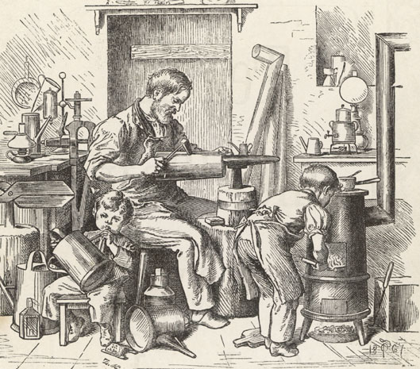
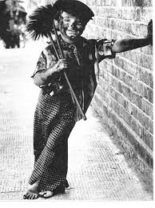
How would you describe attitudes to child labour in the Victorian Era?

Slide 4
Subordinate conjunctions
.

Slide 5
Subordinate conjunctions
.

Slide 6
Inventions

Slide 7
Vocabulary:
___________- copyright, official registration of an invention.
________________ the person who invents things or creates something.
Entrepreneur
Patent

Slide 8
Vocabulary:
Patent- copyright, official registration of an invention.
Entrepreneur- the person who invents things or creates something.

Slide 9
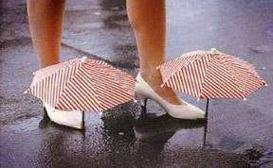
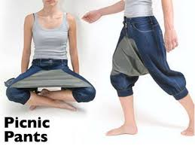
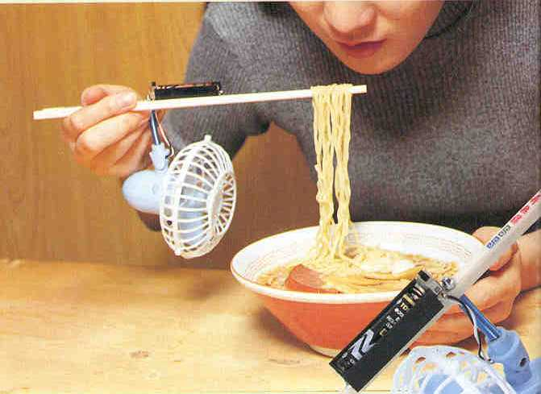
What is it?
Notes:
Umbrella shoes
Baby broom
Picnic pants
Noodle cooler

Slide 10
What is it?
Umbrella shoes
Baby broom
Noodle cooler
Notes:
Umbrella shoes
Baby broom
Picnic pants
Noodle cooler

Slide 11
What is the invention for which you are the most grateful? Why?
Discuss and share
Notes:
Share with groups – choose one from the group to report out
As a class, share the inventions each group decided on
Vote it down to one top invention

Slide 12
Why are things invented?
Most inventions are created in order to:
Aid communication
Make life more convenient
Cheat nature
Improve transportation
Allow one to defend oneself

Slide 13
Apply the criteria:
Notes:
Print the items out on slides 10-13

Slide 14
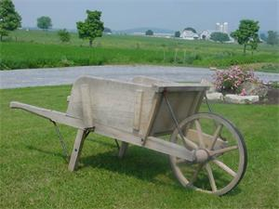
Apply the criteria:

Slide 15
Apply the criteria:

Slide 16
Apply the criteria

Slide 17
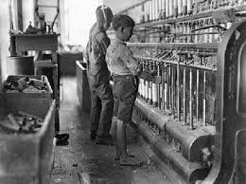
What would it smell and sound like here?
Do you think they knew what a weekend was? A holiday?
When is break/lunchtime?
What is there for lunch?
How long would you want to stand here- in bare feet?

Slide 18
The benefits of living in the 21st Century
Success criteria:
Vary:
Vocabulary/Connectives
Sentence Structures
Spelling – accurate
Punctuation
Grammar – past and present tense
Discuss most/all of the issues on the poster opposite and perhaps:
Clothing
Food
Entertainment
Transport and communication
Technology

Slide 19
The benefits of living in the 21st Century
Twenty first century living for a child today is significantly different to the 19th Century. One of the main differences is access to education, if I were a child in Victorian Britain I would undoubtedly be working: in a factory, as a chimney sweep, perhaps even in the workhouse. As it is today, I am provided with free education to enable me to choose my career path in future life; whatever that may be. At times, school seems like hard work (at least we, the pupils think so) we arrive shortly before 9am and leave just after 3pm with two breaks, whereas in the 1800s, workdays lasted from 12-16 hours, women and children worked six days a week and there were no: paid holidays, vacations or sick days.

Slide 20
Homework Due:
Complete your narrative essay on:
Do any additional research you may require.
HA – 4-6 paragraphs
MA- 3-5 paragraphs
LA – 2 – 4 paragraphs – may include some labelled illustrations.
The benefits of living in the 21st Century.

