Slide 1
Poetry Revision
Which poems do these lines come from?
“coughing like hags”
“So soft, so calm, yet eloquent,”
“under an English Heaven.”
“ I shall but love thee better after death.”
“broken bird’s egg of a skull”
“It will blind you with tears”
“Then, and only then, did I come close”
“Of teenage crushes on worthless boys”
Do Now

Slide 2
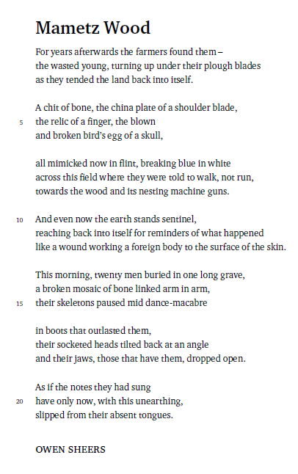
How are the effects of war presented in the poem ‘Mametz Wood’?
Mastery
Annotate the poem.

Slide 3
How are the effects of war presented in the poem ‘Mametz Wood’?
Mastery
Annotate the poem.

Slide 4
How are the effects of war presented in the poem ‘Mametz Wood’?
‘Mametz Wood’ by Owen Sheers explores the idea that the impacts of war are everlasting. The poem looks at the deaths of around 4000 men from the 38th Welsh Division during the Battle of the Somme. It uses gruesome imagery and in no way celebrates the idea of war itself, as the poem strongly juxtaposes the pro-war propaganda of the time.
To begin with, Sheers exhibits how the effects of war are everlasting through the opening lines, ‘For years afterwards’. This phrase emphasises how deadly was by judgement of the time period in which the bodies were unknowingly being dug up. In particular, ‘Years’ and ‘afterwards’ signal a long gap between the event and the discovery of the bodies. ‘For years’ suggests that this was a daily occurrence that the farmers were ploughing up bits of bone.
Mastery
Continue this answer. Cover about 5 more quotes.

