Slide 1
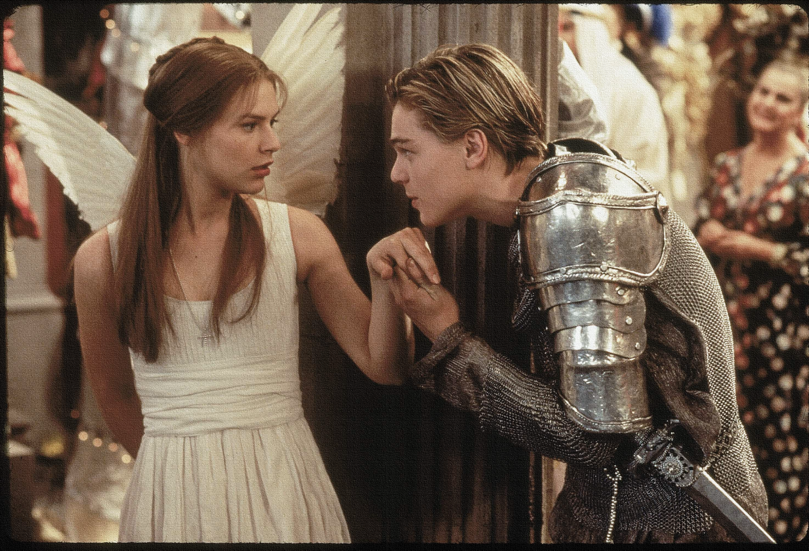
Key Words:
Mercurial
The four humours
Foil
Juxtaposition
Protagonist
Lesson 5 - Mercutio's influence in the play
Success Criteria:
To explore views of Mercutio and his role in the play.
To explain how the audience would view Mercutio in relation to the four humours.
To analyse how Mercutio and Romeo’s view of love differ and why.
‘Romeo + Juliet’
Learning Objectives:
AO1: use textual references, including quotations, to support and illustrate interpretations.
AO2: Analyse the language used by a writer to create meanings and effects.

Slide 2
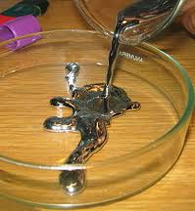
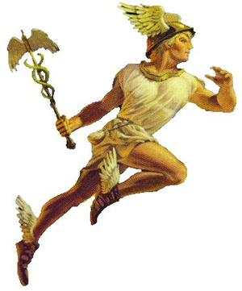
Write today’s date - Sunday, 11 October 2020 and today’s title – Romeo and Juliet Revision in your book
What do you know about the chemical element Mercury?
Mercury
Messenger of the Gods
God of trade, merchants and travel
Guide of the dead
He has influenced the name of many things
Can you name anything that may have been influenced by Mercury?
Do Now
Mercurial:
Something or someone that is erratic, volatile or unstable.
Can you name a character in the play with a similar name?
Extension: Are there any links between this character and the things you know about the messenger and word above?

Slide 3
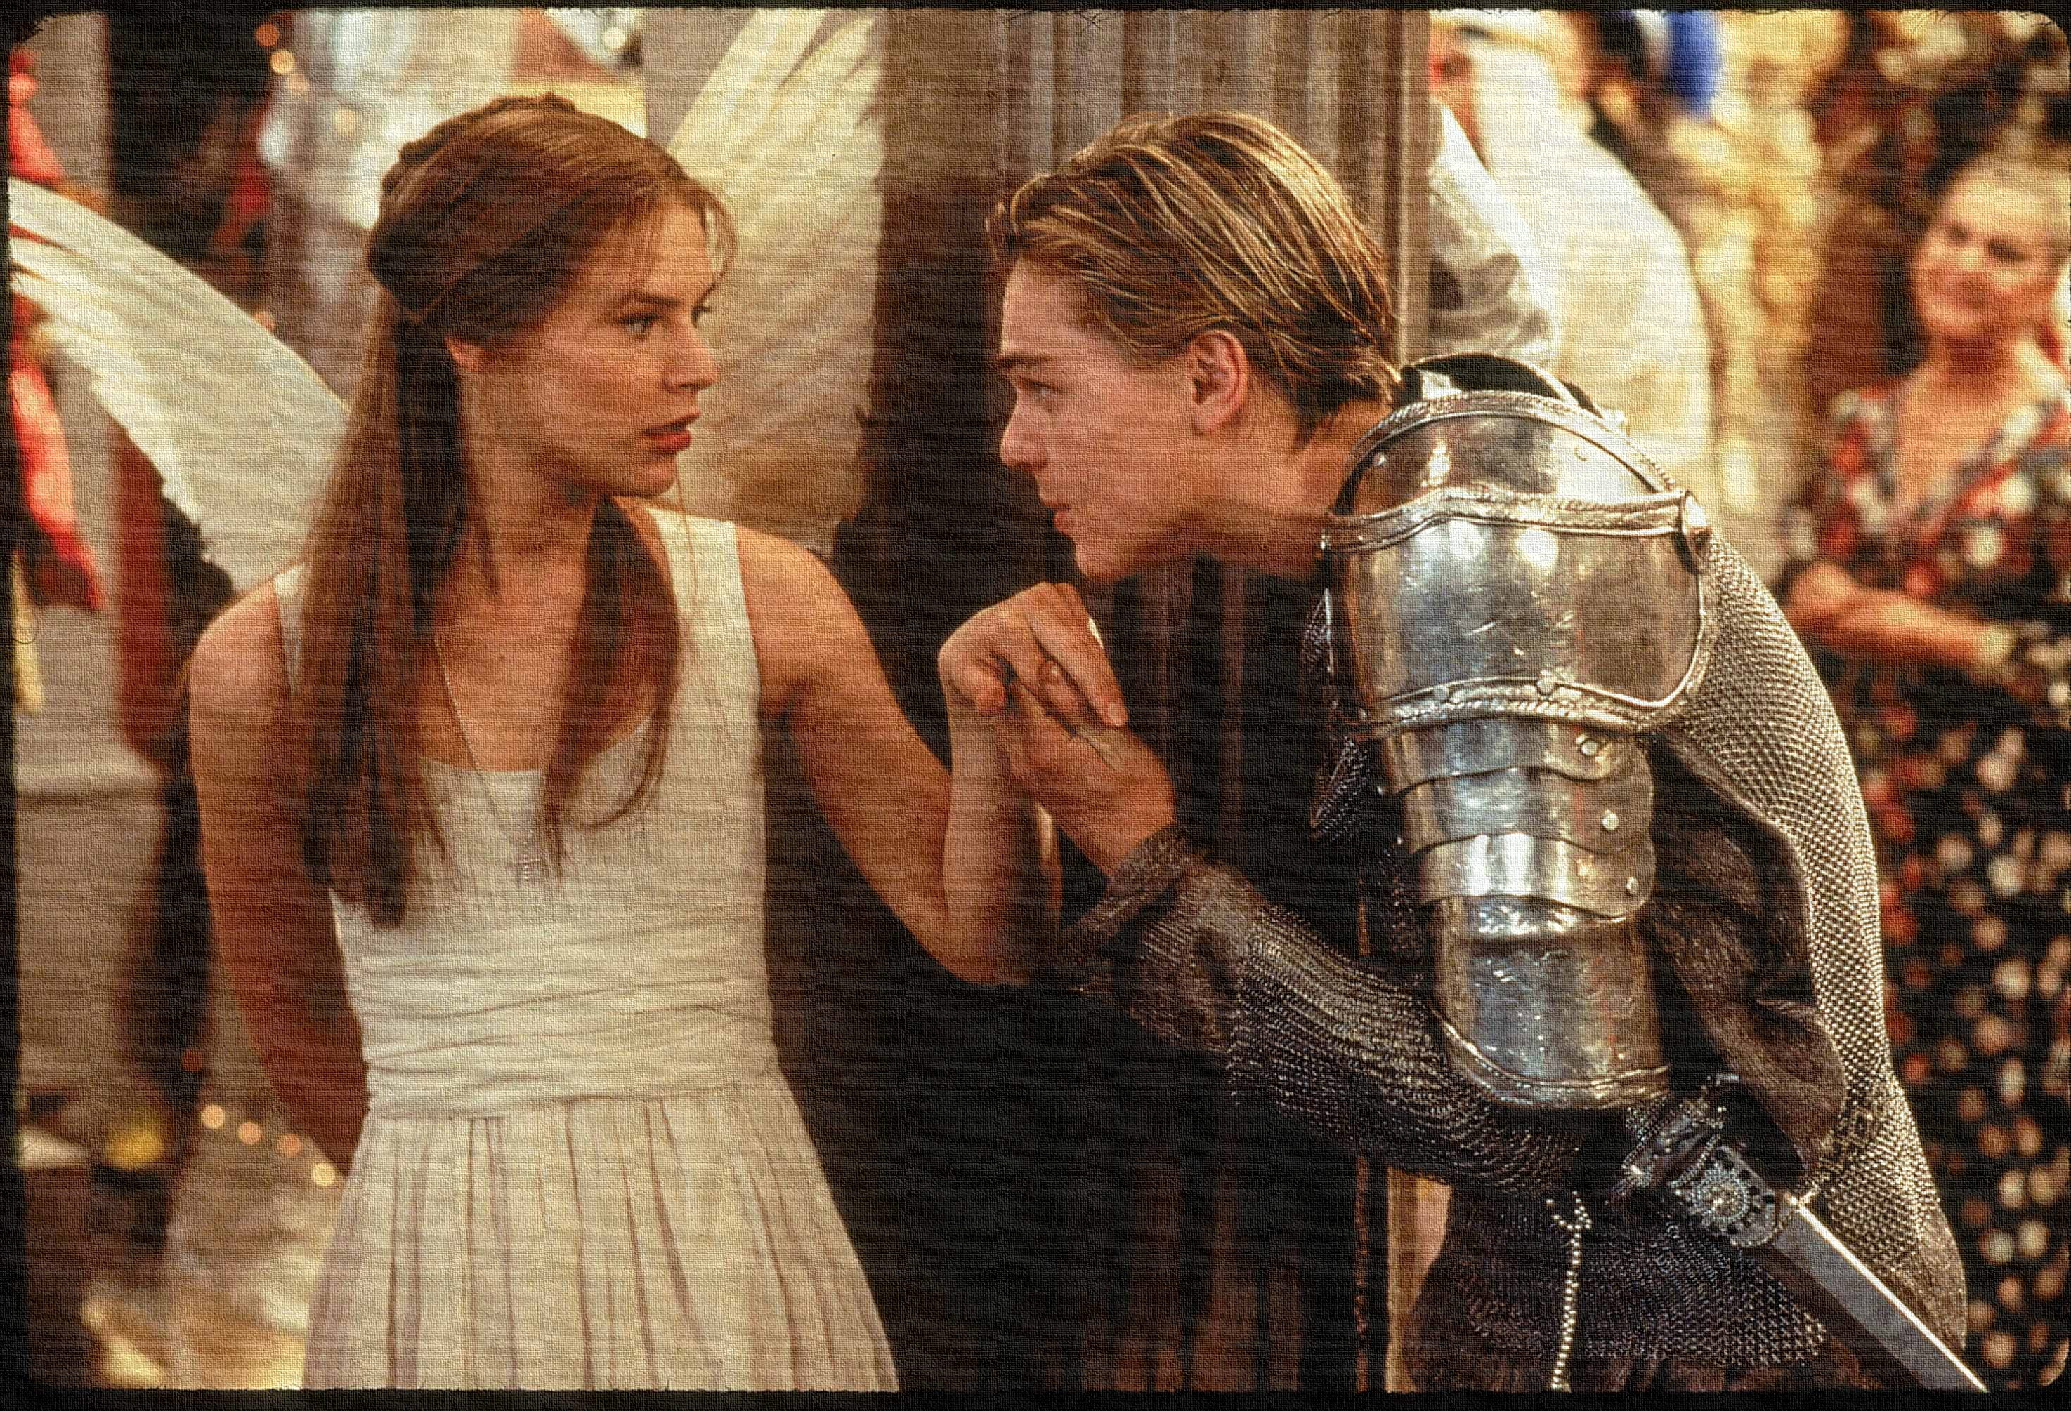
Read the keywords and match their definition: Write them in your books
subject to sudden or unpredictable changes of mood or mind.
Mercurial
The four Humours
The traditional four temperaments are substances that make up the human body are: black bile, yellow bile, blood, and phlegm.
Foil
Unlocking vocabulary
Juxtaposition
the fact of two things being seen or placed close together with contrasting effect.
a person or thing that contrasts with and so emphasizes and enhances the qualities of another.
The leading character or one of the major characters in a play, film, novel, etc.
Protagonist

Slide 4
ANSWERS!
subject to sudden or unpredictable changes of mood or mind.
Mercurial
The four Humours
The traditional four temperaments are substances that make up the human body are: black bile, yellow bile, blood, and phlegm.
Foil
Unlocking vocabulary
Juxtaposition
the fact of two things being seen or placed close together with contrasting effect.
a person or thing that contrasts with and so emphasizes and enhances the qualities of another.
The leading character or one of the major characters in a play, film, novel, etc.
Protagonist

Slide 5
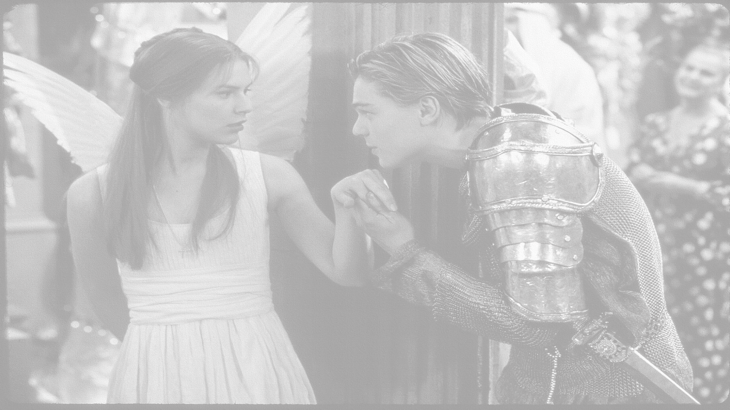
How does Shakespeare show Mercutio’s influence in the play?
In this lesson you will be mastering the following:
To explore views of Mercutio and his role in the play.
To explain how the audience would view Mercutio in relation to the four humours.
To analyse how Mercutio and Romeo’s view of love differ and why.
Learning Content
Notes:
This – as with all aspects of the lesson – can be edited to suit your group.

Slide 6
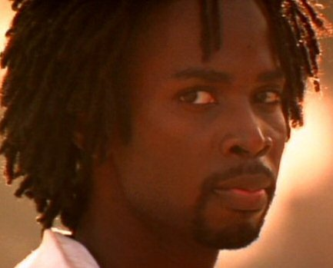
What type of character is Mercutio?
Give reasons.
Challenge: What is Mercutio’s role in the play?
thinking task
How might the following characters view Mercutio:
Romeo
Tybalt
Benvolio
Learning Objectives:
AO1: use textual references, including quotations, to support and illustrate interpretations.
AO2: Analyse the language used by a writer to create meanings and effects.
Notes:
Mercutio, Romeo's quick-tempered, witty friend, links the comic and violent action of the play. He is initially presented as a playful rogue who possesses both a brilliant comic capacity and an opportunistic, galvanized approach to love. Later, Mercutio's death functions as a turning point for the action of the play.

Slide 7
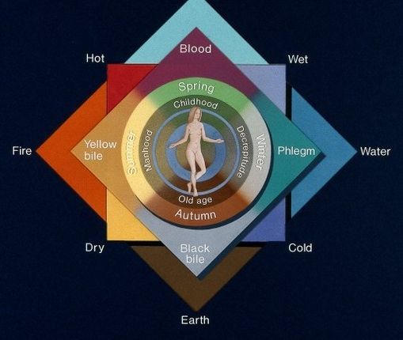
Shakespeare and The Four Humours
Blood, phlegm, black bile and yellow bile: the body’s four humours were believed to control your personality. In Shakespeare’s time, the understanding of medicine and the human body was based on the theory of the four bodily humours. This idea dates back to ancient Greece, where the body was seen more or less as a shell containing four different humours, or fluids: blood, phlegm, black bile and yellow bile. The humours affect your whole being, from your health and feelings to your looks and actions.
If the 4 humours were in their proper proportions a person has perfect health in body and peace of mind. This seldom happened and usually one humour was dominant. If blood dominates, you will have a sanguine temperament; yellow bile makes you choleric; black bile melancholic; and phlegm leads you to being phlegmatic. The characteristics of the humours: Blood: ruddy, fair, agreeable, cheerful, and courageous, or lusty, riotous, and impractical. Yellow bile - Choler: prone to anger, rashness and pride. Phlegm: pale complexion, fat, lazy and dull. Black bile -Melancholy: lean, swarthy, morose and introspective.
thinking task
Take your own notes!
Learning Objectives:
AO1: use textual references, including quotations, to support and illustrate interpretations.
AO2: Analyse the language used by a writer to create meanings and effects.

Slide 8
The Four Humours - Mercutio
The characteristics of the humours:
Blood: ruddy, fair, agreeable, cheerful, and courageous, or lusty, riotous, and impractical.
Choler: prone to anger, rashness and pride.
Phlegm: pale complexion, fat torpid and dull.
Melancholy: lean, swarthy, morose and introspective.
Which humour does Mercutio fit into the most?
Does he fit into all of the humours? Think about his name and associations with it.
Checking understanding
Learning Objectives:
AO1: use textual references, including quotations, to support and illustrate interpretations.
AO2: Analyse the language used by a writer to create meanings and effects.

Slide 9
How do Mercutio and Romeo’s view of love differ?
Act IV, Scene I
ROMEO: Is love a tender thing? it is too rough, Too rude, too boisterous, and it pricks like thorn.
MERCUTIO: If love be rough with you, be rough with love; Prick love for pricking, and you beat love down. Give me a case to put my visage in: A visor for a visor! what care I What curious eye doth quote deformities? Here are the beetle brows shall blush for me.
BENVOLIO: Come, knock and enter; and no sooner in, But every man betake him to his legs.
ROMEO: A torch for me: let wantons light of heart Tickle the senseless rushes with their heels, For I am proverb'd with a grandsire phrase; I'll be a candle-holder, and look on. The game was ne'er so fair, and I am done.
MERCUTIO: Tut, dun's the mouse, the constable's own word: If thou art dun, we'll draw thee from the mire Of this sir-reverence love, wherein thou stick'st Up to the ears. Come, we burn daylight, ho!
ROMEO: Nay, that's not so.
MERCUTIO: I mean, sir, in delay We waste our lights in vain, like lamps by day. Take our good meaning, for our judgment sits Five times in that ere once in our five wits.
ROMEO: And we mean well in going to this mask; But 'tis no wit to go.
MERCUTIO: Why, may one ask?
ROMEO: I dream'd a dream to-night.
Enter ROMEO, MERCUTIO, BENVOLIO, with five or six Maskers, Torch-bearers, and others
ROMEO: What, shall this speech be spoke for our excuse? Or shall we on without a apology?
BENVOLIO: The date is out of such prolixity: We'll have no Cupid hoodwink'd with a scarf, Bearing a Tartar's painted bow of lath, Scaring the ladies like a crow-keeper; Nor no without-book prologue, faintly spoke After the prompter, for our entrance: But let them measure us by what they will; We'll measure them a measure, and be gone.
ROMEO: Give me a torch: I am not for this ambling; Being but heavy, I will bear the light.
MERCUTIO:Nay, gentle Romeo, we must have you dance.
ROMEO: Not I, believe me: you have dancing shoes With nimble soles: I have a soul of lead So stakes me to the ground I cannot move.
MERCUTIO: You are a lover; borrow Cupid's wings, And soar with them above a common bound.
ROMEO: I am too sore enpierced with his shaft To soar with his light feathers, and so bound, I cannot bound a pitch above dull woe: Under love's heavy burden do I sink.
MERCUTIO: And, to sink in it, should you burden love; Too great oppression for a tender thing.
Reading task
Learning Objectives:
AO1: use textual references, including quotations, to support and illustrate interpretations.
AO2: Analyse the language used by a writer to create meanings and effects.
Notes:
Handouts in resource folder

Slide 10
How do Mercutio and Romeo’s view of love differ?
Act IV, Scene I
How do Mercutio and Romeo’s view of love differ?
Act IV, Scene I
Mercutio on Love | Romeo on Love
Mastery
Learning Objectives:
AO1: use textual references, including quotations, to support and illustrate interpretations.
AO2: Analyse the language used by a writer to create meanings and effects.
Notes:
Get students to draw table in books – find quotes and analyse.
Extension task: Use PETER to write a response to ‘ How does Shakespeare show the differing views on love between Romeo and Mercutio?’

Slide 11
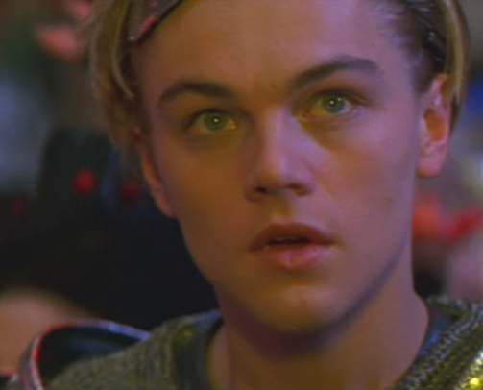
Extension: How does Shakespeare show the differing views on love between Romeo and Mercutio?
We can best see Romeo's and Mercutio's different perspectives on love in Act 1, Scene 4, the scene in which both Mercutio and Benvolio try to persuade Romeo to crash the Capulets' ball. Here we can see that Romeo takes love very seriously, while Mercutio treats love as a joke. Even though Romeo's feelings of love are guided by physical attraction, his love is an emotion rather than just physical desire. Mercutio we can see, on the other hand, only sees love as sexual activity.
Extension Task
Remember to use comparative discourse markers!
Learning Objectives:
AO1: use textual references, including quotations, to support and illustrate interpretations.
AO2: Analyse the language used by a writer to create meanings and effects.

Slide 12
Mercutio is a foil for Romeo (a character which has the complete opposite characteristics and views of the protagonist).
Why has Shakespeare decided to use Mercutio in this manner?
What is the effect of this juxtaposition on the audience?
Extension Task
Extension: Who else has a foil in the play and who is it?
Learning Objectives:
AO1: use textual references, including quotations, to support and illustrate interpretations.
AO2: Analyse the language used by a writer to create meanings and effects.

Slide 13
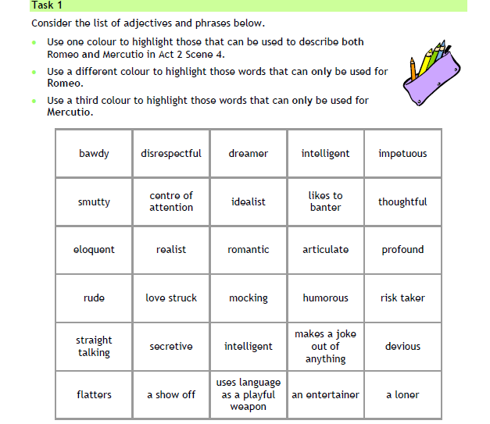
Homework
Why do you think they are such good friends?
Homework
Notes:
Homework is optional - Print off this slide to give out as homework.

