Slide 1
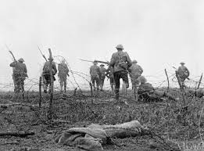
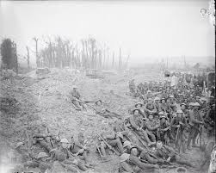
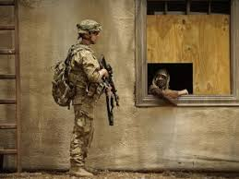
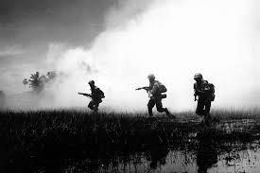
‘War Poems’
Mametz Wood
LO: To develop poetry analysis skills. ST: I can understand writers’ methods and use subject terminology.
Learning Objective:
AO2: Analyse the language, form and structure used by a writer to create meanings and effects, using relevant subject terminology where appropriate.

Slide 2
Key Words:
Battle of the Somme
Fragility
Relic
sentinel
In your book write down the following quotes. Annotate your ideas around them. What do these THREE phrases make you think of?
‘broken bird’s egg’
‘nesting machine guns’
‘linked arm in arm’
Learning Objective:
AO2: Analyse the language, form and structure used by a writer to create meanings and effects, using relevant subject terminology where appropriate.
Notes:
Eg‘broken bird’s egg’ – delicate, fragile, new birth or death.
‘nesting machine guns’ – oxymoronic, violent set against home, guns altogether like baby birds waiting to be fed.
‘linked arm in arm’ – solidarity, togetherness, a barrier strength .

Slide 3
Key Words:
Battle of the Somme
Fragility
Relic
sentinel
For years afterwards the farmers found them –
the wasted young, turning up under their plough blades
as they tended the land back into itself.
A chit of bone, the china plate of a shoulder blade,
the relic of a finger, the blown
and broken bird’s egg of a skull,
all mimicked now in flint, breaking blue in white
across this field where they were told to walk, not run,
towards the wood and its nesting machine guns.
And even now the earth stands sentinel,
reaching back into itself for reminders of what happened
like a wound working a foreign body to the surface of the skin.
This morning, twenty men buried in one long grave,
a broken mosaic of bone linked arm in arm,
their skeletons paused mid dance-macabre
in boots that outlasted them,
their socketed heads tilted back at an angle
and their jaws, those that have them, dropped open.
As if the notes they had sung
have only now, with this unearthing,
slipped from their absent tongues.
Start with the title, Mametz Wood.
Let’s read our poem Mametz Wood by Owen Sheers
What are your initial thoughts?
Learning Objective:
AO2: Analyse the language, form and structure used by a writer to create meanings and effects, using relevant subject terminology where appropriate.

Slide 4
Structure | How is the piece organised on the page? Think punctuation? | Can you identify the topic of each stanza? | Are the stanzas equal or unequal?
 | How many stanzas/verses? | Is there rhythm/repetition/enjambment? | What is the line length/rhyme scheme?
Effect
What effect on the reader is the poet aiming to achieve? (How is it intended to make you think/feel?)
What opinion is conveyed by the poet?
What is the purpose of the poet’s choice of language/opinion/theme?
For years afterwards the farmers found them –
the wasted young, turning up under their plough blades
as they tended the land back into itself.
A chit of bone, the china plate of a shoulder blade,
the relic of a finger, the blown
and broken bird’s egg of a skull,
all mimicked now in flint, breaking blue in white
across this field where they were told to walk, not run,
towards the wood and its nesting machine guns.
And even now the earth stands sentinel,
reaching back into itself for reminders of what happened
like a wound working a foreign body to the surface of the skin.
This morning, twenty men buried in one long grave,
a broken mosaic of bone linked arm in arm,
their skeletons paused mid dance-macabre
in boots that outlasted them,
their socketed heads tilted back at an angle
and their jaws, those that have them, dropped open.
As if the notes they had sung
have only now, with this unearthing,
slipped from their absent tongues.
Meaning
What is the poem about?
Can you discover more than one meaning of the poem?
What ideas and themes is the poet portraying?
What is the poet’s point of view?
Language | Which words has the poet used to convey meaning? | What are the connotations of the language used? Is there more than one meaning of the word/phrase? | Has the poet used figurative language? (onomatopoeia, alliteration, assonance…) | How has the poet used language to infer meaning?
Imagery | Which images are conveyed to the reader? | Does the poem contain metaphors, similes or personification? | Why do you think the poet has included the images in the poem?

Slide 5
Key Words:
Battle of the Somme
Fragility
Relic
sentinel
Context
https://www.youtube.com/watch?v=r6eCsXibJWo
Mametz Wood was one of the bloodiest battles of World War One. As part of the first Battle of the Somme in 1916, soldiers of the Welsh division were ordered to take Mametz Wood, the largest area of trees on the battlefield.
The 38th Welsh Division lost 4,000 men during the attack which lasted five days.
The poet Owen Sheers grew up in Wales and wrote the poem in 2005 as he felt their bravery and sacrifice was never really acknowledged.
The poem describes how farmers ploughing today regularly find the remains of those gunned-down soldiers. There is an extended metaphor of the land being injured, with the farmers tending it back to itself, helping to rid it of wounds.
Be proactive take your own notes!
Learning Objective:
AO2: Analyse the language, form and structure used by a writer to create meanings and effects, using relevant subject terminology where appropriate.

Slide 6
Key Words:
Battle of the Somme
Fragility
Relic
sentinel
Structure
The poem is in seven three-line stanzas and is in narrative form (story like).
The poem immediately delves into strong imagery of war, with recounts of how farmers found the remains of dead bodies years after when ploughing fields. This links the cycle of farming to the cycle of war.
The second stanza continues with a list of human debris – deliberate to shock the reader ( bone, shoulder, blade, finger, skull – as if everyday objects.
There is no set rhyme or rhythm – to relate to the fragmented body parts. There is enjambment between stanza two and three – no punctuation.
Stanza four shows the land as a guard – the battle is a wound that will be healed and end the pain.
The next stanza reflects on the horrors of war – the bodies found linked together. The poem ends as it starts with their jaws appearing like singers who had no voice and were simply ordered into battle and death.
• Form: third person – sense of detachment; tercets – three line stanzas; long sentences with enjambment – reflective/sad.
The structure builds up chronologically in seven stanzas; images of the past occur throughout the poem.
Be proactive take your own notes!
Learning Objective:
AO2: Analyse the language, form and structure used by a writer to create meanings and effects, using relevant subject terminology where appropriate.

Slide 7
For years afterwards the farmers found them –
the wasted young, turning up under their plough blades
as they tended the land back into itself.
A chit of bone, the china plate of a shoulder blade,
the relic of a finger, the blown
and broken bird’s egg of a skull,
all mimicked now in flint, breaking blue in white
across this field where they were told to walk, not run,
towards the wood and its nesting machine guns.
And even now the earth stands sentinel,
reaching back into itself for reminders of what happened
like a wound working a foreign body to the surface of the skin.
This morning, twenty men buried in one long grave,
a broken mosaic of bone linked arm in arm,
their skeletons paused mid dance-macabre
in boots that outlasted them,
their socketed heads tilted back at an angle
and their jaws, those that have them, dropped open.
As if the notes they had sung
have only now, with this unearthing,
slipped from their absent tongues.
Read the poem again.
Annotate key ideas.

Slide 8
Check your annotations and answer the questions on the following slides.
2. What effect does the adjective ‘wasted’ have?
What are the farmers finding? What could this symbolise? What effect does the alliteration have?
For years afterwards the farmers found them –
the wasted young, turning up under their plough blades
as they tended the land back into itself.
A chit of bone, the china plate of a shoulder blade,
the relic of a finger, the blown
and broken bird’s egg of a skull,
3. What does the metaphor suggest?
4. What does the metaphor suggest?

Slide 9
2. What effect does the juxtaposition have?
What does this imperative suggest about how the soldiers died?
all mimicked now in flint, breaking blue in white
across this field where they were told to walk, not run,
towards the wood and its nesting machine guns.
And even now the earth stands sentinel,
reaching back into itself for reminders of what happened
like a wound working a foreign body to the surface of the skin.
3. What does the land become?
4. What is the double meaning of ‘foreign’? What does this suggest about the bodies?

Slide 10
What does this metaphor suggest?
2. This means ‘dance of death’. What does this suggest?
This morning, twenty men buried in one long grave,
a broken mosaic of bone linked arm in arm,
their skeletons paused mid dance-macabre
in boots that outlasted them,
their socketed heads tilted back at an angle
and their jaws, those that have them, dropped open.
3. What does this suggest about the men who died?
4. What is the significance of their jaws being open?

Slide 11
How does the verb ‘sung’ relate to the Welsh soldiers?
As if the notes they had sung
have only now, with this unearthing,
slipped from their absent tongues.
2. What does this image suggest about the men who died?

Slide 12
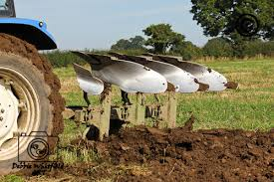
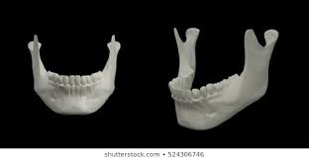
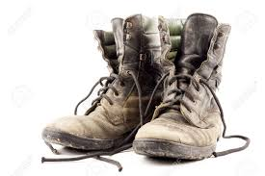
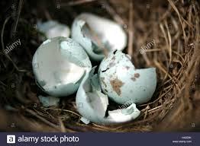
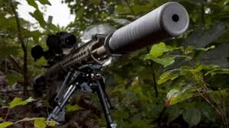
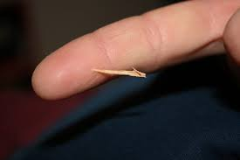
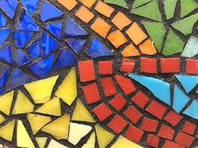
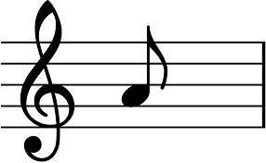
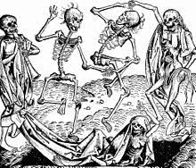
Mametz Wood Images Task –
Step1. Highlight quotations in the poem that match these images.
Step 2. Identify language techniques and word types in at least SIX of these quotations.
THEN answer this question: “How does Sheers present the horror of war in the poem?

Slide 13
Key Words:
Battle of the Somme
Fragility
Relic
sentinel
Task: How does Owen Sheers present the horrors of war and how these men died?
refer to the text – included quotations
Write as:
P
E
E
D
Learning Objective:
AO2: Analyse the language, form and structure used by a writer to create meanings and effects, using relevant subject terminology where appropriate.

Slide 14
Mamtez Wood
Extension work - optional
‘The poem demonstrates the soldiers’ struggle to be remembered and refusal to be forgotten.’ To what extent do you agree with this statement? | Sheers is a Welshman, interested in the struggles that people face trying to live. How is this relevant to the poem? | ‘The final stanza draws a conclusion to the poem by remembering the fallen soldiers in death.’ To what extent do you agree with this statement? | Explore three words that show repeated ideas of delicate or fragile things; how were the soldiers fragile?
Explore the simile, ‘like a wound working a foreign body to the surface…’ What is being unearthed? The bodies? Memories? The truth? The enemy’s actions? | The lines within the poem vary in length and rhythm, creating a disjointed, disordered effect. What might this reflect? A) the bones of the soldiers or b) the disturbed earth. | The poem is from a collection of poetry entitled Skirrid Hill : the word Skirrid means divorce or separation. How might this link to the ideas within the poem? | Consider the line, ‘slipped from their absent tongues;’ Does it hint that the soldiers were found as accidentally as they were discarded OR hints at their lack of voice to tell their final stories?
During the battle of the Somme, the 38th Welsh Division was ordered to take Mametz Wood. The objective was finally achieved a week later but over four thousand men were lost. Owen visited the site- why might he have written this poem as a result? | Where is death presented at its most ugly within the poem (don’t pick your first idea- it is the most obvious!). What is Sheers showing us about death? | The stanza topics rotate as follows: land/remains/soldiers/land/remains/soldiers. Why might the speaker go round in circles in this way? | How is the metaphor of a ‘broken mosaic of bone’ and imagery of ‘paused mid-dance’ disturbing to the reader?
Meaning | Context | Structure | Language

