Slide 1
Macbeth
LO: To write a first person account on the final battle.
ST: I can write with purpose, form and audience.

Slide 2
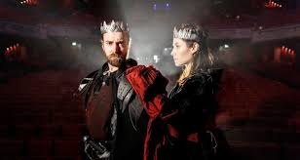
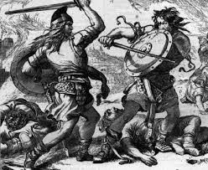
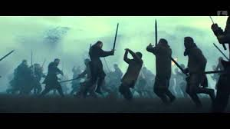
Task: Write a war diary kept by an ordinary soldier in Malcolm’s army.
Think about the march from England to Scotland.
The conditions in Birnam Woods.
Using the trees and branches as camouflage.
The storming of the castle.
Witnessing the fight between Macduff and Macbeth.

