Slide 1
Unseen poetry
Tell the story of the poem (WHO, WHAT, WHEN, WHERE) | This poem tells the story of ………………………………………………….. They seem to ………………………
Comment Evidence Development (For the development consider: imagery, emotions, message, techniques, the writer) | It begins by describing “___________________________” as a ……………………………………………….., using an image of ………………………………………….to show ………………………………………………. It’s almost suggesting that ………………………………………………………………. (do as many paragraphs like this as possible in the time allowed)
Sum up the poem’s purpose/ message (address the WHY) | The writer is reflecting on ………………………………………………….. The poem is designed to show how ……………………….. I really feel that ………………………………….

Slide 2
Monday 7th December Lit paper 2
45 minutes on An Inspector Calls (one question)
45 minutes on A Christmas Carol (one question)
1 hour on unseen poetry (20 minute analysis question + 40 minute comparison question)
DO NOT SPEND LONGER THAN THE ABOVE ON EACH QUESTION. THE SINGLE BIGGEST MISTAKE ON THIS PAPER IS NOT LEAVING ENOUGH TIME FOR THE POETRY!

Slide 3
Get the basics right
For the exploding extract questions, try and do a page on the extract (15 minutes) and 2 pages on the rest of the text (30 minutes).
If you only talk about the extract you CANNOT get above a grade 3! You must use the quotations/plot events you have learned.
Make sure you tell the key parts of the story which relate to the question – the examiner wants to know if you know the story.
SPAG – An Inspector Calls carries 5 SPAG marks. Make sure you use capitals for names and spell the writer as Priestley (‘e’ before the ‘y’!)

Slide 4
An Inspector Calls
Engagement party
Expects knighthood
Incorrect predictions
Inspector arrives
Arthur sacked Eva
Sheila had Eva sacked
Gerald’s affair with Daisy (Eva)
Mrs Birling refused Eva help
Eric’s affair with Eva
Inspector’s final speech
Inspector real?
No suicides
The family is divided
Police inspector coming
The whole play
– in 43 words!

Slide 5
“Girls of that class”
Mrs Birling shows how snobby she is
She is judging the lower classes
Has no respect for the poor
Links to theme of capitalism – the rich divide themselves away from the poor

Slide 6
“We are members of one body”
The inspector believes in socialism
It shows togetherness and equality
He and Priestley believe in breaking down class barriers

Slide 7
“Mixed up together like bees in a hive – community and all that nonsense”
Birling doesn’t want classes to be mixed up like bees
He believes in separation
Insulting community is insulting socialism
The writer (a socialist) is showing how stupid this attitude is

Slide 8
“It frightens me the way you talk”
Sheila wants to show how she now finds the capitalist attitudes of her parents shocking
She’s become more socialist and caring
She’s started to sound like the Inspector

Slide 9
“I did nothing I’m ashamed of”
Mrs Birling still doesn’t care that she turned a poor person away from her charity
She is very cold and selfish
She represents the uncaring nature of capitalism

Slide 10
“Millions and millions of Eva Smiths and John Smiths left with us”
The Inspector is warning that the same selfishness and lack of responsibility that killed Eva Smith can also harm millions of other poor people
The repetition makes it sound quite dramatic/emphasised
The name ‘Smith’ is used as it’s a common name to represent the huge numbers of working class people

Slide 11
“But these girls aren’t cheap labour – they’re people”
Sheila defends Eva Smith/poor workers
She’s saying she disagrees with how rich people, like Mr Birling, exploit them to make money
It is a criticism of capitalism as a whole (which uses the many poor to make money for the few rich)

Slide 12
“You’re not the kind of father a chap can go to when he’s in trouble”
Eric has never had a good relationship with his father
He doesn’t trust or respect him
By the end, he’s become quite distant from him
This represents how Eric has become socialist and now doesn’t see life in the same way as his rich, capitalist father.

Slide 13
“I blame the young man. He ought to be dealt with very severely”
Mrs Birling unknowingly blames her son for the problems Eva Smith faced
She doesn’t know he was the one who got her pregnant (yet)
The writer is showing how if you don’t take responsibility for your actions then you will eventually be punished

Slide 14
MUST MENTION:
Responsibility – this is the key idea of the play.
Capitalism
Socialism
Class/the class system
Dramatic irony
Priestley wants to change society

Slide 15
Little soundbites to remember – drop these into your essay!
Priestley wants to change an unfair capitalist society into a fairer, more responsible socialist one.
The Inspector represents Priestley’s views on how the rich exploit the poor.
The generation gap at the end of the play shows how the young have become more caring and socialist and the old remain selfish and capitalist.
Class is used by Priestley to show the barriers stopping the poor from having a good life.

Slide 16
Question prediction: responsibility
Discuss Mr Birling not accepting responsibility and only being bothered about his own status (knighthood, etc.).
Discuss Sheila’s immediate guilt and how she changes her ways and becomes like the inspector (socialist).
Discuss Gerald only accepting he’s done wrong because he got caught, not because he’s changed.
Discuss Mrs Birling’s cruel and spiteful behaviour towards Eva. She used her influence against her.
Discuss Eric’s foolishness and how he stole from his father to try and fix his mistake. Like Sheila, he shows guilt and is emotional about what has happened and becomes socialist.
Discuss the Inspector’s final speech and how it represents the need for a more socialist, responsible, caring world. Everything in it represents Priestley’s views about society.

Slide 17
A Christmas Carol
Stave 1
Stave 2
Scrooge is cold and miserable at the start and thinks the poor should die
Marley appears in his door knocker , but Scrooge thinks Marley is a hallucination
The Ghost of Christmas Past appears. It shows his memories of Belle, Fezziwig and his own childhood
The Ghost of Christmas Present appears. He sees the Cratchit Christmas, Fred’s party and the children called Ignorance and Want
The Ghost of Christmas Yet to Come appears. He sees a possible future where Tiny Tim dies and he dies as well.
At the end, he promises to change. He buys the Cratchits a turkey, donates a large sum to the charity workers, raises Bob’s salary and becomes a second father to Tiny Tim. He rediscovers his happiness & Christmas spirit.
Stave 3
The whole story
– 126 words!
Stave 4
Stave 5

Slide 18
“tight-fisted hand at the grindstone”
Scrooge is mean and won’t give anything away
He’s closed off from the world
Everything is focused on work

Slide 19
“solitary as an oyster”
Scrooge won’t open up, just like an oyster
He puts a barrier between himself & the world (the shell of the oyster – metaphor)
His entire life is lonely and solitary since he pushed people away in his past

Slide 20
“if they would rather die… they better do it and decrease the surplus population”
Scrooge thinks the poor should just die off if they can’t support themselves
If they are ‘surplus’ they are spare and unnecessary
Dickens hates this selfish attitude
Dickens is mocking the cruel views of Thomas Malthus

Slide 21
“I wear the chains I forged in life”
Marley’s selfish mistakes in his life are the cause of his current pain
He is suffering as a spirit (he’s in purgatory)
Every link on the chain represents a sin from his life
He’s showing Scrooge there are consequences to selfishness

Slide 22
“May you be happy in the life you have chosen”
Belle breaks up with Scrooge in the flashback to his past
She is saying he has chosen a life of money over her
He is supposed to learn that money and selfishness is the root cause of all his problems

Slide 23
“I see a crutch without an owner”
In one possible future, Tiny Tim might die
The Ghost of Christmas Present is warning Scrooge to change his ways or it will have real consequences
It’s Tiny Tim that gets Scrooge to change and hurts him emotionally because he’s so sweet and innocent

Slide 24
“say he will be spared”
This is in response to the last quotation about the crutch
Scrooge is now regretting what he has done
He is beginning to feel emotions for other people which hasn’t happened for a long time

Slide 25
“This boy is Ignorance. This girl is Want.”
These children represent the problems in society
The boy represents how the rich ignore the problems of the poor
The girl represents all the things the poor need, like food, clothing and shelter
Dickens thought it was wrong that society was so unfair

Slide 26
“say he will be spared”
This is in response to the last quotation about the crutch
Scrooge is now regretting what he has done
He is beginning to feel emotions for other people which hasn’t happened for a long time

Slide 27
“tell me I may sponge away the writing on this stone”
Scrooge sees his name on the gravestone and realises he must change his ways
He wants to sponge it away, which represents him changing his future, so he doesn’t die a lonely death
This is where he realises he needs to redeem his past sins
KEY WORD: REDEMPTION

Slide 28
“I will honour Christmas in my heart, and try to keep it all the year”
Scrooge is now fully changed
He used to call Christmas a “humbug”
He will now honour and respect it as it brings people together and he realises how important that is

Slide 29
“God bless us, every one!”
Tiny Tim is given the last line of the story, as he is the one who had the most effect on Scrooge
It links to the key theme of Christianity/discovering a Christian and caring spirit
Scrooge is included in that blessing – everyone shares in the spirit of Christmas

Slide 30
MUST MENTION:
Redemption – key theme of the story.
Christianity/Christmas spirit
Poverty
Selfishness/Greed/Avarice
Social injustice – Dickens thinks the world isn’t fair, so he wants a fairer world for the poor

Slide 31
Little soundbites to remember – drop these into your essay!
Scrooge’s painful past resulted in the selfish attitude he displays in the present.
Dickens wants his readers to realise how the poor are suffering.
Scrooge’s journey of redemption is a lesson to all of Victorian society.
Christmas time and a Christmas spirit showcases the very best bits of humanity – Dickens wants them to be on display all year round.
Tiny Tim symbolises the suffering of the working classes.

Slide 32
Questions: Give a brief answer to these
Discuss how Scrooge has withdrawn from society because of the pain of his past. He has money but not happiness.
Discuss how Marley wants Scrooge to avoid the same mistakes he has made. If Marley changes Scrooge then Marley will be released from purgatory/torment in the after-life.
Discuss the Ghost of Christmas Past and how the loss of Belle, his father’s cruel treatment and not following the lesson of Fezziwig results in the metaphor of Scrooge’s “oyster-like” shell.
Discuss the Cratchitts and how the symbolise the suffering of the poor. This begins to change Scrooge. The children Ignorance & Want also show him the damaging impact of his actions.
Discuss Stave Four and how he begs for a chance to change – he’s no longer thinking of himself but of others.
Discuss Stave Five and all the things he does to fix his past mistakes. This is the definition of redemption. Everything he did up to this point was his journey of redemption.

Slide 33
Unseen poetry – 20 mins (single) and 40 mins (comparison)
Please remember that the poems in the unseen section are deliberately much easier than the poems in the Anthology.
It will tell you in the question at the top something to do with the topic.
Don’t try and look for really hidden/obscure meanings – explain obvious interpretations.
Talk about what messages the writer has for us about the topic given in the question.

Slide 34
Unseen poetry
Tell the story of the poem
Explain what phrases mean
Comment on why things are written like that
Follow the order you have been taught
KEY WORDS: Who, what, when, where, QUOTATIONS, why

Slide 35
Unseen poetry
Tell the story of the poem (WHO, WHAT, WHEN, WHERE) | This poem tells the story of ………………………………………………….. They seem to ………………………
Comment Evidence Development (For the development consider: imagery, emotions, message, techniques, the writer) | It begins by describing “___________________________” as a ……………………………………………….., using an image of ………………………………………….to show ………………………………………………. It’s almost suggesting that ………………………………………………………………. (do as many paragraphs like this as possible in the time allowed)
Sum up the poem’s purpose/ message (address the WHY) | The writer is reflecting on ………………………………………………….. The poem is designed to show how ……………………….. I really feel that ………………………………….

Slide 36
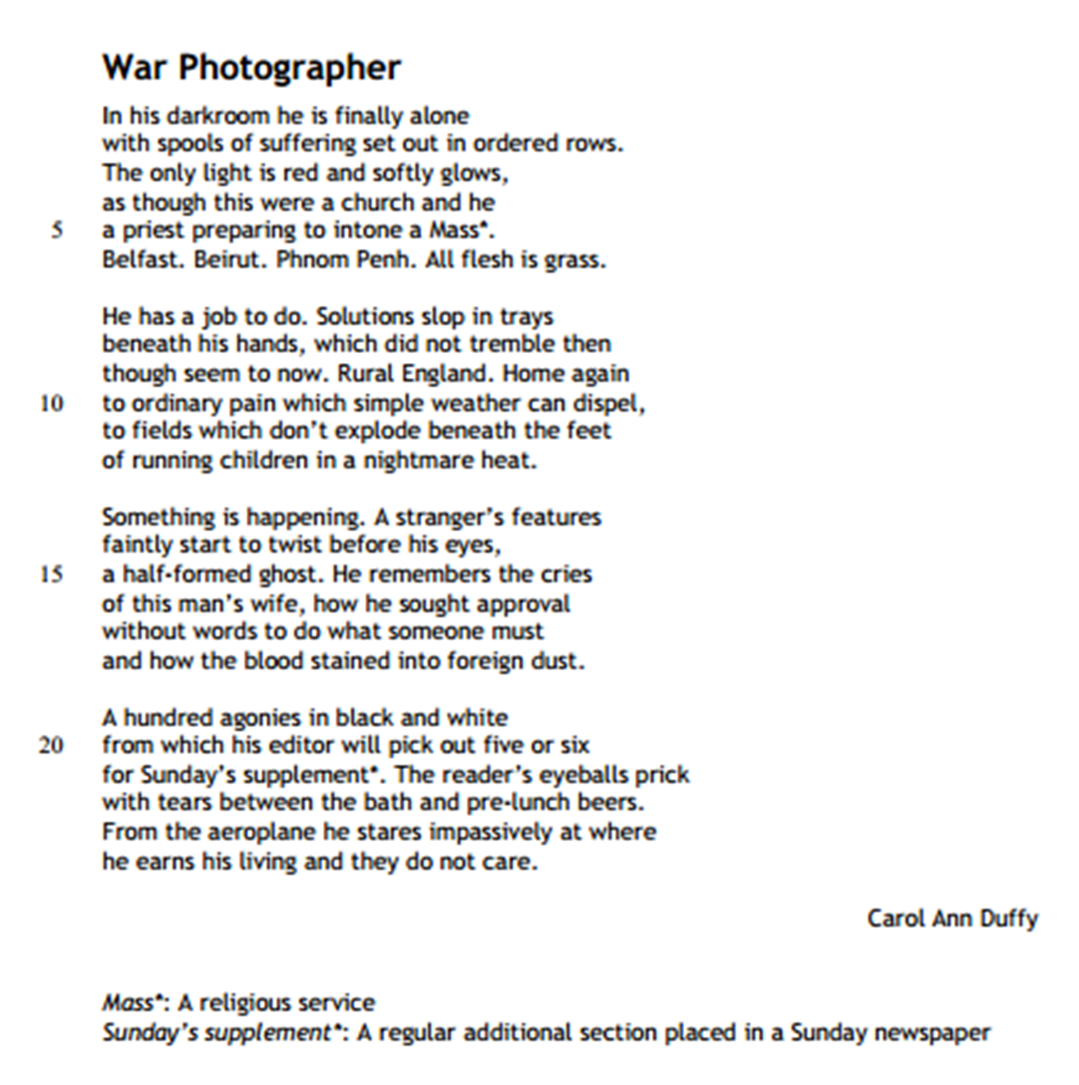
Unseen poetry

Slide 37
Unseen poetry comparison
This should be exactly the same as the single poem analysis, but you do two at once.
Focus more on the second poem as you haven’t said anything about that poem yet.
Sum up both poems (WWWW) at the start
Talk about quotations from the second poem first then connect them back to similar/contrasting points from the first poem.
Then describe the purpose (WHY) of each poem at the end and give any personal opinions.

Slide 38
FINAL THOUGHTS – WHOLE PAPER
Stick to the timings – 45/45/20/40.
Tell the story of each text.
Use the quotations you have remembered.
If you can’t remember a quotation just describe what happened in general instead – do not spend time sitting there remembering and not writing anything!

