Slide 1
Boy Tales of Childhood by Roald Dahl
LO: To explore how humour is used in storytelling.
ST: I can identify the writer’s choice of language for effect.

Slide 2
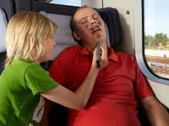
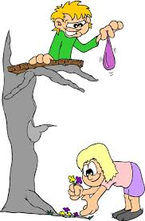
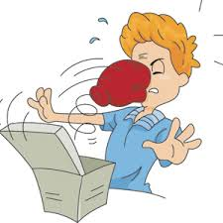
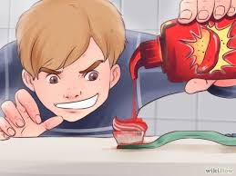
Starter: Have you ever played a trick on someone? What was their reaction? Have you ever had a trick played on you? What was your reaction? Do you think you’ve got a sense of humour?

Slide 3
Let’s read! ‘Goat’s Tobacco’, turn to page 154 in your book, we will read up to page 161.

Slide 4
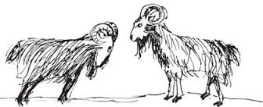
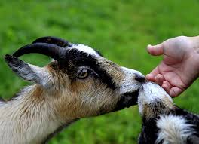
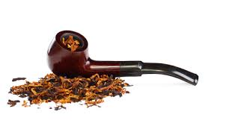
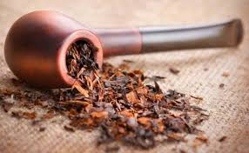
Task: What makes this chapter humorous? Find three examples that make it funny.

Slide 5
Task 2: Using your template sequence the events in this chapter. How has the writer structured it to interest us as a reader?

Slide 6
Task 3: What do you think the ‘Manly lover’ said to Roald Dahl when he caught him?
Write a conversation between the pair of them:
Roald Dahl:
Manly Lover:
Roald Dahl:
Manly Lover:
Roald Dahl:
Manly Lover:
Be ready to read your conversation script to the class in pairs.

Slide 7
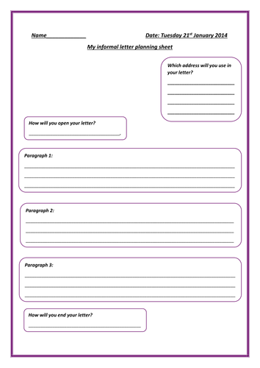
Extension task: Write a letter of apology to the Manly Lover.

