Slide 1
Lesson 9: jane Austen
LO: To explore the representation of women in the Georgian Era.

Slide 2
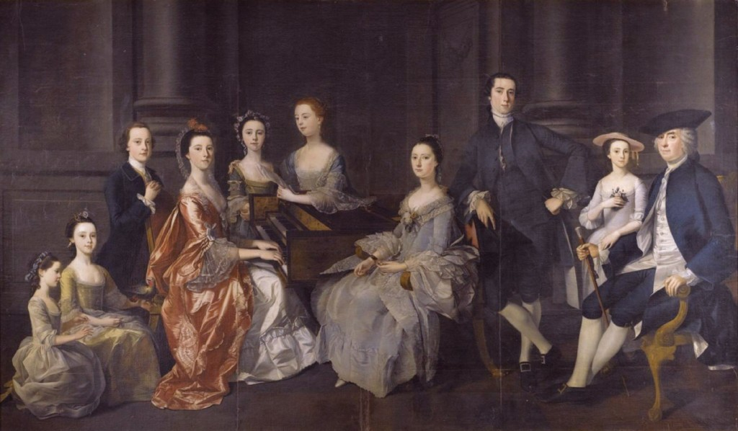
Starter
What can women do now that they couldn’t in 1813?
Do Now
LO: To explore the representation of women in the Georgian Era.
Notes:
Allow thinking time, develop on women voting/owning property/jobs/abortion/divorce etc

Slide 3
Match the vocabulary to the correct definitions.
Intention/to intend.
Enthusiastic, energetic, and often loudly expressed.
Causing one to feel bored or annoyed
The quality of being prompt to understand, think, or learn.
Extremely careful about doing everything correctly and exactly as it should be done.
Unlocking Vocabulary
Tiresome Design Over-Scrupulous Hearty Quickness
LO: To explore the representation of women in the Georgian Era.

Slide 4
Check your answers:
Design: Intention/to intend.
Hearty: Enthusiastic, energetic, and often loudly expressed.
Tiresome: Causing one to feel bored or annoyed.
Quickness: The quality of being prompt to understand, think, or learn.
Over-Scrupulous: Extremely careful about doing everything correctly and exactly as it should be done.
Answers
LO: To explore the representation of women in the Georgian Era.

Slide 5
Add to the timeline
Jane Austen ‘Pride and Prejudice’ (1813)
Ancient Literature
Middle Ages/ Renaissance
The Georgians & Victorians
The Twentieth Century
Representing change
Draw It
Today’s primary text is ‘Pride and Prejudice’ by Jane Austen.
Austen was an English novelist known for her six major novels.
Austen's plots often explore the dependence of women on marriage in the pursuit of favourable social standing and economic security.
LO: To explore the representation of women in the Georgian Era.

Slide 6
What do you know about jane Austen?
Contextual Information
LO: To explore the representation of women in the Georgian Era.
Notes:
Discuss first, video second https://youtu.be/MBucQqanhfE

Slide 7
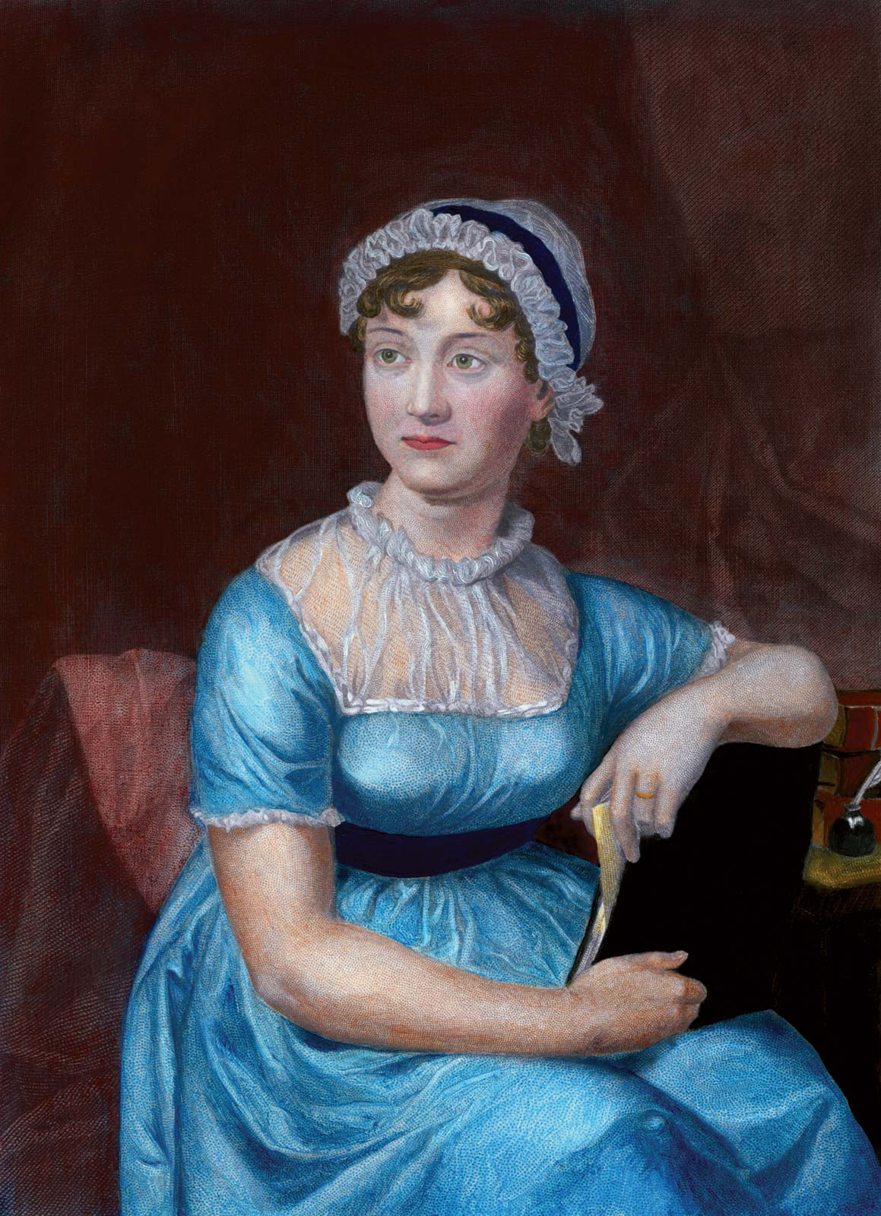
Video feedback
What struggles did
Jane have to overcome?
2. Why wasn’t she
successful as a writer
in her lifetime?
Checking Understanding
LO: To explore the representation of women in the Georgian Era.

Slide 8
Read the extract
In one colour, highlight what Mr. Bennett says about women In another, highlight what Mrs. Bennett says about women
Reading Activity
Annotate your highlights – what do they tell you about women in the Georgian era?
LO: To explore the representation of women in the Georgian Era.
Notes:
Large extract, maybe do as a class. For highlighting, work in pairs?

Slide 9
How are women portrayed in this extract?
Checking Understanding
LO: To explore the representation of women in the Georgian Era.
Notes:
Take feedback, make sure quotes are given

Slide 10
How are women portrayed in this extract?
In ‘Pride and Prejudice’, women are portrayed as…
This is seen in…
The use of… shows us that in the Georgian Era women were…. and makes a modern reader feel…
Mastery
Paragraph MUST HAVE: Red: Point Yellow: Evidence Green: Terminology Purple: Effect (context)
Blue: Reader
LO: To explore the representation of women in the Georgian Era.
Notes:
Use paragraph structure if needed – if HA, just use ‘must have’ list

Slide 11
OUT OF THE DOOR plenary Everyone must have a different word!
How were women presented in P&P?
Checking Understanding
LO: To explore the representation of women in the Georgian Era.

Slide 12
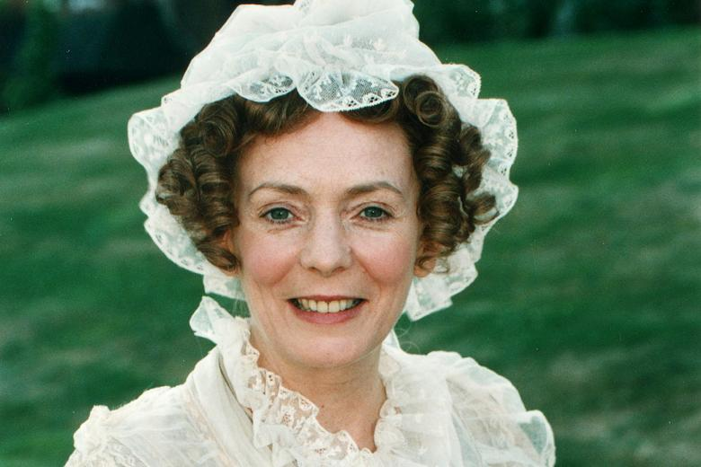
Mrs Bennet’s guide to being a perfect lady
Create a guide for a Georgian Lady to follow.
Here are three rules they would have to follow. The first has been written for you. What other rules would the Guide need?
DON’T be alone in the company of a Gentleman.
If a lady is unmarried and under the age of thirty, it is not allowed for her to be seen in the company of a man without having a chaperone. A chaperone will ensure that the lady’s reputation will not be tarnished, either by indiscreet eyes or by vulgar conversations with her companion.
A chaperone can be another lady, an appropriate man, or a servant. If the lady’s reputation is somewhat tarnished, it indicates that the chaperone was unable to protect her and it will automatically ruin the reputation of the lady’s entire family.
DO stand straight and walk tall.
DO wait to be introduced to someone.
Extension Task
LO: To explore the representation of women in the Georgian Era.

