Slide 1
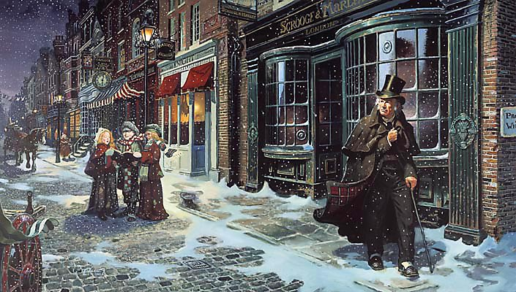
sso
LESSON NINE

Slide 2
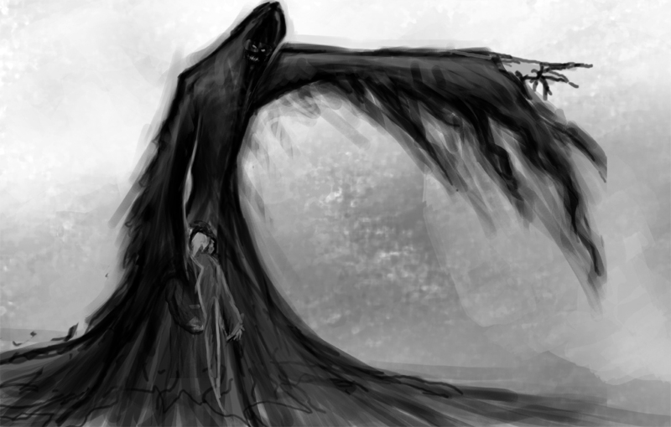
sso
GHOST OF CHRISTMAS YET TO COME
EXTRA LEVEL OF CHALLENGE
S
Consider the following statement:
‘Scrooge is right to refuse the poor help at the beginning of the novel. It is their own fault that they are in that situation.’
To what extent do you agree?
Write your answer in your books using quotations from the text where appropriate.
KINFLINT: A worshipper of gold and
material wealth.
C
HEATING:
R
O
Do Now
O
Create an acrostic poem that details Scrooge’s character in ‘A Christmas Carol’.
G
E
Today’s key questions:
Can I consider and discuss the ALLEGORICAL aspects of ‘A Christmas Carol?’
Can I explain how a writer uses language to convey key ideas?
Can I link my ideas to the social and historical aspects of ‘A Christmas Carol’?

Slide 3
sso
MATCH THE VOCABULARY TO THEIR DEFINITIONS
to have an opinion about something, but not a strong opinion
serious and formal
cover or envelop so as to conceal from view
having a reputation of the worst kind
to decrease in strength, intensity
SHROUDED SOLEMN WANING
INCLINED INFAMOUS
Unlocking Vocabulary
Today’s key questions:
Can I consider and discuss the ALLEGORICAL aspects of ‘A Christmas Carol?’
Can I explain how a writer uses language to convey key ideas?
Can I link my ideas to the social and historical aspects of ‘A Christmas Carol’?

Slide 4
sso
CHECK YOUR ANSWERS:
INCLINED: to have an opinion about something, but not a strong opinion
SOLEMN: serious and formal
SHROUDED: cover or envelop so as to conceal from view
INFAMOUS: having a reputation of the worst kind
WANING: to decrease in strength, intensity
Answers
Today’s key questions:
Can I consider and discuss the ALLEGORICAL aspects of ‘A Christmas Carol?’
Can I explain how a writer uses language to convey key ideas?
Can I link my ideas to the social and historical aspects of ‘A Christmas Carol’?

Slide 5
sso
AO2:
Analyse Language/
Form/Structure
Analyse Dickens’ description of the Ghost of Christmas Yet to Come using the correct subject terminology. Answer as annotations around the extract or make notes.
In your answers, consider:
Dickens’ purpose
Social/historical context points
Language devices
Word Classes
ALL can attempt analysis of the RED terms.
SOME can attempt analysis of the GREEN terms.
YOUR TASK
As the last stroke ceased to vibrate, he remembered the prediction of old Jacob Marley, and lifting up his eyes, beheld a solemn Phantom, draped and hooded, coming, like a mist along the ground, towards him.
The Phantom slowly, gravely, silently approached. When it came, Scrooge bent down upon his knee; for in the very air through which this Spirit moved it seemed to scatter gloom and mystery.
It was shrouded in a deep black garment, which concealed its head, its face, its form, and left nothing of it visible save one outstretched hand. But for this it would have been difficult to detach its figure from the night, and separate it from the darkness by which it was surrounded.
He felt that it was tall and stately when it came beside him, and that its mysterious presence filled him with a solemn dread. He knew no more, for the Spirit neither spoke nor moved.
Mastery
NOT SURE WHERE TO BEGIN?
Today’s key questions:
Can I consider and discuss the ALLEGORICAL aspects of ‘A Christmas Carol?’
Can I explain how a writer uses language to convey key ideas?
Can I link my ideas to the social and historical aspects of ‘A Christmas Carol’?

Slide 6
sso
Answer the following questions:
The other ghosts carry some source of light. This one does not. Why?
What could the light from Scrooge’s previous encounters have symbolised?
The other spirits have been kind and gentle. This one is not. How will this new intervention change Scrooge?
Checking Understanding
Is it significant that this ghost does not speak? What could this significance be?
How is the Ghost of Christmas Yet to Come the antithesis of the Christmas spirit?
Why has Dickens made the decision to present the ghost like this?
Today’s key questions:
Can I consider and discuss the ALLEGORICAL aspects of ‘A Christmas Carol?’
Can I explain how a writer uses language to convey key ideas?
Can I link my ideas to the social and historical aspects of ‘A Christmas Carol’?

Slide 7
sso
HOW IS THE LAST OF THE SPIRITS PRESENTED?
Answer the following questions in your book. Consider the ASSESSMENT OBJECTIVES and how you are going to include all of them in your answer.
Don’t forget to look back at your previous target to help you make progress.
The Last of the Spirits is a … character compared to the other ghosts.
When the spirit first appears, Dickens notes “…” which is interesting to note because…
This suggests to us that…
Furthermore, …
The noun/adjective/verb, “…” gives readers the impression that … because ...
On the other hand, …
What should my work look like?
Mastery
The most recognisable difference between this spirit and the others is the sense of dread and death it brings with it. Dickens uses the adjective, ‘solemn’ to describe its being, solemnity being the antithesis to Christmas joy and cheer. Perhaps Dickens wants to present the ghost in this way because… Furthermore,…
STUCK?
Use these!
Today’s key questions:
Can I consider and discuss the ALLEGORICAL aspects of ‘A Christmas Carol?’
Can I explain how a writer uses language to convey key ideas?
Can I link my ideas to the social and historical aspects of ‘A Christmas Carol’?

Slide 8
sso
STAVE 4: The Ghost of Christmas Yet to Come
Read from the beginning of the stave to ‘…show that person to me, Spirit, I beseech you!’
Make notes in your text as you read along.
Reading Activity
Today’s key questions:
Can I consider and discuss the ALLEGORICAL aspects of ‘A Christmas Carol?’
Can I explain how a writer uses language to convey key ideas?
Can I link my ideas to the social and historical aspects of ‘A Christmas Carol’?

Slide 9
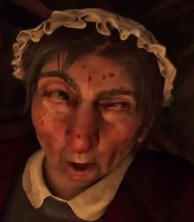
sso
Answer the following questions:
How has Dickens used the merchants, the characters in Joe’s shop and the settings to help the reader further understand the character of Scrooge?
How will showing Scrooge the characters in Joe’s shop and the merchants help him?
Checking Understanding
What else could we say about Scrooge and his reaction to the events he is witnessing?
How does the mood/tone and atmosphere differ from Stave Three? What is the point in this contrast?
Today’s key questions:
Can I consider and discuss the ALLEGORICAL aspects of ‘A Christmas Carol?’
Can I explain how a writer uses language to convey key ideas?
Can I link my ideas to the social and historical aspects of ‘A Christmas Carol’?

Slide 10
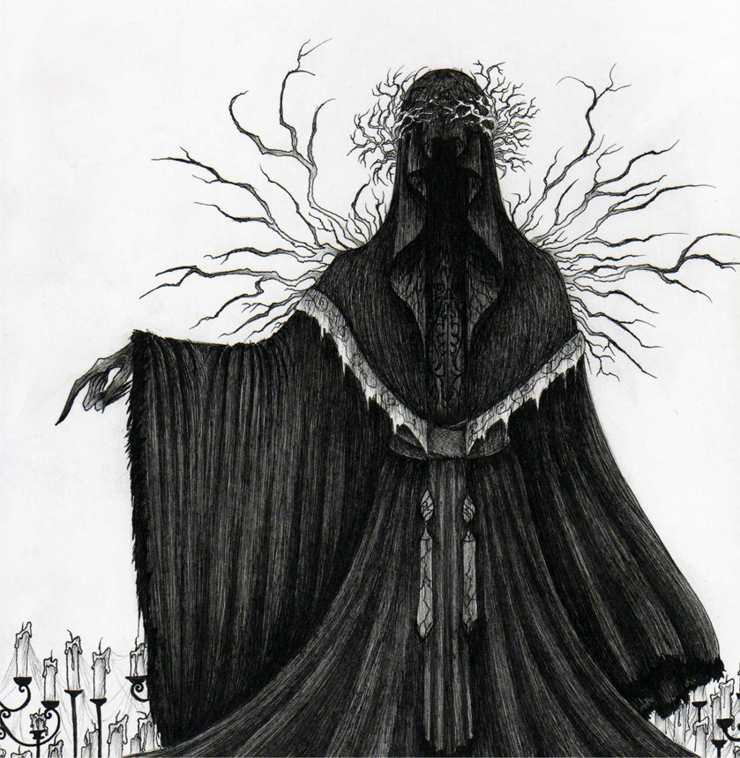
sso
TO FINISH: COMPLETE ONE OF THE FOLLOWING…
Now that we know more about the Ghost of Christmas Yet to Come, ADD to your paragraph from the beginning of the lesson.
If the Ghost of Christmas Yet to Come could speak, what do you think it would say?
Write a small script showing a conversation between Scrooge and the Ghost.
Checking Understanding
Sketch an image of the Ghost of Christmas Yet to Come and add notes around it explaining how it has helped Scrooge so far.
‘Fear can make a man do anything.’
What is your response to this statement? Link your ideas to ‘A Christmas Carol’ and the character, Scrooge.
Today’s key questions:
Can I consider and discuss the ALLEGORICAL aspects of ‘A Christmas Carol?’
Can I explain how a writer uses language to convey key ideas?
Can I link my ideas to the social and historical aspects of ‘A Christmas Carol’?

