Slide 1
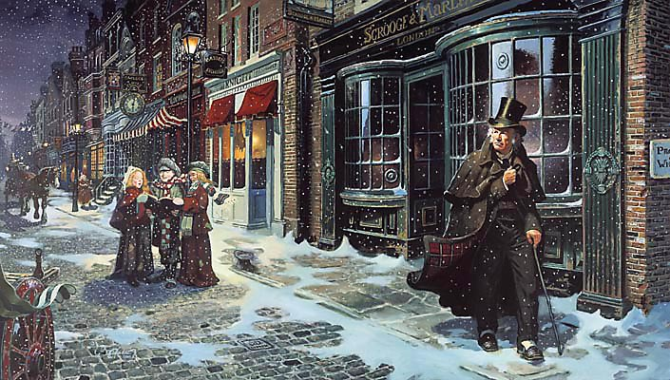
sso
The Ghost of Christmas Yet to Come
The other spirits have been kind and gentle. This one is not. How will this new ghost change Scrooge?
The other ghosts carry some source of light. This one does not.
Why do you think Dickens focuses on darkness for this Spirit?
Checking Understanding
Why do you think this ghost doesn’t speak?
Today’s key questions:
Can I consider and discuss the ALLEGORICAL aspects of ‘A Christmas Carol?’
Can I explain how a writer uses language to convey key ideas?
Can I link my ideas to the social and historical aspects of ‘A Christmas Carol’?

Slide 2
sso
HOW IS THE LAST OF THE SPIRITS PRESENTED?
The Last of the Spirits is a much darker character compared to the other ghosts.
When the spirit first appears, Dickens says “………………………………………………………………..”
This suggests to us that…
Furthermore, this Spirit is also shown as …
The text says “……………………………………………………………………………………………..”
This gives readers the impression that …
Mastery
STUCK?
Use these!
Today’s key questions:
Can I consider and discuss the ALLEGORICAL aspects of ‘A Christmas Carol?’
Can I explain how a writer uses language to convey key ideas?
Can I link my ideas to the social and historical aspects of ‘A Christmas Carol’?

Slide 3
sso
STAVE 4: The Ghost of Christmas Yet to Come
Read from the beginning of the stave to ‘…show that person to me, Spirit, I beseech you!’
Reading Activity
Today’s key questions:
Can I consider and discuss the ALLEGORICAL aspects of ‘A Christmas Carol?’
Can I explain how a writer uses language to convey key ideas?
Can I link my ideas to the social and historical aspects of ‘A Christmas Carol’?

Slide 4
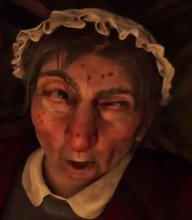
sso
YOUR TASK
How will showing Scrooge the characters in Joe’s shop and the merchants help him?
Checking Understanding
How does the mood/tone and atmosphere differ from Stave Three? What is the point in this contrast?
Today’s key questions:
Can I consider and discuss the ALLEGORICAL aspects of ‘A Christmas Carol?’
Can I explain how a writer uses language to convey key ideas?
Can I link my ideas to the social and historical aspects of ‘A Christmas Carol’?

Slide 5
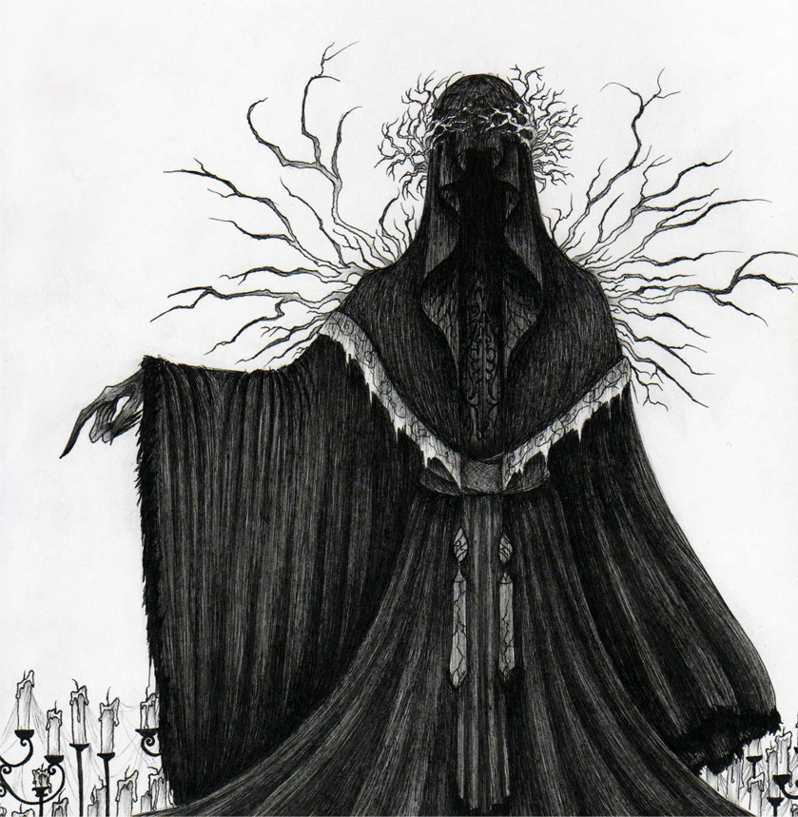
sso
TO FINISH:
Sketch an image of the Ghost of Christmas Yet to Come and add notes around it explaining how it has helped Scrooge so far.
Checking Understanding
Today’s key questions:
Can I consider and discuss the ALLEGORICAL aspects of ‘A Christmas Carol?’
Can I explain how a writer uses language to convey key ideas?
Can I link my ideas to the social and historical aspects of ‘A Christmas Carol’?

