Slide 1
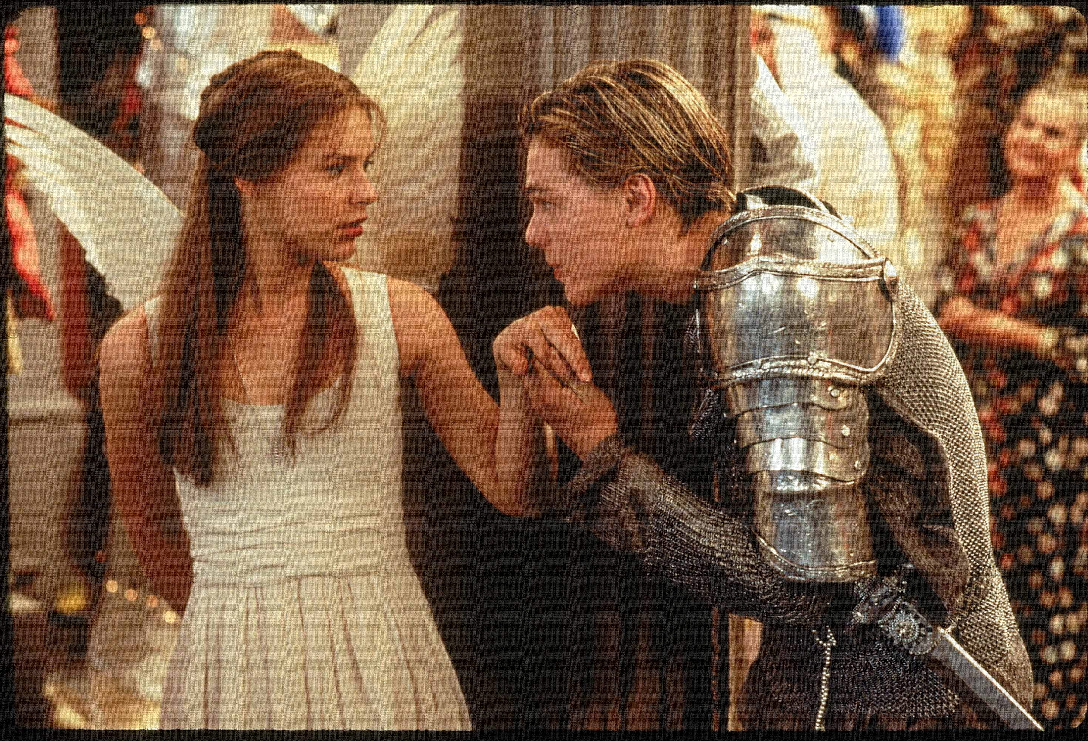
Key Words:
Connotations
Foreshadow
Pathetic fallacy
Alliance
apothecary
Lesson 9: Act 2, Scene 3
The friar's part
Success Criteria:
To explore the structure of the play and how it foreshadows later events.
To explain how Shakespeare uses techniques to create tension.
To understand the Friar's important part in the play.
‘Romeo + Juliet’
Learning Objective:
AO2: Analyse the language and structure used by a writer to create meanings and effects, using relevant subject terminology where appropriate.

Slide 2
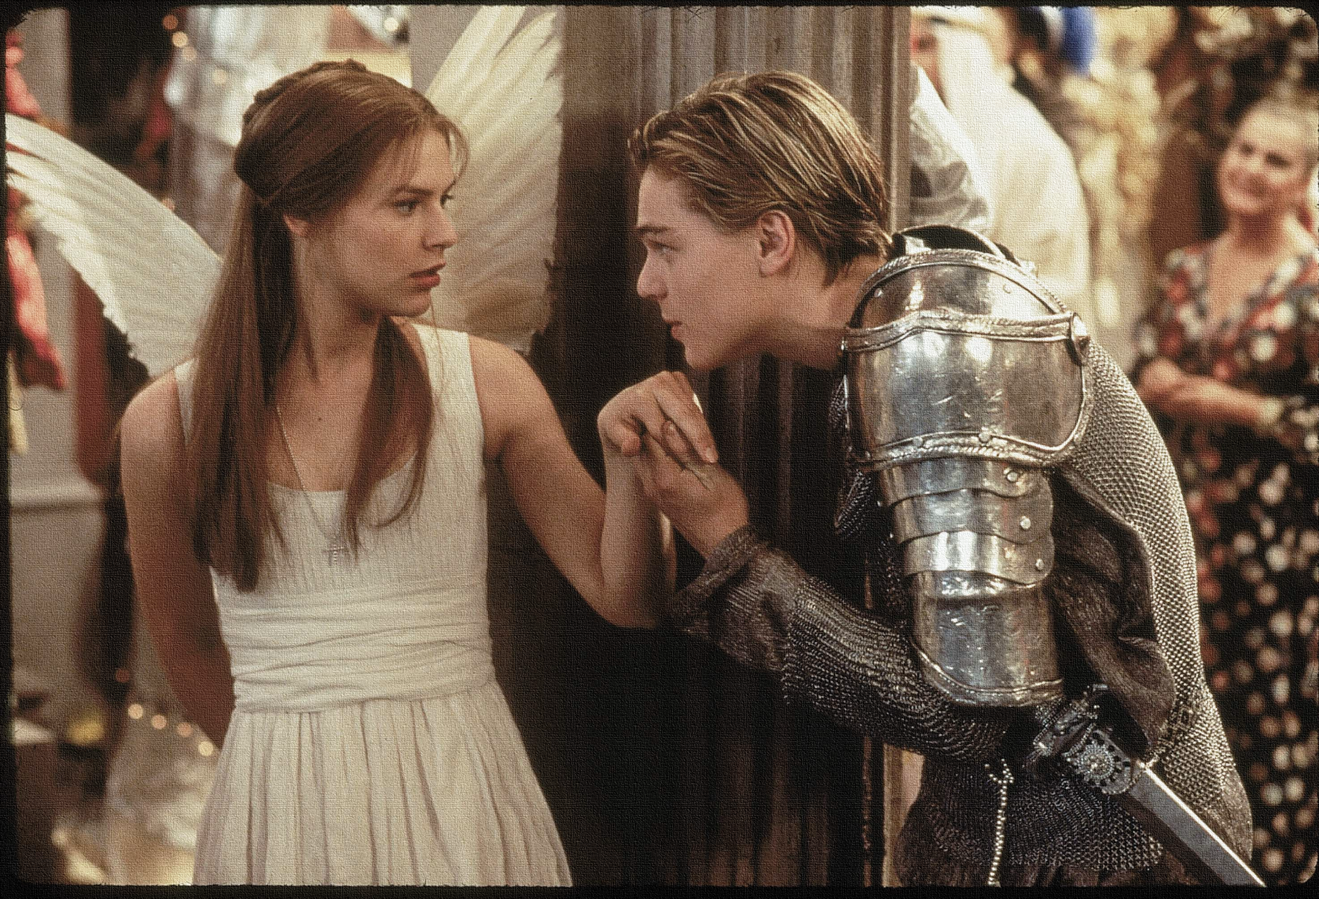
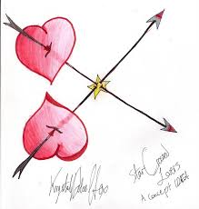
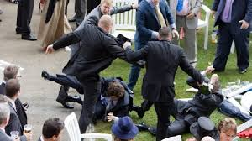
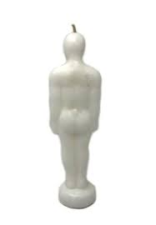
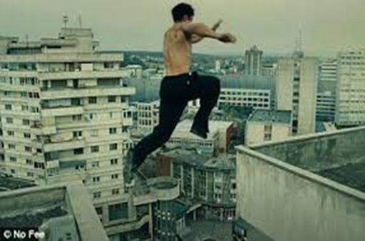
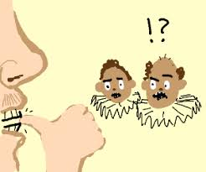
Write today’s date - Thursday, 26 March 2020 and today’s title – Romeo and Juliet Revision in your book
Can you make a link with an image below to what we have read so far?
Do Now

Slide 3
Read the keywords and match their definition: Write them in your books
A kind of personification that gives human emotions to inanimate objects of nature; for example, referring to weather features reflecting a mood.
Pathetic fallacy
alliance
The state of being joined or associated.
Apothecary
Unlocking vocabulary
Connotations
a person who prepared and sold medicines and drugs.
an idea or feeling which a word invokes for a person in addition to its literal or primary meaning.
Be a warning or indication of (a future event).
foreshadow

Slide 4
Read the keywords and match their definition: Write them in your books
A kind of personification that gives human emotions to inanimate objects of nature; for example, referring to weather features reflecting a mood.
Pathetic fallacy
alliance
The state of being joined or associated.
Apothecary
Unlocking vocabulary
Connotations
a person who prepared and sold medicines and drugs.
an idea or feeling which a word invokes for a person in addition to its literal or primary meaning.
Be a warning or indication of (a future event).
foreshadow

Slide 5
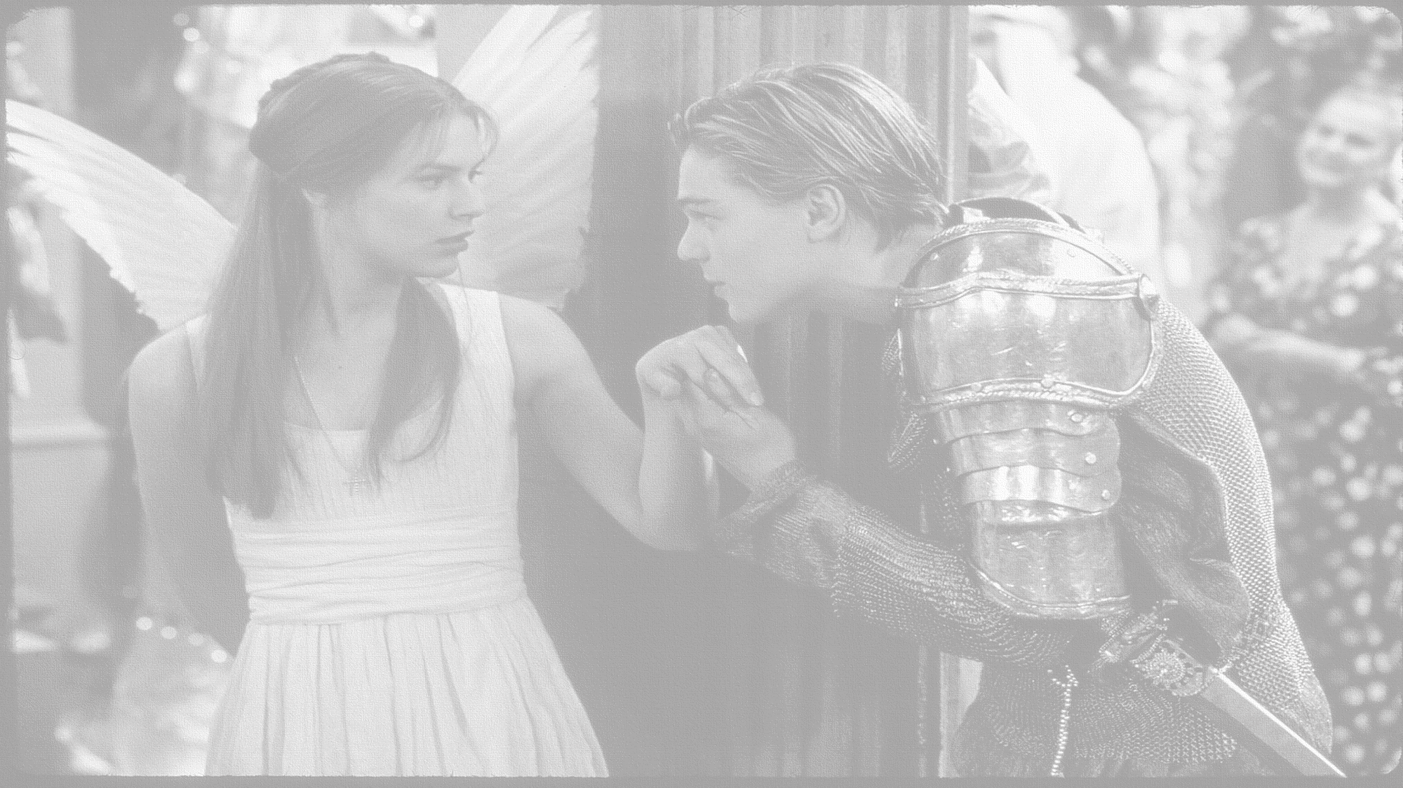
How does Shakespeare present the Friar?
In this lesson you will be mastering the following:
To explore the structure of the play and how it foreshadows later events.
To understand the Friar's important part in the play.
To summarise key scenes revising plot and understanding.
Learning Content
Notes:
This – as with all aspects of the lesson – can be edited to suit your group.

Slide 6
Let’s read!
Act 2 scene 3
Romeo:
Friar Lawrence:
Discussion
How seriously should we take Romeo’s new found love for Juliet?
Does his language suggest that he is now genuinely in love, or is this just another infatuation?
What evidence do we have to link this to?
Reading task
Learning Objectives:
AO1: use textual references, including quotations, to support and illustrate interpretations.
AO2: Analyse the language used by a writer to create meanings and effects.

Slide 7
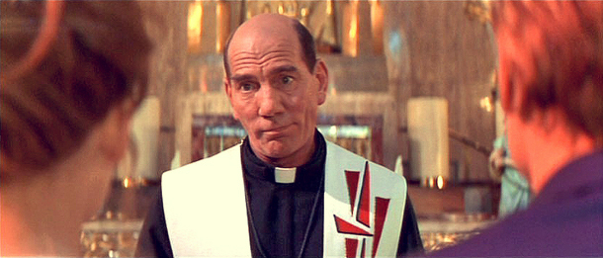
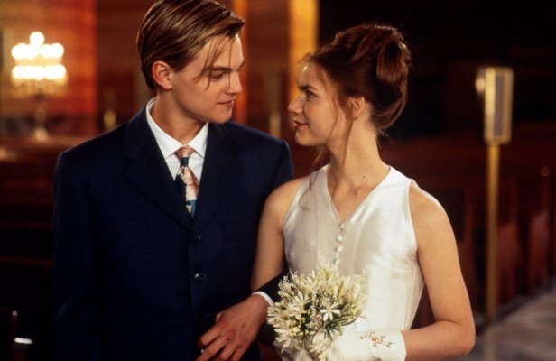
FRIAR LAWRENCE
Our Romeo hath not been in bed tonight.
God pardon sin! Wast thou with Rosaline?
FRIAR LAWRENCE
O mickle is the powerful grace that lies
In plants, herbs stones and their true qualities:
For nought so vile, that on earth doth live,
But to the earth some special good doth give;
FRIAR LAWRENCE
Holy Saint Francis, what a change is here!
Is Rosaline, that thou didst love so dear, So soon forsaken?
Consolidating learning
FRIAR LAWRENCE
For this alliance may so happy prove
To turn your households’ rancour to pure love.
FRIAR LAWRENCE
Within the infant rind of this weak flower
Poison hath residence, and medicine power:
Learning Objective:
AO2: Analyse the language and structure used by a writer to create meanings and effects, using relevant subject terminology where appropriate.
Notes:
Ask students to write down key quotes and annotate them. You can work as a class on the board or independently and then feed back.
EXTENSION TASK: How does Shakespeare present the character Friar Lawrence?

Slide 8
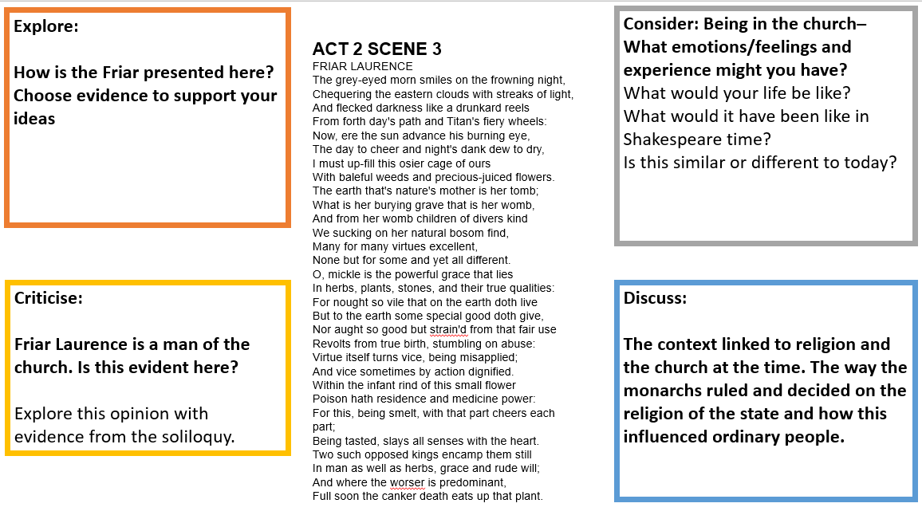
Mastery
Learning Objectives:
AO1: use textual references, including quotations, to support and illustrate interpretations.
AO2: Analyse the language used by a writer to create meanings and effects.
Notes:
Print off slide or see resources folder.

Slide 9
Act 2, Scene 4,5 & 6 Re-cap
Scene 4: Benvolio and Mercutio share some jokes about Tybalt’s challenge to Romeo and Romeo’s obsession with Rosaline – until the Nurse comes to find Romeo.
THEME: CONFLICT - the scene opens with the news that Tybalt has challenged Romeo to a duel. This reminds the audience how dangerous Romeo’s actions are. WHY DOES SHAKESPEARE DO THIS?
The scene ends with Romeo and the Nurse arranging the wedding and Romeo ‘s night with Juliet.
KEY QUOTES:
N: the gentlewoman is young; and , therefore, if you should deal double with her, truly it were an ill thing to be offered…
R: Bid her devise some means to come to shrift this afternoon; and there she shall at Friar Lawrence’ cell be shrived and married.
R: Within this hour my man shall be with thee, and bring thee cords made like a tackled stair, must be my convoy in the secret night.
B:Tybalt, the kinsman of old Capulet, hath sent a letter to his father's house.
M:A challenge, on my life
There is lots of comical word play in this scene – to CONTRAST the SERIOUSNESS of the previous scenes to provide the audience with light relief.
Consolidating learning
Learning Objective:
AO2: Analyse the language and structure used by a writer to create meanings and effects, using relevant subject terminology where appropriate.
Notes:
This slide can be printed off OR get students to independently take notes

Slide 10
Act 2, Scene 4,5 & 6 Re-cap
Scene 5: Juliet is impatiently waiting for the Nurse to return with news from Romeo. The Nurse teases Juliet and tells her about the arrangements that she has made with Romeo for the wedding.
Character: Juliet speaks playfully to the nurse to CONTRAST the different relationship she has to her parents, and the formal way she speaks to them.
Juliet: is trusted to go to confession on her own. This is the first sign of her disobedience as she uses this time to marry Romeo.
J: The clock struck nine when I did send the Nurse, in half an hour she did promise to return, Perchance she cannot meet him.
N: Then Hie you hence to Friar Lawrence’ cell, There stays a husband to make you a wife.
This scene shows Juliet’s immaturity but it also increases the excitement for the audience as it shows how quickly everything is happening.
Consolidating learning
Learning Objective:
AO2: Analyse the language and structure used by a writer to create meanings and effects, using relevant subject terminology where appropriate.
Notes:
This slide can be printed off OR get students to independently take notes

Slide 11
Act 2, Scene 4,5 & 6 Re-cap
Scene 6: Friar Lawrence warns Romeo about getting married too quickly – although the Friar is keen to get the wedding underway. WHY? Juliet meets Romeo at the Friar’s cell and they go to the church for the ceremony.
Theme: FATE
This is dramatic irony – it’s as if Romeo is tempting fate. The audience already know that they will both die.
Thinking task: Why do you think Romeo and Juliet are married off stage?
This scene is very brief and hurried. This matches the frantic pace of Romeo and Juliet’s relationship.
Consolidating learning
R: But come what sorrow can, it cannot countervail the exchange of joy… do thou but close our hands with holy words, then love-devouring death do what he dare.
Learning Objective:
AO2: Analyse the language and structure used by a writer to create meanings and effects, using relevant subject terminology where appropriate.
Notes:
This slide can be printed off OR get students to independently take notes

Slide 12
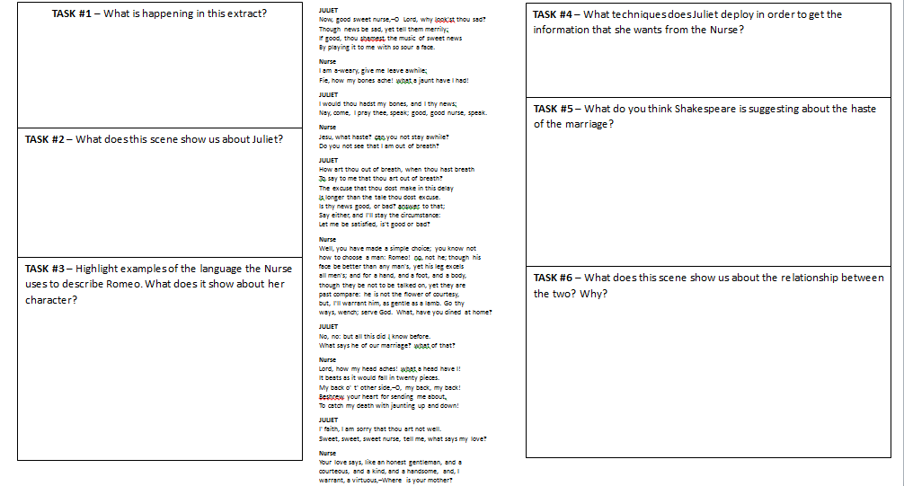
Extension Task
Learning Objectives:
AO1: use textual references, including quotations, to support and illustrate interpretations.
AO2: Analyse the language used by a writer to create meanings and effects.
Notes:
This slide can be printed off or see resources in folder.

Slide 13
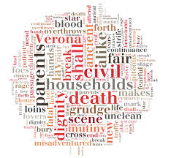
Homework
Create a collage for the character of Friar Lawrence.
Use:
Images
Symbols
Quotations
Adjectives and verbs
Colours
Different fonts and texts
Homework
Notes:
Homework is optional - Print off this slide to give out as homework.

