Slide 1
Learning content
Key words:
Regicide
Tension
LO: To explore how Macbeth and Lady Macbeth deal with King Duncan’s murder.
ST: I can explore techniques used by Shakespeare.

Slide 2
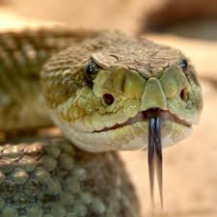
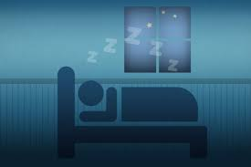
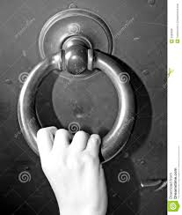
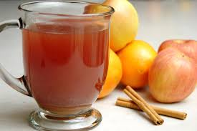
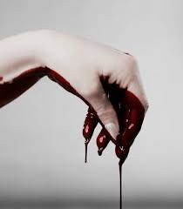
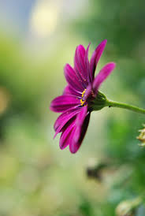
Starter: Make a connection between the images below and what we have read.
DO NOW!

Slide 3
Match the word to the definition.
Unlocking vocabulary
_____________ a person who sees an event, typically a crime or accident, take place.
_________ the action or practice of deceiving someone by concealing or misrepresenting the truth.
__________ having or showing skill in achieving one's ends by deceit or evasion.
____________ the power to influence or direct people's behaviour or the course of events.
Control Cunning
Deceit Witness

Slide 4
Answers! Please give yourself a tick
Unlocking vocabulary
Witness a person who sees an event, typically a crime or accident, take place.
Deceit the action or practice of deceiving someone by concealing or misrepresenting the truth.
Cunning having or showing skill in achieving one's ends by deceit or evasion.
Control the power to influence or direct people's behaviour or the course of events.

Slide 5
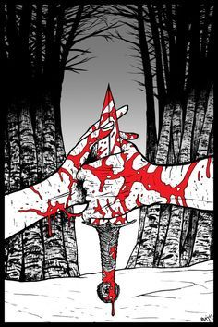
Context Question
Mastery
Annotate the extract with at least five ideas about the characters at this point.
Consider who has control and what their concerns are.
Consider Machiavelli's ideas: who uses cunning and deceit more effectively here?

Slide 6
Mastery
Context Question: Act 2, Scene 2
What do we learn about the characters in this extract?
MACBETH
But wherefore could not I pronounce 'Amen'? I had most need of blessing, and 'Amen' Stuck in my throat.
LADY MACBETH
These deeds must not be thought After these ways; so, it will make us mad.
MACBETH
Methought I heard a voice cry 'Sleep no more! Macbeth does murder sleep', the innocent sleep, Sleep that knits up the ravell'd sleeve of care, The death of each day's life, sore labour's bath, Balm of hurt minds, great nature's second course, Chief nourisher in life's feast,—
LADY MACBETH
What do you mean?
MACBETH
Still it cried 'Sleep no more!' to all the house: 'Glamis hath murder'd sleep, and therefore Cawdor Shall sleep no more; Macbeth shall sleep no more.'
LADY MACBETH
Who was it that thus cried? Why, worthy thane, You do unbend your noble strength, to think So brainsickly of things. Go get some water, And wash this filthy witness from your hand. Why did you bring these daggers from the place? They must lie there: go carry them; and smear The sleepy grooms with blood.
Notes:
Annotate with students

Slide 7
Mastery
Context Question: Act 2, Scene 2
What do we learn about the characters in this extract?
MACBETH
But wherefore could not I pronounce 'Amen'? I had most need of blessing, and 'Amen' 690 Stuck in my throat.
LADY MACBETH
These deeds must not be thought After these ways; so, it will make us mad.
MACBETH
Methought I heard a voice cry 'Sleep no more! Macbeth does murder sleep', the innocent sleep, Sleep that knits up the ravell'd sleeve of care, The death of each day's life, sore labour's bath, Balm of hurt minds, great nature's second course, Chief nourisher in life's feast,—
LADY MACBETH
What do you mean?
MACBETH
Still it cried 'Sleep no more!' to all the house: 'Glamis hath murder'd sleep, and therefore Cawdor Shall sleep no more; Macbeth shall sleep no more.'
LADY MACBETH
Who was it that thus cried? Why, worthy thane, You do unbend your noble strength, to think So brainsickly of things. Go get some water, And wash this filthy witness from your hand. Why did you bring these daggers from the place? They must lie there: go carry them; and smear The sleepy grooms with blood.
Shakespeare presents Macbeth as feeling …
Shakespeare shows that Lady Macbeth is …
The word/phrase “…..” tells me that Lady Macbeth is ….
The word/phrase “…..” tells me that Macbeth is ….
This is clever because it makes an audience think/feel/understand …
An alternative idea is …. Which shows Macbeth to be ….
Notes:
Reiterate the use of PEA for their response. Ask students to write about the contrast of characters First Paragraph about Macbeth and then about LM.

Slide 8
Extension task: The Great Chain of Being
Extensions task
Elizabethans believed that God set out an order for everything in the universe. This was known as the Great Chain of Being. On Earth, God created a social order for everybody and chose where you belonged:
God
angels
stars
moon
kings
princes
nobles
commoners
animals
trees
plants
precious stones
precious metals
other minerals
hell
Glue in the ‘Great Chain of Being’ picture and annotate it.
How does the Great Chain of Being increase the tragedy of Macbeth’s deeds?

Slide 9
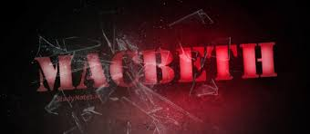
Homework task: After Act 2 when the King has been murdered
Homework
Imagine that you are one of Macbeth’s servants at Inverness. You have watched Macbeth’s strange behaviour since he returned from the wars and overheard snatches of what he and Lady Macbeth said. Write a letter home to tell what you know.

Slide 10
Notes:
Resources: Printable slide for students

