Slide 1
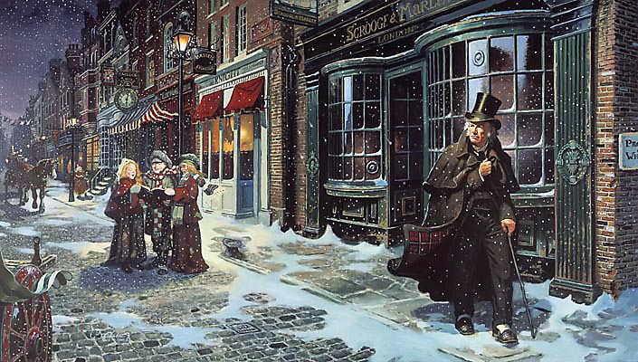
sso
LESSON EIGHT

Slide 2
sso
How is Bob Cratchit presented at the beginning of the novel?
THE CRATCHITS
Choose one of the following quotations from Stave One of ‘A Christmas Carol’ to annotate
‘The door of Scrooge’s counting-house was open that he might keep his eye upon his clerk, who in a dismal little cell beyond, a sort of tank, was copying letters.’
OR
‘Scrooge had a very small fire, but the clerk’s fire was so very much smaller that it looked like on coal.’
Do Now
Today’s key questions:
Can I consider the importance of THEMES in ‘A Christmas Carol?’
Can I explain how a writer uses language to convey key ideas?
Can I link my ideas to the social and historical aspects of ‘A Christmas Carol’?

Slide 3
sso
MATCH THE VOCABULARY TO THEIR DEFINITIONS
a person who makes or sells women's hats
great energy or enthusiasm in pursuit of a cause or an objective
in a brave or heroic manner
present, appearing, or found everywhere
GALLANTLY ZEAL UBIQUITOUS MILLINER
Unlocking Vocabulary
Today’s key questions:
Can I consider the importance of THEMES in ‘A Christmas Carol?’
Can I explain how a writer uses language to convey key ideas?
Can I link my ideas to the social and historical aspects of ‘A Christmas Carol’?

Slide 4
sso
MATCH THE VOCABULARY TO THEIR DEFINITIONS
MILLINER: a person who makes or sells women's hats
ZEAL: great energy or enthusiasm in pursuit of a cause or an objective
GALLANTLY: in a brave or heroic manner
UBIQUITOUS: present, appearing, or found everywhere
Answers
Today’s key questions:
Can I consider the importance of THEMES in ‘A Christmas Carol?’
Can I explain how a writer uses language to convey key ideas?
Can I link my ideas to the social and historical aspects of ‘A Christmas Carol’?

Slide 5
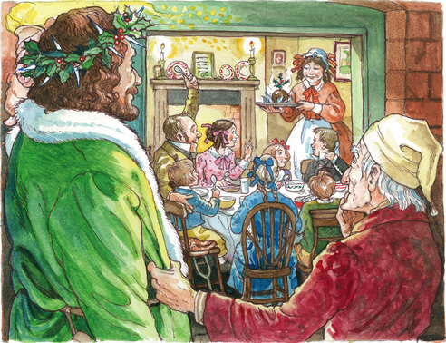
sso
THE CRATCHITS
You will need to read a section of Stave 3 to complete the Cratchit activity booklet.
READ FROM: “And perhaps it was the pleasure the good Spirit”
READ UP TO: ‘…would have blushed at such a thing’
http://www.stormfax.com/3dickens.htm
On a computer press CTRL and F and type in ‘And perhaps it was’ into the text box that appears to find the section easily.
Reading Activity

Slide 6
sso
STAVE 3: The Cratchits
Let’s continue reading from ‘…would have blushed at such a thing’ to ‘…especially on Tiny Tim, until the last.’
Reading Activity
Today’s key questions:
Can I consider the importance of THEMES in ‘A Christmas Carol?’
Can I explain how a writer uses language to convey key ideas?
Can I link my ideas to the social and historical aspects of ‘A Christmas Carol’?

Slide 7
sso
TO NOTE
Bob Cratchit represents the ideal Christmas character. He has been mistreated by Scrooge for many years and has Scrooge to blame for his poverty and his constant state of cold, and yet he forgives his master and will not allow anyone to be blamed or talked badly about on Christmas.
Dickens shows how the city’s poverty has caused a generation of lost childhoods – Peter and Martha work as hard as their father does, but though they’ve lost their innocence, Christmas makes them innocent again and music soothes their woes.
Link to Context
Today’s key questions:
Can I consider the importance of THEMES in ‘A Christmas Carol?’
Can I explain how a writer uses language to convey key ideas?
Can I link my ideas to the social and historical aspects of ‘A Christmas Carol’?

Slide 8
sso
STAVE 3: The Cratchits
Read the rest of the chapter!
Reading Activity
Today’s key questions:
Can I consider the importance of THEMES in ‘A Christmas Carol?’
Can I explain how a writer uses language to convey key ideas?
Can I link my ideas to the social and historical aspects of ‘A Christmas Carol’?

Slide 9
sso
YOUR TASK
Pick out useful quotations about the different Christmas celebrations Dickens describes to us. Look for contrasts between the setting and the attitude of the people.
EXTRA LEVEL OF CHALLENGE:
Why does the ghost show Scrooge all these different celebrations?
Fred’s Christmas
Miners’ Christmas
Mastery
Different kinds of Christmas
Today’s key questions:
Can I consider the importance of THEMES in ‘A Christmas Carol?’
Can I explain how a writer uses language to convey key ideas?
Can I link my ideas to the social and historical aspects of ‘A Christmas Carol’?

Slide 10
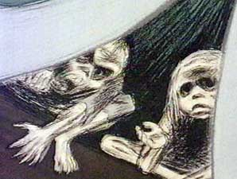
sso
MINI TASKS: IGNORANCE AND WANT
Scrooge wishes to speak at the end of the stave but there is no time. What do you suppose he would have said? Write a few lines for him.
At the end of Stave 3, the ghost describes ‘Ignorance’ and ‘Want’. Sketch these ‘children’, as described by Dickens in the novel. You may need to look up ‘prostrate’ and ‘humility’ on google before you start. Add quotations around your sketches.
Mastery
Why has Dickens personified Ignorance and Want? What do Ignorance and Want represent?
What is the effect of having the Ghost of Christmas Present repeat Scrooge’s earlier words back to him?
Eg. ‘Are there no prisons?’
Today’s key questions:
Can I consider the importance of THEMES in ‘A Christmas Carol?’
Can I explain how a writer uses language to convey key ideas?
Can I link my ideas to the social and historical aspects of ‘A Christmas Carol’?

