Slide 1
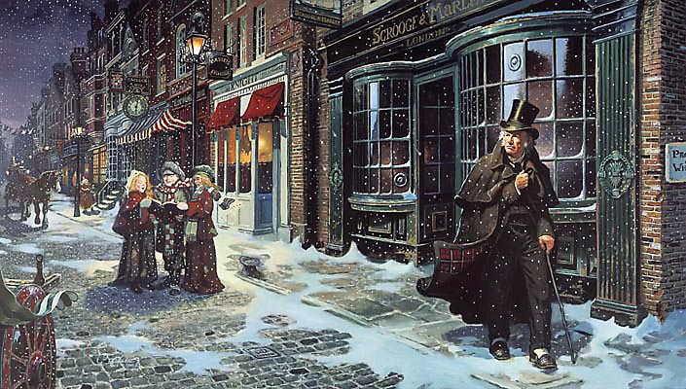
sso
LESSON EIGHT

Slide 2
sso
THE CRATCHITS
What do these quotes show about how Scrooge treats Bob Cratchit?
‘The door of Scrooge’s counting-house was open that he might keep his eye upon his clerk, who in a dismal little cell beyond, a sort of tank, was copying letters.’
OR
‘Scrooge had a very small fire, but the clerk’s fire was so very much smaller that it looked like on coal.’
Do Now
Today’s key questions:
Can I consider the importance of THEMES in ‘A Christmas Carol?’
Can I explain how a writer uses language to convey key ideas?
Can I link my ideas to the social and historical aspects of ‘A Christmas Carol’?

Slide 3
sso
MATCH THE VOCABULARY TO THEIR DEFINITIONS
a person who makes or sells women's hats
great energy or enthusiasm in pursuit of a cause or an objective
in a brave or heroic manner
present, appearing, or found everywhere
GALLANTLY ZEAL UBIQUITOUS MILLINER
Unlocking Vocabulary
Today’s key questions:
Can I consider the importance of THEMES in ‘A Christmas Carol?’
Can I explain how a writer uses language to convey key ideas?
Can I link my ideas to the social and historical aspects of ‘A Christmas Carol’?

Slide 4
sso
MATCH THE VOCABULARY TO THEIR DEFINITIONS
MILLINER: a person who makes or sells women's hats
ZEAL: great energy or enthusiasm in pursuit of a cause or an objective
GALLANTLY: in a brave or heroic manner
UBIQUITOUS: present, appearing, or found everywhere
Answers
Today’s key questions:
Can I consider the importance of THEMES in ‘A Christmas Carol?’
Can I explain how a writer uses language to convey key ideas?
Can I link my ideas to the social and historical aspects of ‘A Christmas Carol’?

Slide 5
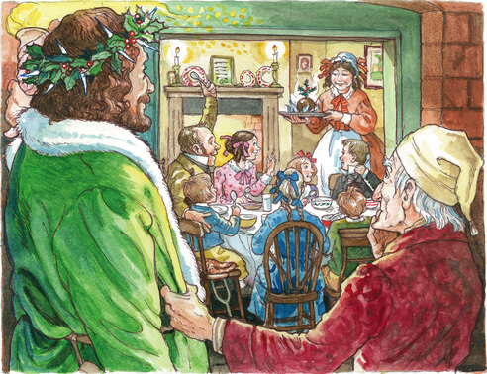
sso
THE CRATCHITS
Instead of reading as a class, you will be reading independently.
I will give you all an activity booklet to complete.
Complete the activities in pairs before moving on to the next part of the booklet.
DO NOT rush ahead. You must work together, communicating and supporting with each other.
READ UP TO: ‘…would have blushed at such a thing’
Reading Activity

Slide 6
sso
STAVE 3: The Cratchits
Let’s continue reading as a class from ‘…would have blushed at such a thing’ to ‘…especially on Tiny Tim, until the last.’
Reading Activity
Today’s key questions:
Can I consider the importance of THEMES in ‘A Christmas Carol?’
Can I explain how a writer uses language to convey key ideas?
Can I link my ideas to the social and historical aspects of ‘A Christmas Carol’?

Slide 7
sso
TO NOTE
Bob Cratchit represents the ideal Christmas character. He has been mistreated by Scrooge for many years and has Scrooge to blame for his poverty and his constant state of cold, and yet he forgives his master and will not allow anyone to be blamed or talked badly about on Christmas.
Dickens shows how the city’s poverty has caused a generation of lost childhoods – Peter and Martha work as hard as their father does, but though they’ve lost their innocence, Christmas makes them innocent again and music soothes their woes.
Link to Context
Today’s key questions:
Can I consider the importance of THEMES in ‘A Christmas Carol?’
Can I explain how a writer uses language to convey key ideas?
Can I link my ideas to the social and historical aspects of ‘A Christmas Carol’?

Slide 8
sso
STAVE 3: The Cratchits
Read the rest of the chapter!
Reading Activity
Today’s key questions:
Can I consider the importance of THEMES in ‘A Christmas Carol?’
Can I explain how a writer uses language to convey key ideas?
Can I link my ideas to the social and historical aspects of ‘A Christmas Carol’?

Slide 9
sso
YOUR TASK
How do the miners and the sailors spend Christmas time?
Who is at Fred’s Christmas Party?
What type of games do the group play?
What sort of atmosphere is there at the party?
What do the party guests think of Scrooge? How do you know?
How does Scrooge show he is beginning to change while watching the party?
Mastery
Today’s key questions:
Can I consider the importance of THEMES in ‘A Christmas Carol?’
Can I explain how a writer uses language to convey key ideas?
Can I link my ideas to the social and historical aspects of ‘A Christmas Carol’?

Slide 10
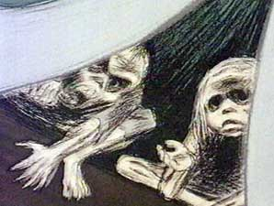
sso
MINI TASKS: IGNORANCE AND WANT
Draw Ignorance and Want. Add quotations around your sketches.
Why does the Ghost of Christmas Present repeat ‘Are there no prisons?’
Mastery
What do Ignorance and Want represent?
Today’s key questions:
Can I consider the importance of THEMES in ‘A Christmas Carol?’
Can I explain how a writer uses language to convey key ideas?
Can I link my ideas to the social and historical aspects of ‘A Christmas Carol’?

Slide 11
sso

