Slide 1
Lesson 8: SWIFT AND WELLS
LO: To look at exploration in the Victorian Era through Swift and Wells

Slide 2
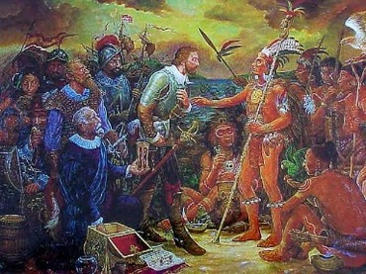
starter
Imagine you have found a new land and you were the only human (there are other civilisations though!).
What would be good about it? What things would you be worried about? What would you look for first?
Do Now
LO: To look at exploration in the Victorian Era through Swift and Wells.

Slide 3
Match the vocabulary to the correct definitions.
Acting with or showing care and thought for the future.
Freedom to do as desired.
Demands or specifies a requirement, typically as part of an agreement.
Feeding on fruit.
Throwing oneself flat on the ground so as to be lying face downwards.
The desire to harm someone.
Unlocking Vocabulary
Malice Liberty Prostrating Stipulates Prudent Frugivorous
LO: To look at exploration in the Victorian Era through Swift and Wells.
Notes:
Can print for students.

Slide 4
Check your answers:
Prudent: Acting with or showing care and thought for the future.
Liberty: Freedom to do as desired.
Stipulates: Demands or specifies a requirement, typically as part of an agreement.
Frugivorous: Feeding on fruit.
Prostrating: Throwing oneself flat on the ground so as to be lying face downwards.
Malice: The desire to harm someone.
Answers
LO: To look at exploration in the Victorian Era through Swift and Wells.
Notes:
Can print for students.

Slide 5
new time period!
Read the information on the Victorians and make notes on the questions.
Be ready to feedback!
Learning Content
LO: To look at exploration in the Victorian Era
through Swift and Wells.

Slide 6
Add to your Timeline
Jonathan Swift ‘Gulliver’s Travels’ (1726)
Ancient Literature
Middle Ages/ Renaissance
The Georgians & Victorians
The Twentieth Century
Representing change
Draw It
H.G. WELLS ‘The Time Machine’ (1895)
Today’s primary extract is ‘Gulliver’s Travels’, which was written by Jonathan Swift, published 1726. Swift was very politically minded and ‘Gulliver’s Travels’ is about varying political conflicts.
The secondary extract is ‘The Time Machine’, written by HG Wells, published 1895. ‘The Time Machine’ combines politics with science and discusses new scientific theory.
LO: To look at exploration in the Victorian Era through Swift and Wells.

Slide 7
New era – new rules!
Learning Content
LO: To look at exploration in the Victorian Era through Swift and Wells.
Notes:
https://youtu.be/1NHIVFNGQX8 Afterwards, discuss the impact of Empire/Industrial Rev

Slide 8
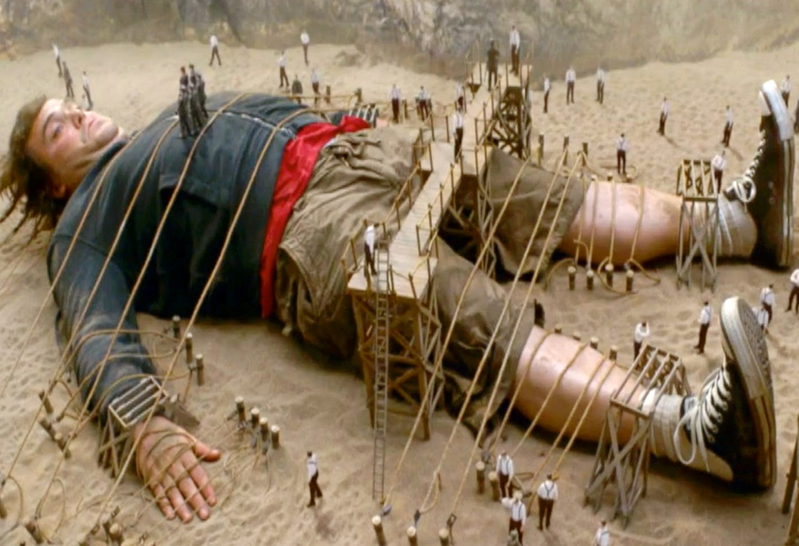
‘Gulliver’s travels’ – read/answer in books
What impression do you get of the Lilliputians?
How do you think Gulliver feels?
What do you think this could represent about the time it was written in (think about how much we knew about the world in the 1700s…)
Reading Activity
LO: To look at exploration in the Victorian Era through Swift and Wells.

Slide 9
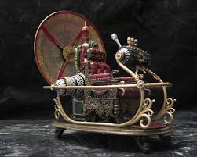
‘the time machine’ – read/answer in books
What impression do you get of the people from ‘The Time Machine’ ?
What kind of place do you think it is? Why?
What do you think this could represent about the time it was written in (think about how much we knew about the world in the 1800s…)
Reading Activity
LO: To look at exploration in the Victorian Era through Swift and Wells.

