Slide 1
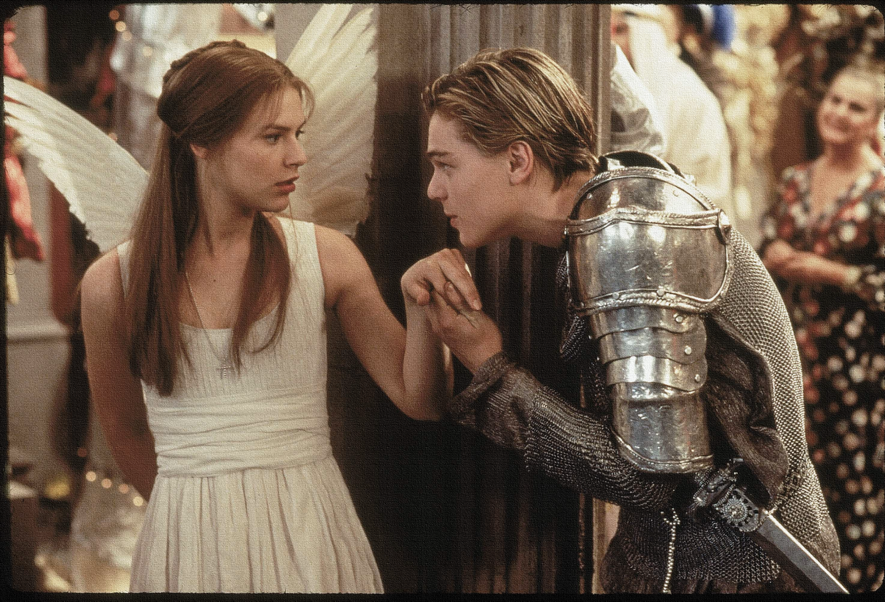
Key Words:
Marred
Iambic pentameter
Astrological
Loathed
omen
Lesson 8: Theme – Love
Success Criteria:
To identify the feelings shown in the relationship.
To explain the effect of the language in the quotation and how it links to the play’s context.
To use PETER to structure ideas about the relationship shown.
‘Romeo + Juliet’
Learning Objectives:
AO1: Use textual references, including quotations, to support and illustrate interpretations.
AO2: Analyse the language, form and structure used by a writer to create meanings and effects.

Slide 2
Write today’s date - Wednesday, 25 March 2020 and today’s title – Romeo and Juliet Revision in your book
Quick quiz: turn to the back of your books – no. 1-15
Act 1:
1. What are the names of the two feuding families?
2. Where does the play take place?
3. What does Prince Escalus say will happen to the next person who ‘disturbs’ the streets?
4. What is the name of the man who wishes to marry Juliet?
5. “And too soon marr’d are those so early made. Earth has swallowed all my hopes but she; she’s the hopeful lady of my earth.” Which character says this and who are they talking about?
6. Who does Romeo say he is in love with at the beginning of the play?
7. How old is Juliet?
8. How do the Nurse and Lady Capulet describe Paris?
9. Who is Romeo’s best friend?
10. What do Benvolio and Mercutio try to persuade Romeo to do?
11. Finish Romeo’s line: “Did my heart love till now? Forswear it, sight…”
12. Which character first recognises Romeo?
13. Who is Tybalt – which family does he belong to?
14. Which character tells Juliet who Romeo is?
15. Why does Juliet say “my only love sprung from my only hate” when talking about Romeo?
Do Now

Slide 3
Answers!
Act 1:
1. What are the names of the two feuding families? Montague & Capulet
2. Where does the play take place? Verona, Italy
3. What does Prince Escalus say will happen to the next person who ‘disturbs’ the streets? Your lives shall pay the forfeit of the peace
4. What is the name of the man who wishes to marry Juliet? The County Paris
5. “And too soon marr’d are those so early made. Earth has swallowed all my hopes but she; she’s the hopeful lady of my earth.” Which character says this and who are they talking about? Lord Capulet, Juliet
6. Who does Romeo say he is in love with at the beginning of the play? Rosaline
7. How old is Juliet? 13 years , nearly 14
8. How do the Nurse and Lady Capulet describe Paris? A Man of Wax
9. Who is Romeo’s best friend? Benvolio
10. What do Benvolio and Mercutio try to persuade Romeo to do? Examine other beauties – go out and enjoy himself
11. Finish Romeo’s line: “Did my heart love till now? Forswear it, sight…” For I ne'er saw true beauty till this night.
12. Which character first recognises Romeo? Tybalt
13. Who is Tybalt – which family does he belong to? Juliet’s cousin - Capulet
14. Which character tells Juliet who Romeo is? The Nurse
15. Why does Juliet say “my only love sprung from my only hate” when talking about Romeo? The only man I love is the son of the only man I hate!
Do Now

Slide 4
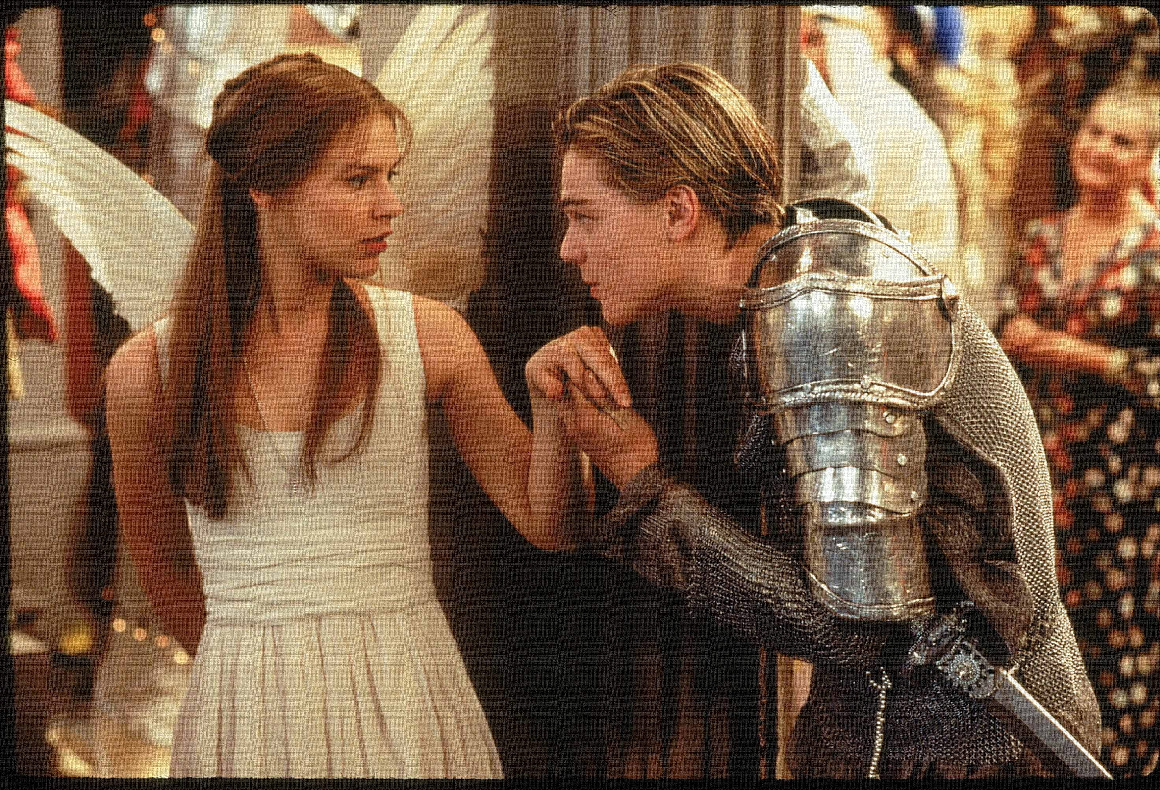
Read the keywords and match their definition: Write them in your books
A line of verse with five metrical feet, each consisting of one short (or unstressed) syllable followed by one long (or stressed) syllable.
Iambic pentameter
astrological
Feel intense dislike or disgust for.
Omen
Unlocking vocabulary
loathed
Information relating to the stars that can effect a life.
an event regarded as a portent of good or evil.
To impair the quality or appearance of; spoil.
Marred

Slide 5
ANSWERS!
A line of verse with five metrical feet, each consisting of one short (or unstressed) syllable followed by one long (or stressed) syllable.
Iambic pentameter
astrological
Feel intense dislike or disgust for.
Omen
Unlocking vocabulary
Information relating to the stars that can effect a life.
an event regarded as a portent of good or evil.
loathed
To impair the quality or appearance of; spoil.
Marred

Slide 6
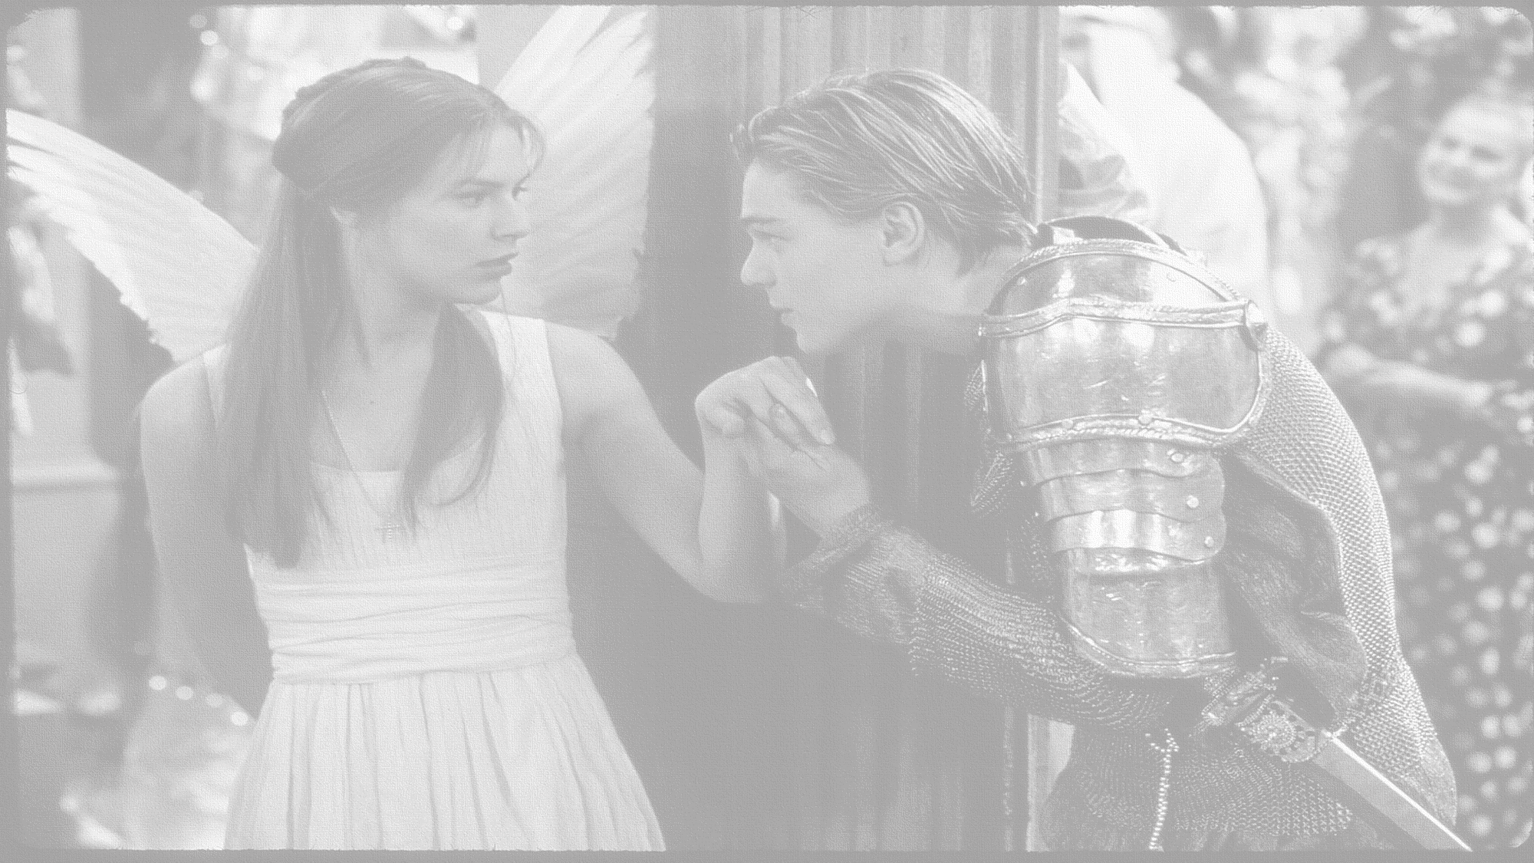
How does Shakespeare show the theme of love?
In this lesson you will be mastering the following:
To identify the feelings shown in the relationship.
To explain the effect of the language in the quotation and how it links to the play’s context.
To use PETER to structure ideas about the relationship shown.
Learning Content
Notes:
This – as with all aspects of the lesson – can be edited to suit your group.

Slide 7
Let’s read!
Act 2 scene 1&2
Romeo:
Benvolio:
Mercutio:
Juliet:
Nurse:
Discussion
How seriously should we take Romeo’s new found love for Juliet?
Does his language suggest that he is now genuinely in love, or is this just another infatuation?
What evidence do we have to link this to?
Reading task
Learning Objectives:
AO1: use textual references, including quotations, to support and illustrate interpretations.
AO2: Analyse the language used by a writer to create meanings and effects.

Slide 8
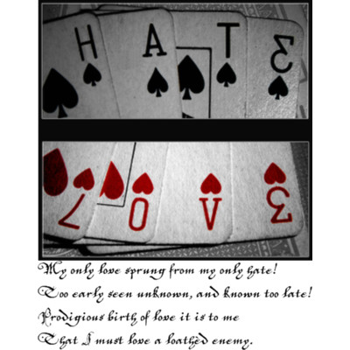
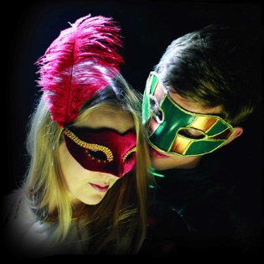
JULIET (aside) My only love sprung from my only hate!
Too early seen unknown, and known too late!
Prodigious birth of love it is to me,
That I must love a loathèd enemy.
Checking understanding
In Shakespeare's time: a "prodigy" was someone or something abnormal, a monstrosity. Prodigies were taken to be omens of a family's bad fortune.
Learning Objective:
AO2: Analyse the language, form and structure used by a writer to create meanings and effects.

Slide 9
Listen to me read Romeo’s speech and think of one word/ phrase that sticks in your mind the most and why.
Images of nature
Religious Imagery
Task:
Using your copy of the play. Identify language choices and categorise the images in Romeo’s speech through mind maps. Use the headings here to help you.
Explode quotes and offer alternative ideas
Night Imagery
Mastery
Astrological Imagery
Light Imagery
Learning Objective:
AO2: Analyse the language, form and structure used by a writer to create meanings and effects.

Slide 10
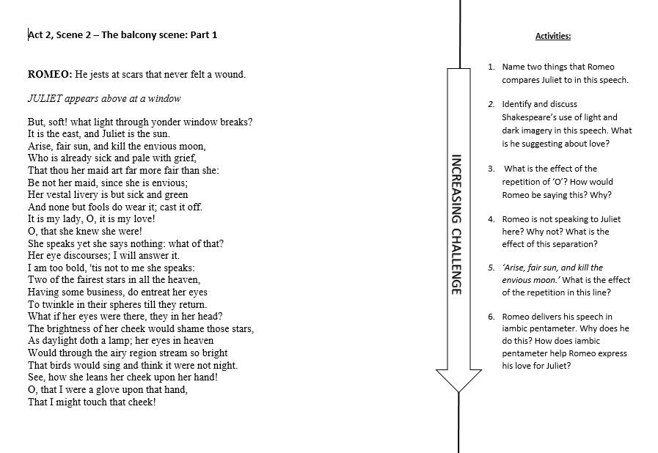
Extension Task
Learning Objectives:
AO1: use textual references, including quotations, to support and illustrate interpretations.
AO2: Analyse the language used by a writer to create meanings and effects.

Slide 11
Homework
Write a four line poem for the front of a Valentine’s day card using words from one of the categories of images.
For Example:
Astrological Imagery -
The brightest of suns
Could not dim your twinkling eyes
As they gaze upon
The expanse of our shared universe
Homework
Notes:
Homework is optional - Print off this slide to give out as homework.

