Slide 1
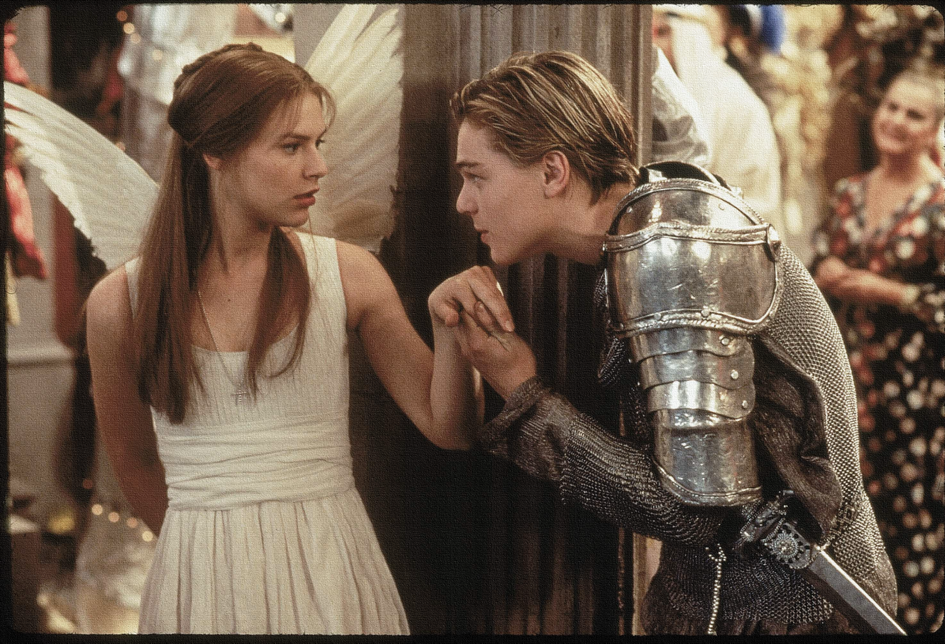
Key Words:
Infatuation
Soliloquy
Alternative interpretation
Ethiope
Trooping
Lesson 7: Character - Romeo
Success Criteria:
To explore the language that Romeo uses to describe Juliet.
To use quotations to support views on his character.
To analyse language techniques used and how they develop our opinions about Romeo.
‘Romeo + Juliet’
Learning Objectives:
AO1: use textual references, including quotations, to support and illustrate interpretations.
AO2: Analyse the language used by a writer to create meanings and effects.

Slide 2
Write today’s date - Monday, 19 October 2020 and today’s title – Romeo and Juliet Revision in your book
Let’s read
We must finish Act 1 scene 5 From line 92 – end.
Romeo:
Juliet:
Nurse:
Benvolio:
Capulet:
Do Now

Slide 3
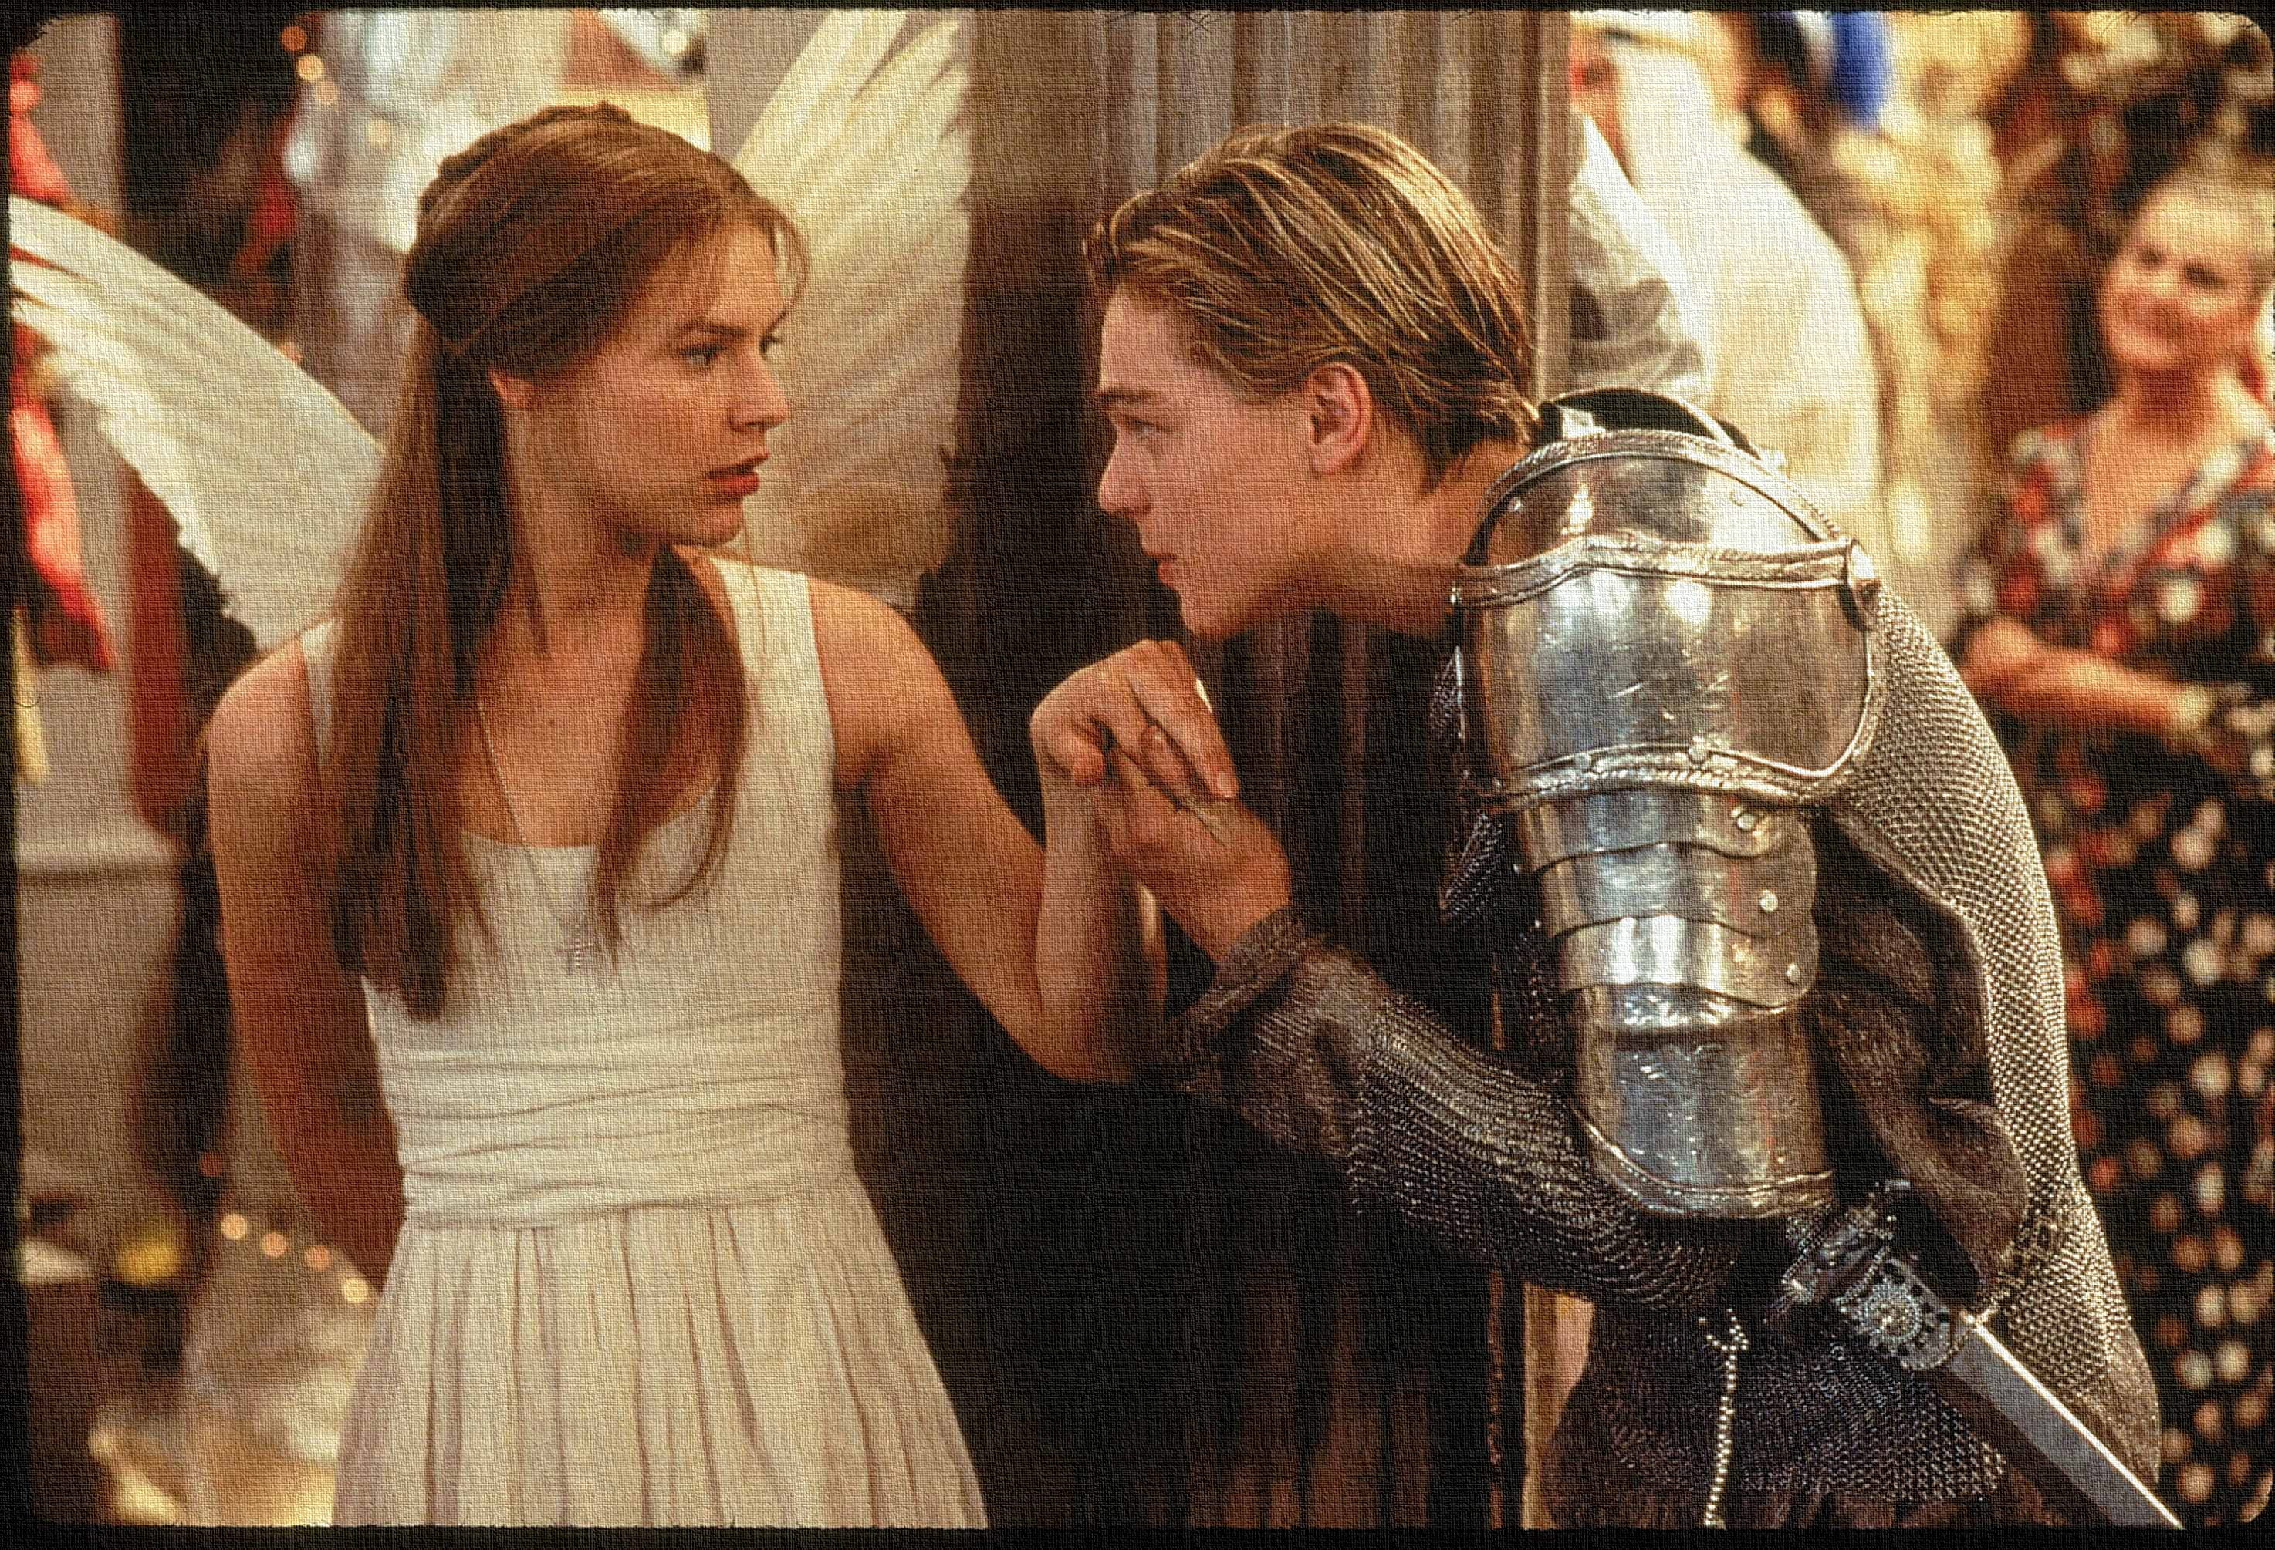
Read the keywords and match their definition: Write them in your books
To give multiple ideas
Alternative interpretation
Soliloquy
Archaic words for a dark-skinned person
Infatuation
Unlocking vocabulary
Ethiope
an act of speaking one's thoughts aloud
an intense but short-lived passion or admiration for someone or something.
A group of people come or go together or in large numbers.
Trooping

Slide 4
ANSWERS!
To give multiple ideas
Alternative interpretation
Soliloquy
Archaic words for a dark-skinned person
Infatuation
Unlocking vocabulary
Ethiope
an act of speaking one's thoughts aloud
an intense but short-lived passion or admiration for someone or something.
A group of people come or go together or in large numbers.
Trooping

Slide 5
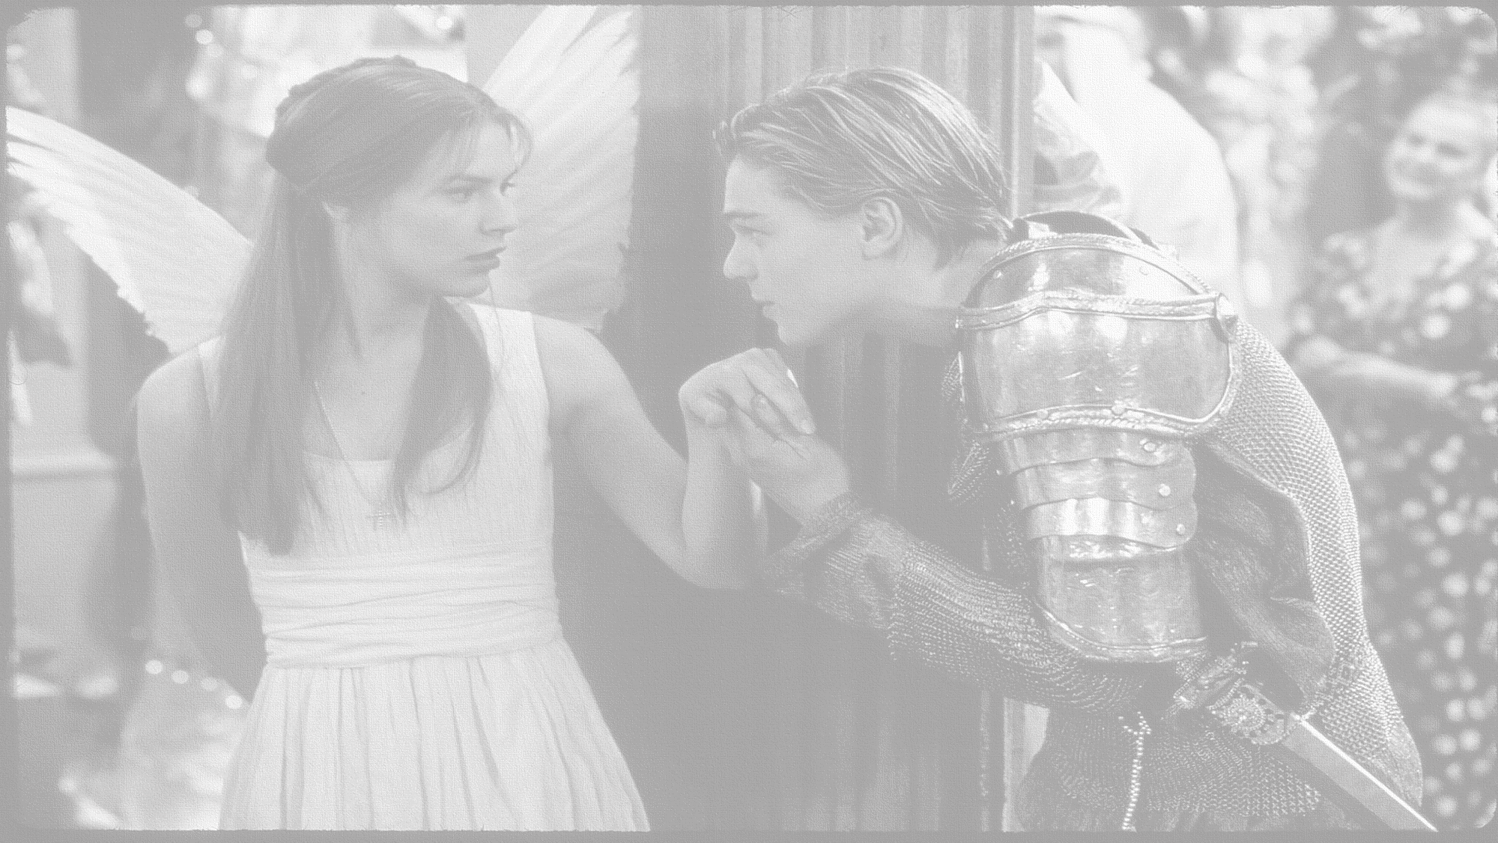
How does Shakespeare use language to show Romeo’s character?
In this lesson you will be mastering the following:
To explore the language that Romeo uses to describe Juliet.
To use quotations to support views on his character.
To analyse language techniques used and how they develop our opinions about Romeo.
Learning Content
Notes:
This – as with all aspects of the lesson – can be edited to suit your group.

Slide 6
Match the boxes to Romeo’s soliloquy.
ROMEO
Oh, she doth teach the torches to burn bright!
It seems she hangs upon the cheek of night
Like a rich jewel in an Ethiope’s ear,
Beauty too rich for use, for earth too dear.
So shows a snowy dove trooping with crows
As yonder lady o'er her fellows shows.
The measure done, I’ll watch her place of stand,
And, touching hers, make blessèd my rude hand.
Did my heart love till now? Forswear it, sight!
For I ne'er saw true beauty till this night.
Unearthly beauty.
Juliet lights up the room.
Romeo’s shock and amazement.
She is far more beautiful than the other girls.
Rhetorical question.
Mastery
Juliet is like a dove walking amongst crows.
She’s like a beautiful exotic jewel.
He will touch her hand when the dance is over.
Rhyming couplet.
Learning Objectives:
AO1: use textual references, including quotations, to support and illustrate interpretations.
AO2: Analyse the language used by a writer to create meanings and effects.
Notes:
This is a very basic task and will not provide enough challenge for the top sets. SEE NEXT SLIDE FOR DIFFERENTIATION

Slide 7
Read and annotate Romeo’s soliloquy.
What types of imagery does Shakespeare use?
ROMEO
Oh, she doth teach the torches to burn bright!
It seems she hangs upon the cheek of night
Like a rich jewel in an Ethiope’s ear,
Beauty too rich for use, for earth too dear.
So shows a snowy dove trooping with crows
As yonder lady o'er her fellows shows.
The measure done, I’ll watch her place of stand,
And, touching hers, make blessèd my rude hand.
Did my heart love till now? Forswear it, sight!
For I ne'er saw true beauty till this night.
What do we learn about Romeo’s characterisation?
Mastery
What does the rhyme scheme suggest?
What methods/linguistic devices does Shakespeare use?
Learning Objectives:
AO1: use textual references, including quotations, to support and illustrate interpretations.
AO2: Analyse the language used by a writer to create meanings and effects.
Notes:
NEXT SLIDE FOR DIFFERENTIATION

Slide 8
Read and annotate Romeo’s soliloquy.
What types of imagery does Shakespeare use?
ROMEO
Oh, she doth teach the torches to burn bright!
It seems she hangs upon the cheek of night
Like a rich jewel in an Ethiope’s ear,
Beauty too rich for use, for earth too dear.
So shows a snowy dove trooping with crows
As yonder lady o'er her fellows shows.
The measure done, I’ll watch her place of stand,
And, touching hers, make blessèd my rude hand.
Did my heart love till now? Forswear it, sight!
For I ne'er saw true beauty till this night.
What do we learn about Romeo’s characterisation?
Mastery
What does the rhyme scheme suggest?
What methods/linguistic devices does Shakespeare use?
Learning Objectives:
AO1: use textual references, including quotations, to support and illustrate interpretations.
AO2: Analyse the language used by a writer to create meanings and effects.
Notes:
NEXT SLIDE FOR DIFFERENTIATION

Slide 9
Writing task:
How does Shakespeare use language to show Romeo’s character?
Shakespeare shows Romeo to be infatuated with Juliet the first time that he sees her. He describes her as a ‘snowy dove trooping with crows’ this imagery of light and dark shows Juliet to have the quality of brilliance in comparison to other women at the masquerade ball. To be compared to a ‘snowy dove’ allows a reader to think …
P.E.T.E.R
Mastery
Learning Objectives:
AO1: use textual references, including quotations, to support and illustrate interpretations.
AO2: Analyse the language used by a writer to create meanings and effects.
Notes:
Top sets won’t need this formulaic scaffolding but helps to show elements needed in answers. Also talk about contemporary/modern audience reactions.

Slide 10
Thinking hard -Romeo’s name means:
a roamer, a wanderer.
Is there any evidence of this?
Discussion
How seriously should we take Romeo’s new found love for Juliet?
Does his language suggest that he is now genuinely in love, or is this just another infatuation?
What evidence do we have to link this to?
Checking understanding
Learning Objectives:
AO1: use textual references, including quotations, to support and illustrate interpretations.
AO2: Analyse the language used by a writer to create meanings and effects.

Slide 11
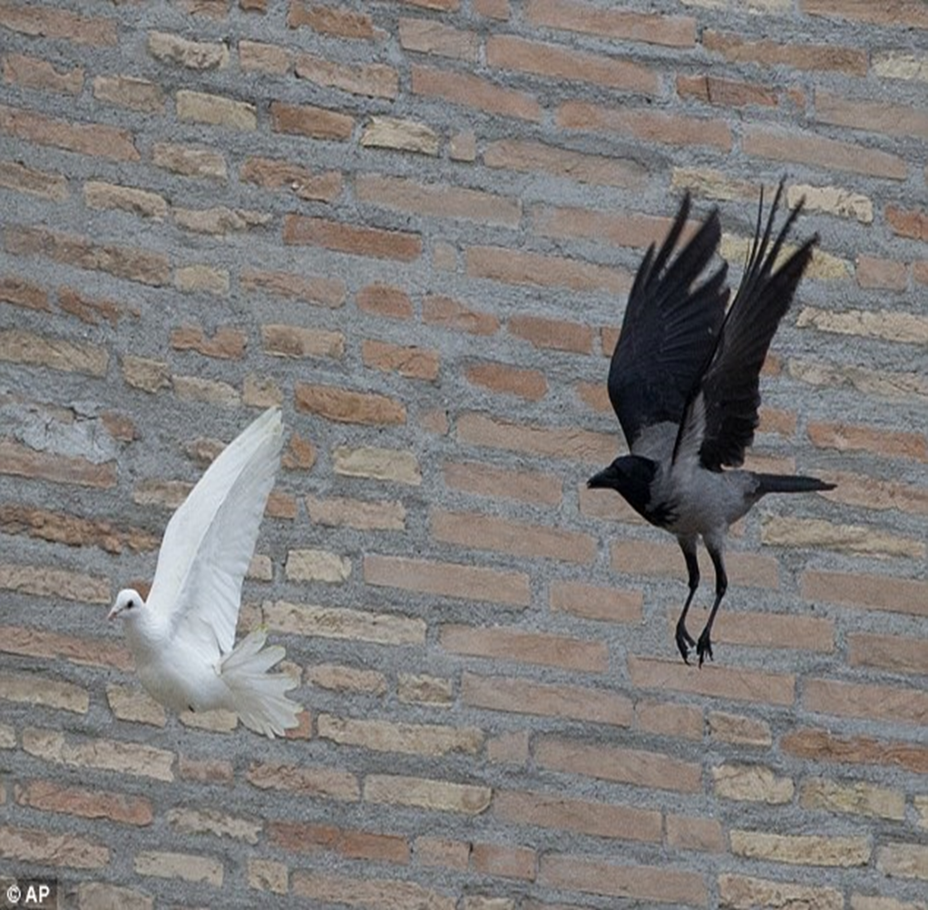
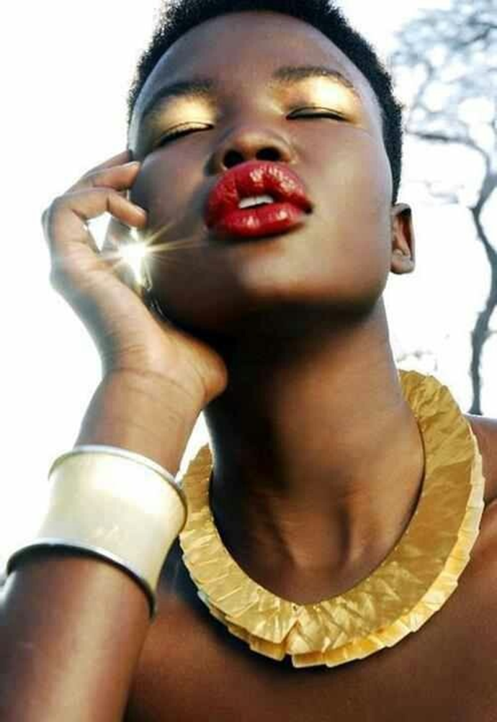
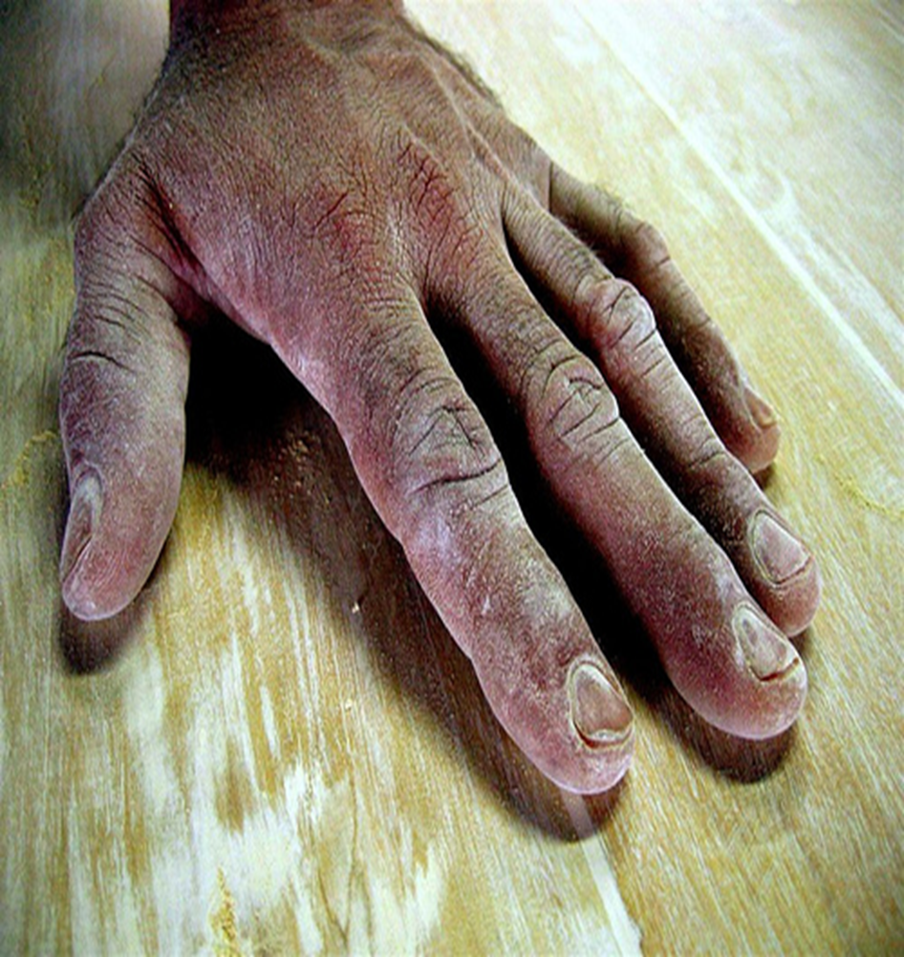
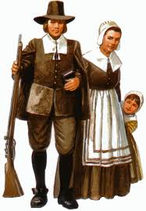
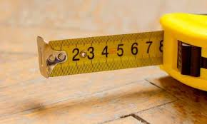
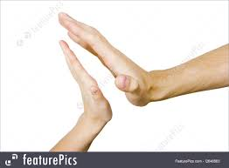
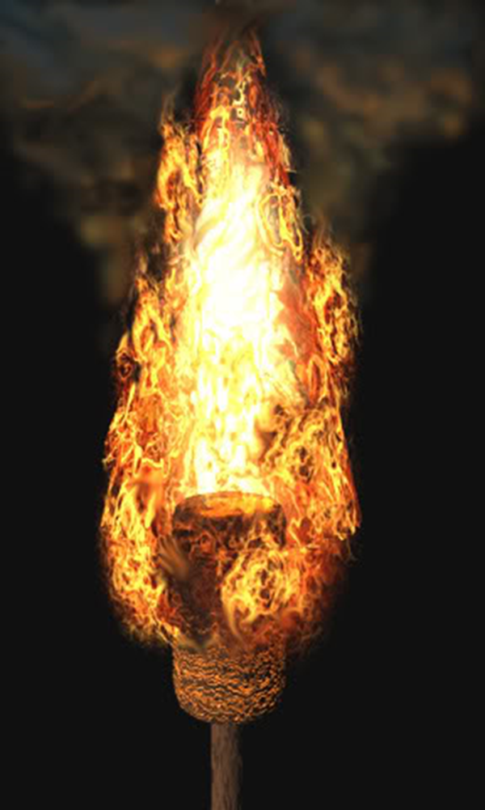
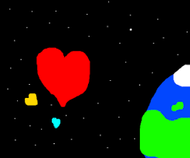
Extension Task
Romeo & Juliet Act 1 Scene 5 Images Task –
Step1. Match a quotation from Romeo’s soliloquy and his first words to Juliet to each of the images above.
Step 2. Annotate meanings/ connotations and ‘explode’ each quote to identify language techniques and word types in at least SIX of these quotations.
THEN answer this question: “How does Shakespeare present Romeo’s first sight of Juliet?
Notes:
A nice and easy task that can be done as an extension or given as homework. Print off slide

Slide 12
Homework
Write a gossip column reporting all that went on at the Ball. You might consider:
• Who was seen with who
• Who was wearing what
• Who said what to whom
• Who did what to whom
You can elaborate some of these details. Use what you remember from the play and the film.
Homework
Notes:
Homework is optional - Print off this slide to give out as homework.

