Slide 1
Learning content
LO: To track the tension in Act 2.
ST: I can explore techniques used by Shakespeare.

Slide 2
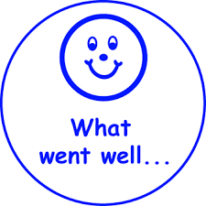
W.I.N & M.R. I
Please read your What Went Well, Improve, Next Steps feedback in your exercise book.
In GREEN PEN respond to your directed improvements with MY RESPONSE IS…
Notes:
This slide can be used for feedback on the context question from the last lesson.

Slide 3
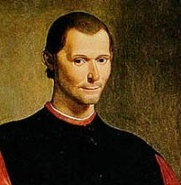
Starter: Machiavelli
DO NOW!
“One must be a fox to recognise traps and a lion to frighten wolves… when it comes to being a ruler, the ends justify the means.”
Write a definition of Machiavellianism and explain how it can be related to Macbeth.
Niccolò Machiavelli was an Italian politician and philosopher.

Slide 4
Match the word to the definition.
Unlocking vocabulary
_____________ the action or fact of showing something.
_________ a person who kills or takes part in killing a king.
__________ experiencing bad luck.
____________ an omission.
Elision Cursed
Manifestation Regicide
Notes:
Shakespeare uses the structural device of elision with the murder of King Duncan’s death off stage – this is to keep pace and make the play have a rapid tempo.

Slide 5
Match the word to the definition.
Unlocking vocabulary
_____________ the action or fact of showing something.
_________ a person who kills or takes part in killing a king.
__________ experiencing bad luck.
____________ an omission.
Elision Cursed
Manifestation Regicide
Notes:
Shakespeare uses the structural device of elision with the murder of King Duncan’s death off stage – this is to keep pace and make the play have a rapid tempo.

Slide 6
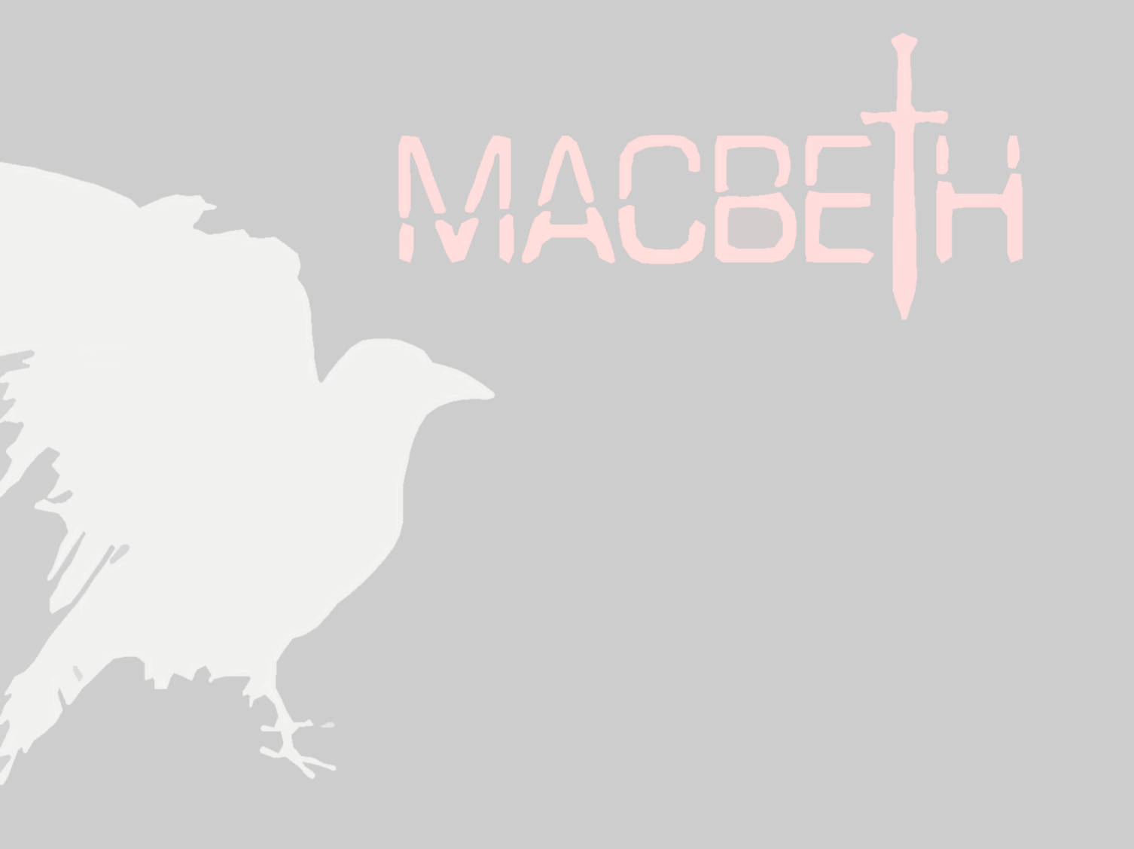
Answers! Please give yourself a tick
Unlocking vocabulary
Manifestation the action or fact of showing something.
Regicide a person who kills or takes part in killing a king.
Cursed experiencing bad luck.
Elision an omission.

Slide 7
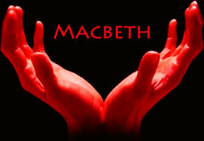
Let’s read Act 2, scene 1 & 2
Reading task
For this scene we will need the following roles:
Lady Macbeth
Banquo
Macbeth

Slide 8
Tracking the Tension
Mastery
Use a full page in your exercise book and plot how Shakespeare manipulates the tension throughout Act 2 – we will carry this graph on next lesson, so be sure to leave enough space!
Remember to log the key events as we read through the scenes in Act 2.

Slide 9
Act 2
Tension grid
Tension on a scale 1-10
Act 2
Scene 1 scene 2

Slide 10
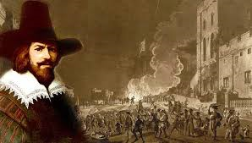
The Gunpowder Plot
Homework
Did you know?
The Gunpowder Plot happened in 1605 - one year before Macbeth was written.
What do you know about The Gunpowder Plot?
How can we link it to the play?
How is it still relevant today?

Slide 11
Notes:
Resources: Printable slide for students

