Slide 1
Language Paper 1 the Writer’s Craft
LO: An introduction on how a writer structures a piece of writing to engage a reader.
ST: I can apply my learning to an exam style question.

Slide 2
Let’s feedback on the extract from Man from the South. Highlight the variety of sentence structures and annotate around them. What is the writer trying to achieve?
No one else said anything. The boy kept his eyes on the lighter. The little man held the chopper up in the air and he too was watching the lighter.
‘Three!’
‘Four!’
Five!’
‘Six!’
‘Seven!’ Obviously it was one of those lighters that worked. The flint gave a big spark and the wick was the right length.
I watched the thumb snapping the top down on the flame. Then a pause. Then the thumb raising the top once more. This was an all-thumb operation. The thumb did everything. I took a breath, ready to say eight. The thumb flicked the wheel. The flint sparked. The little flame appeared.
‘Eight!’ I said, and as I said it the door opened. We all turned and we saw a woman standing in the doorway, a small, black-haired woman, rather old, who stood there for about two seconds then rushed forward, shouting, ‘Carlos! Carlos!’ She grabbed his wrist, took the chopper from him, threw it on the bed, took hold of the little man by the lapels of his white suit and began shaking him very vigorously, talking to him fast and loud and fiercely all the time in some Spanish-sounding language. She shook him so fast you couldn’t see him anymore. He became a faint, misty, quickly moving outline, like the spokes of a turning wheel.

Slide 3
Starter: Read the next extract and decide what the narrative viewpoint is.
‘But a man has been murd_’
‘A formal investigation,’ Kohler said, his voice firm, ‘will take place.
However, it will most certainly involve a search of Vetra’s lab, a space he and his daughter hold most private. Therefore, it will wait until Ms Vetra’s has arrived. I feel I owe her at least that modicum of discretion.’
Kohler turned the key.
As the door swung open, a blast of icy air hissed into the hall and hit Langdon in the face. He fell back in bewilderment. He was gazing across the threshold of an alien world. The flat before him was immersed in a thick, white fog. The mist swirled in smoky vortexes around furniture and shrouded the room in opaque haze.
‘What the…?’ Langdon stammered.
‘Freon cooling system,’ Kohler replied. ‘I chilled the flat to preserve the body.’
Langdon buttoned his tweed jacket against the cold. I’m in Oz, he thought. And I forgot my magic slippers.
Angels and Demons Dan Brown

Slide 4
Read the next extract and decide what the narrative viewpoint is.
Mr. Sherlock Holmes, who was usually very late in the mornings save upon those not infrequent occasions when he was up all night, was seated at his breakfast table. I stood upon the hearth-rug and picked up the stick which our visitor had left behind him the night before. It was a fine, thick piece of wood, bulbous-headed, of the sort which is known as a “Penang lawyer.” Just under the head was a broad silver band nearly an inch across. “To James Mortimer, M.R.C.S, from his friends of the C.C.H.,” was engraved upon it, with the date “1884.” It was just such a stick as the old-fashioned family practitioner used to carry – dignified, solid, and reassuring.
“Well, Watson, what do you make of it?”
Holmes was sitting with his back to me, and I had given him no sign of my occupation.
“How did you know what I was doing? I believe you have eyes in the back of your head.”
“I have, at least, a well-polished, silver-plated coffee-pot in front of me.” said he. “But, tell me, Watson, what do you make of our visitor’s stick? Since we have been so unfortunate as to miss him and have no notion of his errand, this accidental souvenir becomes of importance. Let me hear you reconstruct the man by an examination of it.”
“I think,” said I, following as far as I could the methods of my companion, “that Dr. Mortimer is a successful, elderly medical man, well-esteemed since those who know him give him this mark of their appreciation.”
The Hound of the Baskervilles Sir Arthur Conan Doyle

Slide 5
Read the next extract and decide what the narrative viewpoint is.
You are not the kind of guy who would be at a place like this at this time of the morning. But here you are, and you cannot say that the terrain is entirely unfamiliar, although the details are fuzzy. You are at a nightclub talking to a girl with a shaved head. The club is either Heartbreak or the Lizard Lounge… the night has already turned on that imperceptible pivot where two a.m. changes to six a.m. You know this moment has come and gone, but you are not willing to concede that you have crossed the line beyond which all is gratuitous damage and the palsy of unravelled nerve endings. Somewhere back there you could have cut your losses, but you rode past that moment.
Bright Lights, Big City Jay McInerney

Slide 6
Narrative viewpoint
Write a definition for a first person narrative. What effect does it have on a reader?
Write a definition for a third person narrative. What effect does it have on the reader?
Use this specific terminology when writing about 3rd person narratives: Omniscient.
Notes:
Look in Year 10 teaching structure for the first time slide 55!

Slide 7
A way to look at structure: SAME, 3Ps & 5Ts - How to use this mnemonic in text analysis.
S start Always comment on the focus at the start of the text.
A address Who is the writer speaking to? Direct address?
M movement A path? Journey? Character leaves etc.?
E ending How does it end? Different to the start?
P people characters? How are they written about?
P places follow the places, where are they?
P perspective whose point of view is shown? Does it change?
T time does it change through the text?
T topic do topics change?
T talk/dialogue do characters talk? Diction/ informal/ colloquial?
T tenses does the verb tense change? Why?
T tone what is the tone attitude of the writer?

Slide 8
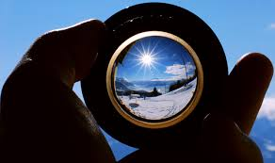
Task:
Answer the questions on narrative viewpoint on your handout .

Slide 9
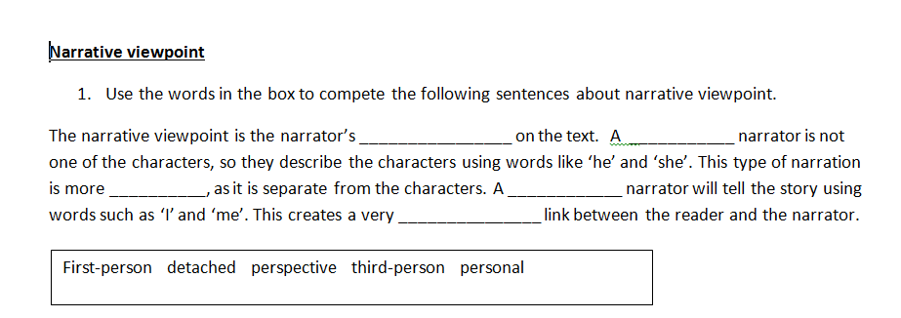
Answers:

Slide 11
The first person narrative is effective as a reader feels that they are in the operating theatre with the character. Equally, this type of narrative allows the reader to hear their thoughts; it gives an intimate view of their feelings. The character describes their ordeal with vivid imagery using words such as, ‘terror’ and ‘filled my gut with ice’ these graphic phrases show how the character really feels and makes it more realistic. A reader can experience the moment with the character as they become involved with their stream of consciousness.

Slide 12
Reading for meaning.
Read the extract from The Time Machine.
Answer the 20 comprehension questions.
Now look at the structure of the text. Identify the SAME, 3Ps and 5Ts.
Feedback to me.

Slide 13
In this extract, the narrator describes an evening at the Time Traveller’s house. A group of friends are waiting for the Time Traveller to appear. They do not know where he has been. The door from the corridor opened slowly and without noise. I was facing the door, and saw it first. “Hallo!” I said. “At last!” And the door opened wider, and the Time Traveller stood before us. I gave a cry of surprise. “Good heavens, man! What’s the matter?” cried the Medical Man, who saw him next. And the whole table turned towards the door. He was in an amazing plight. His coat was dusty and dirty, and smeared with green down the sleeves; his hair disordered, and it seemed to me greyer – either with dust and dirt or because its colour had actually faded. His face was ghastly pale; his chin had a brown cut on it – a cut half healed; his expression was haggard and drawn, as by intense suffering. For a moment he hesitated in the doorway, as if he had been dazzled by the light. Then he came into the room. He walked with just such a limp as I have seen in footsore tramps. We stared at him in silence, expecting him to speak. He said not a word, but came painfully to the table, and made a motion towards the wine. The Editor filled a glass with champagne, and pushed it towards him. He drained it, and it seemed to do him good: for he looked round the table, and the ghost of his old smile flickered across his face. “What on earth have you been up to, man?” said the Doctor. The Time Traveller did not seem to hear. “Don’t let me disturb you,” he said, with a faltering articulation. “I’m all right.” He stopped, held out his glass for more, and took it off at a draught. “That’s good,” he said. His eyes grew brighter, and a faint colour came into his cheeks. His glance flickered over our faces with a certain dull approval, and then went round the room. Then he spoke again, still feeling his way among his words. “I’m going to wash and dress, and then I’ll come down and explain things… Save me some of that mutton. I’m starving for a bit of meat.” The Editor began a question. “Tell you presently,” said the Time Traveller. “I’m…funny! Be all right in a minute.” He put down his glass, and walked towards the door. Again I remarked his lameness, and I saw his feet as he went out. He had nothing on them but a pair of tattered, blood-stained socks. Then the door closed.
No. | Question | Answer
1 | What word is used to describe the speed that the door opened?
2 | Who was facing the door as it opened?
3 | What did the narrator say to the Time Traveller as he came through the door?
4 | Who cried “Good heavens, man! What’s the matter?”
5 | What did the group at the table do as the Time Traveller entered?
6 | What did the Time Traveller’s coat look like?
7 | What colour was the smear on the Time Traveller’s coat sleeves?
8 | What word is used to describe the Time Traveller’s hair?
9 | What did the Time Traveller’s face look like?
10 | On which part of his body was the brown cut?
11 | Which two words are used to describe the Time Traveller’s expression?
12 | How was the Time Traveller walking?
13 | Who filled the Time Traveller’s glass?
14 | What liquid was poured into the Time Traveller’s glass?
15 | What is the first thing that the Time Traveller says?
16 | What did the Doctor say to the Time Traveller?
17 | How did the Time Traveller’s appearance change after his second glass?
18 | What did the Time Traveller say he was going to do before he explained things?
19 | What did the Time Traveller ask the group to save him?
20 | What was the Time Traveller wearing on his feet?

Slide 14
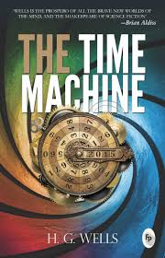
What effect has the writer tried to present/achieve /show?

