Slide 1
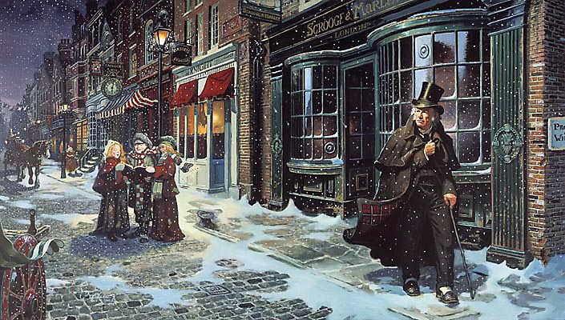
sso
LESSON SEVEN

Slide 2
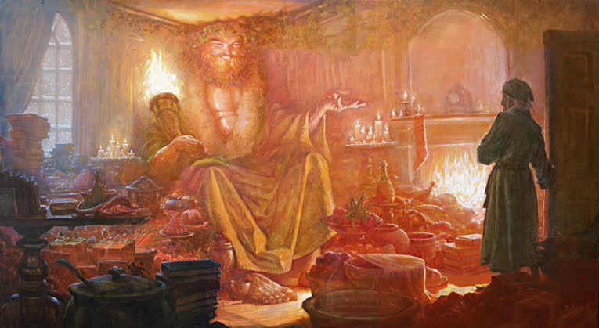
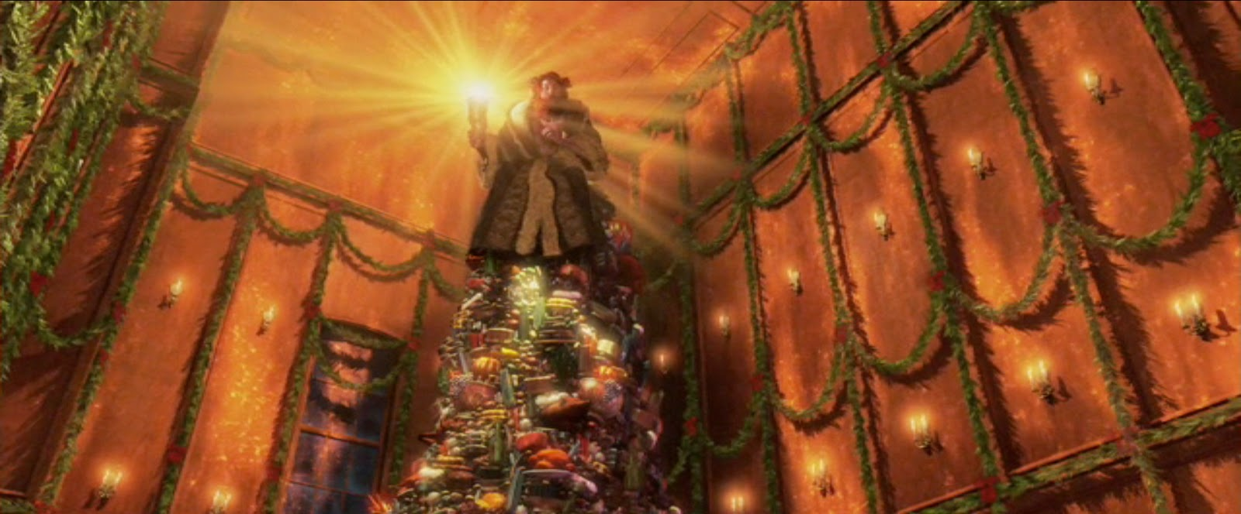
sso
DISCUSSION POINT
Speaking & Listening
How are these images different to the settings we have seen before in A Christmas Carol?
Today’s key questions:
Can I find the correct quotation to help me back up my ideas?
Can I explain how Dickens uses language to present his ideas?
Can I explain how and why Scrooge is changing across the novel?

Slide 3
sso
MATCH THE VOCABULARY TO THEIR DEFINITIONS
great wealth or luxuriousness
friendly and cheerful
the quality of being well meaning; kindness
very complicated or detailed
having a lot of space inside; roomy.
CAPACIOUS GENIAL INTRICATE
BENEVOLENCE OPULENCE
Unlocking Vocabulary
Today’s key questions:
Can I find the correct quotation to help me back up my ideas?
Can I explain how Dickens uses language to present his ideas?
Can I explain how and why Scrooge is changing across the novel?

Slide 4
sso
CHECK YOUR ANSWERS:
OPULENCE: great wealth or luxuriousness
GENIAL: friendly and cheerful
BENEVOLENCE: the quality of being well meaning; kindness
INTRICATE: very complicated or detailed
CAPACIOUS: having a lot of space inside; roomy.
Answers
Today’s key questions:
Can I find the correct quotation to help me back up my ideas?
Can I explain how Dickens uses language to present his ideas?
Can I explain how and why Scrooge is changing across the novel?

Slide 5
sso
STAVE 3: The Ghost of Christmas Present
Let’s continue reading from the beginning of Stave 3 to ‘… the ancient sheath was eaten up with rust.’
Reading Activity
Today’s key questions:
Can I find the correct quotation to help me back up my ideas?
Can I explain how Dickens uses language to present his ideas?
Can I explain how and why Scrooge is changing across the novel?

Slide 6
sso
AO2:
Analyse Language/
Form/Structure
Read the extract.
The moment Scrooge's hand was on the lock, a strange voice called him by his name, and bade him enter. He obeyed.
It was his own room. There was no doubt about that. But it had undergone a surprising transformation. The walls and ceiling were so hung with living green, that it looked a perfect grove; from every part of which, bright gleaming berries glistened. The crisp leaves of holly, mistletoe, and ivy reflected back the light, as if so many little mirrors had been scattered there; and such a mighty blaze went roaring up the chimney, as that dull petrifaction of a hearth had never known in Scrooge's time, or Marley's, or for many and many a winter season gone. Heaped up on the floor, to form a kind of throne, were turkeys, geese, game, poultry, brawn, great joints of meat, sucking-pigs, long wreaths of sausages, mince-pies, plum-puddings, barrels of oysters, red-hot chestnuts, cherry-cheeked apples, juicy oranges, luscious pears, immense twelfth-cakes, and seething bowls of punch, that made the chamber dim with their delicious steam. In easy state upon this couch, there sat a jolly Giant, glorious to see:, who bore a glowing torch, in shape not unlike Plenty's horn, and held it up, high up, to shed its light on Scrooge, as he came peeping round the door.
"Come in!" exclaimed the Ghost. "Come in, and know me better, man.“
Scrooge entered timidly, and hung his head before this Spirit. He was not the dogged Scrooge he had been; and though the Spirit's eyes were clear and kind, he did not like to meet them.
‘I am the Ghost of Christmas Present,’ said the Spirit. ‘Look upon me.’
Scrooge reverently did so. It was clothed in one simple green robe, or mantle, bordered with white fur. This garment hung so loosely on the figure, that its capacious breast was bare, as if disdaining to be warded or concealed by any artifice. Its feet, observable beneath the ample folds of the garment, were also bare; and on its head it wore no other covering than a holly wreath, set here and there with shining icicles. Its dark brown curls were long and free; free as its genial face, its sparkling eye, its open hand, its cheery voice, its unconstrained demeanour, and its joyful air. Girded round its middle was an antique scabbard; but no sword was in it, and the ancient sheath was eaten up with rust.
Mastery

Slide 7
sso
Answer the questions about the Ghost of Christmas Present
How does the setting creating a Christmas feeling?
What is the Ghost of Christmas Present sat on? What is Dickens trying to tell us? (HINT: Link to the poor people)
What sort of personality do you think the Ghost of Christmas Present has?
How does Scrooge act differently towards this Ghost compared with Marley and the Ghost of Christmas Past?
Draw a picture of the Ghost of Christmas Present. Label it with quotes.
Mastery

Slide 8
sso
STAVE 3: The Ghost of Christmas Present
Let’s continue reading from ‘… the ancient sheath was eaten up with rust’ to ‘… it was possible he could have done in any lofty hall.’
Reading Activity
Today’s key questions:
Can I find the correct quotation to help me back up my ideas?
Can I explain how Dickens uses language to present his ideas?
Can I explain how and why Scrooge is changing across the novel?

Slide 9
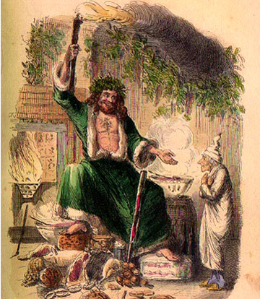
sso
DISCUSSION POINTS
Why do you think Dickens shows us everybody celebrating Christmas?
How might showing Scrooge the present help him change? Do you think it will be more effective than showing him the past?
Speaking & Listening
The Ghost of Christmas Present closely resembles Father Christmas from local folklore. Why do you think Dickens has made this decision?
What similarities does the Ghost of Christmas Present have with the Ghost of Christmas Past?
HINT: The significance of light.
Today’s key questions:
Can I find the correct quotation to help me back up my ideas?
Can I explain how Dickens uses language to present his ideas?
Can I explain how and why Scrooge is changing across the novel?

Slide 10
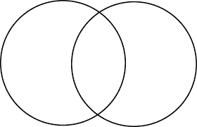
sso
TO FINISH
Draw a Venn diagram into your books.
Consider what Scrooge was like in Stave One. Now think about how he is different in Stave Three. In the middle, consider how Scrooge is the same. Remember, his transition is not complete yet!
S1
S3
Cold hearted
Checking Understanding
Curious to see more
Today’s key questions:
Can I find the correct quotation to help me back up my ideas?
Can I explain how Dickens uses language to present his ideas?
Can I explain how and why Scrooge is changing across the novel?

Slide 11
sso

