Slide 1
Boy Tales of Childhood by Roald Dahl
LO: To highlight specific language techniques used by an author.
ST: I can identify the effect it has on a reader.

Slide 2
Let’s read! ‘The Matron’, turn to page 98 in your book, we will read up to page 108.

Slide 3
Task 1: On your extract high-light words and phrases that describe the Matron. Can you tell me what techniques Roald Dahl uses?
‘Go away and come back in five minutes!’ she cried, and I shot out of the room like a bullet. After’ lights out’ the Matron would prowl the corridor like a panther trying to catch the sound of a whisper behind a dormitory door, and we soon learnt that her powers of hearing were so phenomenal that it was safer to keep quiet.
Once, after lights out, a brave boy called Wragg tiptoed out of our dormitory and sprinkled castor sugar all over the linoleum floor of the corridor. When Wragg returned and told us that the corridor had been successfully sugared from one end to the other, I began shivering with excitement. I lay there in the dark in my bed waiting for the Matron to go on the prowl. Nothing happened. Perhaps, I told myself, she is in her room taking another speck of dust out of Mr Victor Corrado’s eye.
Suddenly, from far down the corridor came a resounding crunch! Crunch crunch crunch went the footsteps. It sounded as though a giant was walking on loose gravel.

Slide 4
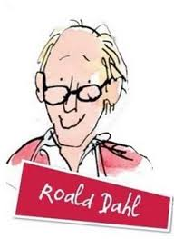
Task 2: List five things about the dormitory. Remember to write in full sentences!
Each dormitory had about twenty beds in it. These were smallish narrow beds ranged along the walls on either side. Down the centre of the dormitory stood the basins where you washed your hands and face and did your teeth, always with cold water which stood in large jugs on the floor.

Slide 5
Task 3: In pairs find quotes that describe the Matron, ready to feed back to me.
‘The Matron’

Slide 6
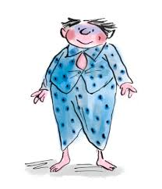
Using the quotes draw and label what you think the Matron looks like.

Slide 7
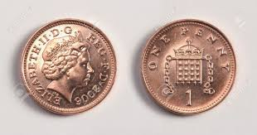
Homework: You have been given a penny. You must take it everywhere with you over the weekend – it is going on a journey with you! Make sure you bring it to our next English lesson.

