Slide 1
Lesson 6: Chaucer
LO: To explore attitudes to religion through ‘The Canterbury Tales’

Slide 2
Title: Chaucer How much do you know about religions and their rules?
Make a mind map.
You could start with Christianity/ Catholicism and then add other religions.
Do Now
LO: To explore attitudes to religion through ‘The Canterbury Tales’.

Slide 3
How much do you know about religions and their rules?
Judaism
Christianity
Checking Understanding
Religious Rules
Hinduism
Buddhism
Sikhism
LO: To explore attitudes to religion through ‘The Canterbury Tales’.

Slide 4
Match the vocabulary to the correct definitions
1. A building or buildings occupied by a community of monks living under religious vows.
2. A man who is the head of an abbey of monks.
3. A person who journeys to a sacred place for religious reasons.
4. Make an amount or supply of something last longer by using or consuming it carefully.
5. The pursuit of or indulgence in sexual pleasure.
6. A humorous way of criticizing people or ideas to show that they have faults or are wrong.
Unlocking Vocabulary
Pilgrim Satire Venery Monastery Abbot Eke
LO: To explore attitudes to religion through ‘The Canterbury Tales’.
Notes:
Can be printed for students.

Slide 5
Check Your Answers:
1. Monastery: A building or buildings occupied by a community of monks living under religious vows.
2. Abbot: A man who is the head of an abbey of monks.
3. Pilgrim: A person who journeys to a sacred place for religious reasons.
4. Eke: Make an amount or supply of something last longer by using or consuming it carefully.
5.Venery: The pursuit of or indulgence in sexual pleasure.
6. Satire: A humorous way of criticizing people or ideas to show that they have faults or are wrong.
Answers
LO: To explore attitudes to religion through ‘The Canterbury Tales’.
Notes:
Can be printed for students.

Slide 6
ADD TO YOUR timeline
Geoffrey Chaucer ‘The Canterbury Tales’ (1387-1400)
Draw It
Ancient Literature
Middle Ages/ Renaissance
The Georgians & Victorians
The Twentieth Century
Representing change
Today’s primary text is Geoffrey Chaucer’s ‘The Canterbury Tales’. It is over 17,000 lines long!
LO: To explore attitudes to religion through ‘The Canterbury Tales’.

Slide 7
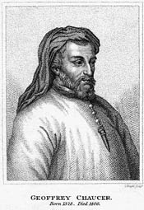
chaucer
Geoffrey Chaucer (1343 –1400), known as the Father of English literature, is widely considered the greatest English poet of the Middle Ages. He was the first poet to be buried in Poets' Corner of Westminster Abbey.
‘The Canterbury Tales’ is a collection of stories told by fictional pilgrims on the road to the cathedral at Canterbury. Chaucer mixes satire and realism in lively characterisations of his pilgrims. The tales offer a fascinating insight into English life during the late 14th century.
Contextual Information
LO: To explore attitudes to religion through ‘The Canterbury Tales.

Slide 8
The medieval era
Contextual Information
LO: To explore attitudes to religion through ‘The Canterbury Tales.
Notes:
https://youtu.be/6EAMqKUimr8

Slide 9
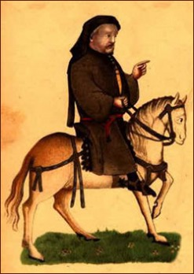
Read the extract from ‘The Canterbury Tales’ (Page 11)
What do you notice about the
presentation of religion?
Reading Activity
LO: To explore attitudes to religion through ‘The Canterbury Tales’.

Slide 10
The Murder of Thomas Becket
Mastery
LO: To explore attitudes to religion through ‘The Canterbury Tales’.
Notes:
Print out slide for students

Slide 11
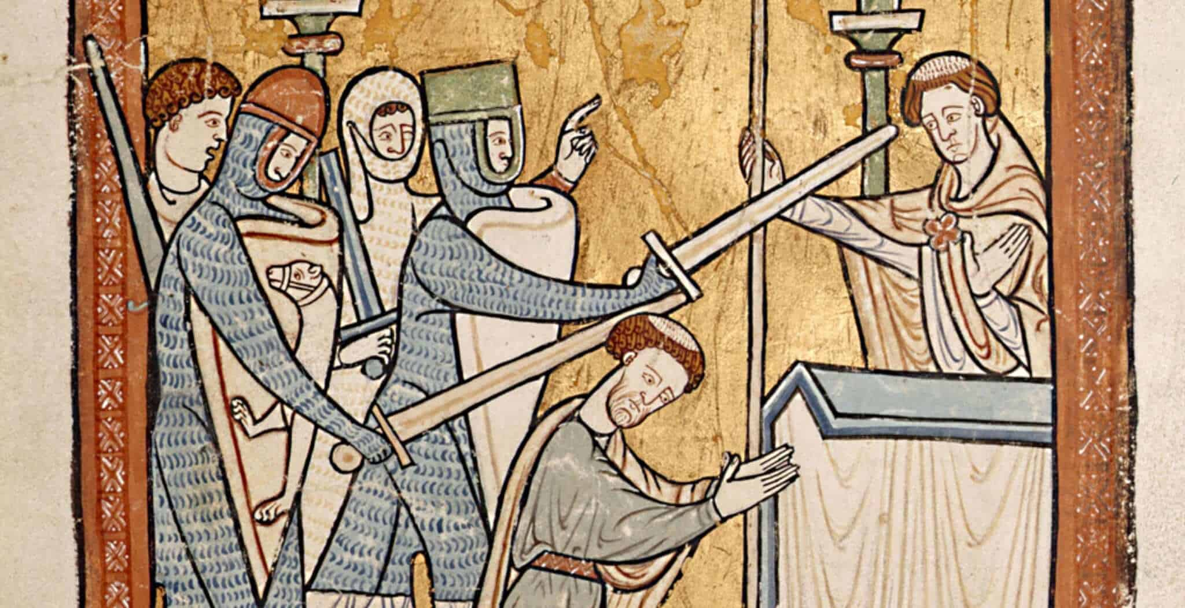
Read the Article: ‘Why Was Thomas Becket Murdered in Canterbury Cathedral?’
Create notes (mind map?/bullet points?) about the additional information you learn about Thomas Becket’s murder from
this secondary source.
Extension Activity
LO: To explore attitudes to religion through ‘The Canterbury Tales’.

Slide 12
Newspaper Article:
Use the planning sheet and your notes to create a newspaper article reporting on the murder of Thomas Becket.
Extension Writing Activity
LO: To explore attitudes to religion through ‘The Canterbury Tales’.

