Slide 1
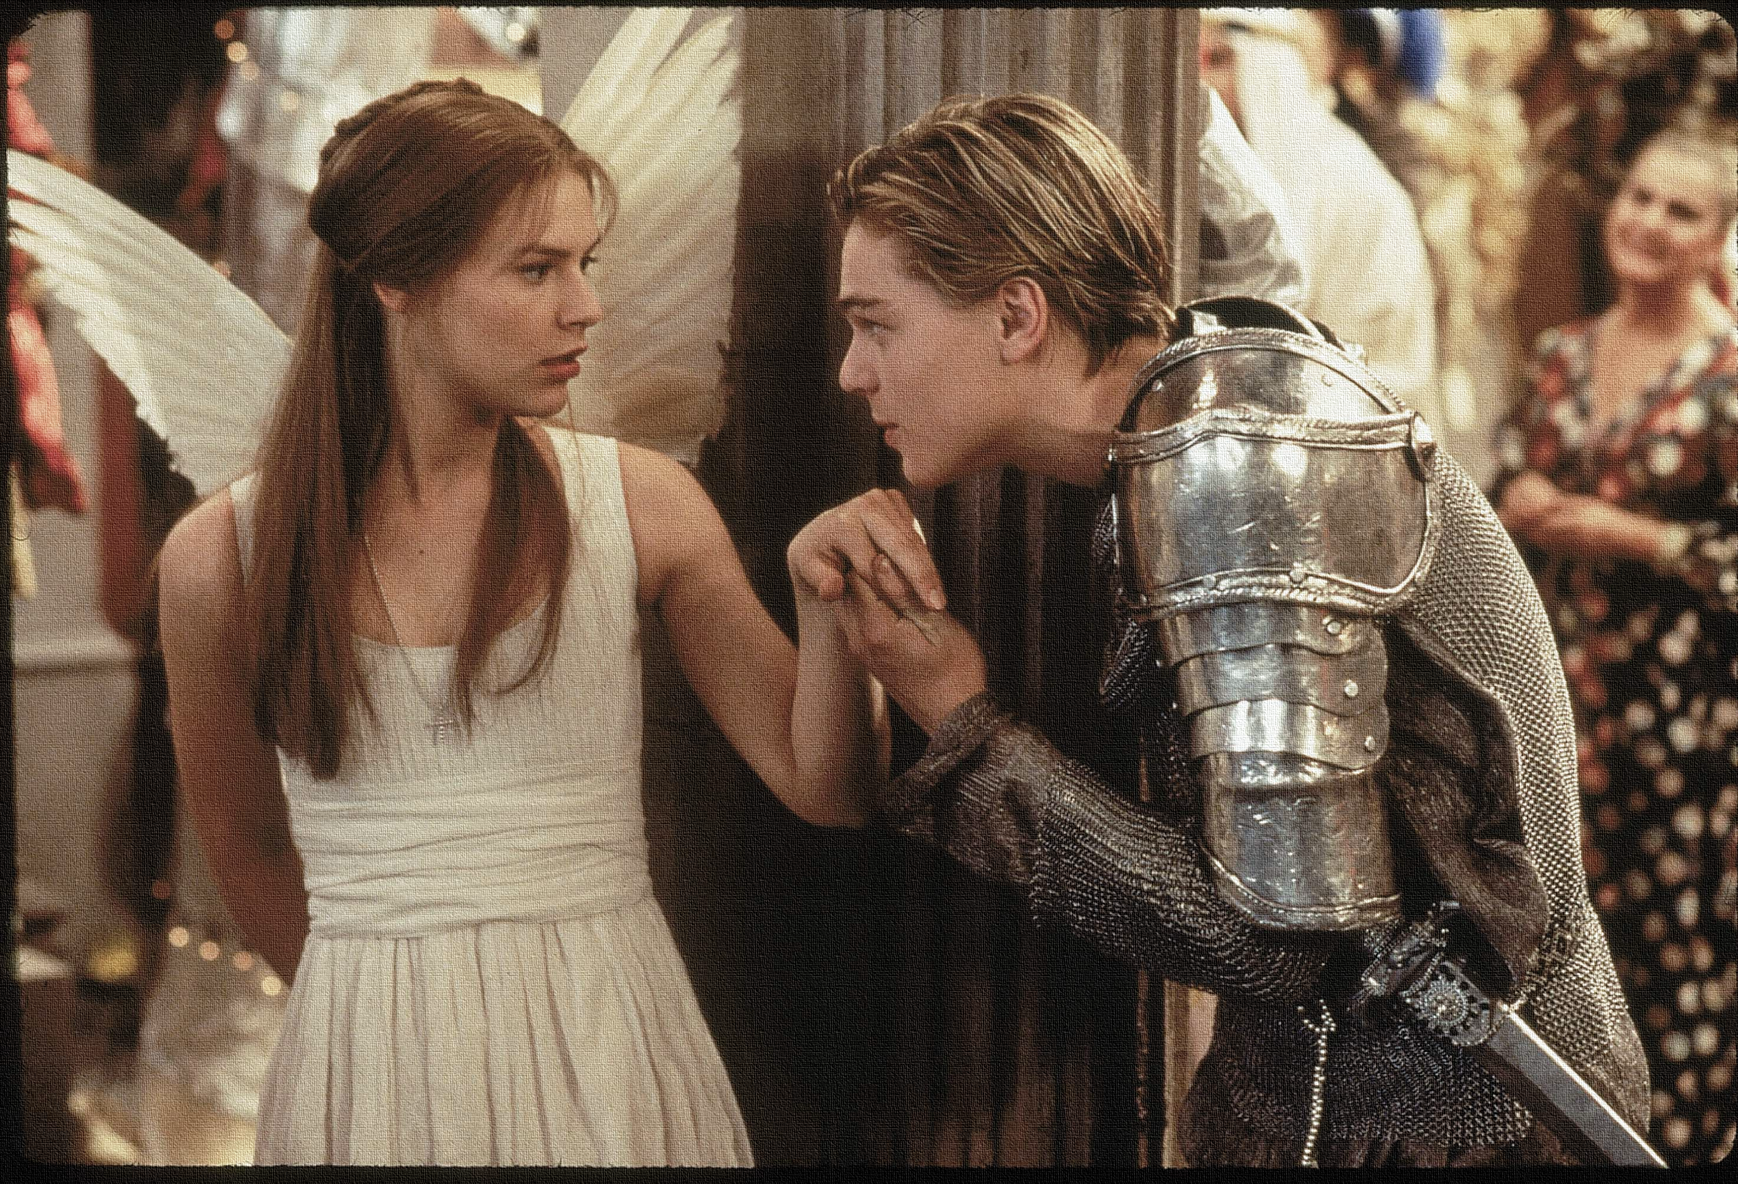
Key Words:
Foreshadowing
Tension
Endure
Villain
solemnity
Lesson 6: Act I, Scene 5.
Foreshadowing Violent Ends
Success Criteria:
To use textual evidence to explore a character’s views/ personality.
To explain Shakespeare’s use of language and structure to create tension.
To use PEEL to analyse how tension is created in a scene.
‘Romeo + Juliet’
Learning Objective:
AO2: Analyse the language, form and structure used by a writer to create meanings and effects, using relevant subject terminology where appropriate.

Slide 2
Write today’s date - Friday, 27 March 2020 and today’s title – Romeo and Juliet Revision in your book
5-4-3-2-1
Write 5 words that you associate with Mercutio
Name the 4 Humours – bonus points for the characteristics of each
3 differences between Romeo and Mercutio’s views on love
2 themes that Mercutio represents
1 definition of a ‘foil’ character
Do Now

Slide 3
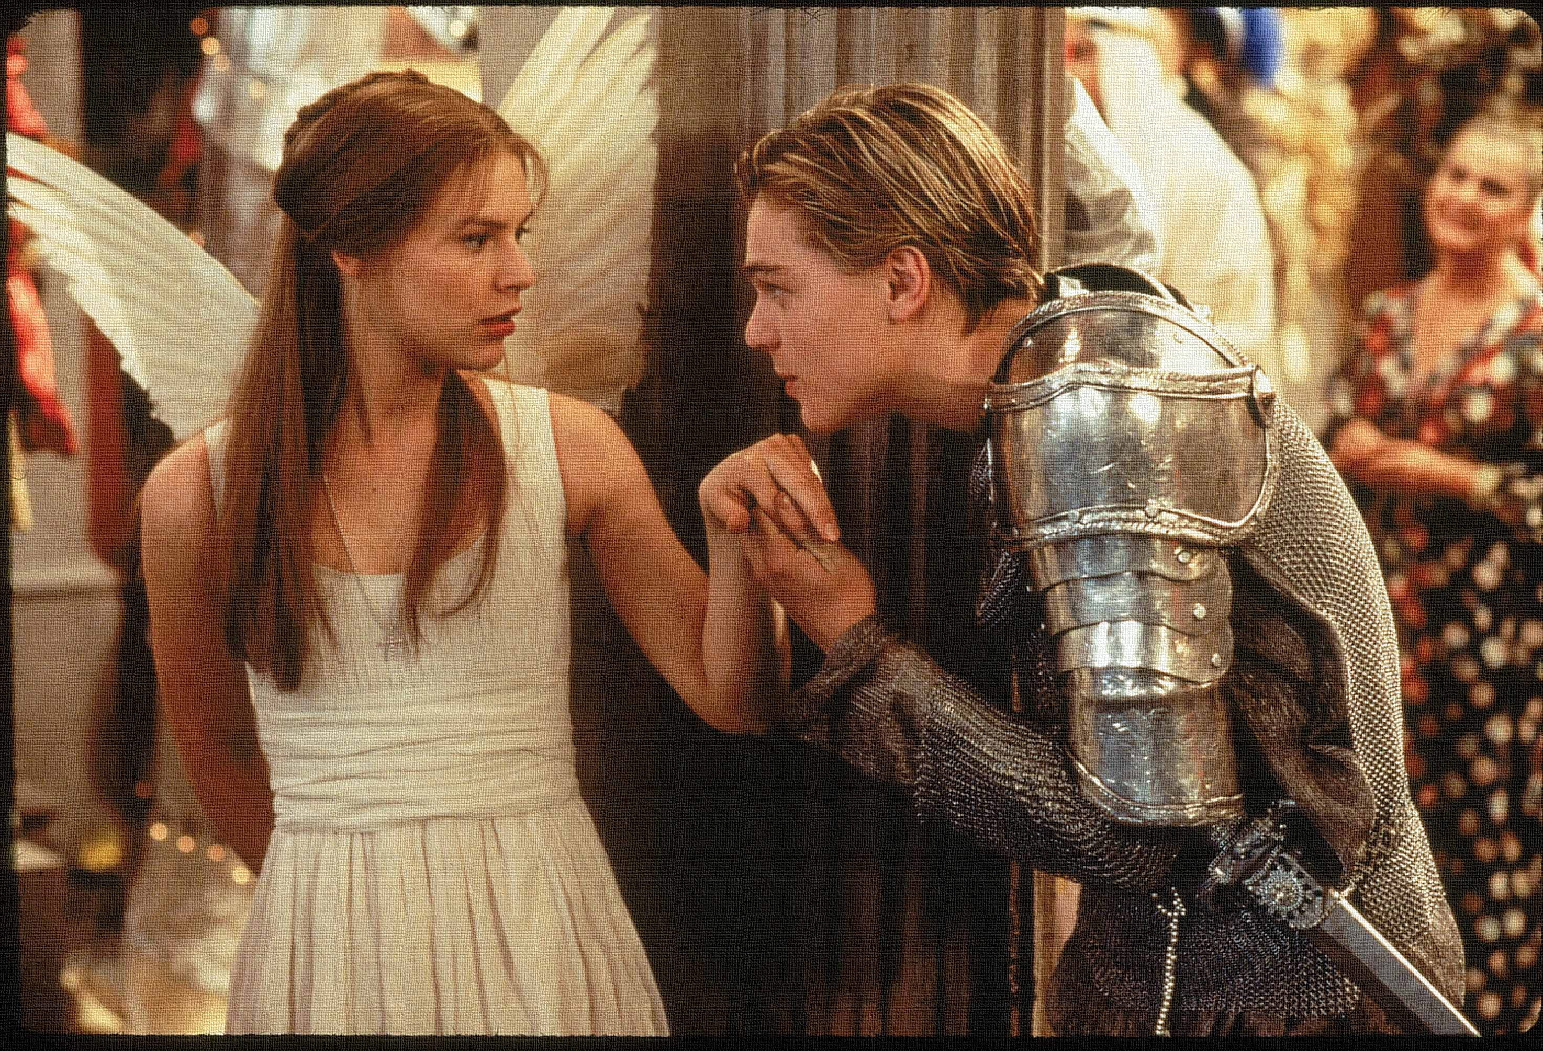
Read the keywords and match their definition: Write them in your books
A warning or indication of (a future event).
Foreshadowing
endure
The state or quality of being serious and dignified.
Villain
Unlocking vocabulary
solemnity
suffer (something painful or difficult) patiently.
"a person of uncouth mind and manners."
That element in a novel that evokes emotions such as worry, anxiety, fear and stress on the part of both the reader and the characters in a novel.
Tension
Notes:
The word ‘villain’ comes from the medieval word ‘villager’ so, they are below the landed aristocracy and therefore don’t have the manners and morals gained with the power and political strength of those high in society. Thus why it is such an effective insult given by Tybalt!

Slide 4
ANSWERS!
A warning or indication of (a future event).
Foreshadowing
endure
The state or quality of being serious and dignified.
Villain
Unlocking vocabulary
solemnity
suffer (something painful or difficult) patiently.
"a person of uncouth mind and manners."
That element in a novel that evokes emotions such as worry, anxiety, fear and stress on the part of both the reader and the characters in a novel.
Tension
Notes:
The word ‘villain’ comes from the medieval word ‘villager’ so, they are below the landed aristocracy and therefore don’t have the manners and morals gained with the power and political strength of those high in society. Thus why it is such an effective insult given by Tybalt!

Slide 5
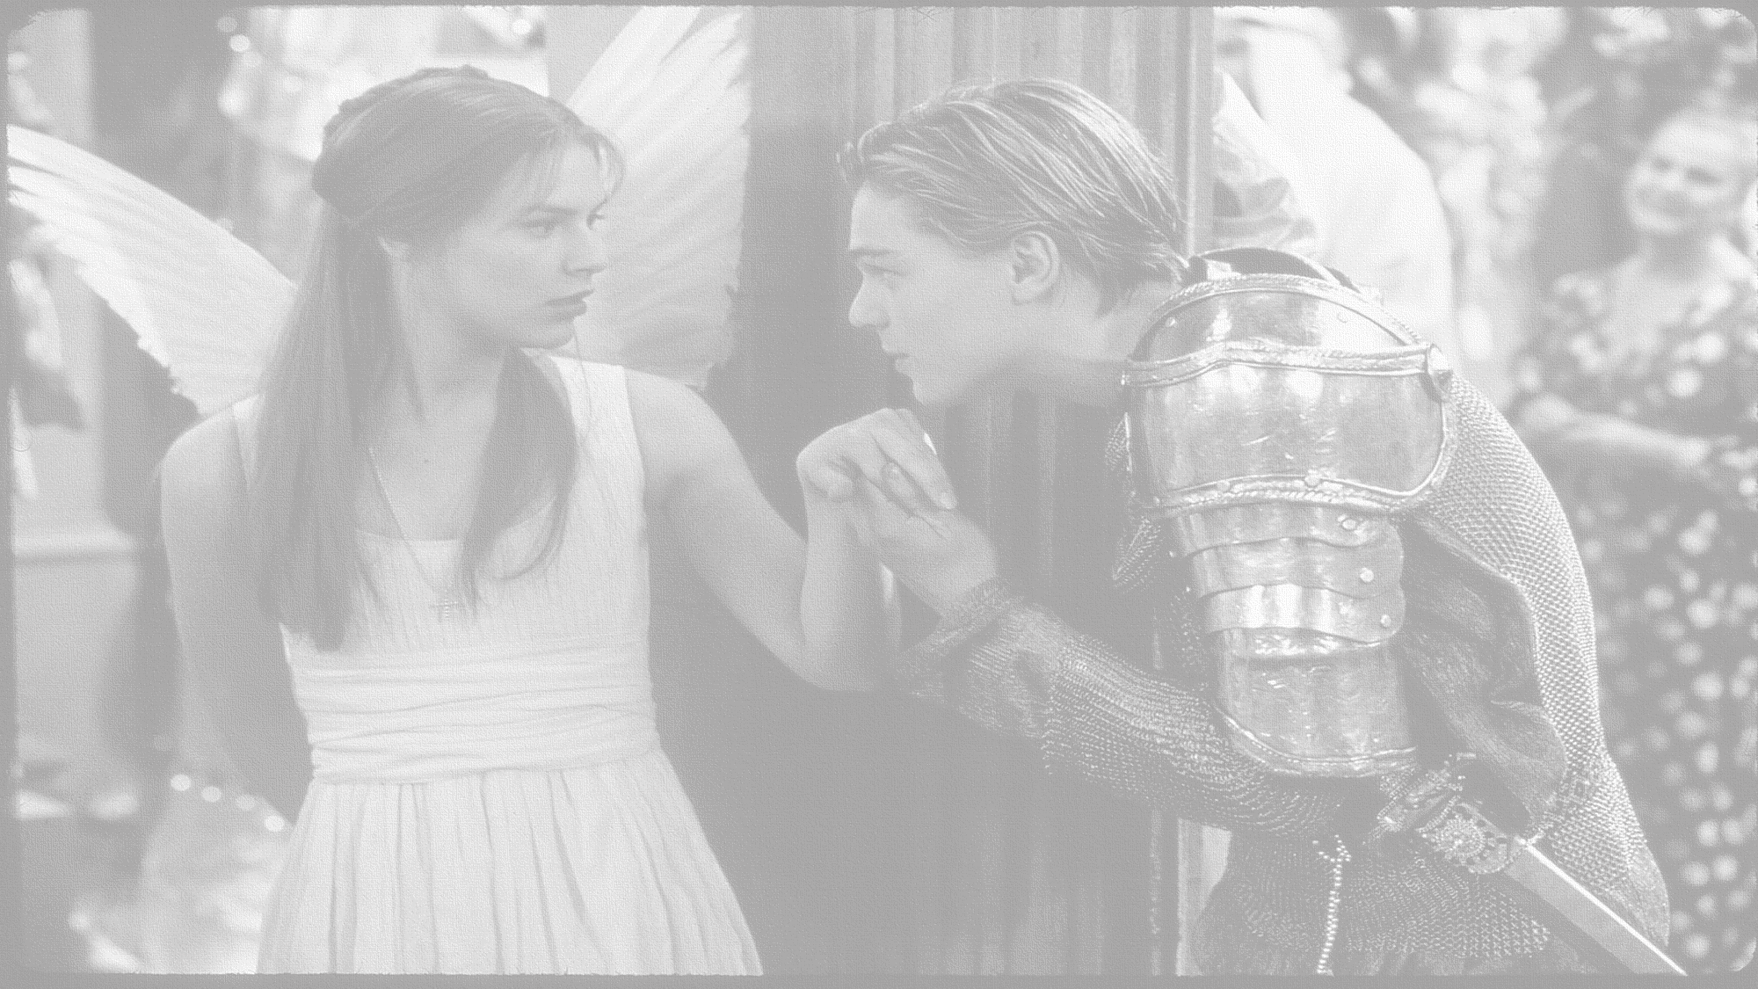
How does Shakespeare foreshadow violent ends?
In this lesson you will be mastering the following:
To use textual evidence to explore a character’s views/ personality.
To explain Shakespeare’s use of language and structure to create tension.
To use PETER to analyse how tension is created in a scene.
Learning Content
Notes:
This – as with all aspects of the lesson – can be edited to suit your group.

Slide 6
Let’s read: Act 1 scene 5 up to line 91
Reading task
First serving man:
Second serving man:
Third serving man:
Fourth serving man:
Capulet:
Cousin Capulet:
Romeo:
Tybalt:

Slide 7
What type of mood is Lord Capulet in? How can you tell?
CAPULET – At the beginning of this scene
Welcome, gentlemen! I have seen the day
That I have worn a visor and could tell
A whispering tale in a fair lady’s ear
Such as would please. 'Tis gone, ’tis gone, ’tis gone.—
You are welcome, gentlemen.—Come, musicians, play.
(music plays and they dance)
A hall, a hall, give room!—And foot it, girls.—
More light, you knaves! And turn the tables up,
And quench the fire. The room is grown too hot.—
Ah, sirrah, this unlooked-for sport comes well.—
CAPULET – At the end of this scene
He shall be endured.
What, goodman boy! I say, he shall. Go to.
Am I the master here, or you? Go to.
You’ll not endure him! God shall mend my soul,
You’ll make a mutiny among my guests.
You will set cock-a-hoop. You’ll be the man!
Extension: What does Tybalt’s reaction to Lord Capulet suggest about their relationship? Why?
Mastery
Challenge Question: What is surprising about Lord Capulet’s response in this scene? Link back to a previous scene to support your point.
Learning Objective:
AO2: Analyse the language, form and structure used by a writer to create meanings and effects, using relevant subject terminology where appropriate.

Slide 8
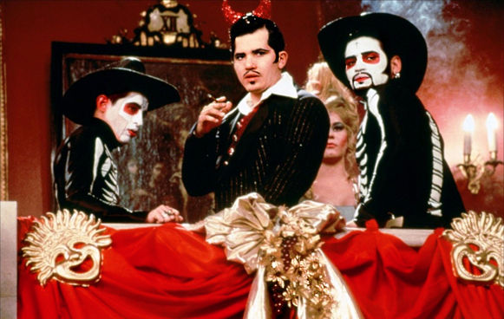
How does Tybalt scene create tension and foreshadow future events?
Use PETER to answer this question.
TYBALT
This, by his voice, should be a Montague.—
(to his PAGE) Fetch me my rapier, boy.—
What, dares the slave
Come hither, covered with an antic face,
To fleer and scorn at our solemnity?
Now, by the stock and honor of my kin,
To strike him dead I hold it not a sin ...
Uncle, this is a Montague, our foe,
A villain that is hither come in spite
To scorn at our solemnity this night ...
'Tis he, that villain Romeo …
It fits when such a villain is a guest.
I’ll not endure him …
Patience perforce with willful choler meeting
Makes my flesh tremble in their different greeting.
I will withdraw, but this intrusion shall
Now seeming sweet, convert to bitterest gall.
Mastery
Bonus Question: Why did Baz Luhrman decide to dress Tybalt as a devil and his ‘gang’ as skeletons? Is it an accurate representation of him as a character? Why/ why not?
Learning Objective:
AO2: Analyse the language, form and structure used by a writer to create meanings and effects, using relevant subject terminology where appropriate.

Slide 9
Act I, Scene V
Lord Capulet –
He shall be endured.
What, goodman boy! I say, he shall. Go to.
Am I the master here, or you? Go to.
You’ll not endure him! God shall mend my soul,
You’ll make a mutiny among my guests.
You will set cock-a-hoop. You’ll be the man!
Tybalt –
This, by his voice, should be a Montague.—
(to his PAGE) Fetch me my rapier, boy.—
What, dares the slave
Come hither, covered with an antic face,
To fleer and scorn at our solemnity?
Now, by the stock and honor of my kin,
To strike him dead I hold it not a sin.
Checking understanding
Who is the most chivalrous in this scene?
Tybalt –
Why, uncle, ’tis a shame.
Learning Objective:
AO3: Show understanding of the relationships between texts and the contexts in which they were written.
Notes:
This slide can be printed off or talked through; it links back to themes of honour and chivalry.

Slide 10
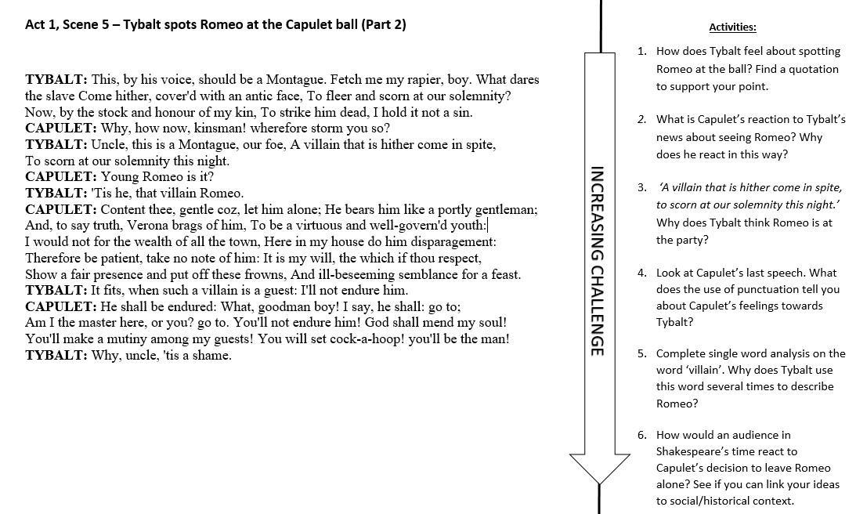
Extension Task

Slide 11
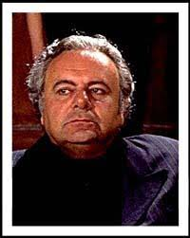
Homework
Lord Capulet plays a pivotal part in the play with regard to theme and character. Using the image on the right record quotes that show how he presents many different characteristics and annotate your ideas around them.
Homework
Notes:
Homework is optional - Print off this slide to give out as homework.

