Slide 1
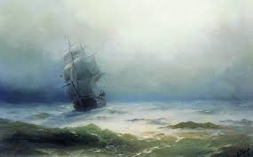
5.
The Tempest
by William Shakespeare
Act 1 Scene 1
LO: To understand how to have dramatic impact on a stage set and design one for Act 1 scene 1.
ST: I can create an effective stage set.

Slide 2
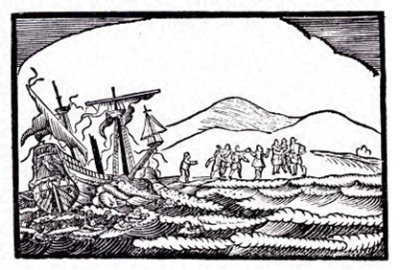
Dramatic Impact
DO NOW!
How does Shakespeare make the opening scene of The Tempest exciting and appealing to the audience?

Slide 3
Match the word to the definition.
Unlocking vocabulary
_____________ introduce (a character, set, or location) into a film or play and allow its identification.
_________ a portable object other than furniture or costumes used on the set of a play or film.
_____________ (of an event or circumstance) sudden and striking.
______________ attractive or interesting.
Dramatic appealing
establish props

Slide 4
Answers! Please give yourself a tick
Unlocking vocabulary
Establish introduce (a character, set, or location) into a film or play and allow its identification.
Props a portable object other than furniture or costumes used on the set of a play or film.
Dramatic (of an event or circumstance) sudden and striking.
Appealing attractive or interesting.

Slide 5
TASK: Imagine that you are a director about to stage the play. Draw FIVE boxes in your book to plan how you will create a scene that establishes a powerful impression on the audience.
Mastery
Lighting – light, dark , coloured etc.
Setting – what will the surroundings include, props etc.
Sound and special effects
Actors – speech / movement
Stage- where will things be positioned, set out etc.

Slide 6
TASK : Draw and label a stage set for The Tempest Act 1 scene 1
Consolidating knowledge

Slide 7
Extension: Let’s read Act 1 scene 2 – to line 185
Extension
Characters: Miranda, Prospero

Slide 8
Notes:
Resources: Printable slide

