Slide 1
Learning content
LO: To explore how Shakespeare contrasts the character of Macbeth between Banquo and Duncan.
ST: I can analyse the character development.

Slide 2
Thinking questions
DO NOW!
How does Macbeth feel when he hears the predictions?
How does Banquo feel when he hears the predictions for Macbeth?
What do the witches predict for Banquo? What do they mean in modern terms? Whose predictions are better?
What is a paradox?
What is a prophesy?

Slide 3
Match the word to the definition.
Unlocking vocabulary
_____________ the state of being strikingly different from something else in juxtaposition or close association.
_________ happening in a way contrary to what is expected, and typically causing wry amusement because of this.
__________ a strong feeling of wanting to have something or wishing for something to happen.
____________ a pair of successive lines of verse, typically rhyming and of the same length.
Couplet Desire
Contrast Ironic

Slide 4
Answers! Please give yourself a tick
Unlocking vocabulary
Contrast the state of being strikingly different from something else in juxtaposition or close association.
Ironic happening in a way contrary to what is expected, and typically causing wry amusement because of this.
Desire a strong feeling of wanting to have something or wishing for something to happen.
Couplet a pair of successive lines of verse, typically rhyming and of the same length.

Slide 5
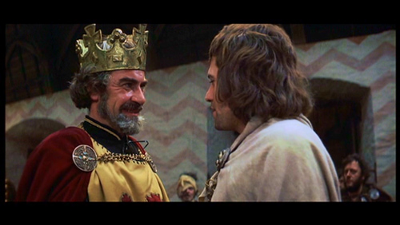
Starter: Act 1, scene 4
Reading task
The following roles will need to be read for this scene:
Duncan
Malcolm
Macbeth
Banquo

Slide 6
Task – write a summary of the scene.
Consolidating knowledge
King Duncan asks his son, Malcolm, to confirm that the Thane of Cawdor has been executed.
He is told that Cawdor died with dignity, repenting his actions.
Macbeth and Banquo enter and are thanked for their efforts in the war.
Duncan proclaims that Malcolm will be his heir. He also says that he will visit Macbeth at home.
Macbeth says he will write to his wife and prepare for the arrival of the King. He is unhappy about Duncan’s announcement that Malcolm is next in line to the throne.
In Macbeth’s absence, Duncan praises him to Banquo.

Slide 7
Thinking task: How does Shakespeare contrast Macbeth? with:
Thinking task
Duncan
Banquo
The Thane of Cawdor
Are they direct and open?
Discuss with a partner – be ready to feedback
How does the former Thane of Cawdor act? Is he repentant? Why is this ironic?

Slide 8
Task: Why is this scene important? How does Shakespeare develop the character of Macbeth?
Mastery
Macbeth
[Aside] The Prince of Cumberland: that is a step
On which I must fall down, or else o’erleap,
For in my way it lies. Stars, hide your fires,
Let not light see my black and deep desires,
The eye wink at the hand. Yet let that be,
Which the eye fears when it is done to see.
How has Macbeth's attitude to murdering the king changed?
How has the vocabulary changed? Is it more matter-of-fact/ Less complex?
Using your handout, annotate and answer the questions around it. Task: now answer the question.
You must use PEA.
What do the couplets reinforce?

Slide 9
How does Shakespeare develop the character of Macbeth?
Consolidating knowledge
Shakespeare presents the character of Macbeth as changing, he is starting to have dark thoughts. It is starting to become clear that his ambition is growing and he wants to become king. For example he believes that the Prince is going to be a problem as he tells the audience ‘it is a step on which [he] must fall down, or else o’erleap.’ This suggests that he sees the Prince as an obstacle that he must overcome, almost like an object that must be disposed of. An audience would have a sense of unease now and question Macbeth’s morals.
Use PEA to develop your answer.

Slide 10
Notes:
Resources: Printable slide for students

