Slide 1
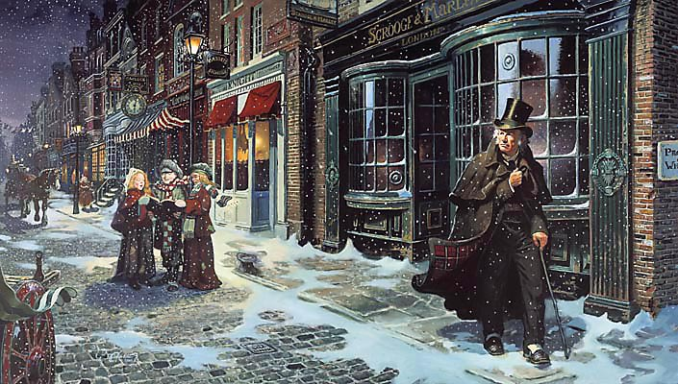
sso
LESSON FIVE

Slide 2
sso
THE GHOST OF CHRISTMAS PAST
Define the following word in your books:
EMPATHY: The ability to understand and share in someone else’s feelings.
EMPATHISE: To share the feelings of another person.
In Stave Two, Dickens shows us a series of events in Scrooge’s life in an attempt to make readers empathise with him. Why would Dickens want us to empathise with Scrooge? Discuss the benefits of making us do this.
How is empathy different to sympathy?
Do Now
Today’s key questions:
Can I confidently explain how Dickens creates empathy for his characters?
Can I explain how a writer uses language to convey key ideas?
Can I link my ideas to the social and historical aspects of ‘A Christmas Carol’?

Slide 3
sso
MATCH THE VOCABULARY TO THEIR DEFINITIONS
cheerful and light-hearted.
with deep and solemn respect.
in low spirits from loss of hope or courage.
completely baffled; very puzzled.
a combination of statements, ideas, or features which are opposed to one another.
PERPLEXED CONTRADICTION REVERENTLY JOCUND DESPONDENT
Unlocking Vocabulary
Today’s key questions:
Can I confidently explain how Dickens creates empathy for his characters?
Can I explain how a writer uses language to convey key ideas?
Can I link my ideas to the social and historical aspects of ‘A Christmas Carol’?

Slide 4
sso
CHECK YOUR ANSWERS:
JOCUND: cheerful and light-hearted.
REVERENTLY: with deep and solemn respect.
DESPONDENT: in low spirits from loss of hope or courage.
PERPLEXED: completely baffled; very puzzled.
CONTRADICTION: a combination of statements, ideas, or features which are opposed to one another.
Answers
Today’s key questions:
Can I confidently explain how Dickens creates empathy for his characters?
Can I explain how a writer uses language to convey key ideas?
Can I link my ideas to the social and historical aspects of ‘A Christmas Carol’?

Slide 5
sso
STAVE 2: The Ghost of Christmas Past
Let’s continue reading from the beginning of Stave Two to ‘Although they had but that moment left the school behind them…’
Reading Activity
Today’s key questions:
Can I confidently explain how Dickens creates empathy for his characters?
Can I explain how a writer uses language to convey key ideas?
Can I link my ideas to the social and historical aspects of ‘A Christmas Carol’?

Slide 6
sso
AO2:
Analyse Language/
Form/Structure
Analyse Dickens’ description of the Ghost of Christmas Past using the correct subject terminology. Answer as annotations around the extract.
In your answers, consider:
Dickens’ purpose
Social/historical context points
Language devices
Word Classes
ALL can attempt analysis of the RED terms.
SOME can attempt analysis of the GREEN terms.
YOUR TASK
It was a strange figure -- like a child: yet not so like a child as like an old man, viewed through some supernatural medium, which gave him the appearance of having receded from the view, and being diminished to a child's proportions. Its hair, which hung about its neck and down its back, was white as if with age; and yet the face had not a wrinkle in it, and the tenderest bloom was on the skin. The arms were very long and muscular; the hands the same, as if its hold were of uncommon strength. Its legs and feet, most delicately formed, were, like those upper members, bare. It wore a tunic of the purest white, and round its waist was bound a lustrous belt, the sheen of which was beautiful. It held a branch of fresh green holly in its hand; and, in singular contradiction of that wintry emblem, had its dress trimmed with summer flowers. But the strangest thing about it was, that from the crown of its head there sprung a bright clear jet of light, by which all this was visible; and which was doubtless the occasion of its using, in its duller moments, a great extinguisher for a cap, which it now held under its arm.
Even this, though, when Scrooge looked at it with increasing steadiness, was not its strangest quality. For as its belt sparkled and glittered now in one part and now in another, and what was light one instant, at another time was dark, so the figure itself fluctuated in its distinctness: being now a thing with one arm, now with one leg, now with twenty legs, now a pair of legs without a head, now a head without a body: of which dissolving parts, no outline would be visible in the dense gloom wherein they melted away. And in the very wonder of this, it would be itself again; distinct and clear as ever.
"Are you the Spirit, sir, whose coming was foretold to me?" asked Scrooge.
"I am."
The voice was soft and gentle. Singularly low, as if instead of being so close beside him, it were at a distance.
Mastery
NOT SURE WHERE TO BEGIN?
Today’s key questions:
Can I confidently explain how Dickens creates empathy for his characters?
Can I explain how a writer uses language to convey key ideas?
Can I link my ideas to the social and historical aspects of ‘A Christmas Carol’?

Slide 7
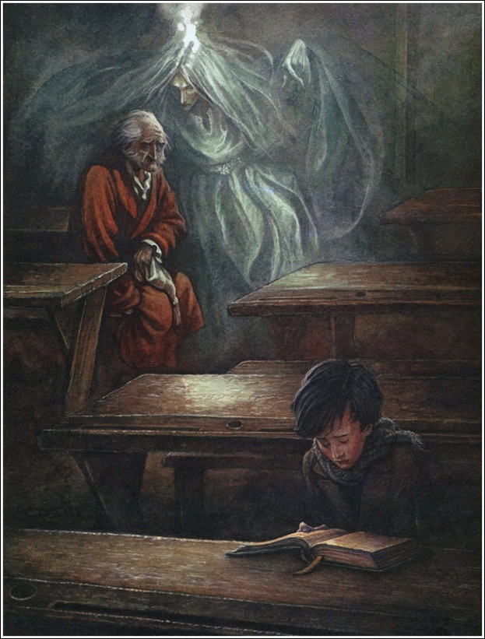
sso
YOUR TASK: Find a quote to answer these questions about Scrooge’s school life.
What do we learn about Scrooge as a student?
What do we learn about Scrooge’s relationship with his parents?
Mastery
What can Scrooge learn from seeing this moment in his past?
How is Scrooge treated in the school community?
Today’s key questions:
Can I confidently explain how Dickens creates empathy for his characters?
Can I explain how a writer uses language to convey key ideas?
Can I link my ideas to the social and historical aspects of ‘A Christmas Carol’?

Slide 8
sso
STAVE 2: The Ghost of Christmas Past
In your opinion, what makes a good boss?
Does Scrooge fulfil your criteria?
Read from ‘Although they had but that moment left the school’ to ‘came upon his feet again without a stagger’.
Reading Activity
Today’s key questions:
Can I confidently explain how Dickens creates empathy for his characters?
Can I explain how a writer uses language to convey key ideas?
Can I link my ideas to the social and historical aspects of ‘A Christmas Carol’?

Slide 9
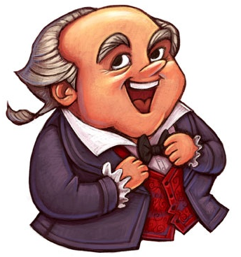
sso
YOUR TASK: FEZZIWIG
Consider WHY Dickens is showing us this stage of Scrooge’s life. How does Fezziwig differ from Scrooge?
Complete the Fezziwig analysis grid.
Mastery
Today’s key questions:
Can I confidently explain how Dickens creates empathy for his characters?
Can I explain how a writer uses language to convey key ideas?
Can I link my ideas to the social and historical aspects of ‘A Christmas Carol’?

Slide 10
sso
YOUR TASK: FEZZIWIG
How does Dickens use language to present Fezziwig as the opposite to Scrooge?
Find quotes to show the difference between Fezziwig and Scrooge for the following:
Description of their personalities
What their businesses are like
How they treat their workers
How they treat visitors
View of Christmas
Mastery
Today’s key questions:
Can I confidently explain how Dickens creates empathy for his characters?
Can I explain how a writer uses language to convey key ideas?
Can I link my ideas to the social and historical aspects of ‘A Christmas Carol’?

Slide 11
sso
YOUR TASK: FEZZIWIG
How does Dickens use language to present Fezziwig as the opposite to Scrooge?
Challenge: Use some the quotations you found to support your answer.
Mastery
Today’s key questions:
Can I confidently explain how Dickens creates empathy for his characters?
Can I explain how a writer uses language to convey key ideas?
Can I link my ideas to the social and historical aspects of ‘A Christmas Carol’?

Slide 12
sso

