Slide 1
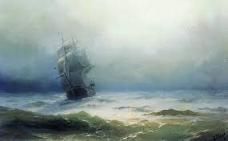
4.
The Tempest
by William Shakespeare
Act 1 Scene 1
LO: To analyse the start of the play.
ST: I can understand Shakespeare’s use of drama to engage an audience.

Slide 2
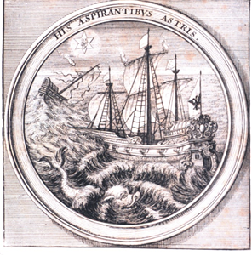
The Tempest – Act 1 Scene 1
Thinking task
The play begins with a storm at sea. The crew of the ship desperately struggle against the strength of the storm whilst the passengers – all noblemen – argue with the crew about their efforts to keep their vessel afloat.

Slide 3
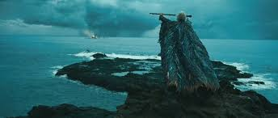
DO NOW!
Let’s read Act 1 scene 1 – pages 1-3
Characters: Boatswain, Master, Alonso, Antonio, Gonzalo, Sebastian

Slide 4
Match the word to the definition.
Unlocking vocabulary
_____________ a man who belongs by rank, title, or birth to the aristocracy; a peer.
_________ a private room or compartment on a ship.
_____________ the events that will necessarily happen to a particular person or thing in the future.
______________ a ship or large boat.
Vessel noblemen
Cabin destiny

Slide 5
Answers! Please give yourself a tick
Unlocking vocabulary
Noblemen a man who belongs by rank, title, or birth to the aristocracy; a peer.
Cabin a private room or compartment on a ship.
Destiny the events that will necessarily happen to a particular person or thing in the future.
Vessel a ship or large boat.

Slide 6
Task: On your extract
Mastery
Highlight all the words and phrases that show:
The strength of the storm
The fears of the crew and their passengers

Slide 7
ACT 1 SCENE 1 :
On a ship at sea; a tempestuous noise of thunder and lightning heard
[Enter a SHIPMASTER and a BOATSWAIN]
MASTER:
Boatswain!
BOATSWAIN:
Here, master: what cheer?
MASTER:
Good! Speak to the mariners: fall to't yarely, or
we run ourselves aground: bestir, bestir.
[Exit]
[Enter MARINERS]
BOATSWAIN:
Hey, my hearts! Cheerly, cheerly, my hearts!
Yare, yare! Take in the topsail. Tend to th' master's
whistle.--Blow till thou burst thy wind, if room enough.
[Enter ALONSO, SEBASTIAN, ANTONIO, FERDINAND, GONZALO, and OTHERS]
ALONSO:
Good boatswain, have care. Where's the master?
Play the men.
BOATSWAIN:
I pray now, keep below.
ANTONIO:
Where is the master, boson?
BOATSWAIN:
Do you not hear him? You mar our labour:
keep your cabins: you do assist the storm.
GONZALO:
Nay, good, be patient.
BOATSWAIN:
When the sea is. Hence! What cares these
roarers for the name of king? To cabin! silence! Trouble
us not.
GONZALO:
Good, yet remember whom thou hast aboard.
BOATSWAIN:
None that I more love than myself. You are
counsellor: if you can command these elements to
silence, and work the peace of the present, we will not
hand a rope more. Use your authority: if you cannot, give thanks you have lived so long, and make yourself ready in your cabin for the mischance of the hour, if it so hap.--Cheerly, good hearts!--Out of our way, I say.
[Exit]
GONZALO:
I have great comfort from this fellow. Methinks
he hath no drowning mark upon him: his complexion is perfect gallows. Stand fast, good Fate, to his hanging!
make the rope of his destiny our cable, for our own doth little advantage! If he be not born to be hang'd, our case is miserable.
[Exeunt]
[Re-enter BOATSWAIN]
BOATSWAIN:
Down with the topmast! yare! lower, lower!
Bring her to try wi' th' maincourse. [A cry within] A plague upon this howling! They are louder than the weather or our office. --
[Re-enter SEBASTIAN, ANTONIO, and GONZALO]
Yet again! What do you here? Shall we give o'er, and
drown? Have you a mind to sink?

Slide 8
SEBASTIAN: A pox o' your throat, you bawling, blasphemous, incharitable dog!
BOATSWAIN: Work you, then.
ANTONIO: Hang, cur, hang! you whoreson, insolent noisemaker, we are less afraid to be drowned than thou art.
GONZALO: I'll warrant him for drowning, though the ship were no stronger than a nutshell, and as leaky as an unstanched wench.
BOATSWAIN: Lay her a-hold, a-hold! set her two courses: off to sea again: lay her off.
[Enter MARINERS, Wet]
MARINERS: All lost! To prayers, to prayers! All lost! [Exeunt]
BOATSWAIN:
What, must our mouths be cold?
GONZALO: The King and Prince at prayers! let us assist them, For our case is as theirs.
SEBASTIAN: I am out of patience.
ANTONIO: We are merely cheated of our lives by drunkards.-- This wide-chapp'd rascal--would thou might'st lie drowning The washing of ten tides!
GONZALO: He'll be hang'd yet, Though every drop of water swear against it, And gape at wid'st to glut him. [A confused noise within:--'Mercy on us!'-- 'We split, we split!'--'Farewell, my wife and children!'-- 'Farewell, brother!'--'We split, we split, we split!'--]
ANTONIO: Let's all sink wi' the King. [Exit]
SEBASTIAN: Let's take leave of him. [Exit]
GONZALO: Now would I give a thousand furlongs of sea for an acre of barren ground - long heath, brown furze, anything.
The wills above be done, but I would fain die dry death. [Exit]

Slide 9
Comprehension: Answer the following questions in your book. Write in FULL sentences!
Mastery
Act 1, Scene 1: Storm!
Who was in charge of the ship during the storm at sea?
Why did Alonso, the king, interfere with the Boatswain’s work in securing the ship during the storm?
Where did the Boatswain tell the king and his courtiers to go?
Who were the first to go to their cabins below the top deck?
What joke does Gonzalo tell concerning the Boatswain?
How does this joke affect the rest of the passengers and crew?
How do Sebastian and Antonio react to the Boatswain?

Slide 10
Extension task: Write a script for the Boatswain and the Master.
Extension
What might they say to each other?
What would they think of the voyage ending like this?
Would they be scared that the Duke may drown?
Who would they blame?

Slide 11
Notes:
Resources: Printable slide

