Slide 1
Narrative writing LO: To write a narrative with a dark twist. So that … I can create a narrative that will come alive for a reader.

Slide 2
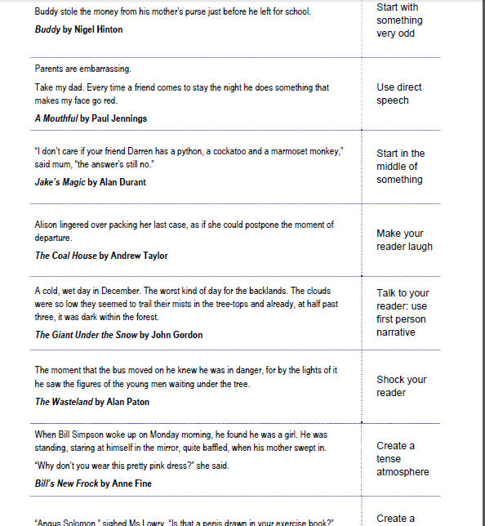
Do Now!
Match the story start with the narrative opening!

Slide 3
Task: Working in pairs think of a story title and brief plot for the next 4 images.

Slide 4
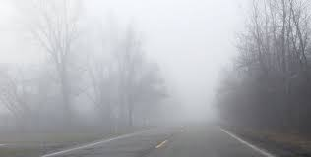

Slide 7
Task: Write a short narrative with a dark twist.
You can use one of these titles or choose one of your own.
Only One Colour
Losing You
A Strange Encounter
Parents are Always Right
A Secret Talent
OR
You can use one of these first lines to help you get started.
As soon as he turned the corner he knew he had made a mistake…
The phone rang loudly, shattering the deathly quiet, the wizened man started with surprise. ..
Rain drops seemed to race down the window, she peered out into the looming darkness of night…
A quiet whimpering came from under the floor boards…
In the cool shadow of the building, he leaned against the wall and waited…
USE THE PLANNING SHEET TO HELP YOU.

Slide 8
Elements to consider when planning your story:
First person or third person narrative?
Choose one or two main characters
Choose one setting
Consider how much time can take place in the story?
Consider the time sequence? Does your story take place in chronological order?
Your story MUST be closely related to your title
Your story MUST be original and interesting

Slide 9
Planning:
Characters: names and descriptions
Plot
Setting: Time and place
Resolution/ ending
Planning
dialogue
Sequence of events
3rd person?
Dramatic irony?

Slide 10
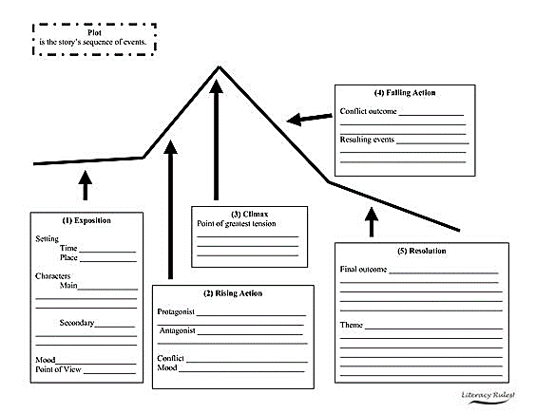

Slide 11
Draft your first paragraph.

Slide 12
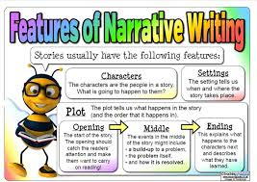
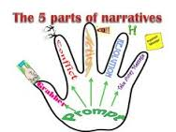
Extension: Carry on with your narrative.

