Slide 1
Learning content
LO: To develop an understanding of Macbeth’s character when he meets the Witches.
ST: I can examine the influence the Witches have on Macbeth.

Slide 2
3 – 2 - 1
DO NOW!
Name 3 things about the setting
Name 2 things that Witches could supposedly do
Name 1 thing about Macbeth's reputation

Slide 3
Match the word to the definition.
Unlocking vocabulary
_____________ a man, often the chief of a clan, who held land from a Scottish king.
_________ a seemingly absurd or contradictory statement or proposition which when investigated may prove to be well founded or true.
__________ say that (a specified thing) will happen in the future.
____________ praise (someone or something) enthusiastically.
Hail Prophesy
Thane Paradox

Slide 4
Answers! Please give yourself a tick
Unlocking vocabulary
Thane a man, often the chief of a clan, who held land from a Scottish king.
Paradox a seemingly absurd or contradictory statement or proposition which when investigated may prove to be well founded or true.
Prophesy say that (a specified thing) will happen in the future.
Hail praise (someone or something) enthusiastically.

Slide 5
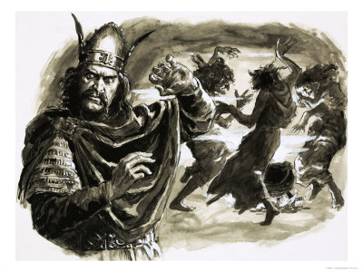
Readers Theatre
Reading task
Task: Read Act 1 Scene 3,
let’s have some volunteer readers!
The following roles need to be read :
Macbeth
Banquo
First Witch
Second Witch
Third Witch
Ross
Angus

Slide 6
Thinking questions
Thinking task
At the end of Act 1, scene 1 the witches say ‘Fair is foul, and foul is fair. Hover through the fog and filthy air’. Similarly, Macbeth enters the play saying ‘So foul and fair a day I have not seen’. Why?
Notes:
Direct students to the fact that this is a paradox and explain why to them.

Slide 7
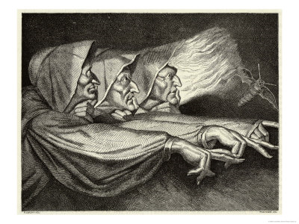
Dramatic Irony
Consolidating knowledge
When the audience knows something that one or more characters does not.
How are the witches predictions to Macbeth an example of dramatic irony?

Slide 8
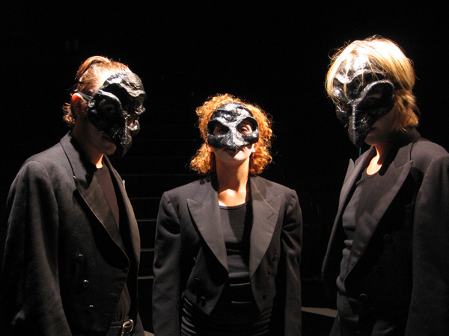
The Three Witches
Mastery
Scene 3 On the moor Thunder. Enter the three Witches.
First Witch: Where hast thou been, sister?
Second Witch: Killing swine.
Third Witch: Sister, where thou?
First Witch: A sailor’s wife had chestnuts in her lap,
And munch’d, and munch’d, and munch’d: ‘Give
me,’ quoth I. ‘Aroint thee, witch!’ the rump-fed runnion cries. Her husband’s to Aleppo gone, master o’the Tiger But in a sieve I’ll thither sail, And, like a rat without tail, I’ll do, I’ll do, and I’ll do.
Second Witch: I’ll give thee a wind,
First Witch: Thou’rt kind.
Third Witch: And I another.
What impression do you get of the Witches?

Slide 9
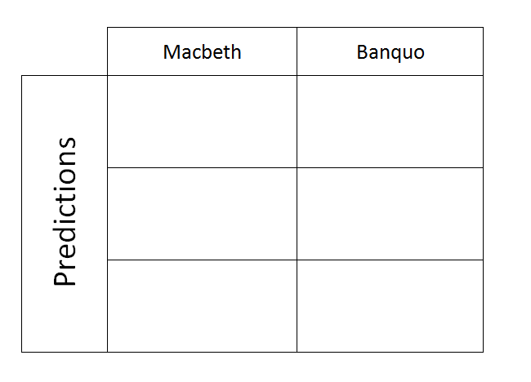
Act 1 Scene 3
Mastery
What predictions do the three Witches make? Draw a template in your book like the one below and copy each quotation into each box.

Slide 10
Extension questions
Extension task
How does Macbeth feel when he hears the predictions?
How does Banquo feel when he hears the predictions for Macbeth?
What do the witches predict for Banquo? What do they mean in modern terms? Whose predictions are better?
Notes:
This could be used as a homework task.

Slide 11
Notes:
Resources: Printable slide for students

