Slide 1
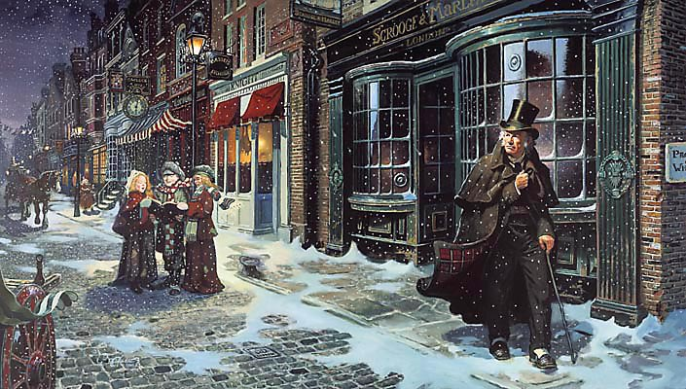
sso
LESSON FOUR
Notes:
By the end of this lesson, you should have finished Stave 1.

Slide 2
sso
MARLEY’S GHOST
STARTER: CONSOLIDATE YOUR KNOWLEDGE
EXTRA CHALLENGE
Define the following terms that we have used in this unit so far. What can you remember?
Answer this question as a paragraph, using at least THREE of the terms in the ‘Consolidate Your Knowledge’ box.
In what literal and figurative ways does Dickens portray Scrooge as isolated—from his family, co-workers, from the rest of humanity, even from himself?
Political diatribe
Stave
Zeitgeist
Allegory
Apathy
Do Now
Miser
Antithesis
Context
Misanthropic
Pathetic Fallacy
Today’s key questions:
Can I confidently explain the allegorical aspects of ‘A Christmas Carol’?
Can I explain how a writer uses language to convey key ideas?
Can I link my ideas to the social and historical aspects of ‘A Christmas Carol’?

Slide 3
sso
MATCH THE VOCABULARY TO THEIR DEFINITIONS
unwilling or unable to believe something.
impossible to pass through or enter.
(of something regarded as unpleasant) continuing without pause or interruption.
unable to be explained or accounted for.
hesitancy; uncertainty.
IMPENETRABLE IRRESOLUTION INEXPLICABLE INCREDULOUS INCESSANT
Unlocking Vocabulary
Today’s key questions:
Can I confidently explain the allegorical aspects of ‘A Christmas Carol’?
Can I explain how a writer uses language to convey key ideas?
Can I link my ideas to the social and historical aspects of ‘A Christmas Carol’?

Slide 4
sso
CHECK YOUR ANSWERS:
INCREDULOUS: unwilling or unable to believe something.
IMPENETRABLE: impossible to pass through or enter.
INCESSANT: (of something regarded as unpleasant) continuing without pause or interruption.
INEXPLICABLE: unable to be explained or accounted for.
IRRESOLUTION: hesitancy; uncertainty.
Answers
Today’s key questions:
Can I confidently explain the allegorical aspects of ‘A Christmas Carol’?
Can I explain how a writer uses language to convey key ideas?
Can I link my ideas to the social and historical aspects of ‘A Christmas Carol’?

Slide 5
YOUR TASK
AO1/AO2/AO3
Read from the paragraph beginning, ‘Now, it is a fact…’ to the end of Stave One.
Consider the LITERATURE assessment objectives as you answer so you know exactly what to discuss.
AO1: Read, understand and respond to texts. Students should be able to:
• maintain a critical style and develop an informed personal response
• use textual references, including quotations, to support and illustrate
interpretations.
AO2: Analyse the language, form and structure used by a writer to create meanings and effects, using relevant subject terminology where appropriate.
AO3: Show understanding of the relationships between texts and the contexts in which they were written.
Reading Activity
WHAT ARE THE AOs?
Today’s key questions:
Can I confidently explain the allegorical aspects of ‘A Christmas Carol’?
Can I explain how a writer uses language to convey key ideas?
Can I link my ideas to the social and historical aspects of ‘A Christmas Carol’?

Slide 6
sso
AO2:
Analyse Language/
Form/Structure
Analyse Dickens’ description of Marley’s Ghost using the correct subject terminology. Answer as annotations around the extract.
In your answers, consider:
Dickens’ purpose
Social/historical context points
Language devices
Word Classes
ALL can attempt analysis of the RED terms.
SOME can attempt analysis of the GREEN terms.
YOUR TASK
You now have THREE minutes to talk to as many people in the room as you can.
Try and steal at least FOUR ideas and add them to your annotations around the extract.
His colour changed though, when, without a pause, it came on through the heavy door, and passed into the room before his eyes. Upon its coming in, the dying flame leaped up, as though it cried, ``I know him! Marley's Ghost!'' and fell again.
The same face: the very same. Marley in his pigtail, usual waistcoat, tights, and boots; the tassels on the latter bristling, like his pigtail, and his coat-skirts, and the hair upon his head. The chain he drew was clasped about his middle. It was long, and wound about him like a tail; and it was made (for Scrooge observed it closely) of cash-boxes, keys, padlocks, ledgers, deeds, and heavy purses wrought in steel. His body was transparent; so that Scrooge, observing him, and looking through his waistcoat, could see the two buttons on his coat behind.
Scrooge had often heard it said that Marley had no bowels, but he had never believed it until now.
No, nor did he believe it even now. Though he looked the phantom through and through, and saw it standing before him; though he felt the chilling influence of its death-cold eyes; and marked the very texture of the folded kerchief bound about its head and chin, which wrapper he had not observed before; he was still incredulous, and fought against his senses.
``How now!'' said Scrooge, caustic and cold as ever. ``What do you want with me?'‘
``Much!'' -- Marley's voice, no doubt about it.
Mastery
NOT SURE WHERE TO BEGIN?
Today’s key questions:
Can I confidently explain the allegorical aspects of ‘A Christmas Carol’?
Can I explain how a writer uses language to convey key ideas?
Can I link my ideas to the social and historical aspects of ‘A Christmas Carol’?

Slide 7
sso
An impressive comment made by someone in the class was…
TO FINISH
The most important thing I have learned today is...
Today, I have learnt...
Choose a number!
1
2
3
4
An interesting idea about the text that I heard today was…
Today, I was successful when...
Checking Understanding
5
6
7
8
The hardest thing to understand about the text was…
To improve further, I need to…
One point I still do not understand is…
Notes:
Choose a student to start the plenary. Give him/her a choice of number. Click on the number, and one of the speech bubbles will change colour. The student then reads out the sentence and completes it in an appropriate manner. He/She may then choose who goes next!

Slide 8
sso
YOUR TASK: YOUR CHOICE
AO1/AO2/AO3
INCREASING CHALLENGE
‘Marley’s Ghost was a vehicle for Dickens to promote social change in the middle and upper class people who ignored the plight of the poor.
Where can you find evidence to support this idea in the section we have read?
Write PETER paragraphs with clear comments about Dickens’ message and concerns and his overall aims.
How does Dickens use language to describe Marley’s ghost?
Answer the question using quotations from the previous task.
How does Dickens present Marley’s ghost and the similarities to Scrooge?
Answer the question using quotations from the previous task.
Mastery
Today’s key questions:
Can I identify key language devices and explain the effect they have on a reader?
Can I evaluate the effectiveness of language and explain the writer’s purpose through his language choices?

Slide 9
sso
HOW DOES DICKENS USE LANGUAGE TO PRESENT MARLEY’S GHOST?
ANNOTATE THE EXTRACT WITH PETER.
Effectively, Dickens presents Marley’s Ghost as a tortured character in: ‘The chain he drew was clasped about his middle. ’The noun ‘chain’ suggests he is restrained and trapped by his past actions when he was alive and working as a businessman with Scrooge. The verb ‘clasped’ sounds aggressive and painful, therefore hinting that he is tortured and tormented by the decisions he made and the attitudes he displayed to the poor people. The chain is a symbol of his business affairs and pursuit of wealth when he was alive. Like Scrooge, he focused on enriching his own life and not that of others. As a result, he is forced to wear the chain as a reminder about how he neglected others and in the hope of encouraging redemption in Scrooge. Without a doubt, Dickens was demonstrating how the wealthy people were consumed by greed and money irrespective of the needs of others ….
Model Answer
Today’s key questions:
Can I identify key language devices and explain the effect they have on a reader?
Can I evaluate the effectiveness of language and explain the writer’s purpose through his language choices?
Notes:
Example answer if needed

Slide 10
sso

