Slide 1
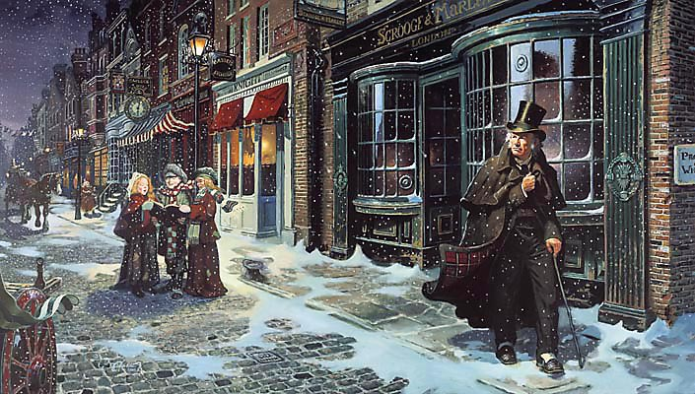
sso
LESSON FOUR
Notes:
By the end of this lesson, you should have finished Stave 1.

Slide 2
sso
MATCH THE VOCABULARY TO THEIR DEFINITIONS
unwilling or unable to believe something.
impossible to pass through or enter.
(of something regarded as unpleasant) continuing without pause or interruption.
unable to be explained or accounted for.
hesitancy; uncertainty.
IMPENETRABLE IRRESOLUTION INEXPLICABLE INCREDULOUS INCESSANT
Unlocking Vocabulary
Today’s key questions:
Can I confidently explain the allegorical aspects of ‘A Christmas Carol’?
Can I explain how a writer uses language to convey key ideas?
Can I link my ideas to the social and historical aspects of ‘A Christmas Carol’?

Slide 3
sso
CHECK YOUR ANSWERS:
INCREDULOUS: unwilling or unable to believe something.
IMPENETRABLE: impossible to pass through or enter.
INCESSANT: (of something regarded as unpleasant) continuing without pause or interruption.
INEXPLICABLE: unable to be explained or accounted for.
IRRESOLUTION: hesitancy; uncertainty.
Answers
Today’s key questions:
Can I confidently explain the allegorical aspects of ‘A Christmas Carol’?
Can I explain how a writer uses language to convey key ideas?
Can I link my ideas to the social and historical aspects of ‘A Christmas Carol’?

Slide 4
YOUR TASK
AO1/AO2/AO3
Read from the paragraph beginning, ‘Now, it is a fact…’ to the end of Stave One. Answer the questions as you go along in as much detail as you can.
Consider the LITERATURE assessment objectives as you answer so you know exactly what to discuss.
AO1: Read, understand and respond to texts. Students should be able to:
• maintain a critical style and develop an informed personal response
• use textual references, including quotations, to support and illustrate
interpretations.
AO2: Analyse the language, form and structure used by a writer to create meanings and effects, using relevant subject terminology where appropriate.
AO3: Show understanding of the relationships between texts and the contexts in which they were written.
Reading Activity
WHAT ARE THE AOs?
Today’s key questions:
Can I confidently explain the allegorical aspects of ‘A Christmas Carol’?
Can I explain how a writer uses language to convey key ideas?
Can I link my ideas to the social and historical aspects of ‘A Christmas Carol’?

Slide 5
sso
AO2:
Analyse Language/
Form/Structure
Analyse Dickens’ description of Marley’s Ghost using the correct subject terminology. Answer as annotations around the extract.
In your answers, consider:
Dickens’ purpose
Social/historical context points
Language devices
Word Classes
ALL can attempt analysis of the RED terms.
SOME can attempt analysis of the GREEN terms.
YOUR TASK
His colour changed though, when, without a pause, it came on through the heavy door, and passed into the room before his eyes. Upon its coming in, the dying flame leaped up, as though it cried, ``I know him! Marley's Ghost!'' and fell again.
The same face: the very same. Marley in his pigtail, usual waistcoat, tights, and boots; the tassels on the latter bristling, like his pigtail, and his coat-skirts, and the hair upon his head. The chain he drew was clasped about his middle. It was long, and wound about him like a tail; and it was made (for Scrooge observed it closely) of cash-boxes, keys, padlocks, ledgers, deeds, and heavy purses wrought in steel. His body was transparent; so that Scrooge, observing him, and looking through his waistcoat, could see the two buttons on his coat behind.
Scrooge had often heard it said that Marley had no bowels, but he had never believed it until now.
No, nor did he believe it even now. Though he looked the phantom through and through, and saw it standing before him; though he felt the chilling influence of its death-cold eyes; and marked the very texture of the folded kerchief bound about its head and chin, which wrapper he had not observed before; he was still incredulous, and fought against his senses.
``How now!'' said Scrooge, caustic and cold as ever. ``What do you want with me?'‘
``Much!'' -- Marley's voice, no doubt about it.
Mastery
NOT SURE WHERE TO BEGIN?
Today’s key questions:
Can I confidently explain the allegorical aspects of ‘A Christmas Carol’?
Can I explain how a writer uses language to convey key ideas?
Can I link my ideas to the social and historical aspects of ‘A Christmas Carol’?

Slide 6
sso
AO2:
Analyse Language/
Form/Structure
How is the ghost of Marley presented in the text?
Write two PETER paragraphs to answer the question.
YOUR TASK
Marley is presented as ______________________
The text says “_____________________________”.
This ______________
Suggests _________________________________
It makes the reader think Marley_______________
Mastery
Today’s key questions:
Can I confidently explain the allegorical aspects of ‘A Christmas Carol’?
Can I explain how a writer uses language to convey key ideas?
Can I link my ideas to the social and historical aspects of ‘A Christmas Carol’?

Slide 7
sso

