Slide 1
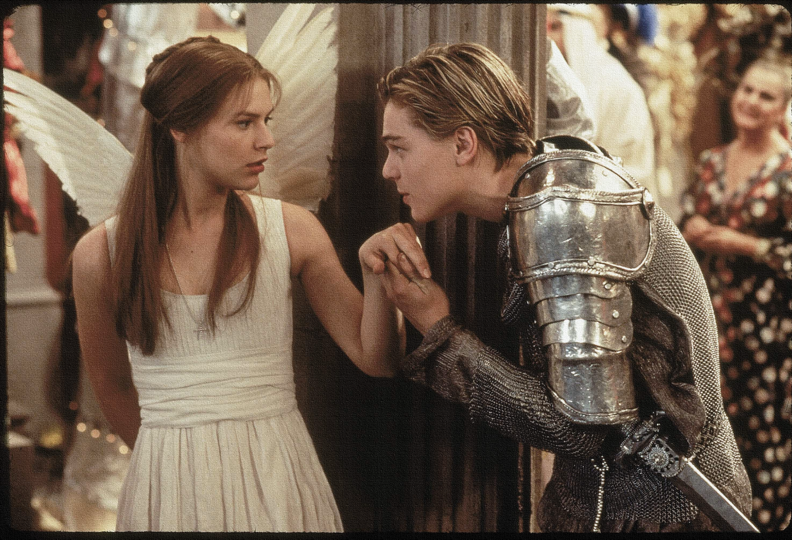
Key Words:
Patriarchal rule
Woo
Naïve
Pragmatic
Wet nurse
Lesson 4 –
Act 1, Scene 2/3.
Differing Views of Love
Success Criteria:
To use textual evidence to explore a character’s views/ personality.
To use contextual knowledge to support interpretations.
To use contextual knowledge to infer and deduce a character’s viewpoint.
‘Romeo + Juliet’
Learning Objective:
AO1: use textual references, including quotations, to support and illustrate interpretations.
Notes:
Lesson 4

Slide 2
Write today’s date - Tuesday, 24 March 2020 and today’s title – Romeo and Juliet Revision in your book
The next FOUR slides show KEY quotes, EXPLODE each quote and analyse in depth.
Do Now

Slide 3
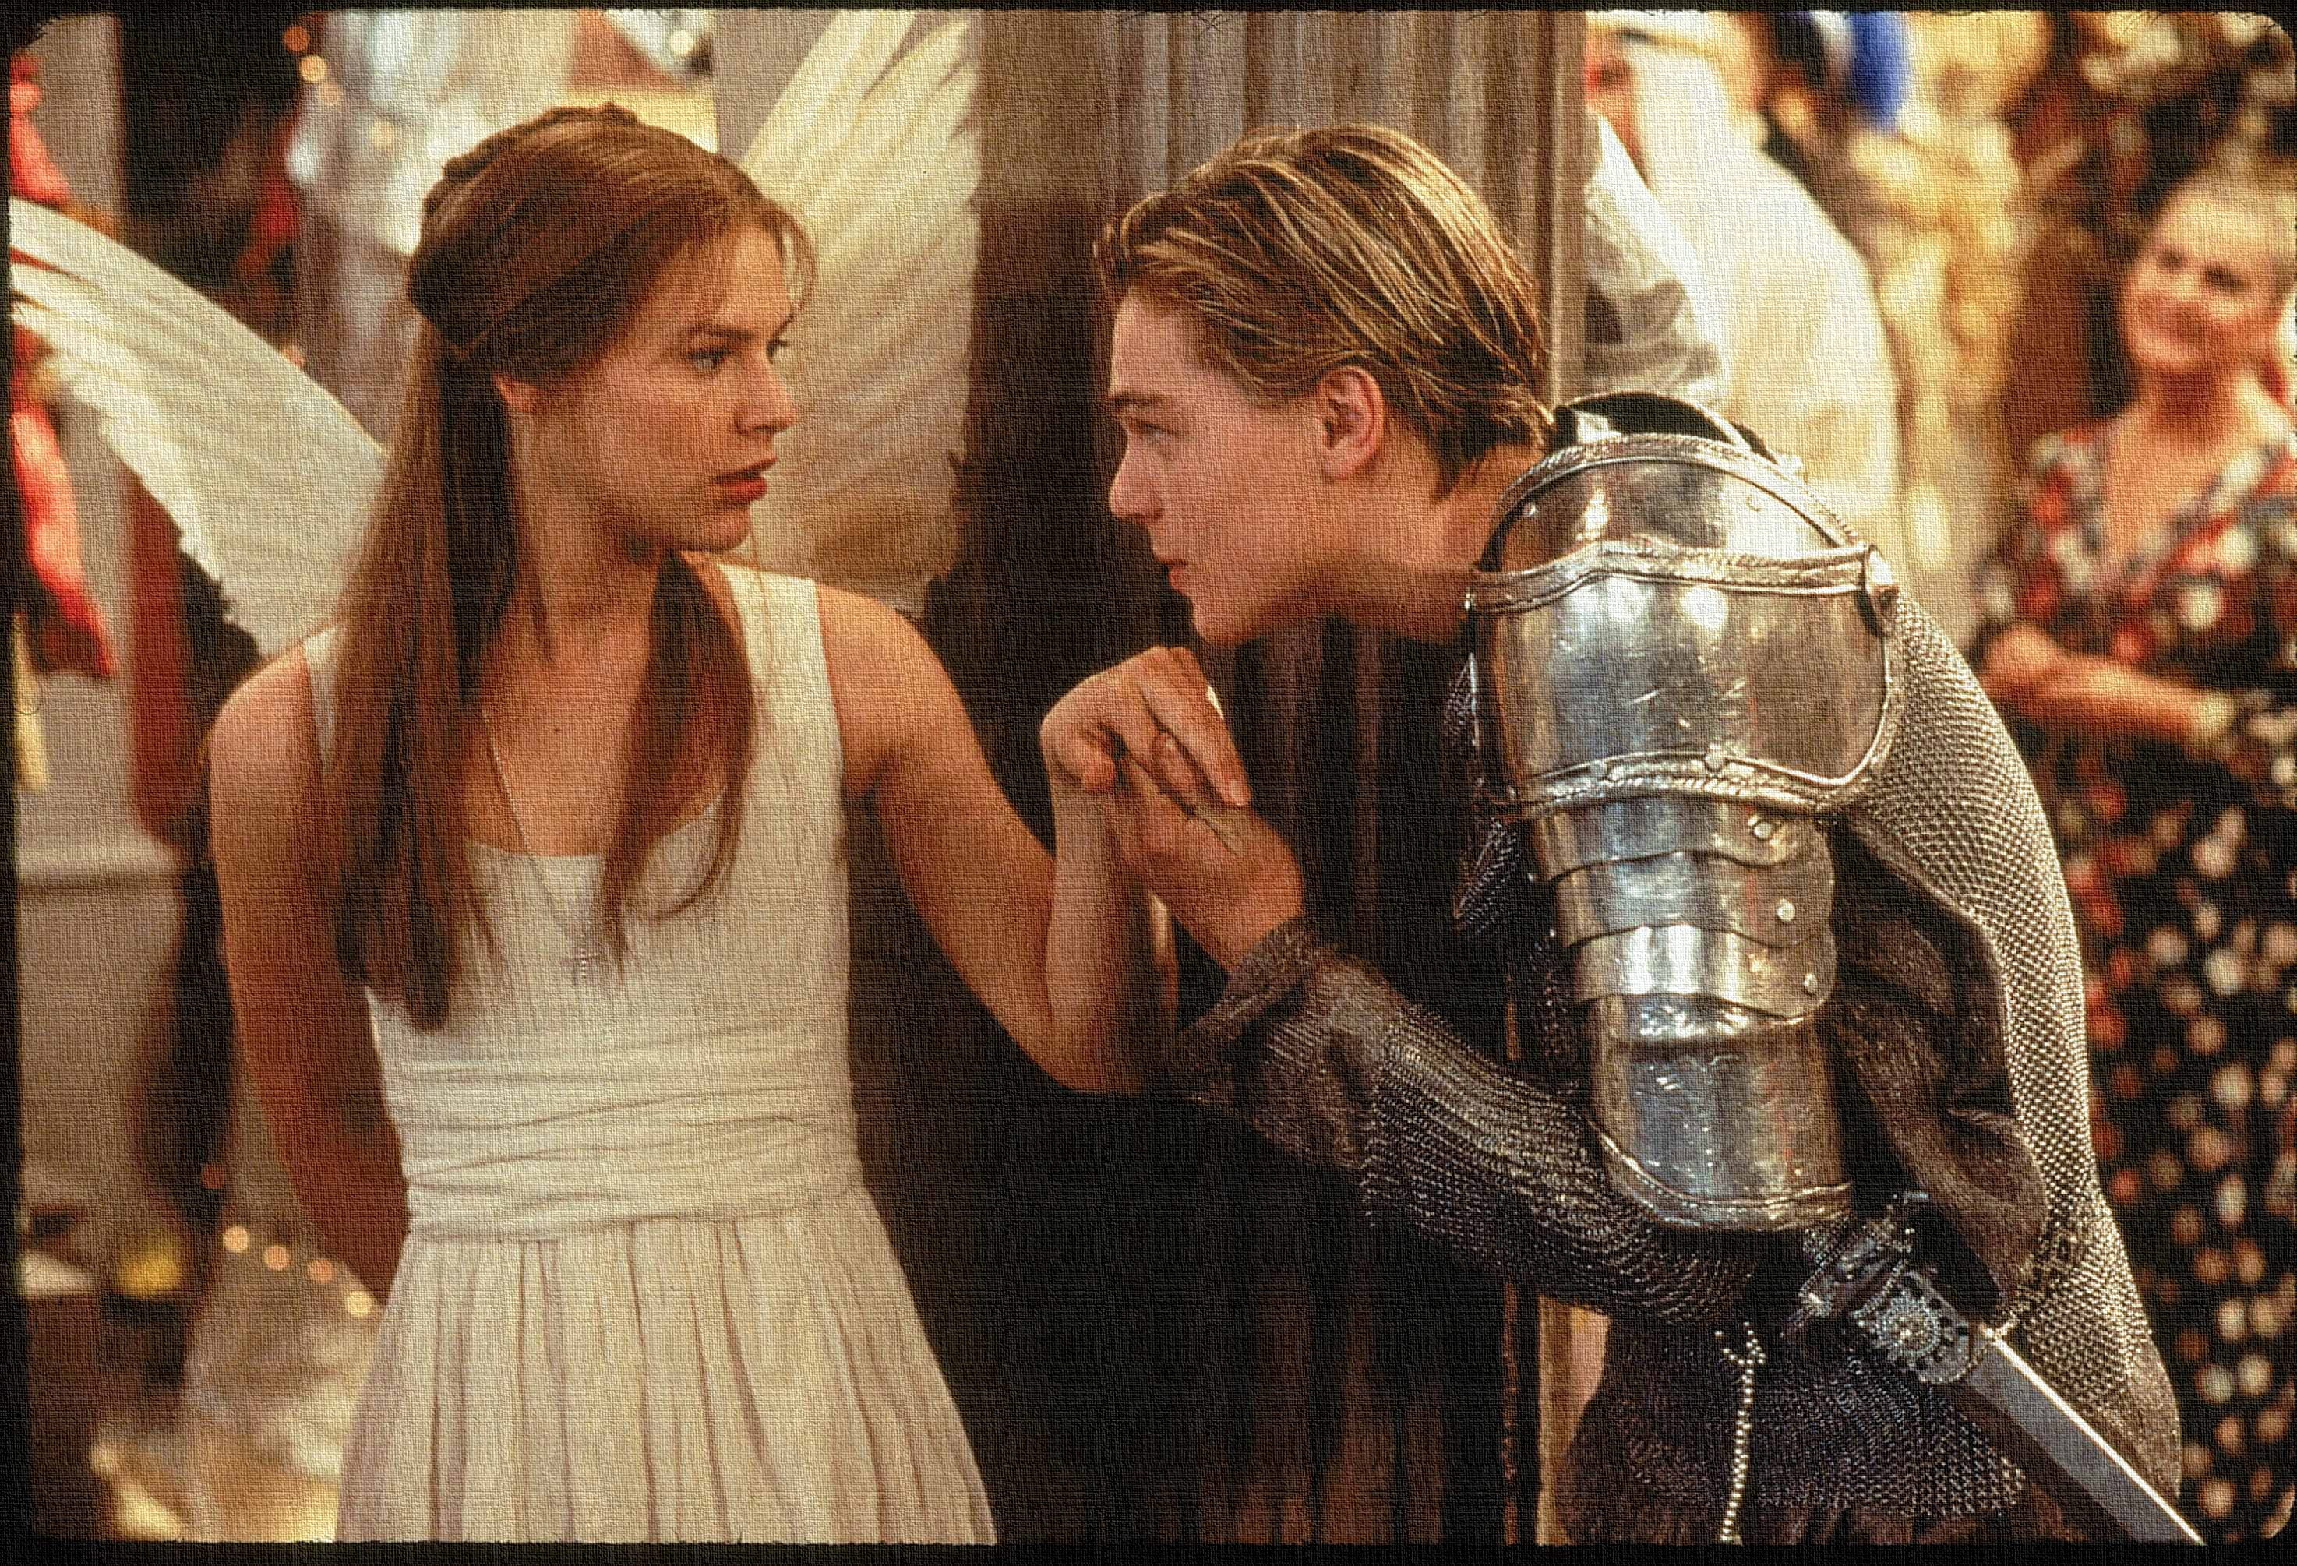
“Earth hath swallowed all my hopes but she; She is the hopeful lady of my earth”
What does this show about how Lord Capulet feels towards his daughter?
Do Now
Learning Objective:
AO1: use textual references, including quotations, to support and illustrate interpretations.

Slide 4
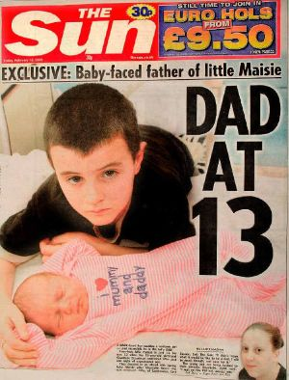
LORD CAPULET: “Let two more summers wither in their pride, Ere we may think her ripe to be a bride” PARIS: “Younger than her are happy mothers made”
What does this show about how Lord Capulet feels towards his daughter?
Do Now
Learning Objective:
AO1: use textual references, including quotations, to support and illustrate interpretations.

Slide 5
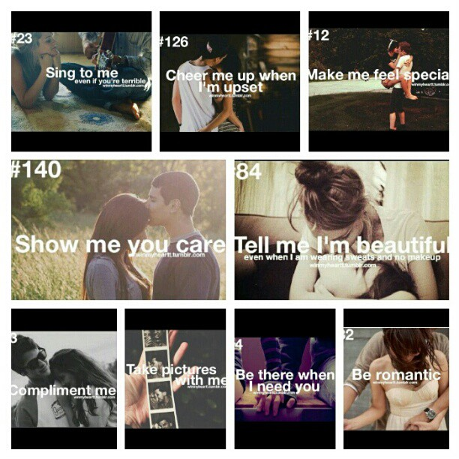
“But woo her, gentle Paris, get her heart: My will to her consent is but a part”
What does this show about how Lord Capulet feels towards his daughter?
Do Now
Learning Objective:
AO1: use textual references, including quotations, to support and illustrate interpretations.

Slide 6
Read the keywords and match their definition: Write them in your books
Showing a lack of experience, wisdom, or judgement.
Naive
Woo
Try to gain the love of (someone), especially with a view to marriage.
Unlocking vocabulary
Pragmatic
a woman employed to suckle another woman's child.
Wet nurse
dealing with things sensibly and realistically
Relating to or denoting a system of society or government controlled by men.
Patriarchal rule

Slide 7
ANSWERS!
Showing a lack of experience, wisdom, or judgement.
Naive
Woo
Try to gain the love of (someone), especially with a view to marriage.
Pragmatic
Unlocking vocabulary
a woman employed to suckle another woman's child.
Wet nurse
dealing with things sensibly and realistically
Relating to or denoting a system of society or government controlled by men.
Patriarchal rule

Slide 8
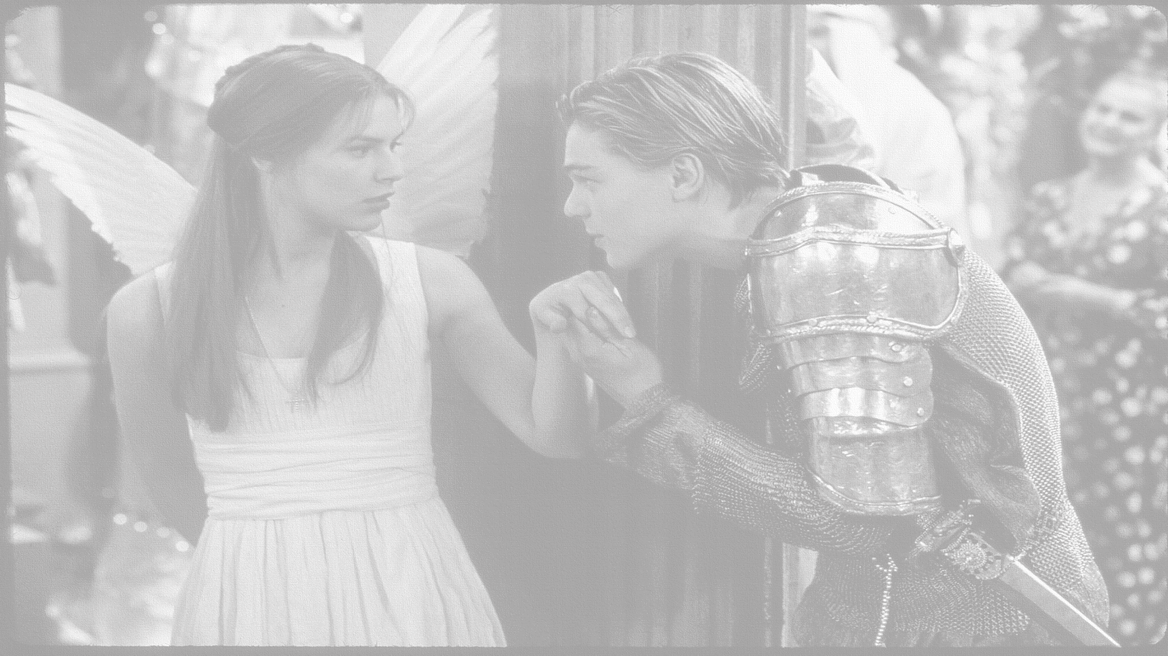
How does Shakespeare show differing views of love in Act 1, scene 3?
In this lesson you will be mastering the following:
To use textual evidence to explore a character’s views/ personality.
To use contextual knowledge to support interpretations.
To use contextual knowledge to infer and deduce a character’s viewpoint.
Learning Content
Notes:
This – as with all aspects of the lesson – can be edited to suit your group.

Slide 9
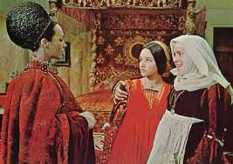
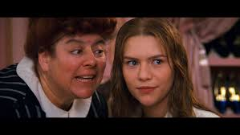
Read Act 1 scene 3
Lady Capulet:
Juliet:
Nurse:
Serving man:
Reading task

Slide 10
Think: When Lady Capulet asks Juliet how she feels about being married, what is Juliet’s answer (line 67), and what does it reveal about her character?
LADY CAPULET
Marry, that 'marry' is the very theme
I came to talk of. Tell me, daughter Juliet,
How stands your disposition to be married?
JULIET
It is an honour that I dream not of.
Nurse
An honour! were not I thine only nurse,
I would say thou hadst suck'd wisdom from thy teat.
LADY CAPULET
Well, think of marriage now; younger than you,
Here in Verona, ladies of esteem,
Are made already mothers: by my count,
I was your mother much upon these years
That you are now a maid. Thus then in brief:
The valiant Paris seeks you for his love.
Nurse
A man, young lady! lady, such a man
As all the world--why, he's a man of wax.
LADY CAPULET
Verona's summer hath not such a flower.
Nurse
Nay, he's a flower; in faith, a very flower.
LADY CAPULET
What say you? can you love the gentleman?
This night you shall behold him at our feast;
Read o'er the volume of young Paris' face,
And find delight writ there with beauty's pen;
Examine every married lineament,
And see how one another lends content
And what obscured in this fair volume lies
Find written in the margent of his eyes.
This precious book of love, this unbound lover,
To beautify him, only lacks a cover:
The fish lives in the sea, and 'tis much pride
For fair without the fair within to hide:
That book in many's eyes doth share the glory,
That in gold clasps locks in the golden story;
So shall you share all that he doth possess,
By having him, making yourself no less.
Nurse
No less! nay, bigger; women grow by men.
LADY CAPULET
Speak briefly, can you like of Paris' love?
JULIET
I'll look to like, if looking liking move:
But no more deep will I endart mine eye
Than your consent gives strength to make it fly.
Act 1 Scene 3
Consider:
Juliet, Lady Capulet and The Nurse’s relationship. What do we learn from this scene? Extension - Why do you think the Nurse has a different view on marriage to Lady Capulet?
Transform: How is Lady Capulet seen as an ineffectual mother, relying on the Nurse for moral and pragmatic support?
Mastery
Prioritise: Choose your top five quotes from this part of the play and explode them with:
Meaning/Effect
Exploration of the context that links & why
Zooming in on a word in the quote
Use triplets to develop your ideas
Focus on context/ theme/tone
Exploration of the connotations
Criticise: Lady Capulet makes marriage sound like an easy, quick undertaking.
Is this the case? Why might Juliet feel apprehensive?
Notes:
Print this slide off for students to work through. Annotate ideas on board with them first. Ask students to stick this in a double page and write around this.

Slide 11
Challenge Question: What do these reactions tell you about how love was viewed by the different classes?
AO3: Show understanding of the relationships between texts and the contexts in which they were written.
1. Look at lines 62-63. What is the nurse’s one wish for Juliet and why?
2. When Lady Capulet asks Juliet how she feels about being married, what is Juliet’s answer (line 67), and what does it reveal about her character?
The nurse and Lady Capulet are both excited and pleased by Paris’ proposal but for different reasons.
The nurse says Paris is “a man of wax” and at the end of the scene encourages Juliet to “Go, girl, seek happy nights to happy days.”
What does the nurse see in Paris, and what does it reveal about her attitude towards love and marriage?
Extension - Find another quotation from the Nurse that shows what she thinks is important in a man.
4. What does Lady Capulet see in Paris that would make him a good match for Juliet? What is Lady Capulet’s attitude towards love and marriage?
Extension - Why do you think the Nurse has a different view on marriage to Lady Capulet?
5. Look at lines 98-100. What is Juliet's attitude toward love and marriage?
Extension - Explain Juliet’s answer to her mother when asked if she can love Paris. What does it reveal about her knowledge of being in love? Is her reaction normal for the time?
Extension Task
Learning Objective:
AO1: use textual references, including quotations, to support and illustrate interpretations.
Notes:
This can be used for homework as an alternative.

Slide 12
Homework
Mind-map all you can about the Nurse and how she is a pivotal/comedic character.
Homework
Notes:
Homework is optional - Print off this slide to give out as homework.

