Slide 1
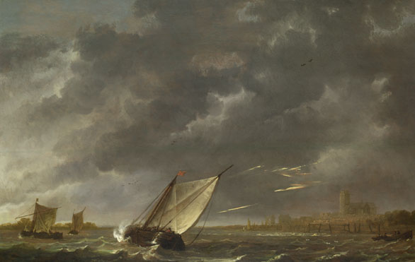
The Tempest
3.
LO: To introduce the characters of the play.
ST: I can understand who is who in the play.

Slide 2
DO NOW!
The Tempest in short!
https://www.youtube.com/watch?v=ovTnJFz3eNM
This is a very brief outline of the play we are going to study.

Slide 3
Match the word to the definition.
Unlocking vocabulary
_____________ being the place or environment in which a person was born or a thing came into being.
_____________ not domesticated or under human control : untamed.
_____________ relating to, using, or resembling magic.
______________ have as belonging to one; own.
Possesses Magical savage native

Slide 4
Answers! Please give yourself a tick
Unlocking vocabulary
Native being the place or environment in which a person was born or a thing came into being.
Savage not domesticated or under human control : untamed.
Magical relating to, using, or resembling magic.
Possesses have as belonging to one; own.

Slide 5
Starter: Who can name this music?
Thinking task
https://www.youtube.com/watch?v=qc8OsZt_dqw

Slide 6
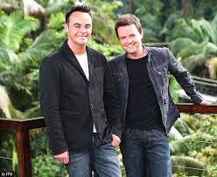
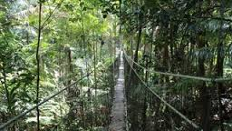
Your task: Who stays? Who goes?
Mastery
From the characters listed on your handouts you must decide who you will vote to stay on the island? Why? You can only choose FOUR characters to stay. Make your own selections then compare your answers with others!
https://www.youtube.com/watch?v=2IOwCvcUZq8
Longer intro!

Slide 7
 | A young teenager who has lived with her father on the island since she was a baby. She has never experienced life in the ‘real’ world. | To vote for Miranda text MIRANDA to 0811 810
 | Once a butler to a rich, powerful man. Likes a drink and can often be found staggering around in a drunken haze. Dreams of being as powerful as his master. | To vote for Stephano text STEPHANO to 0811 811
 | A clown. Likes to keep people entertained with his comments and daft behaviour, but is rather afraid of the island. | To vote for Trinculo text TRINCULO to 0811 812
 | A native of the island. Looks like a cross between a man and a fish and smells like one too! Uses foul language, but – if you can capture and tame him – could be your servant. Knows a lot about survival on the island. | To vote for Caliban text CALIBAN to 0811 813

Slide 8
 | A mysterious spirit with the ability to fly and become invisible. Feels trapped by the island and unable to leave until released. With the promise of freedom, Ariel will be a loyal and obedient servant. | To vote for Ariel text Ariel to 0811 814
 | A king who is desperately worried about his lost son, who is missing, presumed dead. Prone to depression and black moods. | To vote for Alonso text ALONSO to 0811 815
 | An honest old man – Gonzalo looks on the bright side of life and tries to cheer people up. Always makes the best of a situation. | To vote for Gonzalo text GONZALO to 0811 816
 | A good-looking teenage boy, Ferdinand is the kind of young man who easily falls in love. Nevertheless, he is hard working and motivated. | To vote for Ferdinand text FERDINAND to 0811 817
 | A Duke, Antonio came by his title by getting rid of his brother who was Duke before him. Antonio is selfish and devious; he will do anything to get what he wants. | To vote for Antonio text ANTONIO to 0811 818
 | Sebastian’s brother is king – something he envies. He can be cruel and ridicule others. He is easily influenced and seems not to care about what is right and wrong. | To vote for Sebastian text SEBASTIAN to 0811 819

Slide 9
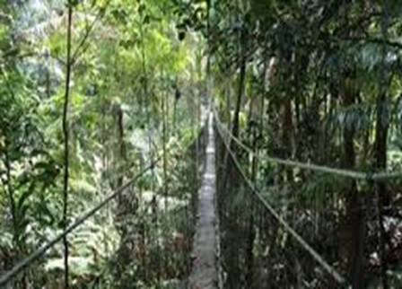
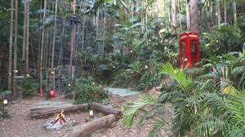
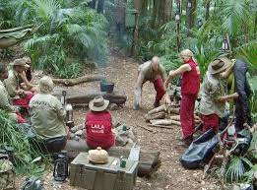
Feedback with your reasons; now let’s count up the votes!
Checking understanding

Slide 10
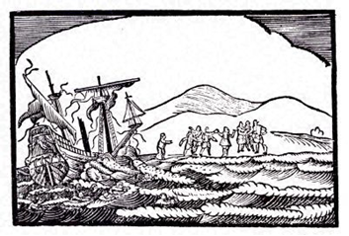
Task: The characters.
Mastery
In your books record the following details of the characters in The Tempest.
PROSPERO - the rightful Duke of Milan
MIRANDA - Daughter to Prospero
ARIEL - an airy Spirit
CALIBAN - a savage and deformed Slave
ALONSO - King of Naples
FERDINAND - Son to Alonso, the King of Naples SEBASTIAN - Alonso’s Brother ANTONIO - Prospero’s Brother, the usurping Duke of Milan GONZALO - an honest old counsellor ADRIAN - Lord FRANCISCO - Lord TRINCULO - a Jester STEPHANO - a drunken Butler
MASTER OF A SHIP BOATSWAIN (pronounced Bo' sun) MARINERS

Slide 11
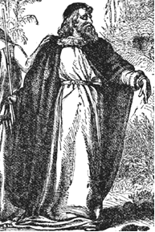
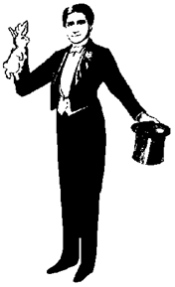
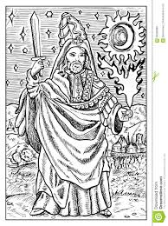
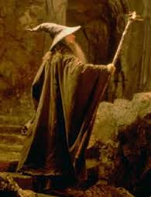
A Magical Island with a Magical Character . . .
Consolidating knowledge
Prospero possesses magical powers. What characteristics, appearance and skills do you associate with a magician? Use the pictures below to brainstorm your ideas. Record them in a mind-map in your books.

Slide 12
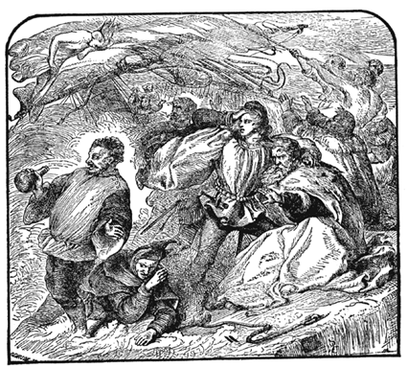
Extension task
Extension Task:
Now that you know who the characters are in the play, have you changed your mind as to what the play may be about? (Think back to our last lesson) Make an informed prediction using your knowledge of the characters.

Slide 13
Notes:
Resources: Printable slide

Slide 14
 | A young teenager who has lived with her father on the island since she was a baby. She has never experienced life in the ‘real’ world. | To vote for Miranda text MIRANDA to 0811 810
 | Once a butler to a rich, powerful man. Likes a drink and can often be found staggering around in a drunken haze. Dreams of being as powerful as his master. | To vote for Stephano text STEPHANO to 0811 811
 | A clown. Likes to keep people entertained with his comments and daft behaviour, but is rather afraid of the island. | To vote for Trinculo text TRINCULO to 0811 812
 | A native of the island. Looks like a cross between a man and a fish and smells like one too! Uses foul language, but – if you can capture and tame him – could be your servant. Knows a lot about survival on the island. | To vote for Caliban text CALIBAN to 0811 813
 | A mysterious spirit with the ability to fly and become invisible. Feels trapped by the island and unable to leave until released. With the promise of freedom, Ariel will be a loyal and obedient servant. | To vote for Ariel text Ariel to 0811 814
 | A king who is desperately worried about his lost son, who is missing, presumed dead. Prone to depression and black moods. | To vote for Alonso text ALONSO to 0811 815
 | An honest old man – Gonzalo looks on the bright side of life and tries to cheer people up. Always makes the best of a situation. | To vote for Gonzalo text GONZALO to 0811 816
 | A good-looking teenage boy, Ferdinand is the kind of young man who easily falls in love. Nevertheless, he is hard working and motivated. | To vote for Ferdinand text FERDINAND to 0811 817
 | A Duke, Antonio came by his title by getting rid of his brother who was Duke before him. Antonio is selfish and devious; he will do anything to get what he wants. | To vote for Antonio text ANTONIO to 0811 818
 | Sebastian’s brother is king – something he envies. He can be cruel and ridicule others. He is easily influenced and seems not to care about what is right and wrong. | To vote for Sebastian text SEBASTIAN to 0811 819

