Slide 1
Learning content
LO: To explore the opening of the play.
ST: I can analyse Act 1 Scene 1 & 2.

Slide 2
Starter
DO NOW!
If you wanted to set an eerie and foreboding scene, how would you set it up?
Where would it take place?
When (time of day) would it take place?
What effects would you use?

Slide 3
Match the word to the definition.
Unlocking vocabulary
_____________ a forecast.
_________ the medieval knightly system with its religious, moral, and social code.
_____________ the beliefs or opinions that are generally held about someone or something.
____________ a feeling that something bad will happen; fearful apprehension.
Foreboding Prediction
Chivalry Reputation

Slide 4
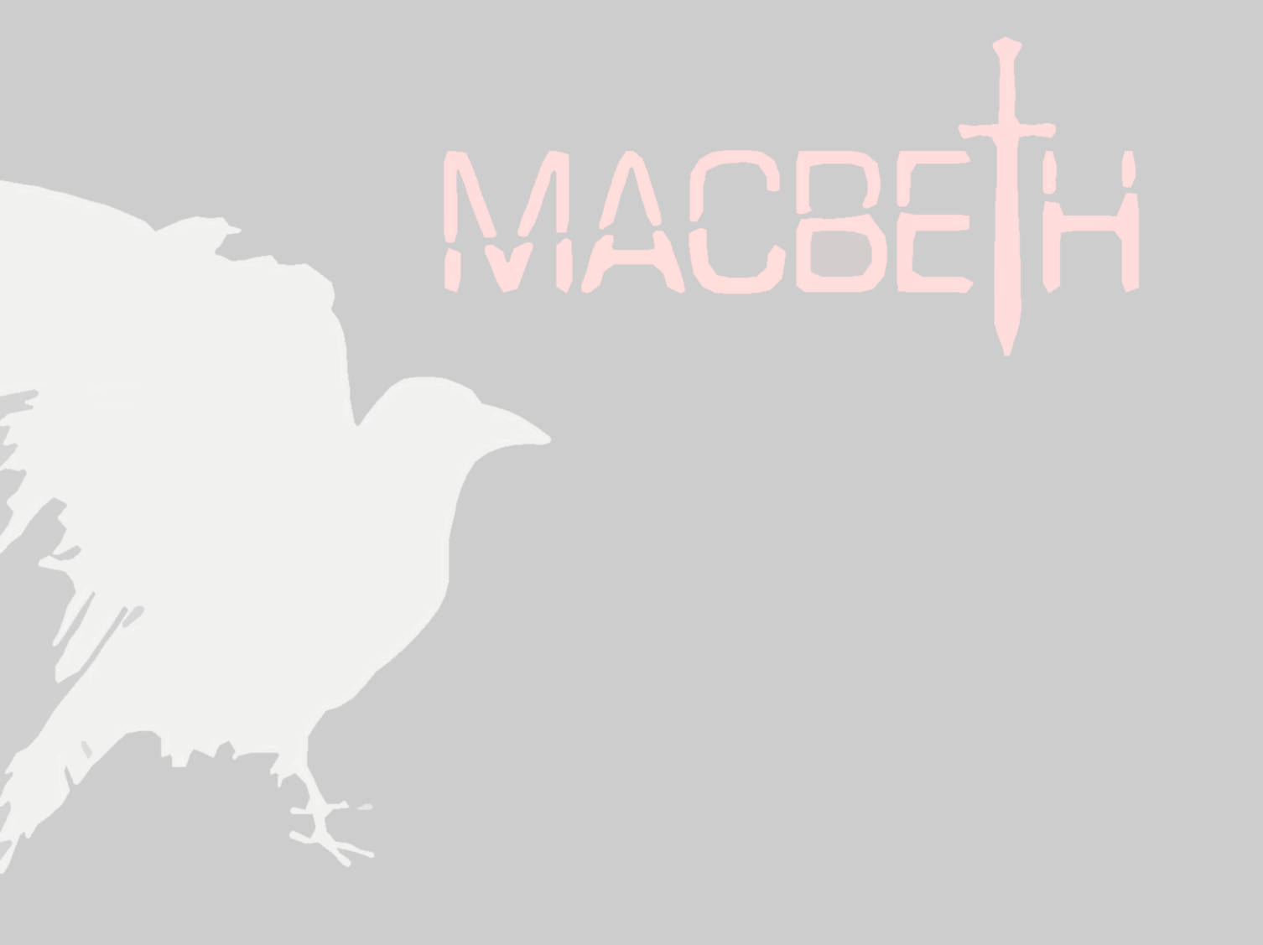
Answers! Please give yourself a tick
Unlocking vocabulary
Prediction a forecast.
Chivalry the medieval knightly system with its religious, moral, and social code.
Reputation the beliefs or opinions that are generally held about someone or something.
Foreboding a feeling that something bad will happen; fearful apprehension.

Slide 5
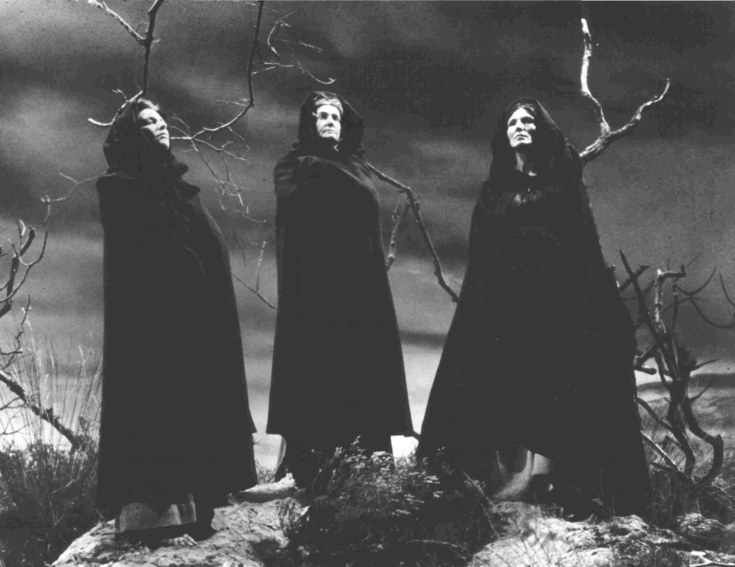
Scene 1: The Setting
Thinking task
The scene starts on a moor.
The three witches enter to thunder and lightening.
What does this tell you about the action that is to follow?

Slide 6
A note on reading Shakespeare
Consolidating knowledge
If you look beside the words in the script, you should notice small numbers that increase by 5. These are line numbers.
Numbering the lines allows us to easily discuss specific parts of the play, and it is important that you keep track of the line numbers during discussions.
Therefore, when we read plays, we do not refer to page numbers, but to the Act, Scene and line number.

Slide 7
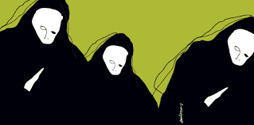
Let’s have some volunteer readers!
Reading task
For this scene (it is very short!), I need three volunteers to read:
First Witch
Second Witch
Third Witch

Slide 8
Questions: Please write them as one detailed paragraph.
Mastery
When do the witches plan to meet again?
Where do they plan to meet?
Who do they want to meet with?
Why do you suppose they want to meet Macbeth?
What are your predictions for what will take place at that meeting?
What impression do you get of the witches from this initial scene?

Slide 9
Act 1, scene 2
Reading task
For this scene we will need the following roles for reading:
Duncan
Malcolm
Captain
Lennox
Ross

Slide 10
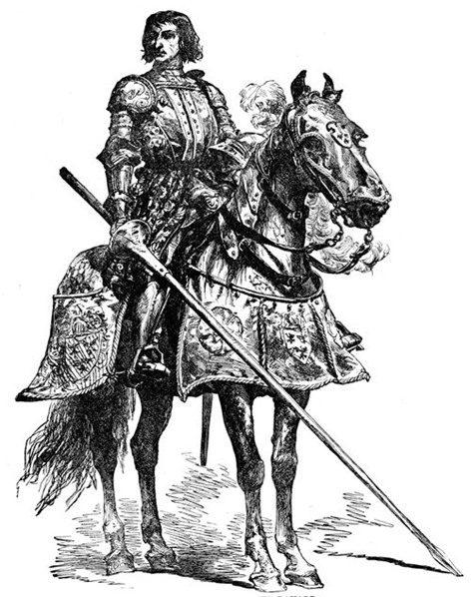
Exploring Chivalry & Macbeth’s reputation
Mastery
Glue the Chivalry worksheet into your exercise book
Highlight the five most important facts
Create the table below and fill out the quotations from scene 2 that help to create a picture of Macbeth’s reputation:
Quotation | Inference

Slide 11
Macbeth’s Reputation
Consolidating knowledge
Quotation: What we are told | Inference: what this reveals about Macbeth

Slide 12
Plenary: Macbeth’s Reputation
Consolidating knowledge
Quotation: What we are told | Inference: what this reveals about Macbeth
“brave Macbeth – well he deserve that name” | Macbeth is incredibly brave and impresses the other soldiers with his fighting skill.
“carved out his passage till he faced the slave … and fixed his head upon our battlements” | Macbeth is a vicious warrior and not only defeats his opponents, but (ironically) punishes traitorous behaviour.
“redoubled strokes upon the foe” | Macbeth is tireless in his defence of his friends and his King’s land.
“noble Macbeth have won” | Macbeth is recognised as a great warrior and a chivalrous man by the King.

Slide 13
Extension questions
Extension task
What is the purpose of this scene?
How is Macbeth described? Why has Shakespeare had the other characters describe Macbeth in this way?
Using a full page in your book, record all information about Macbeth
What does this scene foreshadow?

Slide 14
Notes:
Resources: Printable slide for students

