Slide 1
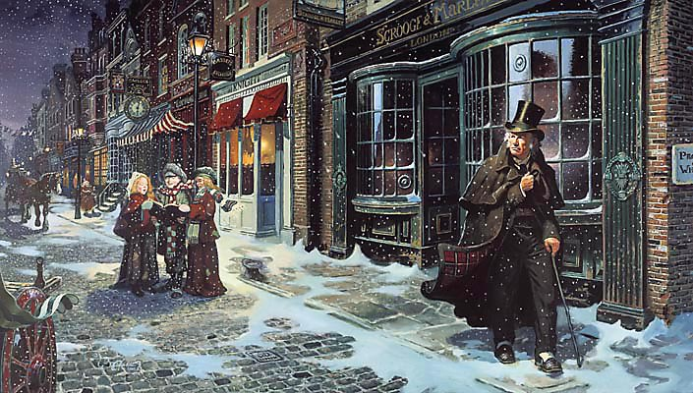
sso
LESSON THREE

Slide 2
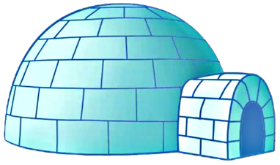
sso
AO1:
Read/Understand/
Respond
The Theme of Coldness in Stave One
Come up with FIVE synonyms for ‘COLD’ on your table.
Now discuss the following with others in your group:
How does the idea of coldness link to this text?
What do you associate with coldness?
What might be the effect of using cold imagery in the novel?
Do Now
EXTRA
CHALLENGE
Answer the following question in your books:
How does Dickens use pathetic fallacy to reflect the miserly, misanthropic characteristics of Scrooge?
Today’s key questions:
Can I identify key language devices and explain the effect they have on a reader?
Can I evaluate the effectiveness of language and explain the writer’s purpose through his language choices?

Slide 3
sso
MATCH THE VOCABULARY TO THEIR DEFINITIONS
shaking or quivering slightly
having a stout body; somewhat fat (used especially of a man)
having or showing a dislike of other people; unsociable
causing a mood of gloom or depression.
DISMAL PORTLY TREMULOUS MISANTHROPIC
Unlocking Vocabulary
Today’s key questions:
Can I identify key language devices and explain the effect they have on a reader?
Can I evaluate the effectiveness of language and explain the writer’s purpose through his language choices?

Slide 4
sso
CHECK YOUR ANSWERS:
TREMULOUS: shaking or quivering slightly
PORTLY: having a stout body; somewhat fat (used especially of a man)
MISANTHROPIC: having or showing a dislike of other people; unsociable
DISMAL: causing a mood of gloom or depression.
Answers
Today’s key questions:
Can I identify key language devices and explain the effect they have on a reader?
Can I evaluate the effectiveness of language and explain the writer’s purpose through his language choices?

Slide 5
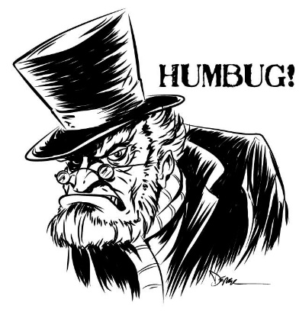
sso
AO1:
Read/Understand/
Respond
YOUR TASK
TASK ONE: Draw a line down the middle of a brand new page in your book. Label the left half PHYSICAL COLDNESS and the right, METAPHORICAL COLDNESS.
TASK TWO: Scan from the beginning of the text to ‘mournful meditation on the threshold.’ How many references to the cold weather you can find?
TASK THREE: Choose three quotations you have found and add them to the left hand side of your page. Give yourself space to write around them so you can annotate it later.
Physical Coldness
Metaphorical
Coldness
Reading Activity
Today’s key questions:
Can I identify key language devices and explain the effect they have on a reader?
Can I evaluate the effectiveness of language and explain the writer’s purpose through his language choices?

Slide 6
sso
QUOTATIONS YOU COULD USE FOR PHYSICAL COLDNESS
‘Scrooge had a very small fire, but the clerk’s fire was so very much smaller that it looked like one coal’.
‘the clerk…tried to warm himself at the candle.’
‘Piercing, searching, biting cold.’
The cold became intense.’
Referring to the church clock) ‘…struck the hour and quarters in the clouds, with tremulous vibrations afterwards, as if its teeth were chattering in its frozen head…’
Checking Understanding
Today’s key questions:
Can I identify key language devices and explain the effect they have on a reader?
Can I evaluate the effectiveness of language and explain the writer’s purpose through his language choices?
Notes:
SEN sheet if needed

Slide 7
sso
AO2:
Analyse Language/
Form/Structure
YOUR TASK
Annotate the quotations you have found like the example below. Don’t forget to consider the success criteria that will help you analyse the quotations to GCSE standards.
SUCCESS CRITERIA
The use of ‘in the clouds’ suggests the tower is high as well as the density of the fog.
Have I…
made a clear point?
explained why Dickens has made certain language choices?
discussed the effect of these language choices?
discussed multiple interpretations of my ideas?
discussed the effect on the reader?
Here Dickens conveys the intensity of the cold be making it sound as if even inanimate objects are affected.
Mastery
(Referring to the church clock) ‘…struck the hour and quarters in the clouds, with tremulous vibrations afterwards, as if its teeth were chattering in its frozen head…’
The verb ‘chattering’ helps us to understand how the sound of the bell echoes after it has rung but the sound seems broken up as if the clock is trembling.
The use of personification ‘frozen head’ and the simile ‘teeth... chattering’ make the reader feel sorry for the clock as it seems to be suffering in the cold.
Today’s key questions:
Can I identify key language devices and explain the effect they have on a reader?
Can I evaluate the effectiveness of language and explain the writer’s purpose through his language choices?

Slide 8
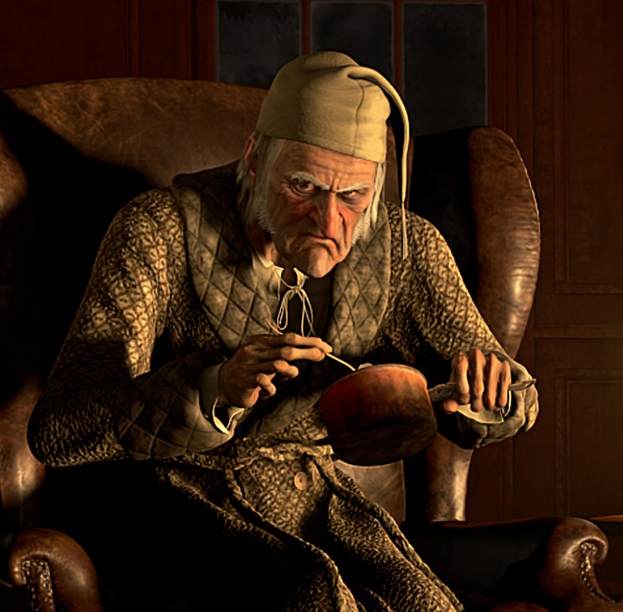
sso
AO2:
Analyse Language/
Form/Structure
YOUR TASK
We have identified examples of physical coldness. How can coldness be seen as metaphorical?
SUCCESS CRITERIA
So the cold is used by Dickens to describe the physical environment, but it also mirrors the cruel and unsympathetic attitude of Scrooge to others.
Look again at the same section of text to identify any words/phrases which indicate how cold, unfeeling and cruel Scrooge can be.
Add at least 3 quotations (on the right hand side of the paper) which shows the ‘coldness’ of Scrooge and annotate it as you did before.
Have I…
made a clear point?
explained why Dickens has made certain language choices?
discussed the effect of these language choices?
discussed multiple interpretations of my ideas?
discussed the effect on the reader?
Mastery
Today’s key questions:
Can I identify key language devices and explain the effect they have on a reader?
Can I evaluate the effectiveness of language and explain the writer’s purpose through his language choices?

Slide 9
sso
QUOTATIONS YOU COULD USE FOR METAPHORICAL COLDNESS. LOOK THEM UP AND THINK ABOUT HOW THEY SHOW SCROOGE BEING COLD AND UNKIND TO OTHERS.
‘What reason have you to be merry, you’re poor enough’.
‘Are there no prisons?’
‘If they would rather die,’ said Scrooge, ‘they had better do it and decrease the surplus population.’
‘It’s not my business.’
‘You’ll want all day tomorrow, I suppose?’ said Scrooge.’
Checking Understanding
Today’s key questions:
Can I identify key language devices and explain the effect they have on a reader?
Can I evaluate the effectiveness of language and explain the writer’s purpose through his language choices?
Notes:
SEN sheet if needed

Slide 10
sso
YOUR TASK: YOUR CHOICE
AO1/AO2/AO3
INCREASING CHALLENGE
‘The power of light and music to shine through the winter gloom is a visual way of showing the moral of this story. It suggests that even though cruelty seems to reign, the goodness embodied by the Christmas message can always find a way through, through the fog, through the keyhole. Scrooge, however, aggressively fights it off.’
Where can you find evidence to support this idea in the section we have read?
Look for images of colour, light or warmth – literal or metaphorical. Write these down in your book.
How does Dickens use the weather to establish the mood and atmosphere at the beginning of the novel?
Answer the question using quotations from the previous task.
How does Dickens present Scrooge as a cold character?
Answer the question using quotations from the previous task.
Mastery
Today’s key questions:
Can I identify key language devices and explain the effect they have on a reader?
Can I evaluate the effectiveness of language and explain the writer’s purpose through his language choices?

Slide 11
sso
HOW DOES DICKENS PRESENT SCROOGE AS A COLD CHARACTER?
Dickens presents Scrooge as a character who doesn’t care about anyone else. He is only worried about looking after his business so that he continues making money. When he is asked to give money to the poor he suggests that there are workhouses they can go to. When he is told that some of them would rather die than go to a workhouse, he says:
‘If they would rather die,’ said Scrooge, ‘they had better do it and decrease the surplus population.’
This shows how cold and unfeeling he is. The words ‘better do it’ suggests that he feels no concern that people would prefer death to a workhouse. It almost sounds as if he is encouraging them. He even sees it as a positive thing as it means there would be no ‘surplus’ of people.
Model Answer
Today’s key questions:
Can I identify key language devices and explain the effect they have on a reader?
Can I evaluate the effectiveness of language and explain the writer’s purpose through his language choices?
Notes:
Example answer if needed

Slide 12
sso
HOW DOES DICKENS PRESENT SCROOGE AS A COLD CHARACTER?
WRITING FRAME
Dickens presents Scrooge as ………………….. This is particularly clear when he is talking to Bob Cratchit about having Christmas day off work. He says:
‘You’ll want all day tomorrow, I suppose?’
This gives us the impression that…………………………………………
The words ‘I suppose’ suggest that…………………………………………
Overall, this creates the impression that Scrooge is…………….
Writing Task
Today’s key questions:
Can I identify key language devices and explain the effect they have on a reader?
Can I evaluate the effectiveness of language and explain the writer’s purpose through his language choices?
Notes:
Example answer if needed

Slide 13
sso
Extension Task
Answer one of the following questions as an essay. Aim to write 1 ½ to 2 sides of A4.
EITHER:
How does Dickens use descriptions of the cold weather to powerful effect at the beginning of the novel?
OR:
2. How does Dickens use the idea of coldness at the beginning of the novel?
OR:
(Only choose this if you completed Task 3)
3. How and why does Dickens present a contrast between warmth and cold and light and dark at the beginning of the novel?
Extension Task
Today’s key questions:
Can I identify key language devices and explain the effect they have on a reader?
Can I evaluate the effectiveness of language and explain the writer’s purpose through his language choices?
Notes:
Alternative Homework

Slide 14
sso

