Slide 1
Lesson 3: cicero & speeches
LO: To understand how and why speeches are used and their impact.

Slide 2
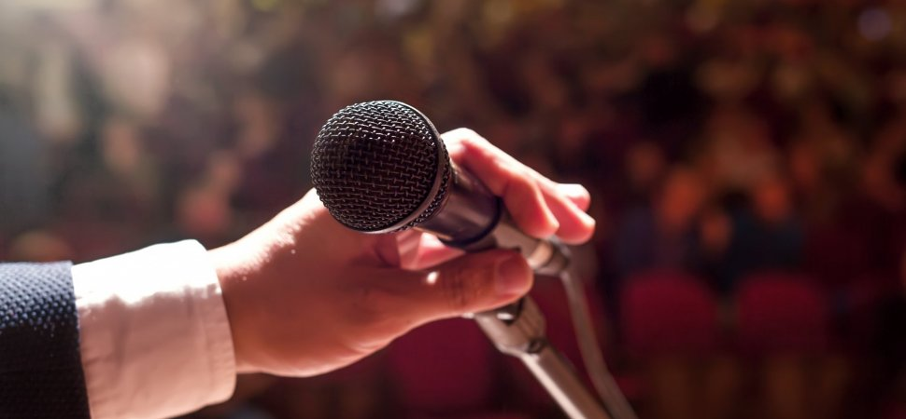
Starter cicero & speeches
Create a 1 minute speech about an aspect of school you’d like to change.
Do Now
Any
volunteers to read theirs?
LO: To understand how and why speeches are used and their impact.

Slide 3
ADD TO YOUR timeline
‘I’ve been to the Mountain Top speech’ Martin Luther King (1968)
Ancient Literature
Middle Ages/ Renaissance
The Georgians & Victorians
The Twentieth Century
Representing change
Draw It
Cicero ‘To the Citizens after his return’ (57BC)
Today our primary extract is by famous Roman orator Cicero. It was performed on his return to Rome in 77BC, where he addresses the people. Our secondary extract is by Martin Luther King. It is an extract from his famous ‘I’ve been to the mountain top’ speech (1968) in which he encourages the black community to overcome their struggles for equality.
LO: To understand how and why speeches are used and their impact.

Slide 4
Match the key vocabulary to the definitions
Agreement or harmony between people or groups.
A public speaker, especially one who is eloquent or skilled.
One of the two annually elected chief magistrates who jointly ruled the republic.
A state in which power is held by the people and their elected representatives, and which has an elected president rather than a monarch.
The refusal to comply with certain laws considered unjust, as a peaceful form of political protest.
Unlocking Vocabulary
Consul Orator Civil Disobedience Concord Republic
LO: To understand how and why speeches are used and their impact.
Notes:
Can be printed for students.

Slide 5
Check Your answers:
CONCORD: Agreement or harmony between people or groups.
ORATOR: A public speaker, especially one who is eloquent or skilled.
CONSUL: One of the two annually elected chief magistrates who jointly ruled the republic.
REPUBLIC: A state in which power is held by the people and their elected representatives, and which has an elected president rather than a monarch.
CIVIL DISOBEDIENCE: The refusal to comply with certain laws considered unjust, as a peaceful form of political protest.
Answers
LO: To understand how and why speeches are used and their impact.

Slide 6
Marcus Tullius CICERO
Marcus Tullius Cicero was a Roman politician and lawyer, who served as consul in the year 63 BC. He is considered one of Rome's greatest orators and prose writers.
In 58BC, Cicero was exiled after a disagreement with Caesar.
He returned the following year but continued to have a disruptive political career. He was assassinated in 43BC.
Contextual Information
LO: To understand how and why speeches are used and their impact.

Slide 7
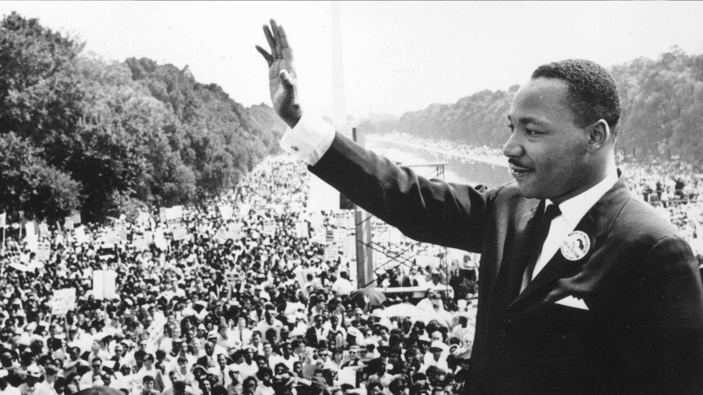
MARTIN LUTHER KING jr
Martin Luther King Jr., 1929 –1968) was an American Baptist minister and activist who became the most visible spokesperson and leader in the Civil Rights Movement.
He is best known for his role in the advancement of civil rights using the tactics of nonviolence and civil disobedience based on his Christian beliefs.
In 1968, King was planning a national occupation of Washington, D.C., to be called the Poor People's Campaign, when he was assassinated by James Earl Ray on April 4 in Memphis, Tennessee
Contextual Information
LO: To understand how and why speeches are used and their impact.

Slide 8
How are cicero and mlk similar?
Checking Understanding
Cicero
&
MLK
LO: To understand how and why speeches are used and their impact.
Notes:
Students to create a mind map of ideas before feeding back.

Slide 9
What makes a powerful speech?
As you watch the following two speeches make notes on:
The content – what are they trying to persuade you about?
The choice of language
The use of persuasive devices
The use of structure in the speech
Mastery
LO: To understand how and why speeches are used and their impact.

Slide 10
Notes:
Winston Churchill German Surrender: Watch and discuss https://youtu.be/sizo0APsLkY?list=PL4A1446D924B9C895

Slide 11
Notes:
MLK I have a dream: Watch and discuss https://youtu.be/3vDWWy4CMhE

Slide 12
What makes a powerful speech? FEEDBACK
As you watch the following two speeches make notes on:
The content – what are they trying to persuade you about?
The choice of language
The use of persuasive devices
The use of structure in the speech
Mastery
LO: To understand how and why speeches are used and their impact.
Notes:
Discuss both videos with students – were there any similarities between them?

Slide 13
CICERO & MLK BOOKLETS: P5
In pairs, read the speeches out loud to each other in the way you think they would have been said.
What similarities/differences are there?
What words have the most impact? Why? What devices do Cicero and MLK use to get their ideas across?
Mastery
LO: To understand how and why speeches are used and their impact.

Slide 14
How are cicero and mlk similar?
PLENARY: ADD TO YOUR EARLIER MINDMAP IN A DIFFERENT COLOUR
Checking Understanding
Cicero
&
MLK
LO: To understand how and why speeches are used and their impact.

Slide 15
Starter: Revisited
Think about the four different speeches we have looked at. How would you now edit your speech from the starter activity based on what you have learnt today?
Things to consider:
The content – what references/allusions could you use?
The choice of language
The use of persuasive devices
The use of structure in the speech
Extension Task
LO: To understand how and why speeches are used and their impact.

