Slide 1
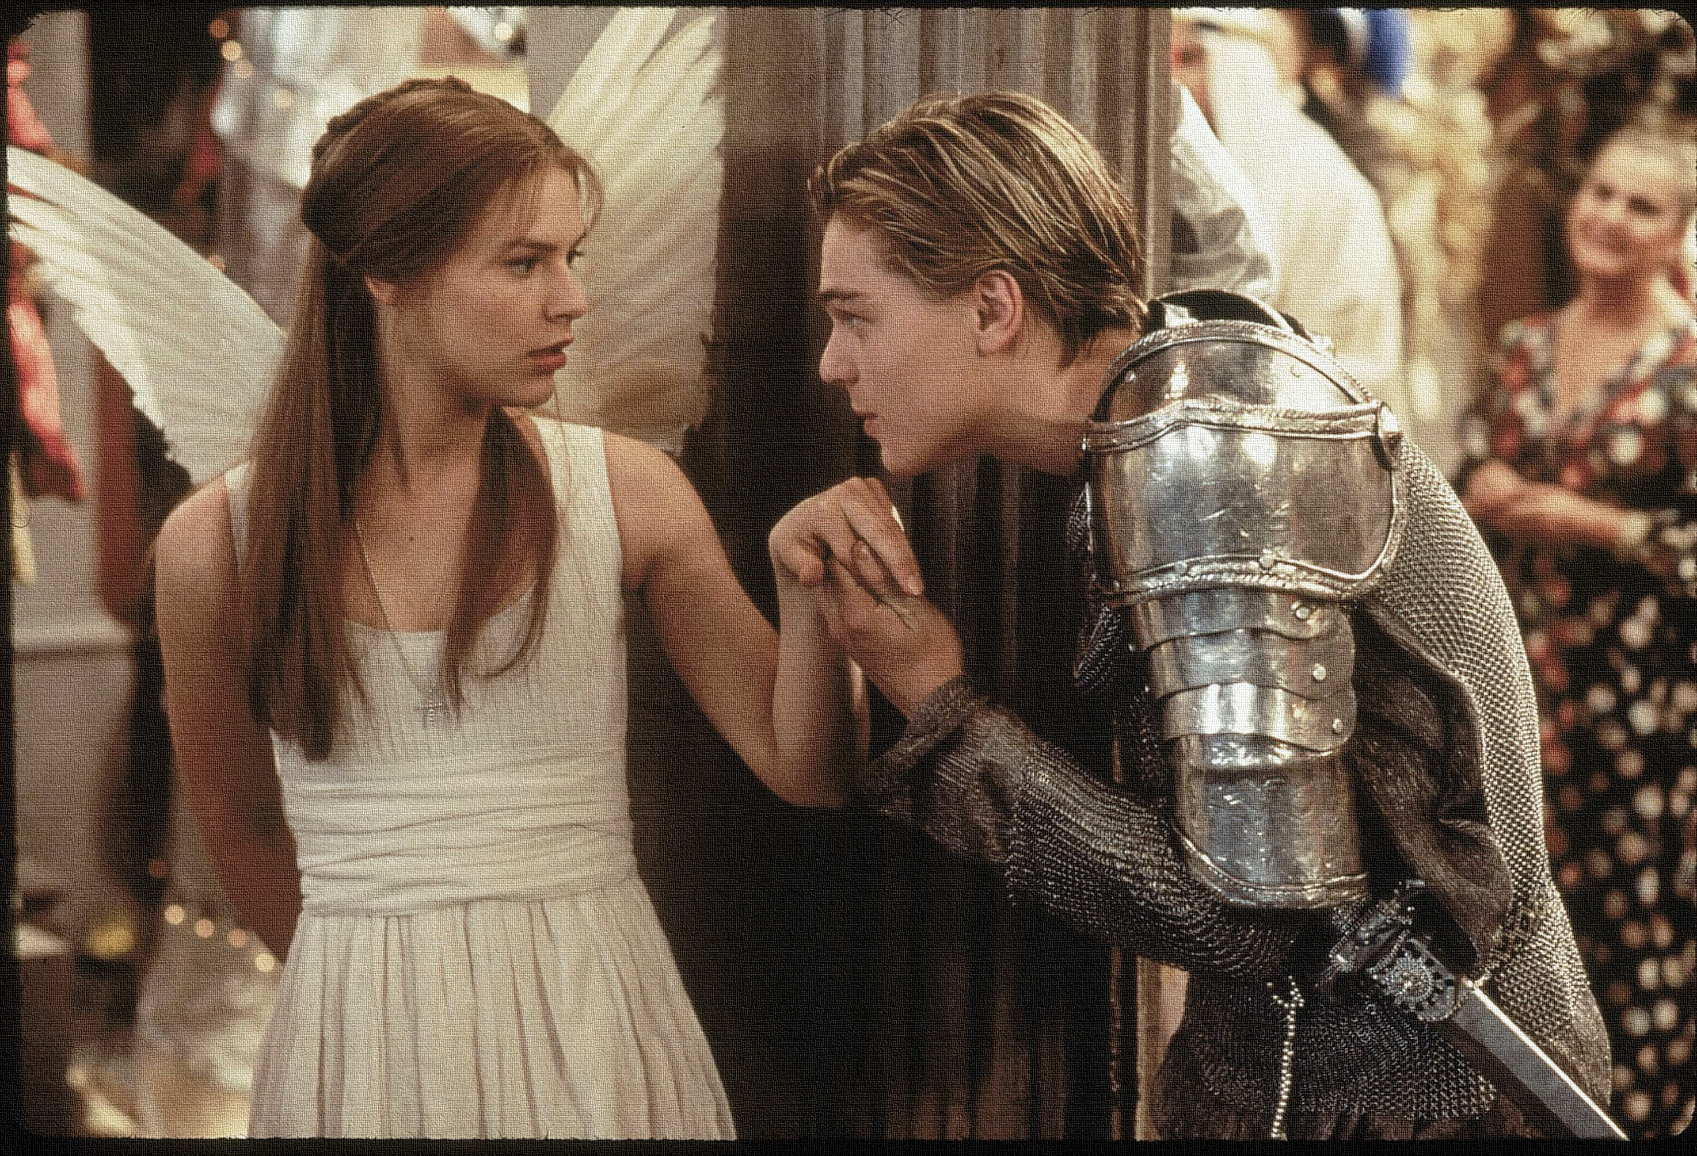
Key Words:
Mature
Attitude
Oxymoron
Infer/deduce
contradictions
Theme – Love (Relationship)
Success Criteria:
To identify how Romeo’s attitude towards love develops.
To compare the language used to describe the love he feels.
To explore how ideas of love have stayed the same/ altered and how relevant the play is to today’s audience.
‘Romeo + Juliet’
Learning Objectives:
AO2: Analyse the language used by a writer to create meanings and effects.
AO3: Show understanding of the relationships between texts and the contexts in which they were written.
Notes:
Lesson 3

Slide 2
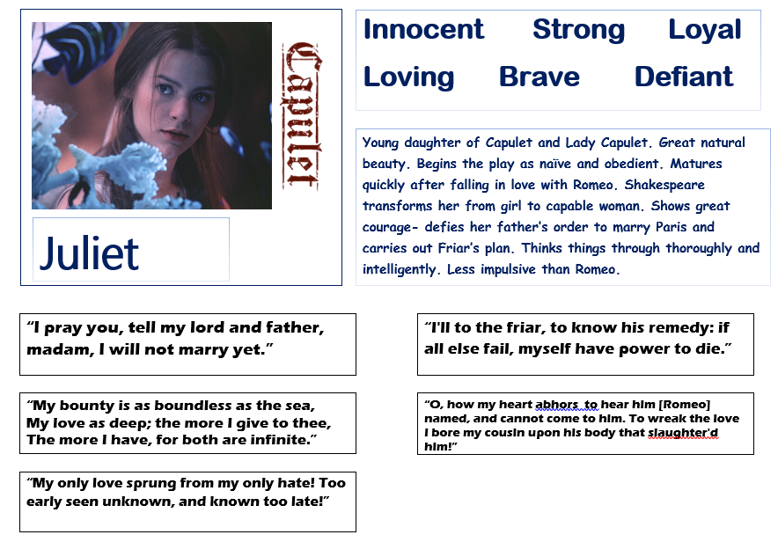
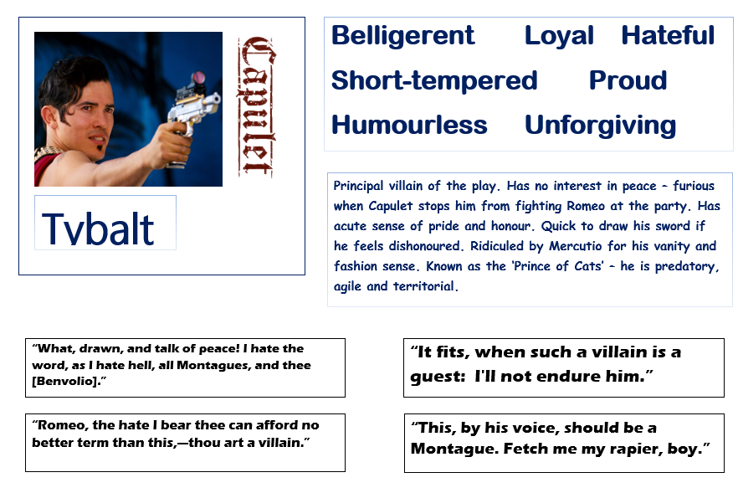
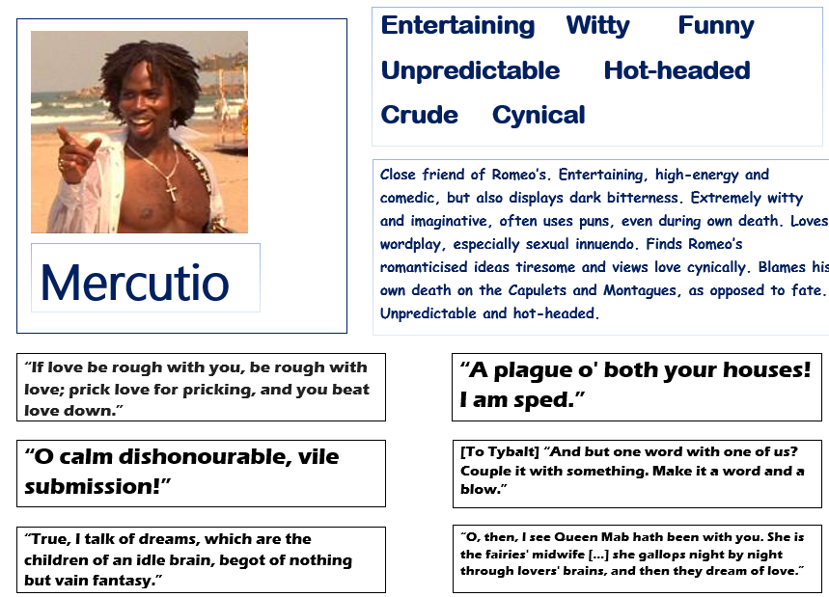
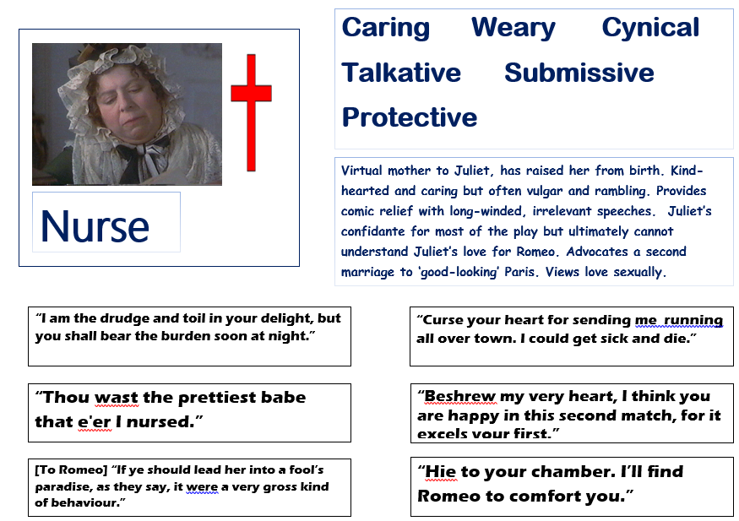
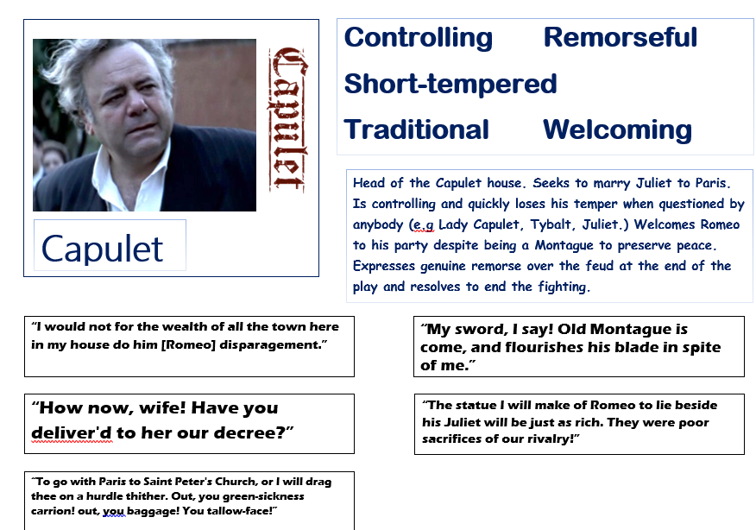
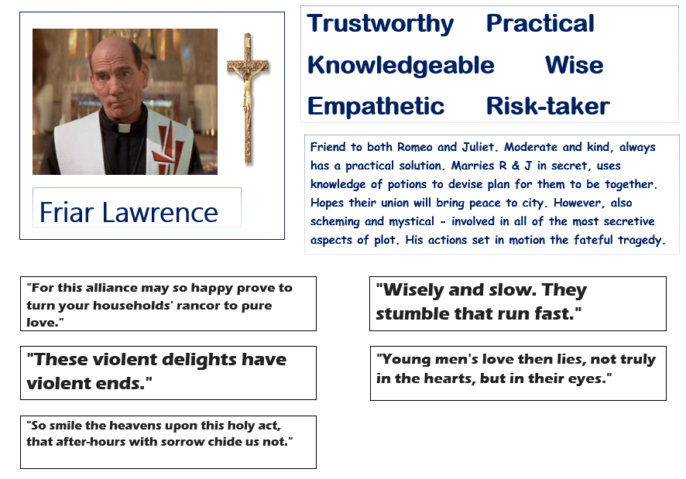
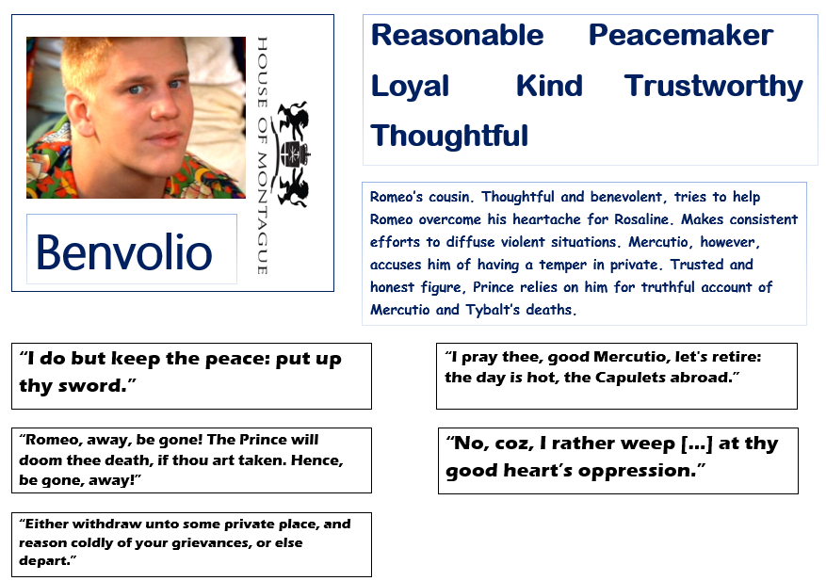
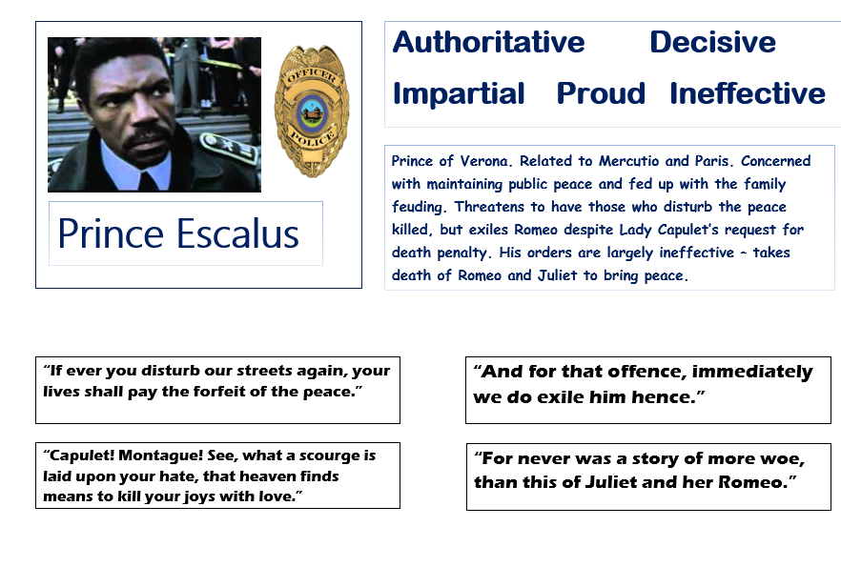
Write today’s date - Tuesday, 24 March 2020 and today’s title – Romeo and Juliet Revision in your book
Working in twos or threes, can you match the quotations, synopsis and adjectives to the character? Make a character page in the back of your book and add key information.
Do Now
Notes:
This can be used as a really good starter and last for at least 30 minutes – see resource in folder for printing.

Slide 3
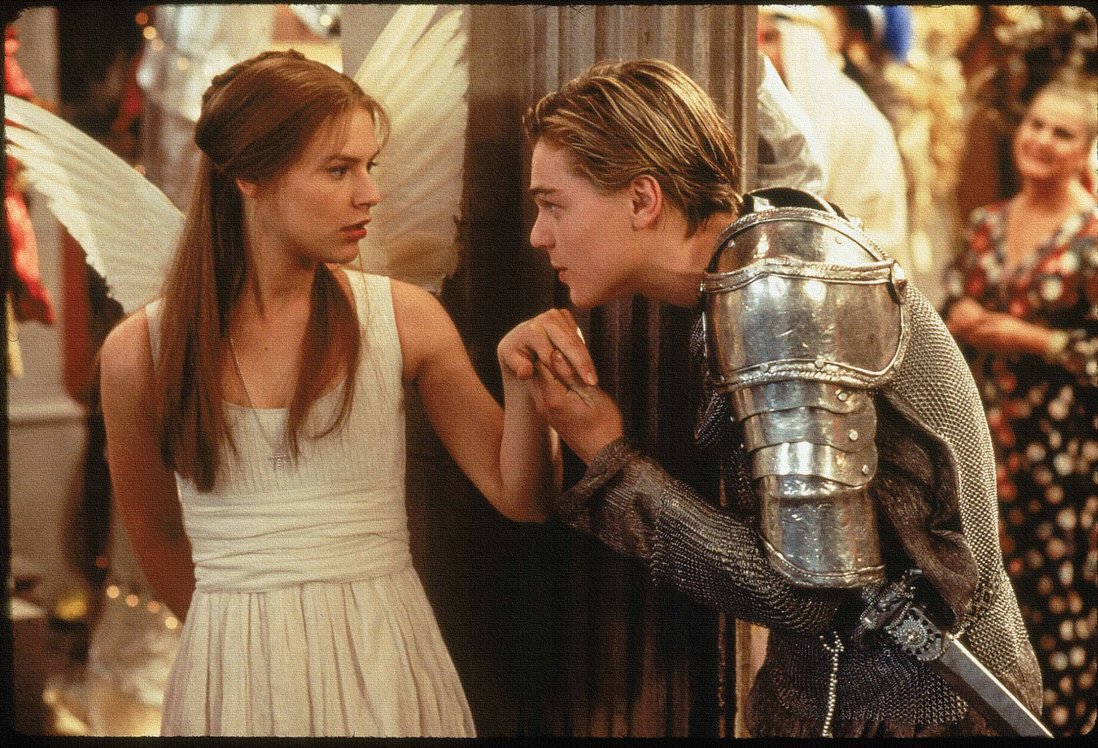

Read the keywords and match their definition: Write them in your books
Oxymoron
A figure of speech in which apparently contradictory terms appear in conjunction.
Infer/deduce
Conclude (something) from evidence and reasoning rather than from explicit statements.
Unlocking vocabulary
mature
a settled way of thinking or feeling about something.
Attitude
reached a stage of mental or emotional development characteristic of an adult.
A combination of statements, ideas, or features which are opposed to one another.
contradictions

Slide 4
ANSWERS!
Oxymoron
A figure of speech in which apparently contradictory terms appear in conjunction.
Infer/deduce
Conclude (something) from evidence and reasoning rather than from explicit statements.
Unlocking vocabulary
mature
a settled way of thinking or feeling about something.
Attitude
reached a stage of mental or emotional development characteristic of an adult.
A combination of statements, ideas, or features which are opposed to one another.
contradictions

Slide 5
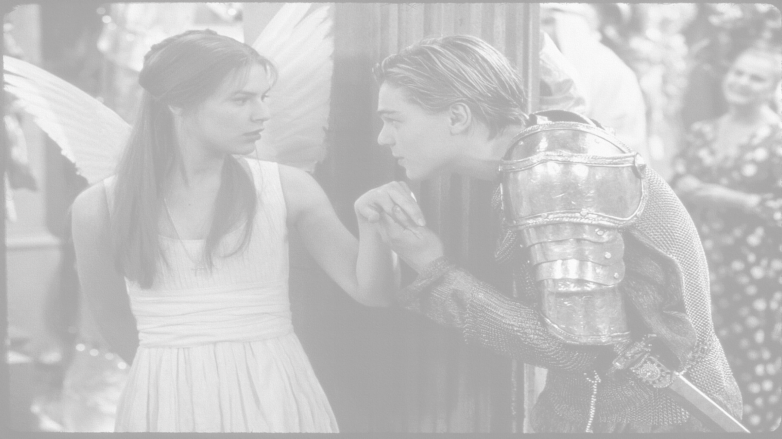
How does Shakespeare establish the theme of love and relationship in Act 1, scene 1?
In this lesson you will be mastering the following:
To identify how Romeo’s attitude towards love develops.
To compare the language used to describe the love he feels.
To explore how ideas of love have stayed the same/ altered and how relevant the play is to today’s audience.
Learning Content
Notes:
This – as with all aspects of the lesson – can be edited to suit your group.

Slide 6
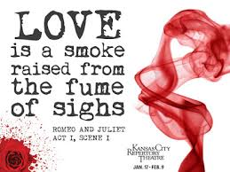
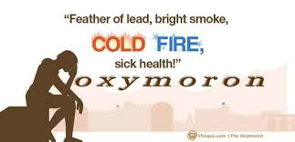
Let’s continue to read: Act 1, scene 1 line 110 - 232
Reading task

Slide 7
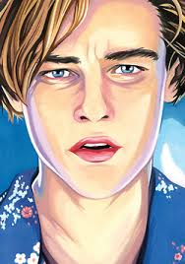
What do you know about Rosaline?
What do you think about Romeo’s view of love at the beginning of the play? Does this change?
Thinking Task
Learning Objectives:
AO2: Analyse the language used by a writer to create meanings and effects.
AO3: Show understanding of the relationships between texts and the contexts in which they were written.

Slide 8
To what extent do you believe that Romeo is in love during the play?
Give reasons.
Checking understanding
Learning Objectives:
AO2: Analyse the language used by a writer to create meanings and effects.
AO3: Show understanding of the relationships between texts and the contexts in which they were written.

Slide 9
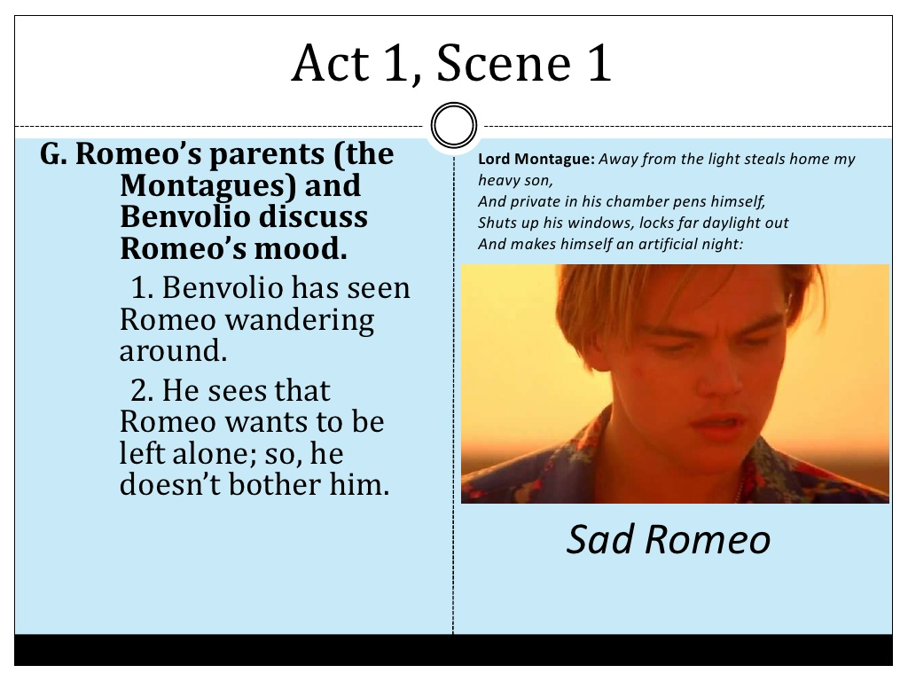
We have just read Act 1 Scene 1 – our first meeting with the character of Romeo.
Read again your extract -
  Highlight all the oxymorons you can find from line 170-182
‘o brawling love’
What are your first impressions of him?
Mastery
To brawl is to fight or quarrel noisily
To have an intense emotional attachment
Learning Objectives:
  AO1: use textual references, including quotations, to support and illustrate interpretations.
AO2: Analyse the language used by a writer to create meanings and effects.

Slide 10
Alas, that love, whose view is muffled still,
Should, without eyes, see pathways to his will!
Where shall we dine?—O me! What fray was here?
Yet tell me not, for I have heard it all.
Here’s much to do with hate but more with love.
Why then, O brawling love, O loving hate,
O anything of nothing first created!
O heavy lightness, serious vanity,
Misshapen chaos of well-seeming forms!
Feather of lead, bright smoke, cold fire, sick health,
Still-waking sleep, that is not what it is!
This love feel I, that feel no love in this.
Dost thou not laugh?
What might the opposites and contradictions symbolise in this speech?
Mastery
Learning Objectives:
  AO1: use textual references, including quotations, to support and illustrate interpretations.
AO2: Analyse the language used by a writer to create meanings and effects.
Notes:
See extract in folder - resources

Slide 11
Analyse your oxymoron: What does it show about Romeo’s feelings?
In the middle circle put your quote.
1) In the next circle EXPLAIN your quote.
2) In the outer circle ANALYSE your quote.
3) In the oval write what this shows us about Romeo’s feelings
‘O brawling
love’
Mastery
Challenge Question:
Why show Romeo directly after the fight between the families?
Learning Objectives:
  AO1: use textual references, including quotations, to support and illustrate interpretations.
AO2: Analyse the language used by a writer to create meanings and effects.
Notes:
Get students to draw circle or print off the template in resources

Slide 12
How do we analyse language?
“O brawling love”
1) Brawling – means to fight
Love – means to like intensely, perhaps obsessively
2) Analysis: The word ‘brawling’ suggests a struggle and difficulty and may be connected to the theme of conflict in the play. By using the word love next to brawling Shakespeare shows us how love can be difficult and confused.
3) This oxymoron shows us that Romeo is prepared for love to be a challenge, like a brawl, and that his attitude towards love is conflicting and possibly negative.
Thinking task
Learning Objectives:
  AO1: use textual references, including quotations, to support and illustrate interpretations.
AO2: Analyse the language used by a writer to create meanings and effects.

Slide 13
To what extent do you believe that Romeo is in love in the play?
Give reasons.
Does his view of love mature?
Give reasons.
Checking understanding
Write down at least three sentences which describe how Romeo’s attitude to love is similar/ different to modern times.
Learning Objectives:
AO2: Analyse the language used by a writer to create meanings and effects.
AO3: Show understanding of the relationships between texts and the contexts in which they were written.

Slide 14
Extension task: Act I, Scene I VS Act II, Scene II
ROMEO
Well, in that hit you miss. She’ll not be hit
With Cupid’s arrow. She hath Dian’s wit.
And, in strong proof of chastity well armed
From love’s weak childish bow, she lives uncharmed.
She will not stay the siege of loving terms,
Nor bide th' encounter of assailing eyes,
Nor ope her lap to saint-seducing gold.
Oh, she is rich in beauty, only poor
That when she dies, with beauty dies her store.
BENVOLIO
Then she hath sworn that she will still live chaste?
ROMEO
She hath, and in that sparing makes huge waste,
For beauty, starved with her severity,
Cuts beauty off from all posterity.
She is too fair, too wise, wisely too fair,
To merit bliss by making me despair.
She hath forsworn to love, and in that vow
Do I live dead that live to tell it now.
ROMEO
Oh, she doth teach the torches to burn bright!
It seems she hangs upon the cheek of night
Like a rich jewel in an Ethiope’s ear,
Beauty too rich for use, for earth too dear.
So shows a snowy dove trooping with crows
As yonder lady o'er her fellows shows.
The measure done, I’ll watch her place of stand,
And, touching hers, make blessèd my rude hand.
Did my heart love till now? Forswear it, sight!
For I ne'er saw true beauty till this night.
What are the similarities and differences between the love he has for Rosaline and that he has for Juliet?
Extension Task
Learning Objectives:
AO2: Analyse the language used by a writer to create meanings and effects.
AO3: Show understanding of the relationships between texts and the contexts in which they were written.

Slide 15

Homework
Write a success criteria for analysing quotes.
Choose 2-3 more oxymorons and explode them.
Homework
Notes:
Homework is optional - Print off this slide to give out as homework.

