Slide 1
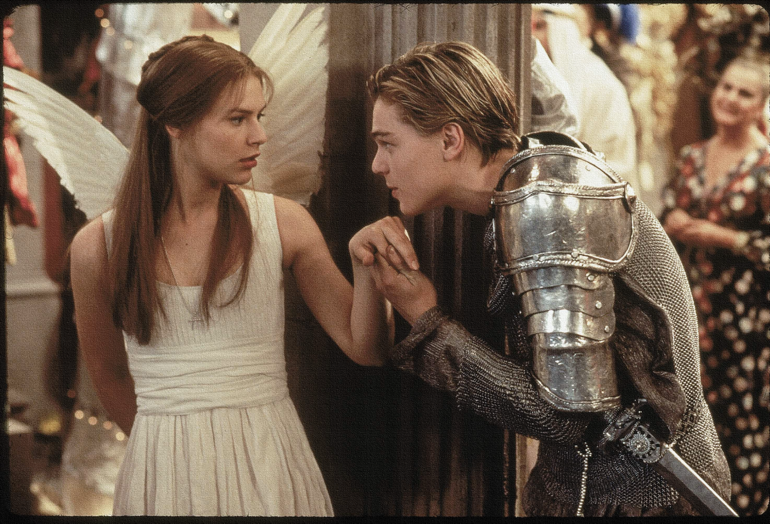
Test yourself – what can you remember about Act 1?
Act 1:
1. What are the names of the two feuding families?
2. Where does the play take place?
3. What does Prince Escalus say will happen to the next person who ‘disturbs’ the streets?
4. What is the name of the man who wishes to marry Juliet?
5. “And too soon marr’d are those so early made. Earth has swallowed all my hopes but she; she’s the hopeful lady of my earth.” Which character says this and who are they talking about?
6. Who does Romeo say he is in love with at the beginning of the play?
7. How old is Juliet?
8. How do the Nurse and Lady Capulet describe Paris?
9. Who is Romeo’s best friend?
10. What do Benvolio and Mercutio try to persuade Romeo to do?
11. Finish Romeo’s line: “Did my heart love till now? Forswear it, sight…”
12. Which character first recognises Romeo?
13. Who is Tybalt – which family does he belong to?
14. Which character tells Juliet who Romeo is?
15. Why does Juliet say “my only love sprung from my only hate” when talking about Romeo?
Do Now

Slide 2
Answers!
Act 1:
1. What are the names of the two feuding families? Montague & Capulet
2. Where does the play take place? Verona, Italy
3. What does Prince Escalus say will happen to the next person who ‘disturbs’ the streets? Your lives shall pay the forfeit of the peace
4. What is the name of the man who wishes to marry Juliet? The County Paris
5. “And too soon marr’d are those so early made. Earth has swallowed all my hopes but she; she’s the hopeful lady of my earth.” Which character says this and who are they talking about? Lord Capulet, Juliet
6. Who does Romeo say he is in love with at the beginning of the play? Rosaline
7. How old is Juliet? 13 years , nearly 14
8. How do the Nurse and Lady Capulet describe Paris? A Man of Wax
9. Who is Romeo’s best friend? Benvolio
10. What do Benvolio and Mercutio try to persuade Romeo to do? Examine other beauties – go out and enjoy himself
11. Finish Romeo’s line: “Did my heart love till now? Forswear it, sight…” For I ne'er saw true beauty till this night.
12. Which character first recognises Romeo? Tybalt
13. Who is Tybalt – which family does he belong to? Juliet’s cousin - Capulet
14. Which character tells Juliet who Romeo is? The Nurse
15. Why does Juliet say “my only love sprung from my only hate” when talking about Romeo? The only man I love is the son of the only man I hate!
Do Now

Slide 3
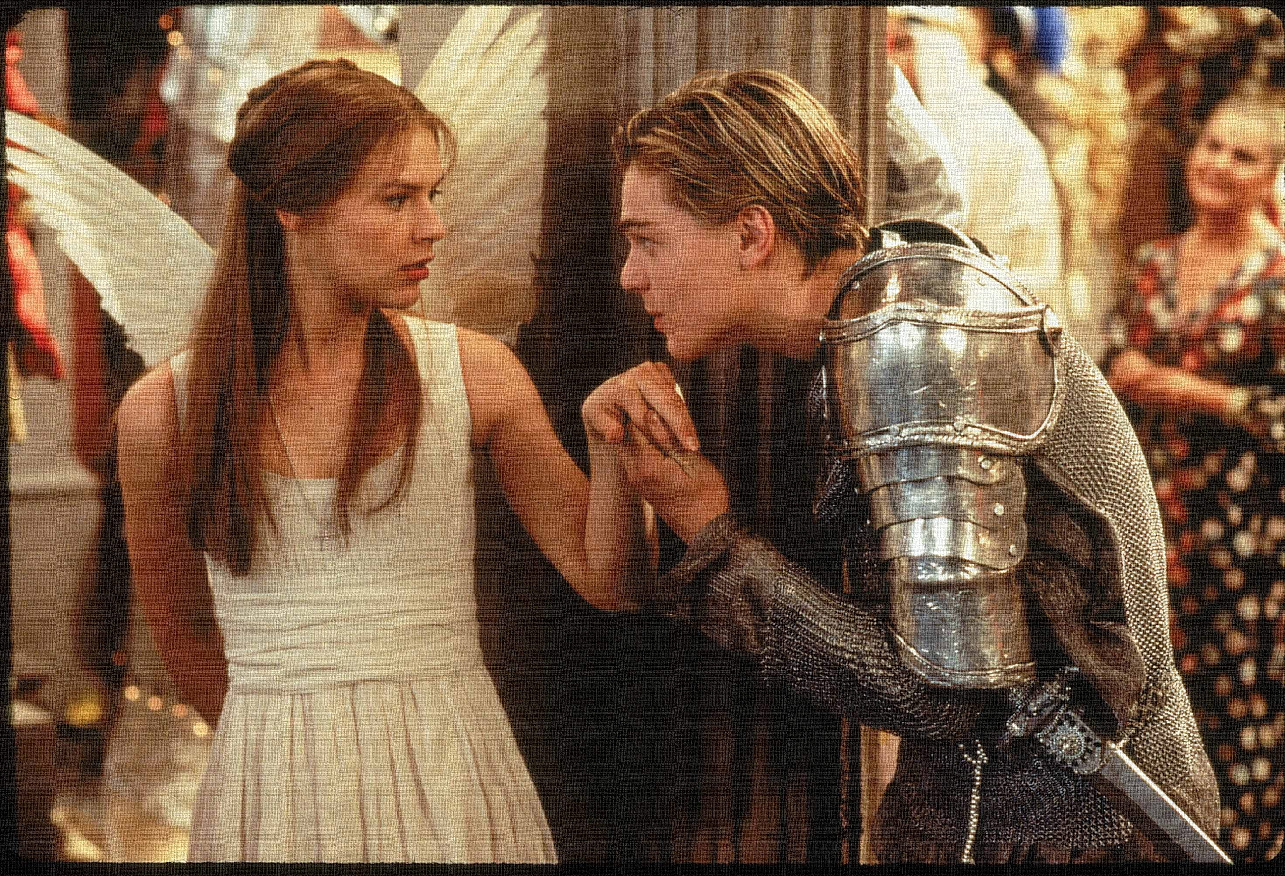
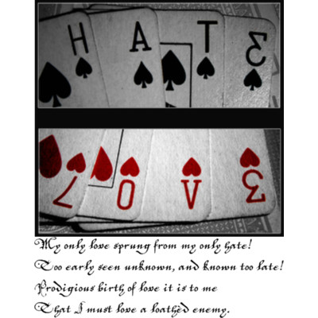
JULIET (aside) My only love sprung from my only hate!
Too early seen unknown, and known too late!
Prodigious birth of love it is to me,
That I must love a loathèd enemy.
Checking understanding
What do you think Juliet means when she says this? Explain in your own words.
Learning Objective:
AO2: Analyse the language, form and structure used by a writer to create meanings and effects.

Slide 4
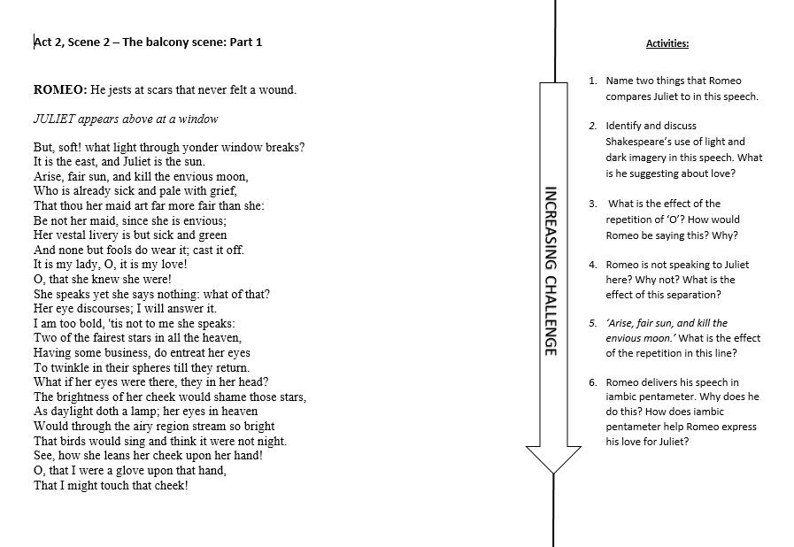
Extension Task
Learning Objectives:
AO1: use textual references, including quotations, to support and illustrate interpretations.
AO2: Analyse the language used by a writer to create meanings and effects.

