Slide 1
Culture Poetry LO: To identify the cultural references in a poem. ST: I Can identify and explain how a poem communicates ideas about culture.

Slide 2
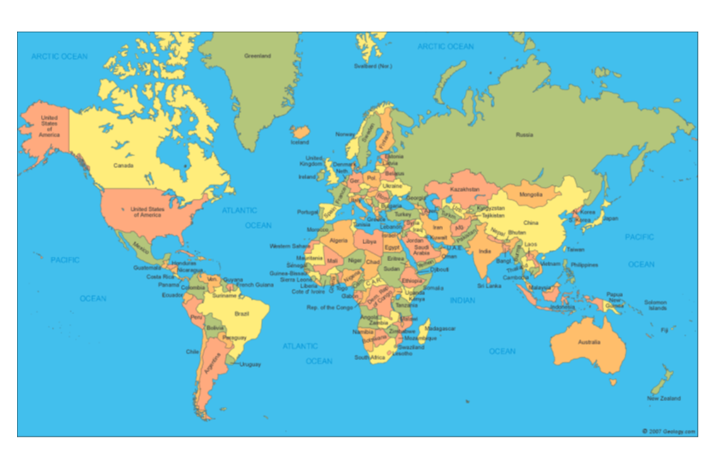
During this project, we will be going on a cultural adventure!
Learning context
This will be our port of departure!

Slide 3
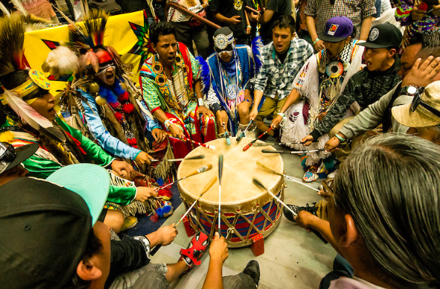
MUSIC LINK
Where are we going today?
What seems to be important in this culture?
DO NOW!

Slide 4
Our cultural adventure begins….
Learning context
DON’T FORGET TO TAKE YOUR PASSPORT!

Slide 5
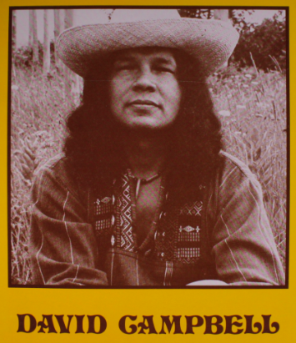
Some important information about the poet…
For each point, consider what features of culture might be particularly important to this poet
A poet / musician who was born in the Pomeroon, and educated in Guyana, before moving to Canada and then on to the UK.
His father was an Arawak, and a politician who fought for Amerindian land rights.
Learning context
Many of his songs and poems are about changing seasons and colonial invasions.
He often calls on people to never forget their cultural heritage.
Today, we will:
Identify the cultural references in a poem
Identify & explain how a poem communicates ideas about a culture

Slide 6
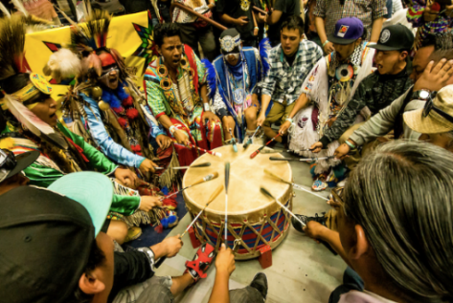
A ‘pow wow’ is a Native American ceremony of feasting and dancing.
Based on the title of the poem ‘The Pow-Wow drum’, what feature of culture might the poet be exploring?
The Pow-Wow Drum by David Campbell
Long Black braids and silken shawls
Moving side by side where the eagle calls,
Answering the beat of the pow-wow drum
we come again
to dance again
Hey-a, Hey-a, Hey-a, Hey-a, Hey!
Hey-a, Hey-a, Hey-a, Hey-a, Hey!
Leave the dusty cities far behind,
Meet our brothers of the country with one mind,
Travelling from the east, north, south and west
we come again
to dance again
Hey-a, Hey-a, Hey-a, Hey-a, Hey!
Hey-a, Hey-a, Hey-a, Hey-a, Hey!
Reading Task

Slide 7
Watching close the feet of lightening fly
Fancy dancers free underneath the sky,
Joining in the circle moving round and round
we come again
to dance again
Hey-a, Hey-a, Hey-a, Hey-a, Hey!
Hey-a, Hey-a, Hey-a, Hey-a, Hey!
Women shining in the morning sun,
Children making rainbows as they laugh and run,
The old and young meeting like they did long ago
we come again
to dance again
Hey-a, Hey-a, Hey-a, Hey-a, Hey!
Hey-a, Hey-a, Hey-a, Hey-a, Hey!
Reading Task
How many different references to Native American culture can you find?
Can you IDENTIFY any POETIC TECHNIQUES that have been used to communicate ideas about culture?

Slide 8
THE POW WOW DRUM
Long Black braids and silken shawls
Moving side by side where the eagle calls,
Answering the beat of the pow-wow drum
we come again
to dance again
Hey-a, Hey-a, Hey-a, Hey-a, Hey!
Hey-a, Hey-a, Hey-a, Hey-a, Hey! (chorus)
Leave the dusty cities far behind,
Meet our brothers of the country with one mind,
Travelling from the east, north, south and west
we come again
to dance again
chorus
Watching close the feet of lightening fly
Fancy dancers free underneath the sky,
Joining in the circle moving round and round
we come again
to dance again
chorus
Women shining in the morning sun,
Children making rainbows as they laugh and run,
The old and young meeting like they did long ago
we come again
to dance again
chorus
Can you identify an example of each of these techniques?
STRONG RHYTHM / RHYME
VISUAL IMAGERY
REPETITION
METAPHOR
Mastery
Can you explain HOW the example is effective?

Slide 9
What ideas about culture is the poet exploring and how are these ideas presented?
language / structural techniques
TASK: Can you? answer the questions VERBALLY, working through these steps:
The poem ‘The Pow Wow Drum’ is about…
One idea the poet explores is…
(Another idea the poet explores is…)
a
Mastery
b
The poet uses the technique of... , for example: “…” (language)
The poet structures the poem using… (structure)
c
This implies that… is important in this culture, because...
(This reminds us of / gives the impression / suggests / emphasises the idea that…)
d
The [adjective / noun / noun phrase / verb] ‘…’ suggests that… because…
(Moreover / Furthermore, this idea is developed later in the poem when…)
e
The poet might be suggesting…
(Perhaps the poet is emphasising…)

