Slide 1
Boy Tales of Childhood by Roald Dahl
LO: To understand how to use descriptive techniques effectively.
ST: I can choose specific language to create a vivid image for a reader.

Slide 2
Starter: What is an adjective? What is a verb? Why do we use them in descriptive writing? Write a definition in your book for both word classes.

Slide 3
Task: What are the five senses?
In pairs choose adjectives and verbs that you can use to describe the senses.
Touch | Sight | Smell | Sound | Taste

Slide 4
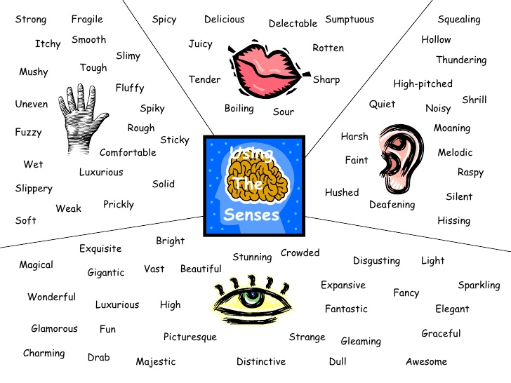
Magpie some of theses words!

Slide 5
Task: Firstly, draw around your hand on a full page in your book. Secondly, take a sweet! Do not let anyone see which one you have taken. Slowly eat it. You must describe the sweet on your hand template.
sight
smell
sound
taste
Touch

Slide 6
Task: Read out your description to the class. Who can guess what the sweet is?
Don’t forget to write the name of the sweet onto the ‘palm’ of your template after you have shared your description!

Slide 7
TASK: What makes a popular sweet?
List the qualities.

Slide 8
Your mission should you wish to accept – design a brand new sweet. What combinations can you mix together? What flavours? Colours? Shape? Size? Mix of savoury and sweet? Textures? What about the packaging? WHAT WILL YOU CALL IT?

Slide 9
TASK: Mind map your ideas like below
shape
texture
size
Flavour combination
NEXT: DRAW YOUR SWEET AND LABEL IT. THEN DRAW YOUR PACKAGING.
colour
Name
packaging

Slide 10
Plenary: Share your ideas!

