Slide 1
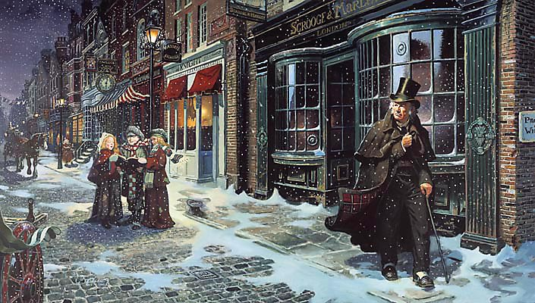
sso
LESSON TWO

Slide 2
sso
Scrooge and Fred
NEED INSPIRATION?
Check out Dickens’ description below!
Dickens uses pathetic fallacy effectively to create a bleak, dark tone for the beginning of his novel.
Task 1: You have FIVE minutes to describe the cold weather affecting a city. Think about your language choices. How are you going to make the cold sound so incredibly bitter that the city cannot escape its grasp?
Meanwhile the fog and darkness thickened so, that people ran about with flaring links, proffering their services to go before horses in carriages, and conduct them on their way. The ancient tower of a church, whose gruff old bell was always peeping slyly down at Scrooge out of a Gothic window
in the wall, became invisible, and struck the hours and quarters in the clouds, with tremulous vibrations afterwards as if its teeth were chattering in its frozen head up there. The cold became intense.
Foggier yet, and colder! Piercing, searching, biting cold.
Do Now
HINTS/TIPS
Try not to use the same words/phrases so close to each other.
Include a range of sentence structures if you can.
Today’s key questions:
Can I discuss how Dickens uses language to influence a reader’s view of the characters?
Can I read, understand and respond to a text?
Can I think about the themes of a novel and how/why they are included?

Slide 3
sso
Task 2: MATCH THE VOCABULARY TO THEIR DEFINITIONS
sullen and ill-tempered.
great respect; reverence
more than what is needed or used; excess.
readily or plainly seen, heard, perceived, etc.; obvious; evident
in a manner indicating anger or annoyance at something perceived as unfair.
PALPABLE MOROSE INDIGNANTLY VENERATION SURPLUS
Unlocking Vocabulary
Today’s key questions:
Can I discuss how Dickens uses language to influence a reader’s view of the characters?
Can I read, understand and respond to a text?
Can I think about the themes of a novel and how/why they are included?

Slide 4
sso
Task 3: SELF ASSESS: CHECK YOUR ANSWERS:
MOROSE: sullen and ill-tempered.
VENERATION: great respect; reverence
SURPLUS: more than what is needed or used; excess.
PALPABLE: readily or plainly seen, heard, perceived, etc.; obvious; evident
INDIGNANTLY: in a manner indicating anger or annoyance at something perceived as unfair.
Answers
Today’s key questions:
Can I discuss how Dickens uses language to influence a reader’s view of the characters?
Can I read, understand and respond to a text?
Can I think about the themes of a novel and how/why they are included?

Slide 5
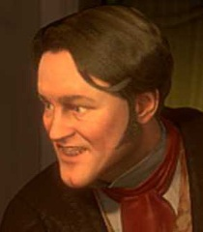
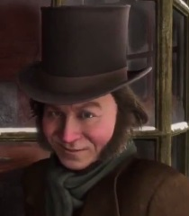
sso
Task 4: retrieving information
Read from ‘Once upon a time – of all the good days in the year,’ to ‘sat in mournful meditation on the threshold.’
As we read, consider how Fred and Bob Cratchit are presented and how they are the antithesis (opposite) of Scrooge. Think about how Scrooge views these characters, but also think about their perspective on Scrooge.
Write your points down in your books, using quotations to back up your ideas. Create a column each for Fred, Scrooge and Bob.
How is Fred presented?
How does Scrooge perceive Fred?
How does Fred perceive Scrooge?
What is Fred’s purpose?
Reading Activity
How is Bob Cratchit presented?
How does Scrooge perceive Bob?
How does Bob perceive Scrooge?
What is Bob’s purpose?
Today’s key questions:
Can I discuss how Dickens uses language to influence a reader’s view of the characters?
Can I read, understand and respond to a text?
Can I think about the themes of a novel and how/why they are included?

Slide 6
sso
YOUR TASK
Answer each question in as much detail as possible.
Use the pdf version of the novella on the website to help you.
The question sheet is attached on the website alongside this PowerPoint.
Mastery
Today’s key questions:
Can I discuss how Dickens uses language to influence a reader’s view of the characters?
Can I read, understand and respond to a text?
Can I think about the themes of a novel and how/why they are included?

Slide 7
sso
Task: make notes
Scrooge represents the ignorant attitude of the wealthy classes that Dickens despised in his own society. Scrooge sees the workhouses as a solution to a problem, and shuts out the idea that their inhabitants are real feeling human beings.
He is smug and condescending about the poor, and refuses to listen to the gentlemen’s reasoning. Scrooge's logic is somewhat consistent—he sees money as being the sole important thing in the world, and therefore sees anyone lacking money as being unimportant. He does not see the basic human value in all people.
The power of light and music to shine through the winter gloom is a visual way of showing the moral of this story.
It suggests that even though cruelty seems to reign, the goodness embodied by the Christmas message can always find a way through, through the fog, through the keyhole. Scrooge, however, aggressively fights it off.
WEALTH
LIGHT AND MUSIC
Link to Context
Today’s key questions:
Can I discuss how Dickens uses language to influence a reader’s view of the characters?
Can I read, understand and respond to a text?
Can I think about the themes of a novel and how/why they are included?

Slide 8
sso
TO FINISH
Below are a selection of themes that appear in ‘A Christmas Carol’. Consider the themes that have already appeared in the novel. Choose ONE theme. Design a poster about the theme you have chosen.
Importance
of family
Compassion
and forgiveness
Power of
Christmas
Isolation
Checking Understanding
Eg. The importance of family is presented through…
Eg. Scrooge continually isolates himself from society. A quotation to prove this is ‘…’
Eg. Compassion and forgiveness is seen in…
Eg. The ‘Power of Christmas’ is clearly evident when…

Slide 9
sso

