Slide 1
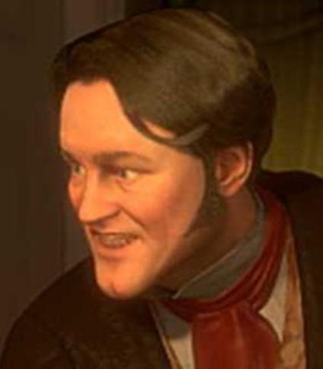
A Christmas Carol
The Clerk (Bob) & The Nephew (Fred)
LO: To understand why Dickens introduces Fred as a contrast to Scrooge.
ST: I can explore the juxtaposition of characters.
Key words: Parable Preface Semantic field Gothic Morality Colloquial Symbolism Simile Impression Pathetic Fallacy Zeitgeist Echo Juxtaposition Antithesis
Notes:
zeitgeist
noun
the defining spirit or mood of a particular period of history as shown by the ideas and beliefs of the time.

Slide 2
Starter: Textual Analysis – on your handout answer the three questions.
“The door of Scrooge's counting-house was open that he might keep his eye upon his clerk, who in a dismal little cell beyond, a sort of tank, was copying letters. Scrooge had a very small fire, but the clerk's fire was so very much smaller that it looked like one coal. But he couldn't replenish it, for Scrooge kept the coal-box in his own room…”
1. What do we learn about the relationship between Scrooge and his clerk (Bob Cratchit)?
2. What do we learn about their social positions?
3. Why make reference to fire? Can this be related back to last lesson’s extracts?
Key words: Parable Preface Semantic field Gothic Morality Colloquial Symbolism Simile Impression Pathetic Fallacy Zeitgeist Echo Juxtaposition Antithesis

Slide 3
How do I analyse for higher grades?
Who is the author and what is their viewpoint or bias?
Who is the audience and how does that influence the way information is presented?
What is the main message of the text?
What evidence has been used to support this main message?
Are there any counter-arguments? Additional evidence to provide a different viewpoint.
Make sure to distinguish between description (re-telling the story!) and analysis (judging why something happened)
Interpret your evidence – explain how and why your evidence supports your point. Interpretation is an important part of analysis, and you should not just rely on the evidence ‘speaking for itself’.
Be specific – don’t make general comments. Stick to precise examples.
Use counter-arguments to your advantage – it will strengthen your argument to include an opposing viewpoint and explain why it is not as convincing as your own line of reasoning.
Key words: Parable Preface Semantic field Gothic Morality Colloquial Symbolism Simile Impression Pathetic Fallacy Zeitgeist Echo Juxtaposition Antithesis
Notes:
Can be printed out to keep in books.

Slide 4
Let’s read up to page 12. As we read pay particular attention to the new characters.
Key words: Parable Preface Semantic field Gothic Morality Colloquial Symbolism Simile Impression Pathetic Fallacy Zeitgeist Echo Juxtaposition Antithesis
Notes:
In Collins classic books

Slide 5
Task: Comparative Table
Complete a comparative table in your exercise book, in which you compare Scrooge, Fred and Bob. Write in sentences and add quotations.
Scrooge | Bob | Fred
Scrooge is cynical about Christmas and other people: “Bah Humbug!” | Bob is similar to Fred in his Christmas spirit, and refuses to be completely oppressed by Scrooge: “The clerk in the tank involuntarily applauded.” | Fred contrasts Scrooge as he loves Christmas, God and even his uncle: “A merry Christmas, uncle! God save you!”
What does the different behaviour of Scrooge and Bob Cratchit on their way home tell us about their characters?
How does Scrooge react to the two men asking for donations to charity?
How does Fred transform the atmosphere?
Key words: Parable Preface Semantic field Gothic Morality Colloquial Symbolism Simile Impression Pathetic Fallacy Zeitgeist Echo Juxtaposition Antithesis

